Slide 1
Traffic-Engineering in
Software Defined Networks
Using Label Switching
在軟體定義網路下利用標籤交換之流量工程系統
Chen-Nien Mao
Advisor: Cheng-Hsin Hsu
Networking and Multimedia System Lab
CS Dept. , National Tsing Hua University

Slide 2


Outline
Introduction
Label Switching
System Architecture
Routing Mechanism
  Tunnel Table Construction
  Path Table Construction
  Dynamic Modules
Evaluation
Conclusion

Slide 3
Introduction

Slide 4


Idle Resource in Networks
Explosive traffic flow comes from different services has brought many challenges on
  Quality of Service (QoS)
  Quality of Experience (QoE)
Traditional core networks perform Interior Gateway Protocol (IGP)
  Shortest path routing
  Idling resources

Slide 5


Software-Defined Networks (SDN)
Decoupling the control plan & data plan
The routing rules are decided by a central controller
Application Layer
API
Control Layer
Infrastructure Layer

Slide 6
Is SDN sufficient ?
Controller can change the routing behaviors
=> Are the problems solved by SDN?
Challenges:
Initialization time in large networks
  Core networks are vulnerable to delay
Scalability
  Decoupling the data flow and control flow brings the scalability issues
Flexibility & Efficiency
  The cost of changing routing behavior is high and complex

Slide 7
Contribution
Propose label routing algorithms to solved the traffic engineering problems in SDNs
  Minimize the initialization delay
  Perform load balancing
  Perform fast recovering
Develop a flexible network architecture
  Virtualize physical links with virtual paths
  Simplify routing mechanisms inside the core networks
Core Networks
Routing
Routing

Slide 8
Label Switching

Slide 9
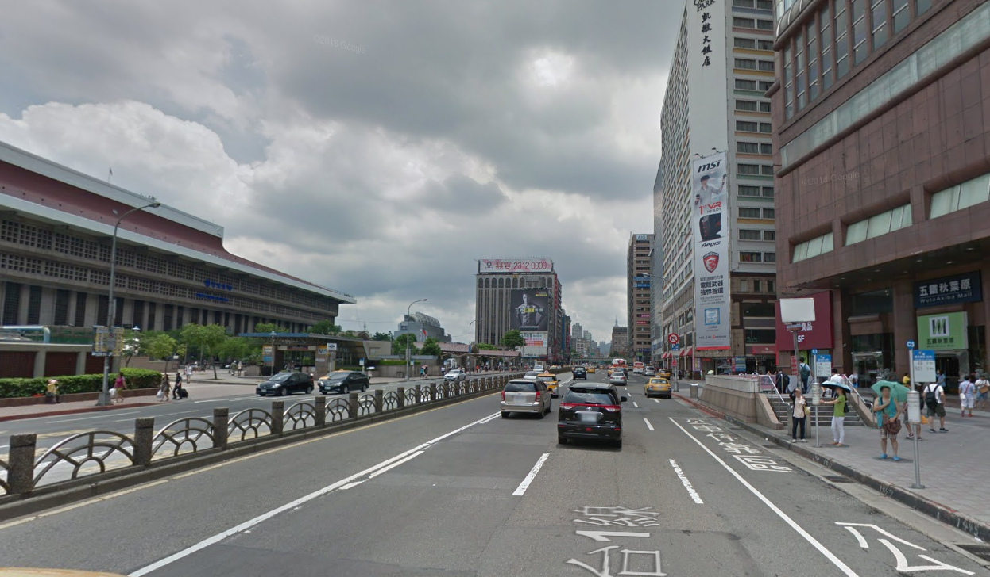
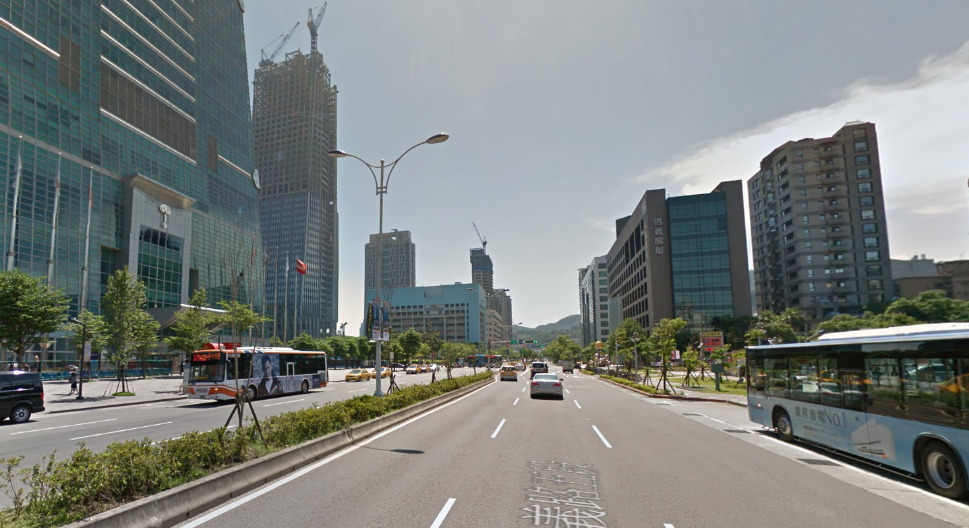
Example to illustrate label switching
Traveler wants to visit Taipei 101 from Taipei Main Station
Passerby A : “I am not sure. Maybe you can go to next stop first”
Passerby B : “I am not sure. Maybe you can go to next stop first” …..

Slide 10

Example to illustrate label switching
If there is a smart guy who knows the best route.
Smart guy : “Take the bus line 22, and you will arrive 101 without traffic gam”

Slide 11

Difference between traditional approaches
Let me see
Let me see
Let me see
Let me see
Traditional IP-Networks
A
I will ask
I will ask
I will ask
I will ask
A
Client A
Client B
Legacy SDN Networks
I will ask
Proposed MPLS Solution

Slide 12
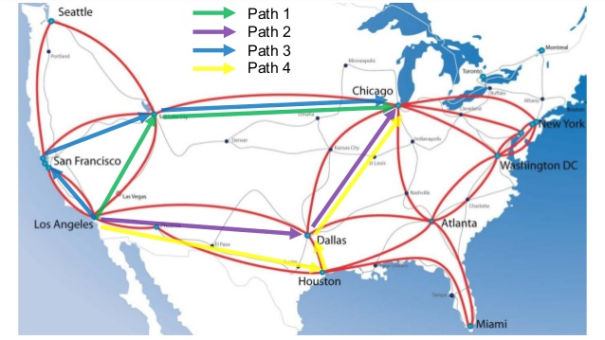
Multiprotocol Label Switching
Forwards the packets according to the label without looking up the network address
MPLS Label
  Label Distribution Protocol
  Stackable, providing higher extensibility,
  Fixed length, allowing more efficient matching
  Supported in OpenFlow protocol
MPLS shows its strength on Traffic Engineering in legacy IP network
  Resource Reservation Protocol
  Reserve bandwidth for QoS
Notes:
Label Distribution Protocol (LDP) and RSVP-TE under a MPLS domain

Slide 13
MPLS in SDN
Difficulties of performing MPLS in traditional network
  Scope of the whole system
  Hierarchy of MPLS system
  Path attributes of label switching paths
Some issues can be solved in SDNs
  Global view of the system => Optimized the Path selection
  Ability to coordinate each switches => Assign Label & handle hierarchy
We can build a our system without lower level protocols !

Slide 14


Label Switching
MPLS labels
  Extract MPLS protocols
  Represent a virtual tunnel ( multiple physical links )
Routing actions in proposed system:
  Push at Ingress
  Swap at Medium
  Pop at Egress
Push Label
Swap Label
Pop Label
…
…
Ingress Switch
Core Switches
Egress Switch

Slide 15
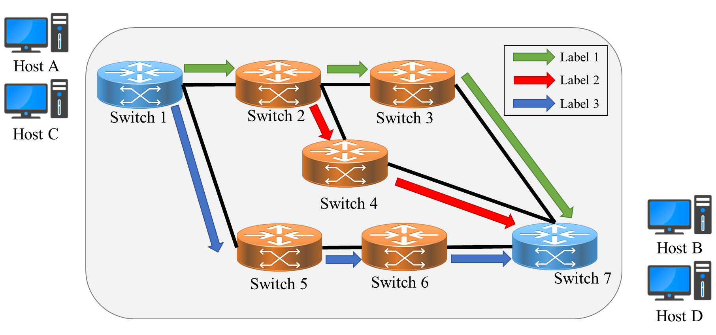
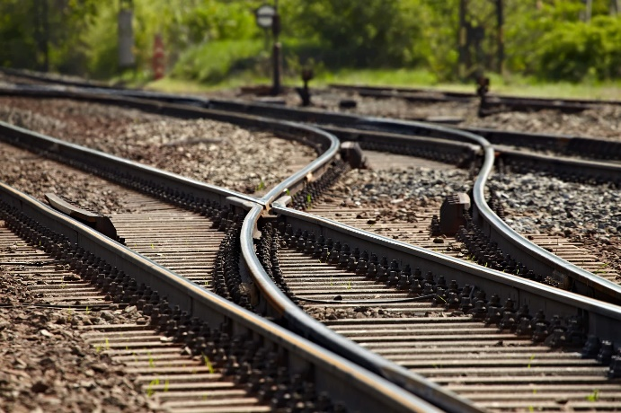
Benefits of using Label Switching
Perform Traffic engineering easily
  Labels => routing decision
  Changing routing behaviors by changing labels
Balance traffic by “switching label”

Slide 16
Routing inside the core networks
Simplify routing mechanisms inside core networks
  Complex routing decisions are made in edge switches
  Switches in core network only focus on packet-forwarding
Core Networks
Push Label
Pop Label
Ingress Switches
Egress Switches

Slide 17
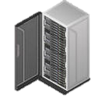

Use case
Tunnel Info
SDN Controller
ISP Server
SDN Controller
Server B
…
Core Switches
Core Switches
Tunnel provided by ISP
Edge switch
A
Site A subnetwork
Site B subnetwork
C
Client A
Client C

Slide 18
System Architecture

Slide 19
Problem statement
Initialization Delay
  Use pre-build tunnels
  Avoid congestion and packet loss
Load Balancing
  Offload the traffic to idling links
Error Resilience
  Fast-rerouting
  Dynamic traffic assigner

Slide 20

Controller Components
Tunnel Constructor
Admission Controller
Tunnel Table
Dynamic Tunnel Finder
Dynamic Traffic Assigner
Tunnel Table
Traffic Status
Static Tunnel Finder
Static Traffic Assigner
Topology
Tunnel Table
Unexpected events
Traffic Table
Traffic Request
Proactive Switch Module
Main Control Logic
(OpenFlow Events Handlers)
Flow Command Dispatcher
MPLS-enabled Network

Slide 21
Tunnel Constructor
Tunnel Constructor
Dynamic Tunnel Finder
Tunnel Table
Construct Tunnels inside SDN domain
Static Tunnel Finder (STF)
  Find tunnels among every two nodes
  Pre-built tunnels in networks
  (System setup or topology change )
Dynamic Tunnel Finder (DTF)
  Take link usage into consideration
  Recover tunnels
  Connect new edge switches to the network
Static Tunnel Finder
Proactive Switch Module

Slide 22
Admission Controller
Admission Controller
Dynamic Traffic Assigner
Traffic Status
Static Traffic
Assigner
Allocate traffic into the system
Dynamic Path Assigner (DPA)
  Real-time traffic assigner (Label Tagger)
  Handle new traffic request
  Handle unexpected traffic re-route
Static Path Assigner (SPA)
  Load Balancer
  Consider Link utilization & Perform load balance
  Avoid congestion
Proactive Switch Module

Slide 23
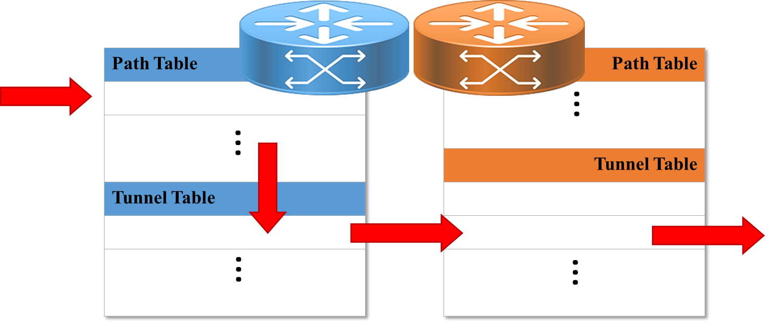
Decoupled Flow Tables
Tunnel table (Lower Table)
  Store pre-built tunnels information (label info.)
Path table (Upper Table)
  Store the bindings between labels (tunnels) and the traffic flows

Slide 24
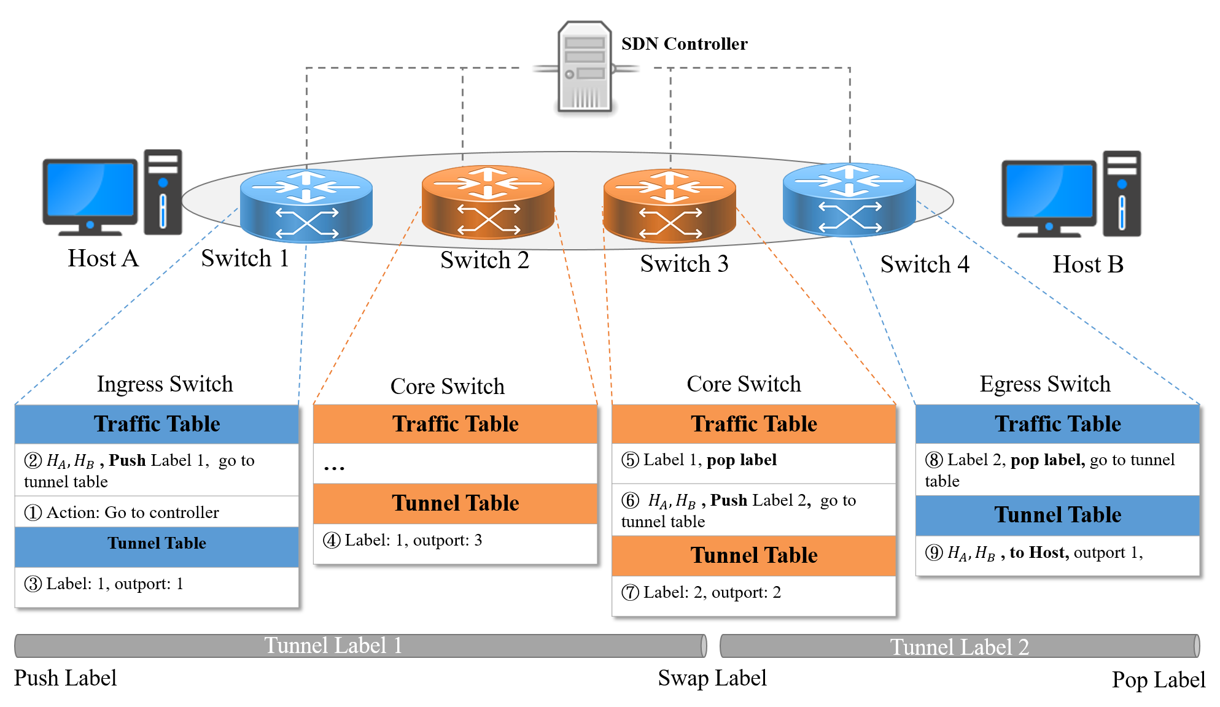
Packet Forwarding

Slide 25
Routing Mechanism

Slide 26
Controller Components
Tunnel Constructor
Admission Controller
Tunnel Table
Dynamic Tunnel Finder
Dynamic Traffic Assigner
Tunnel Table
Traffic Status
Static Tunnel Finder
Static Traffic Assigner
Topology
Tunnel Table
Unexpected events
Traffic Table
Traffic Request
Proactive Switch Module
Flow Command Dispatcher
MPLS-enabled Network

Slide 27
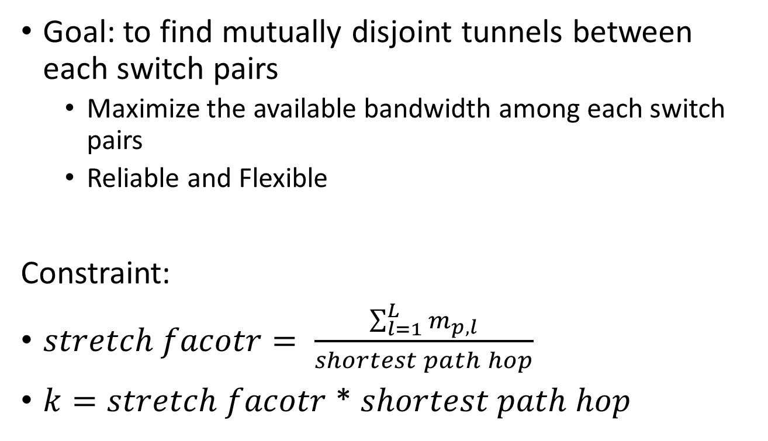
Tunnel Table Problem Formulation
Goal: to find mutually disjoint tunnels between each switch pairs
  Maximize the available bandwidth among each switch pairs
  Reliable and Flexible
Constraint:
$stretch facotr= \frac{\sum_{l=1}^{L}{m_{p,l}}}{shortest path hop}$
$k=stretch facotr$ * $shortest path hop$
Length of tunnels

Slide 28
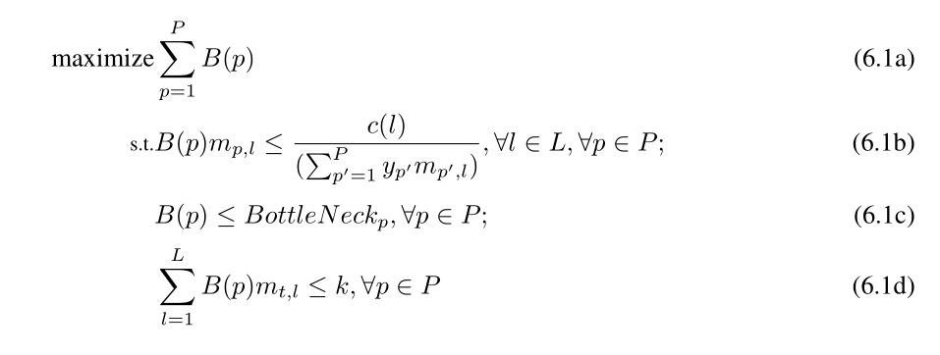
Path Table
Network
Topology
Static
Tunnel
Finder
Set of
Tunnels
Maximize bandwidth of each paths
Path capacity is less than or equal to the minimum link share
Minimal link capacity among all the links
Length of selected tunnel will never exceed k
Notes:
Todo: p’ in 6.1c
->[] ->
Goal: maximum bandwidth of each paths
Eq 6.1b: maximum number of paths between two nodes~(n,m) is x
Eq 6.1c: Each link is shared by several paths ,and thus the path capacity is less than or equal to the minimum link share among the links used by the path
Eq. 6.1.d: We define the bottle neck of each path, $p$, by the minimal link capacity among all the links in the given topology
Eq. 6.1.e: we make sure the length of selected tunnels will never exceed the constraint $k$ to gain better efficiency

Slide 29
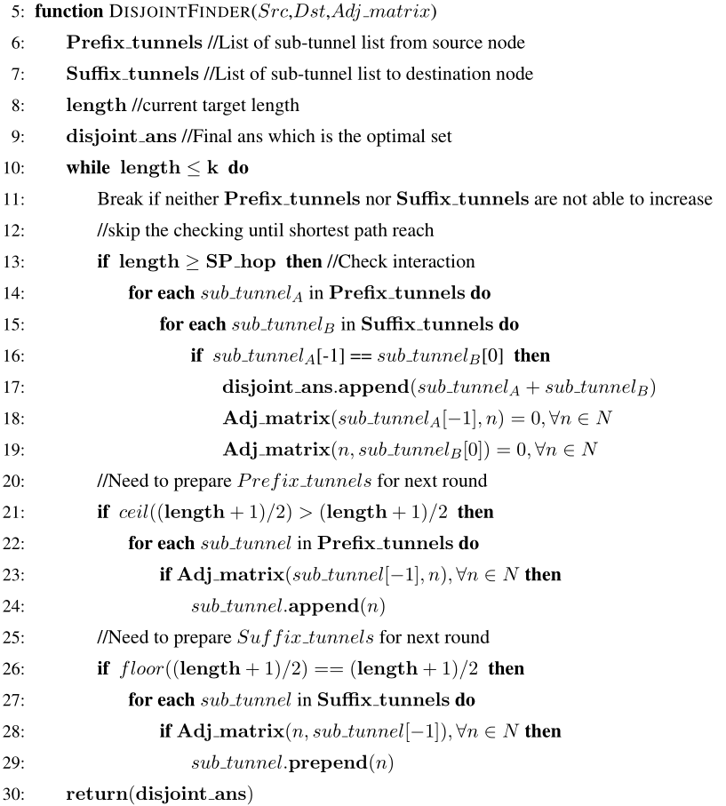
Heuristic Algorithm for Tunnels finding
Check Intersection
Update Adjacency Matrix
Move start indicator forward
Move end indicator backward
D. Torrieri. “Algorithms for finding an optimal set of short disjoint paths in a communication network”. IEEE Transactions on Communications, 1992.

Slide 30
Controller Components
Tunnel Constructor
Admission Controller
Tunnel Table
Dynamic Tunnel Finder
Dynamic Traffic Assigner
Tunnel Table
Traffic Status
Static Tunnel Finder
Static Traffic Assigner
Topology
Tunnel Table
Unexpected events
Traffic Table
Traffic Request
Proactive Switch Module
Main Control Logic
(OpenFlow Events Handlers)
Flow Command Dispatcher
MPLS-enabled Network

Slide 31
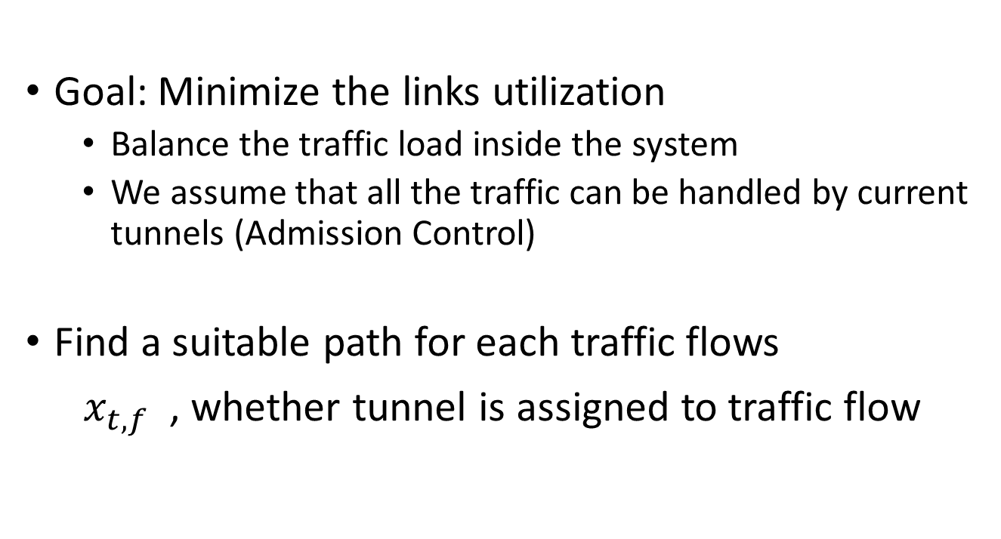
Path Assigner
Goal: Minimize the links utilization
  Balance the traffic load inside the system
  We assume that all the traffic can be handled by current tunnels (Admission Control)
  Find a suitable path for each traffic flows
$x_{t,f}$ , whether tunnel is assigned to traffic flow

Slide 32
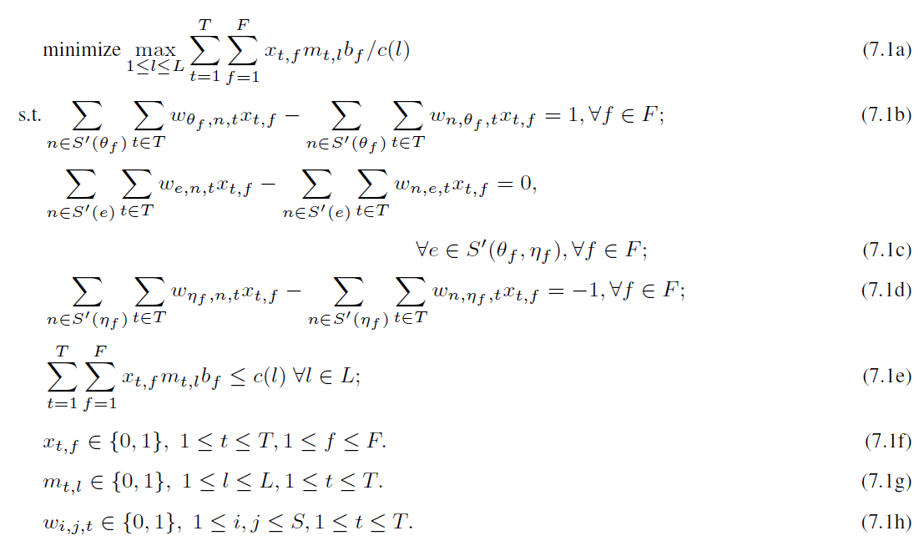
Load balancer
Tunnels
Static
Path
Assigner
Traffic
Assignment
Traffic
Minimize the maximal tunnel utilization
Traffic flows always reach their destination
Traffic flows will not leave from the middle nodes
Traffic flows never leave its destination
Traffic over a link does not exceed its capacity
Notes:
7.1a minimize the maximal tunnel utilization in our system
7.1b the traffic flow never returns to the source of the traffic
7.1c none of the intermediate sites consume the traffic flow
7.1d the traffic flow enters the destination and never leaves it
7.1e the traffic over a link does not exceed its capacity

Slide 33
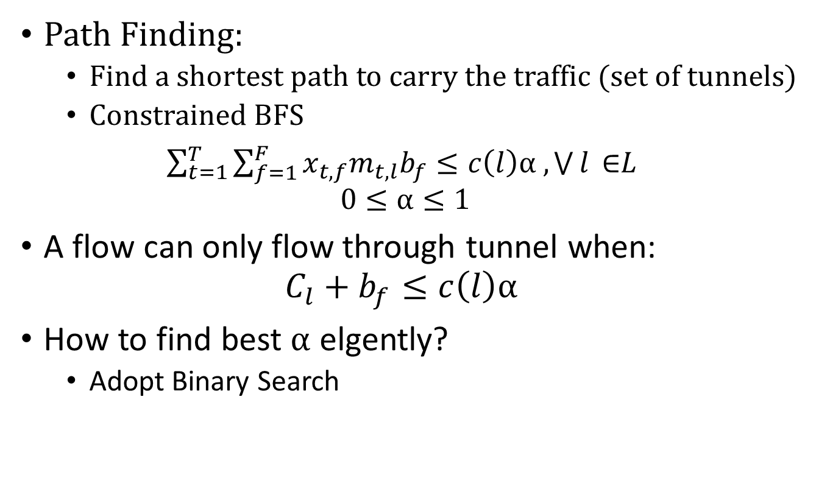
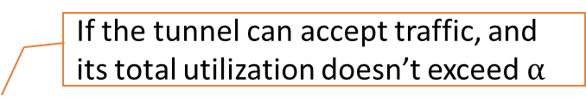
How to find best utilization?
Path Finding:
  Find a shortest path to carry the traffic (set of tunnels)
  Constrained BFS
$\sum_{t=1}^{T}{\sum_{f=1}^{F}{x_{t,f}m_{t,l}b_{f}}}≤c\left(l\right)α , \bigvee{l }\text{∈}L$
$$0≤α≤1$$
A flow can only flow through tunnel when:
$$C_{l}+b_{f}≤c\left(l\right)α$$
How to find best $α$ elgently?
  Adopt Binary Search
If the tunnel can accept traffic, and its total utilization doesn’t exceed $α$

Slide 34
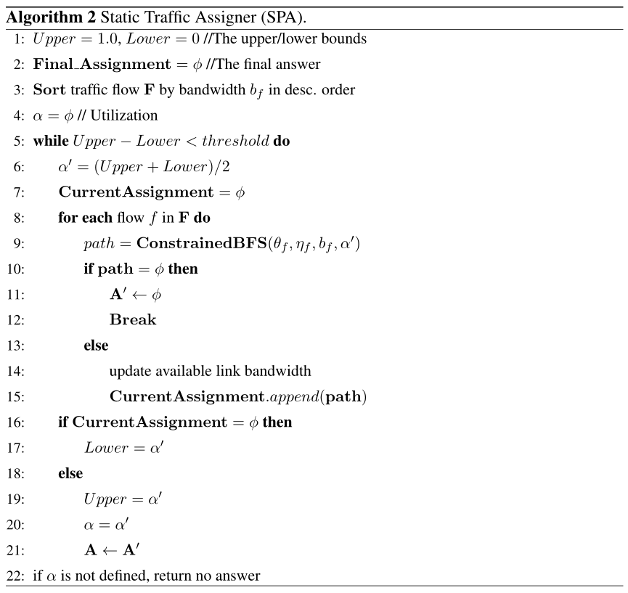
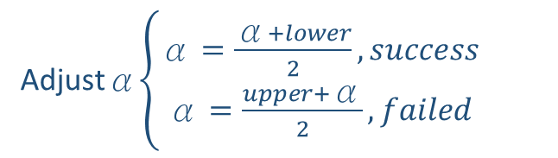
Heuristic Algorithm for Paths finding
Binary search
Assign traffic into system
Adjustα$\left\{\begin{aligned}\text{α}=\frac{\text{α}+lower}{2}, success \\ \text{α}=\frac{upper+\text{α}}{2}, failed\end{aligned}\right.$

Slide 35
Controller Components
Tunnel Constructor
Admission Controller
Tunnel Table
Dynamic Tunnel Finder
Dynamic Traffic Assigner
Tunnel Table
Traffic Status
Static Tunnel Finder
Static Traffic Assigner
Topology
Tunnel Table
Unexpected events
Traffic Table
Traffic Request
Proactive Switch Module
Main Control Logic
(OpenFlow Events Handlers)
Flow Command Dispatcher
MPLS-enabled Network

Slide 36
Dynamic Path Assigner
Determine the routing path in real time
  New traffic request
  Unexpected Events -> traffic flows need to be re-allocated
Decide whether the network can handle traffic
  Quick response to minimize delay
  Leave the utilization optimizing to SPA

Slide 37
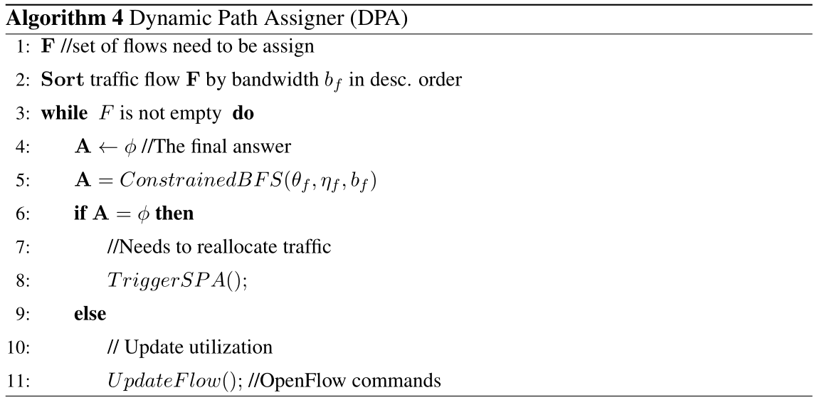
Find a path in real-time
Goal: find sufficient path to fit the traffic
  Using the same BFS module in Static Path Assigner

Slide 38
Controller Components
Tunnel Constructor
Admission Controller
Tunnel Table
Dynamic Tunnel Finder
Dynamic Traffic Assigner
Tunnel Table
Traffic Status
Static Tunnel Finder
Static Traffic Assigner
Topology
Tunnel Table
Unexpected events
Traffic Table
Traffic Request
Proactive Switch Module
Main Control Logic
(OpenFlow Events Handlers)
Flow Command Dispatcher
MPLS-enabled Network

Slide 39

Switch Dynamic
Goal: to find a tunnel with lowest utilization
  Consider link utilization => govern more traffic
Connect New edge switches to the network
  Find lowest utilization tunnels to all the nodes
Recover failed tunnels
  Create virtual nodes => connect two tunnels with overlapping points
Virtual Node S
Virtual Node E
Notes:
Animate

Slide 40
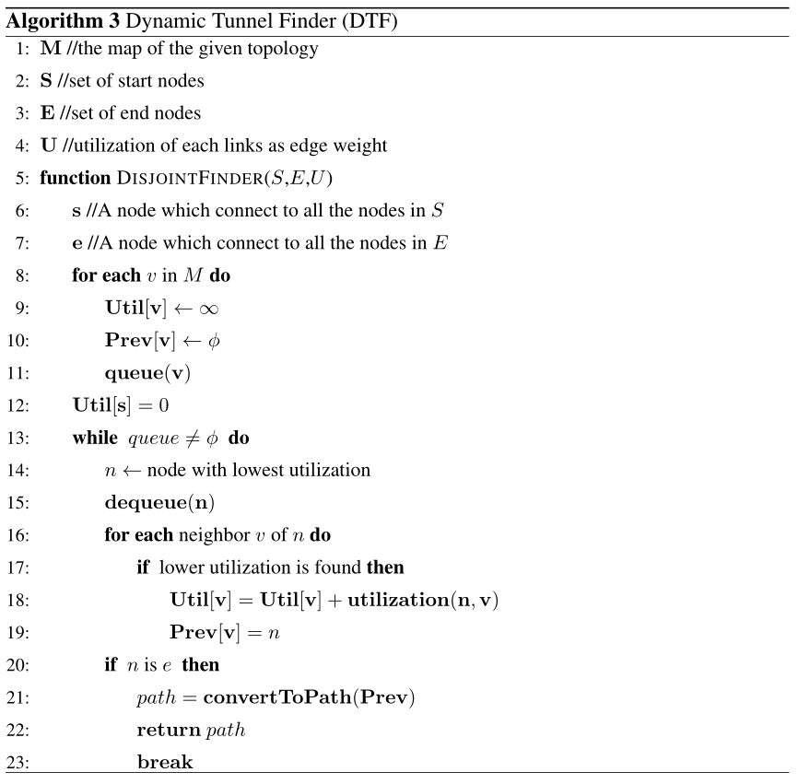
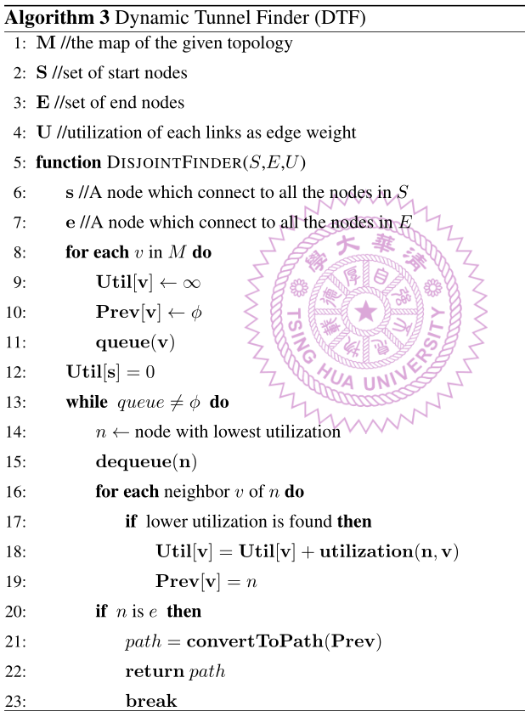
Dijkistra to find path
Weight <- Current link util.

Slide 41
Evaluation

Slide 42
Implementation
TE with
Label Switching
Segment
Routing
IGP
Ryu
Simple
Routing
Ryu Controller
User-defined
Applications …
Built-in Applications
Ryu Libraries
OpenFlow Protocols
IP Network Protocols
Mininet
OpenVSwithc
OpenFlow Switches

Slide 43
Application in RYU
Traffic Engineering with Label Switching (TEL)
  Optimize traffic by proposed algorithms
  Proactively install disjoint paths in system
Segment Routing with IGP (SRI)
  Cisco Pathman[1]
  Shortest Path Routing
  Proactively install paths in system
  Choose path with lowest link usage
Ryu Simple Routing (RSR)
  Spanning Tree Protocols
[1] OpenDaylight Pathman SR App from cisco. https://github.com/CiscoDevNet/pathman-sr.
Notes:
[cite] cisco pathman

Slide 44
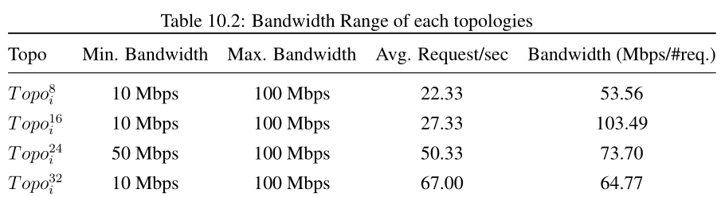
Experiment setup
Mininet network emulator
  OpenVSwich
  Real traffic flows generated by iPerf
4 different sizes, each size has 5 different topologies
Conduct experiments for 10 times
  UDP packets

Slide 45
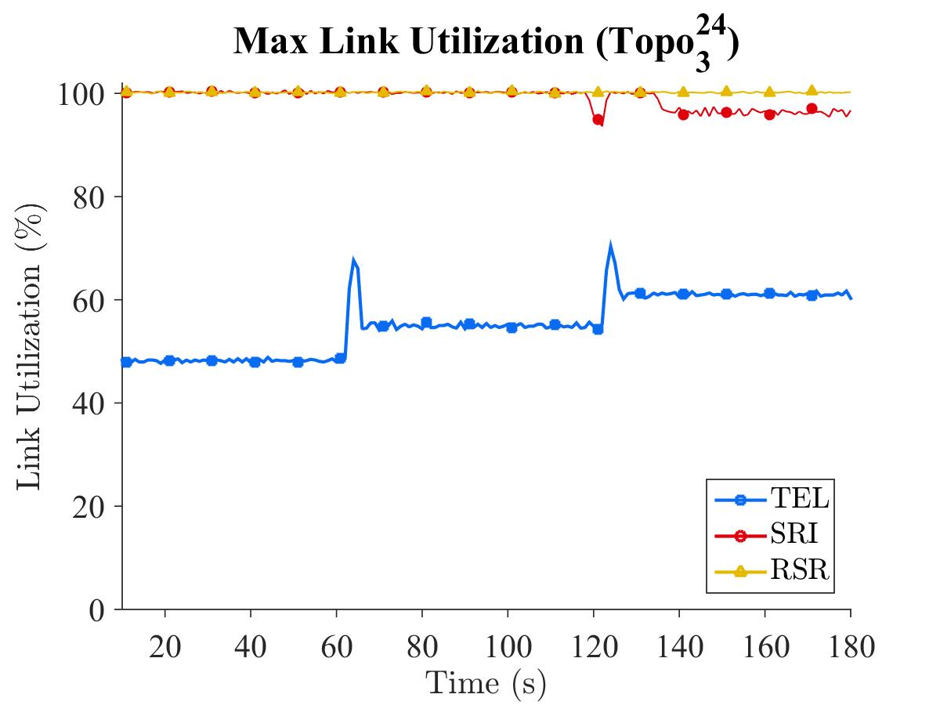
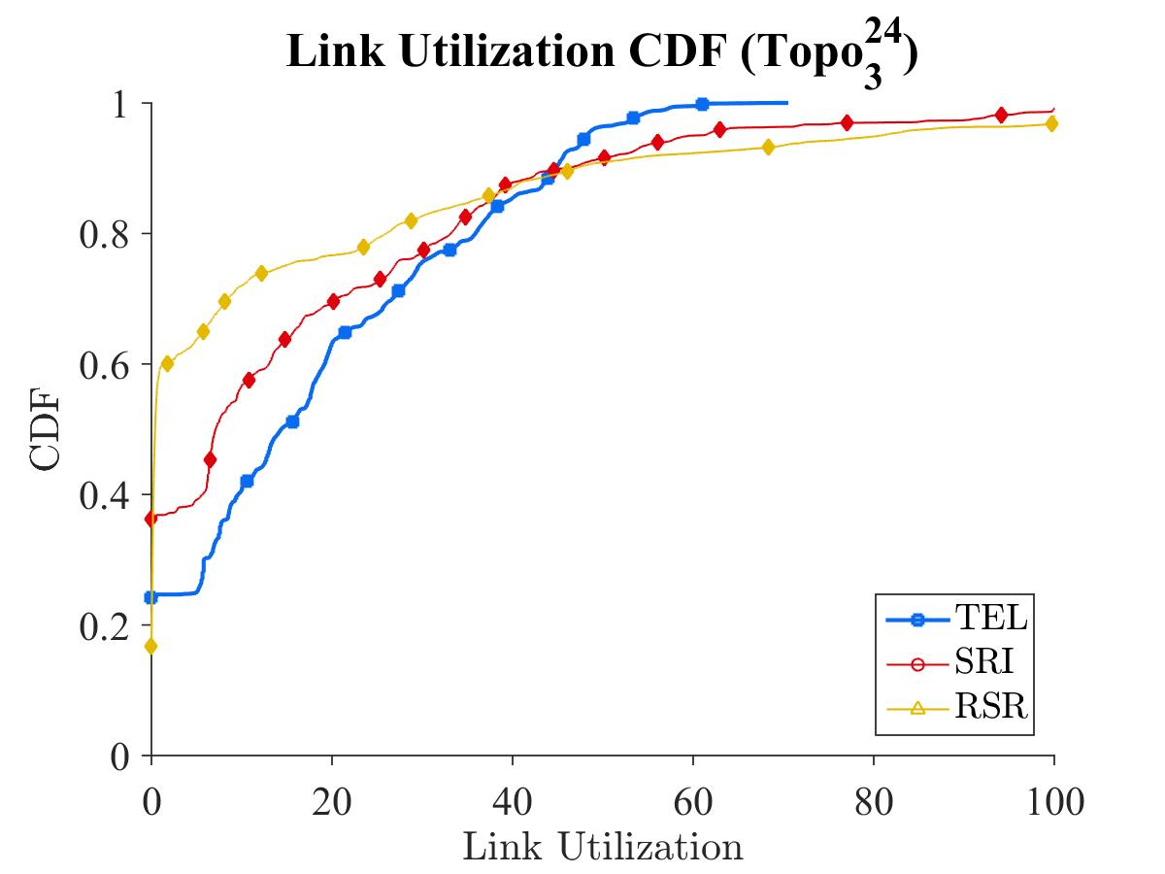
TEL optimizes the max. link utilization
TEL optimize the traffic
  TEL always achieve the lowest max. link utilization
  90% of links have less than 50% link usage

Slide 46
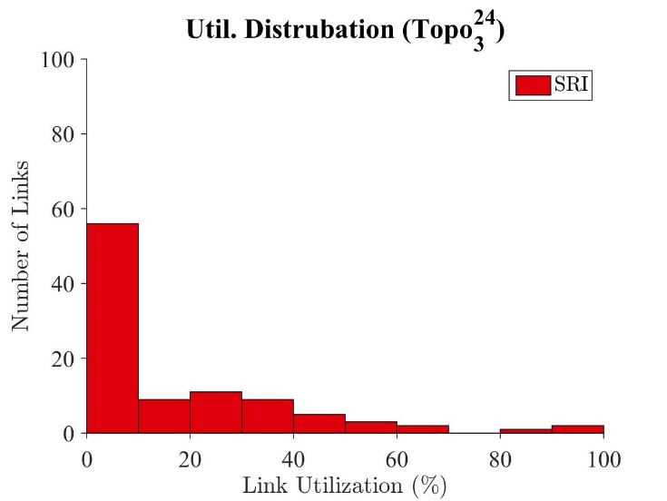
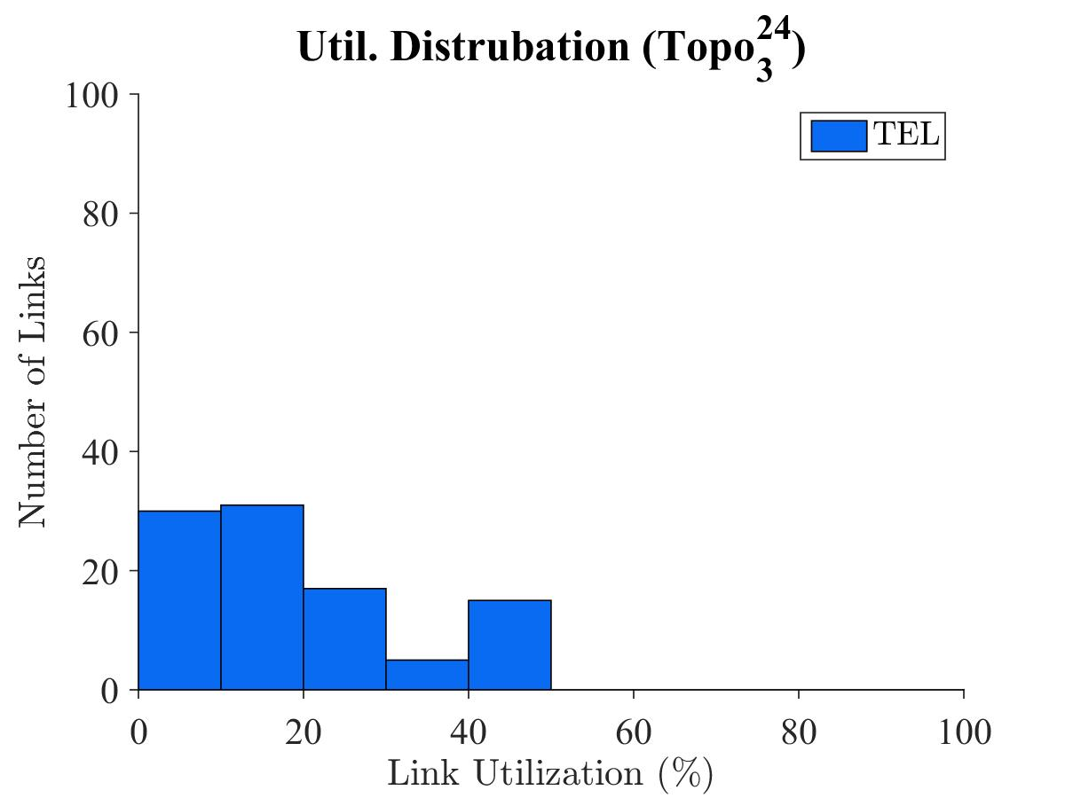
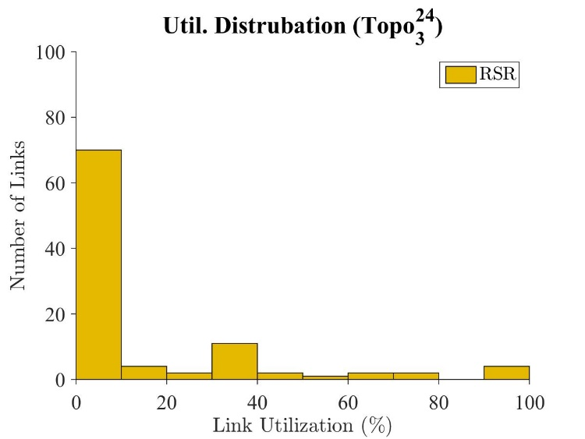
Utilize Idle resources
TEL uses idle resources to balance the traffic
  More links are used
  Minimize utilization

Slide 47
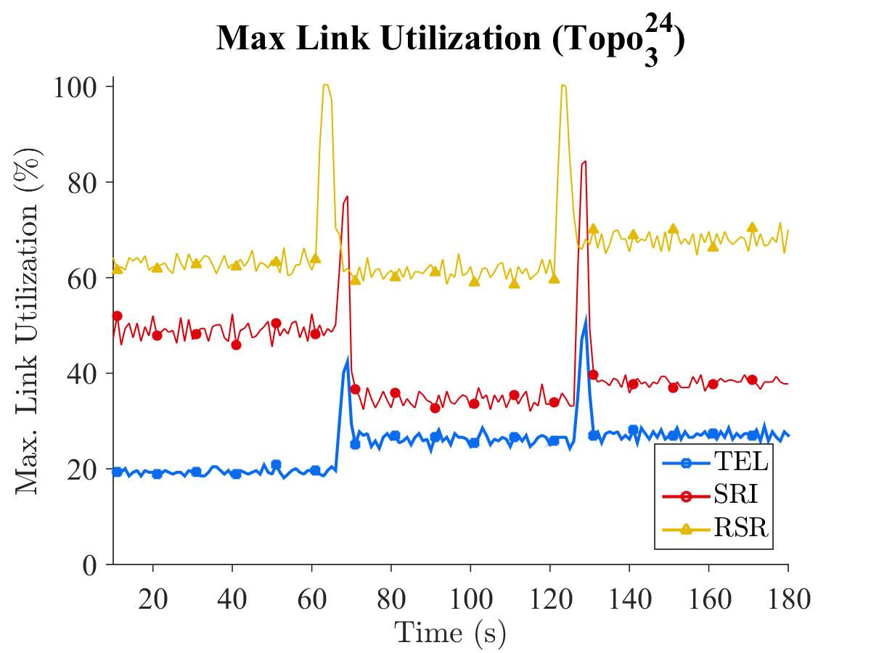
Heavy and Light traffic
TEL is able to minimize the traffic in both heavy traffic & light traffic
Light traffic : 28.96 Mbps
Heavy traffic : 73.70 Mbps

Slide 48
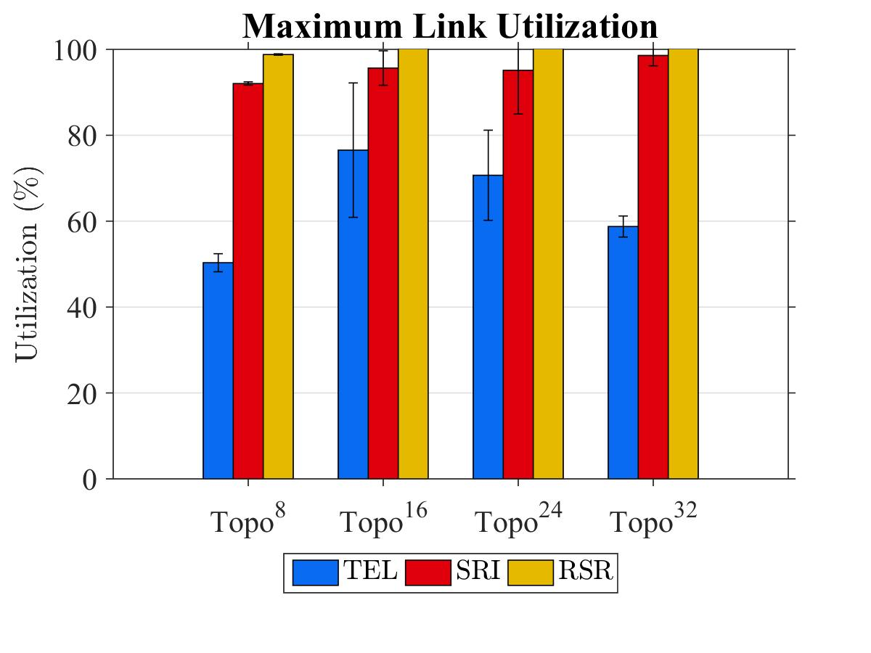
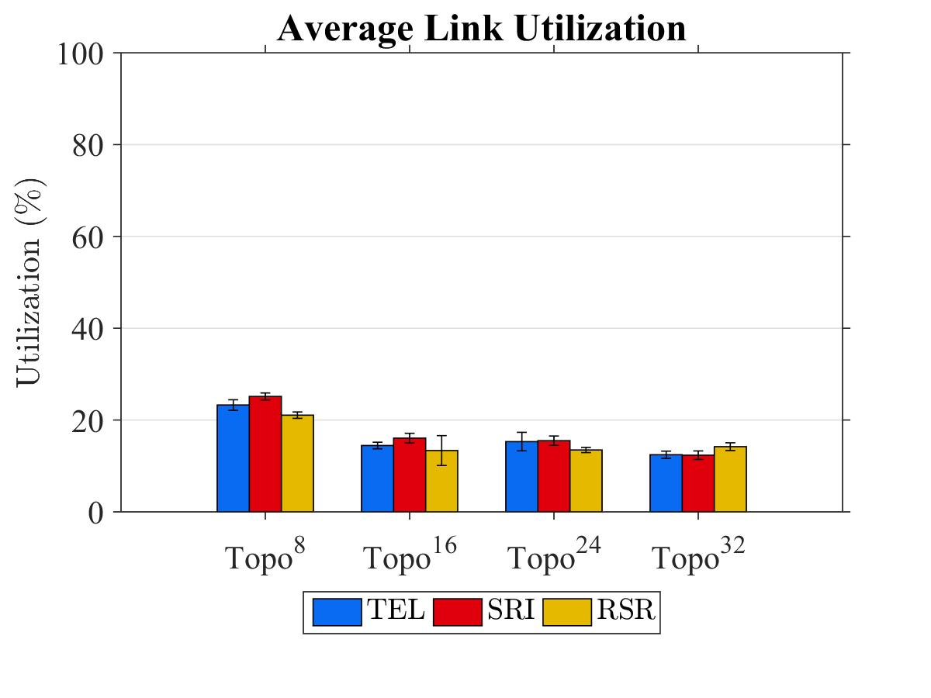
TEL balances the traffic in different topologies
TEL reduces maximal link utilization over
  SRI between 20% ~ 46%
  RSR between 30% ~ 50%
-20%
-46%

Slide 49
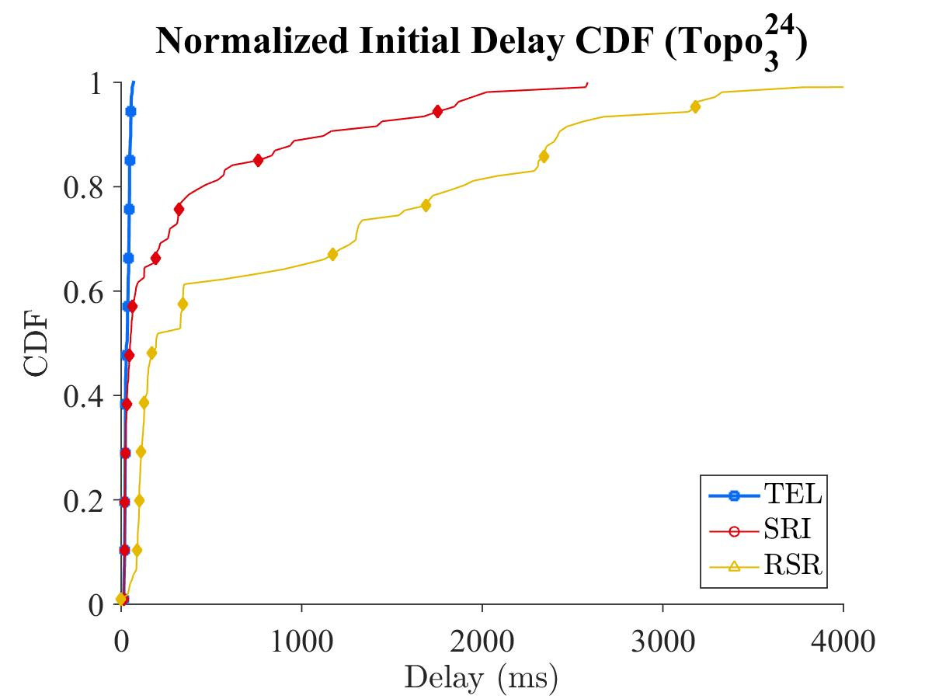
TEL achieves the lowest Init. delay
TEL achieves lowest initialization delay
Both SRI and RSR suffer from congestion, and the delay is relatively high

Slide 50
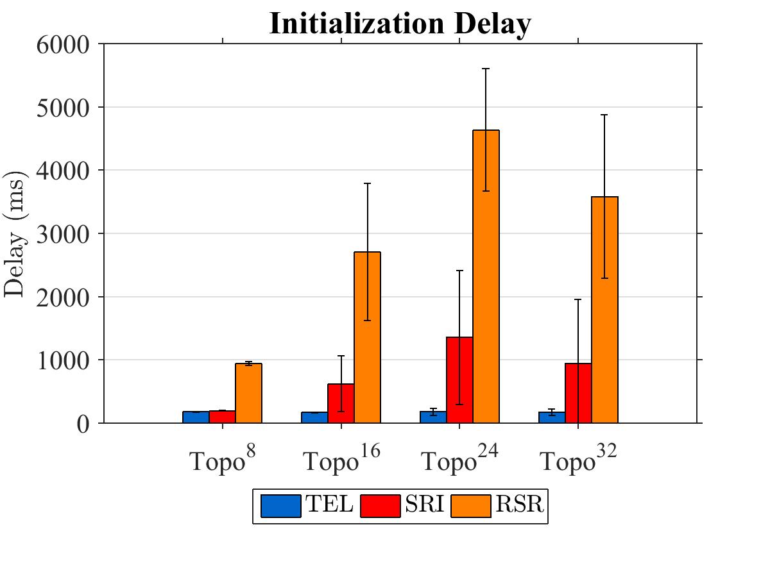
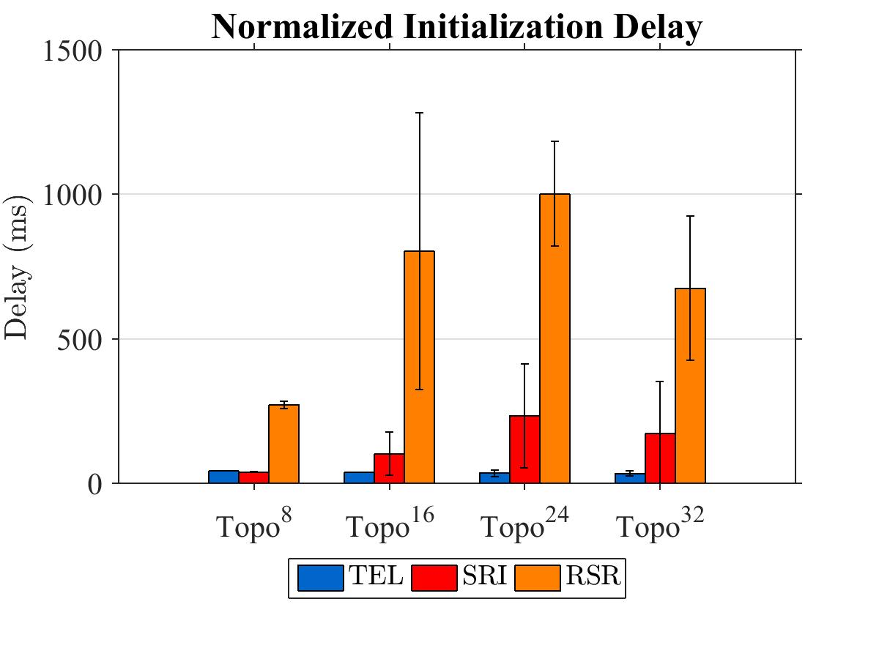

Congestion increases the delay
Initialization delay is reduced by 39.02% and 93.22% compared to the SRI and RSR
  Delay increases along the size
  Heavy congestion in $Topo^{24}$ ( 9% of links suffer from congestion) 3-5% others
Notes:
Show congestion

Slide 51
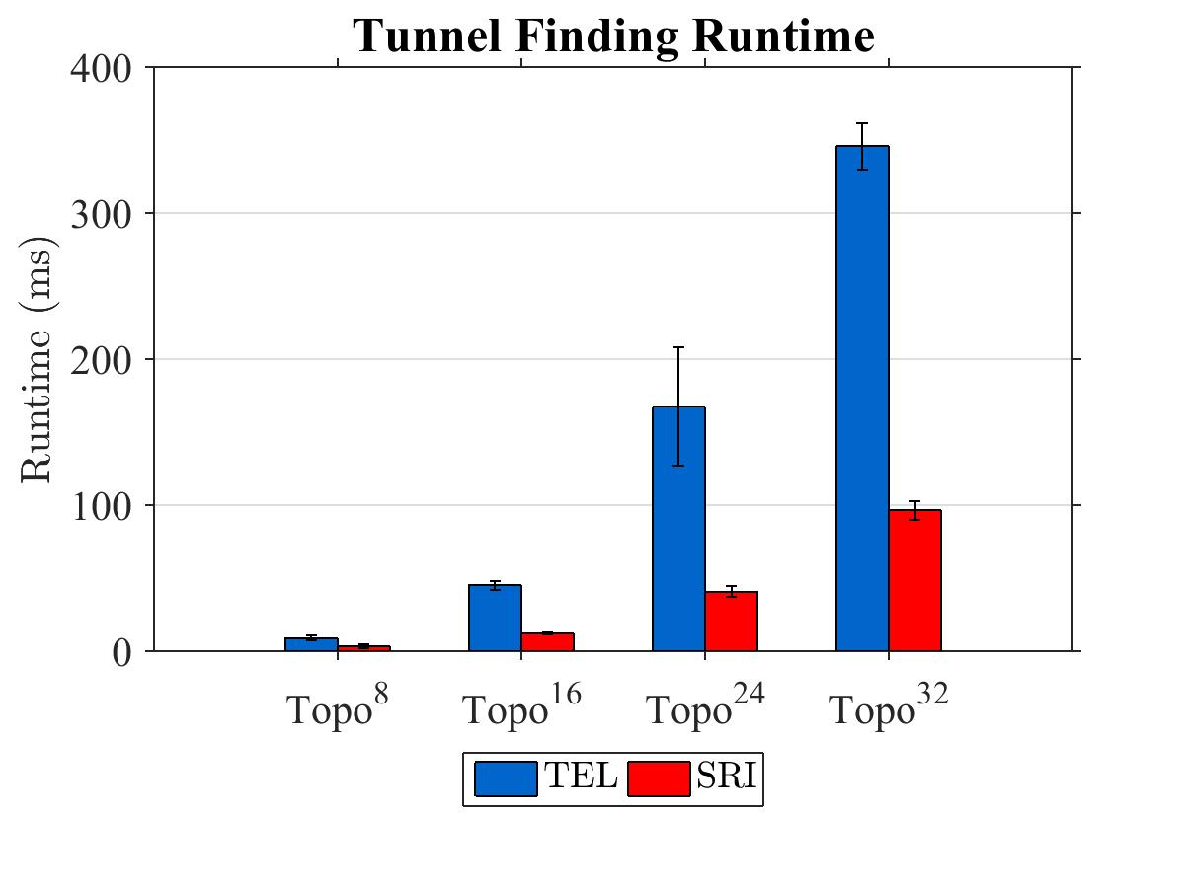
TEL takes more time on pre-built tunnels
We don’t need to compute the tunnels constantly
  The state changes only if the topology changes

Slide 52
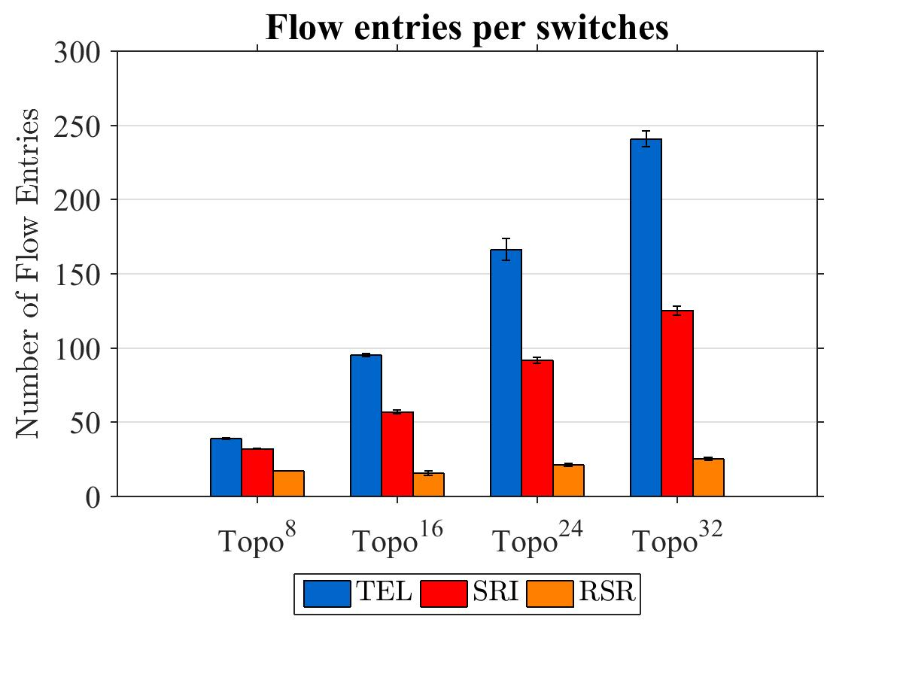
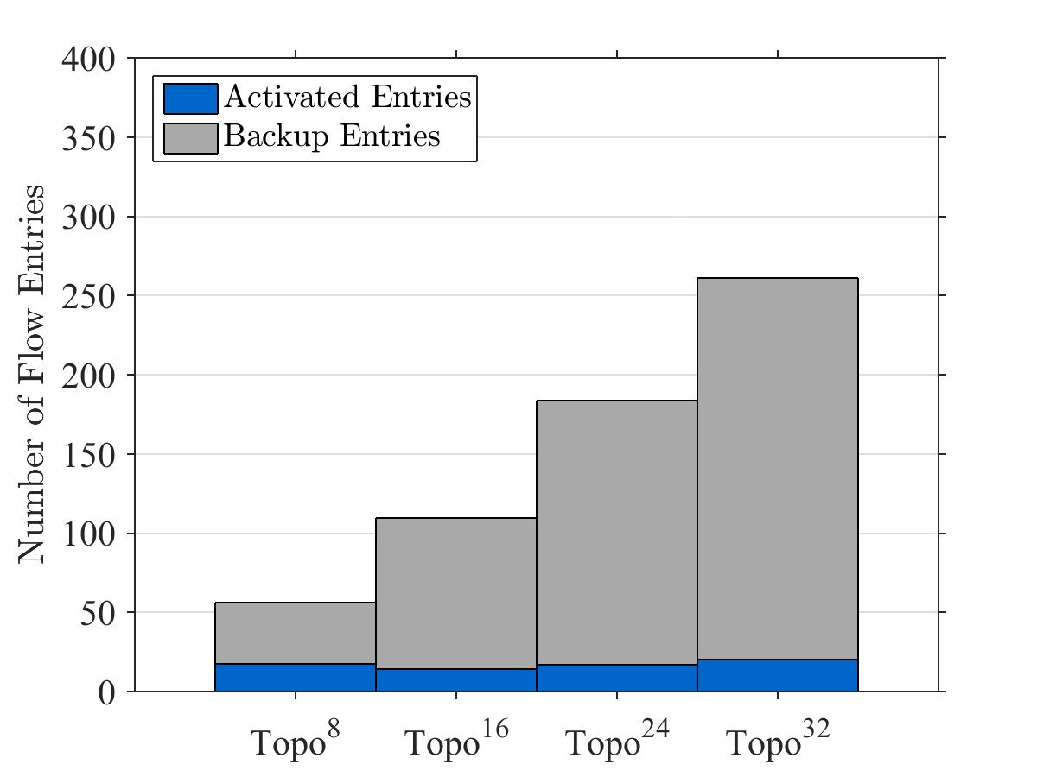
TEL consumes more flow entries
TEL consume more flow entries
  Reductant flow rules => quick response, error resilience
  Tunnels can be further optimized (Future works)

Slide 53










Recover path with backup
$$S_{2}$$
$$S_{4}$$
$$S_{1}$$
$$S_{6}$$
$$H_{1}$$
$$H_{2}$$
$$S_{3}$$
$$S_{5}$$

Slide 54
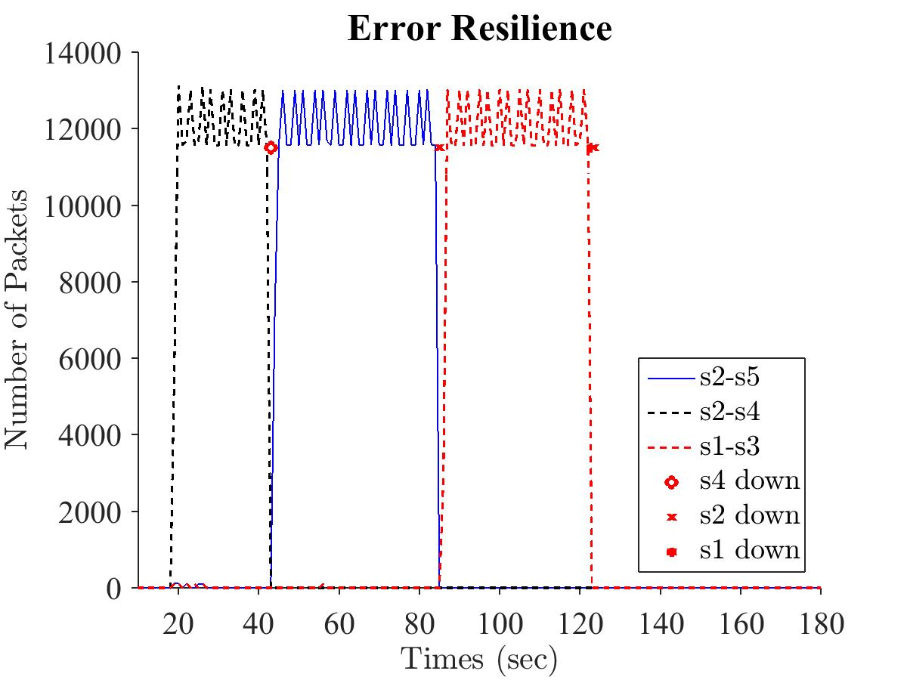

Slide 55
Recover using DPA
$$S_{2}$$
$$S_{4}$$
$$S_{1}$$
$$S_{6}$$
$$H_{1}$$
$$H_{2}$$
$$S_{3}$$
$$S_{5}$$

Slide 57

Wait for edge reconnecting
$$S_{2}$$
$$S_{4}$$
$$S_{6}$$
$$S_{1}$$
$$H_{1}$$
$$H_{2}$$
$$S_{3}$$
$$S_{5}$$

Slide 59
Conclusion

Slide 60
Conclusion
Purposed a label switching for solving Traffic Engineering in SDNs
  Flexibility, Load balancing and Error resilience
Purposed algorithms for the label switching
  2 Tunnel finder algorithm
  1 Load balancer, and 1 admission controller
Emulation results shows that Purposed TEL:
  Reduce the max. link utilization in different condition (Using idle resources)
  Minimize initialization delay
  The dynamic algorithm provide error resilience

Slide 61
Thanks for listening
Q & A

Slide 62
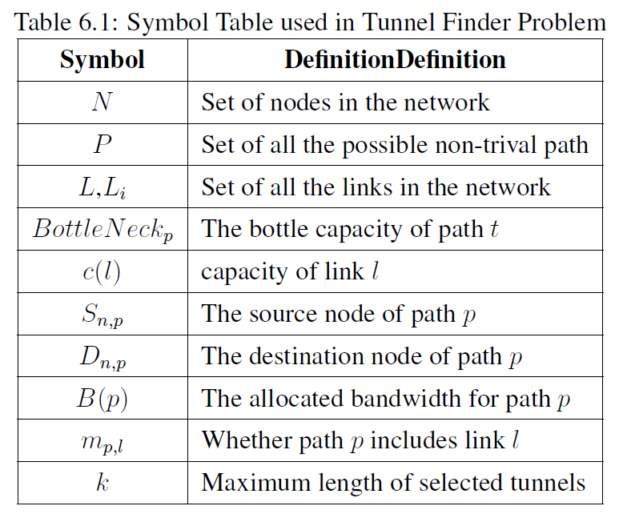
Symbol Table

Slide 63
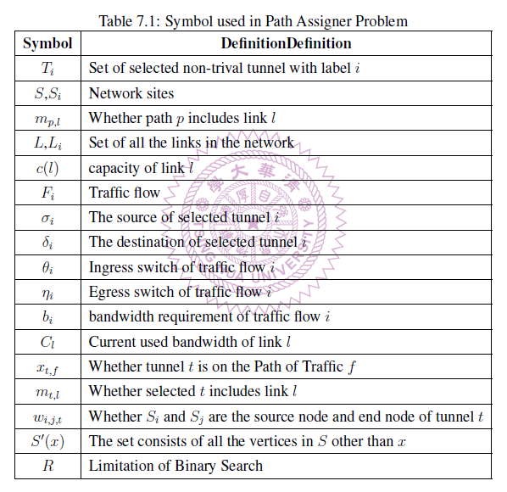
Symbol Table

