Slide 1
Optimizing Live Game Streaming Platforms Using Segment-of-Interests
Tao-Ya Fan-Chiang
NMSL, Department of Computer Science, National Tsing Hua University, Taiwan

Slide 2
Outline
Introduction & Motivation
System Overview
SoI Detector
Resource Allocator
Evaluation
Conclusion

Slide 3
Outline
Introduction & Motivation
System Overview
SoI Detector
Resource Allocator
Evaluation
Conclusion

Slide 4
Twitch
Gameplay
Webcam image
Chat

Slide 5
How Does Live Game Streaming Work?
Viewers
Content Delivery Networks
Video Servers
Content Delivery Networks
Streamers
RTMP/HLS Streams
RTMP/HLS Streams
RTMP/HLS Streams
RTMP/HLS Streams

Slide 6
Streamer
Streamer: send the game stream to video servers
Often with streaming software such as OBS
Using protocols such as RTMP, HTTP Live Streaming
Viewers
Content Delivery Networks
Video Servers
Content Delivery Networks
Streamers
RTMP/HLS Streams
RTMP/HLS Streams
RTMP/HLS Streams
RTMP/HLS Streams

Slide 7
Video Servers
Relay the stream to viewers
Transcode them if necessary
Viewers
Content Delivery Networks
Video Servers
Content Delivery Networks
Streamers
RTMP/HLS Streams
RTMP/HLS Streams
RTMP/HLS Streams
RTMP/HLS Streams

Slide 8
Viewers
Watch the stream with video players
Viewers
Content Delivery Networks
Video Servers
Content Delivery Networks
Streamers
RTMP/HLS Streams
RTMP/HLS Streams
RTMP/HLS Streams
RTMP/HLS Streams

Slide 9
Content Delivery Networks
Streams often go through CDNs
Companies such as Twitch need to pay for the bandwidth (to CDN companies such as Akamai)
Viewers
Content Delivery Networks
Video Servers
Content Delivery Networks
Streamers
RTMP/HLS Streams
RTMP/HLS Streams
RTMP/HLS Streams
RTMP/HLS Streams

Slide 10
Content Delivery Networks
Streams often go through CDNs
Companies such as Twitch need to pay for the bandwidth (to CDN companies such as Akamai)
Viewers
Content Delivery Networks
Video Servers
Content Delivery Networks
Streamers
RTMP/HLS Streams
RTMP/HLS Streams
RTMP/HLS Streams
RTMP/HLS Streams
Who are running these services?

Slide 11
Who Are Running These Services?
Twitch
Spin-off from Justin.tv
The broadcast platform for most E-sport event
Ustream
The streaming service used by Sony PS4
YouTube Gaming
Launched in Aug, 2015

Slide 12
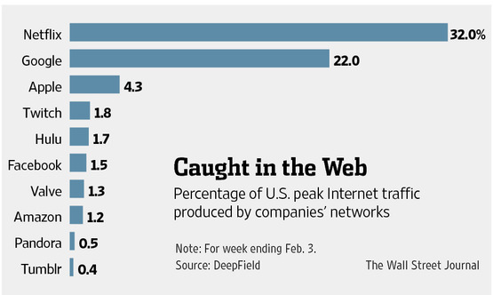
Twitch Is Hot
4th largest in peak US Internet traffic

Slide 13
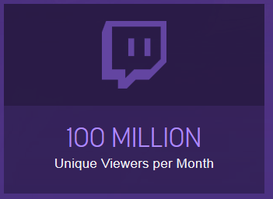
Growing Demands
Number of viewers doubled in 2014
More than twice in 2013
2013
2014
Acquired by Amazon.com for $970 million

Slide 14
What’s the Problem?
Everything looks great

Slide 15
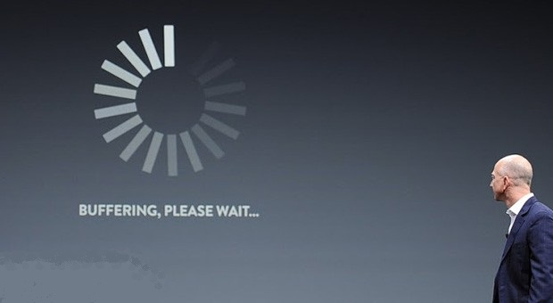
Problem: Lag
Lag is annoying when watching live streams
Rebuffering
Other visual artifacts
Skipped video segment
Bad for user experience

Slide 16
Possible Solutions
Put in more resource
Cost money
Lower the video quality
Bad for user experience

Slide 17
Possible Solutions
Put in more resource
Cost money
Lower the video quality
Bad for user experience
How to do this without degrading the user experience?

Slide 18
Lag at different time cause different level of degradation in user experience

Slide 19
At Clutch Time

Slide 20
At Clutch Time

Slide 21
At Clutch Time

Slide 22
At Clutch Time

Slide 23
At Normal Time

Slide 24
At Normal Time

Slide 25
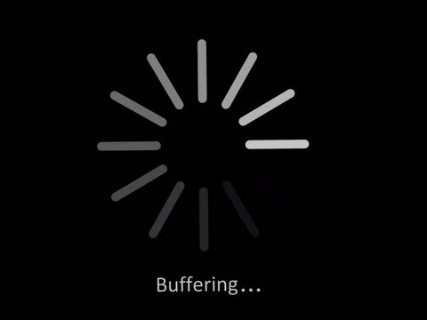
At Normal Time

Slide 26
At Normal Time
Not that bad

Slide 27
Concept of Segment of Interest (SoI)
Different segments have different importance
We refer to the important one as Segment of Interest (SoI)
We should put in more resource to deliver SoI
Sacrifice non-SoI if we have to

Slide 28
Contributions
Develop SoI-driven streaming platform
Answer two questions
How to detect SoI efficiently?
How to allocate resources among channels?

Slide 29
Outline
Introduction & Motivation
System Overview
SoI Detector
Resource Allocator
Evaluation
Conclusion

Slide 30
Outline
Introduction & Motivation
System Overview
SoI Detector
Resource Allocator
Evaluation
Conclusion

Slide 31
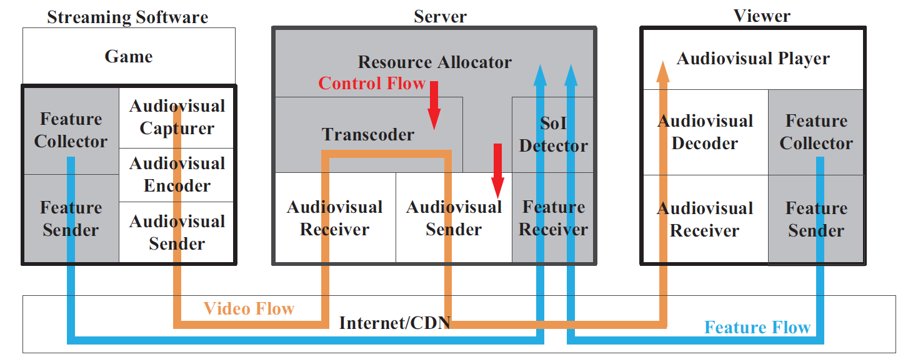
System Architecture

Slide 32
Streaming software
Stream the gameplay to server

Slide 33
Streaming software
Stream the gameplay to server

Slide 34
Streaming Server
Relay the stream to viewers
Transcode if necessary

Slide 35
Streaming Server
Relay the stream to viewers
Transcode if necessary

Slide 36
Viewer
Replay the gameplay stream

Slide 37
Viewer
Replay the gameplay stream

Slide 38
Feature Collector
Collect the features from streamers
Such as CPU usage, foreground window name…
Also from viewers

Slide 39
Feature Collector
Collect the features from streamers
Such as CPU usage, foreground window name…
Also from viewers

Slide 40
Feature Sender/Receiver
Send/receive the collected features
40

Slide 41
Feature Sender/Receiver
Send/receive the collected features
41

Slide 42
SoI Detector
Detect SoI from the collected features
42

Slide 43
SoI Detector
Detect SoI from the collected features
43

Slide 44
Resource Allocator
Allocate resources between different streams in the system
44

Slide 45
Resource Allocator
Allocate resources between different streams in the system
45

Slide 46
Transcoder
Transcode the stream
46

Slide 47
Transcoder
Transcode the stream
47

Slide 48
Core Components
SoI Detector
Resource Allocator
48

Slide 49
Outline
Introduction & Motivation
System Overview
SoI Detector
Resource Allocator
Evaluation
Conclusion

Slide 50
Outline
Introduction & Motivation
System Overview
SoI Detector
Resource Allocator
Evaluation
Conclusion

Slide 51
SoI Detection
How to detect SoI?
How to detect if viewers are interested?
From viewers?
Ask viewers to manually tell us? Too annoying
Automatically? Require mass deploy, privacy issue

Slide 52
SoI Detection
How to detect SoI?
How to detect if viewers are interested?
From viewers?
Ask viewers to manually tell us? Too annoying
Automatically? Require mass deploy, privacy issue
Detect from streamers

Slide 53
How To Detect From Streamer?
Detect from content (video) [1]?
Computationally intensive, not real-time friendly
“The segment at 3 hours ago is valuable, to the viewers who’ve watched it 3 hours ago”
Detect from other features
Features that can be obtained in real-time
Our work
[1]. W. Chu and Y. Chou. Event detection and highlight detection of broadcasted game videos. In Proc. of ACM Workshop on Computational Models of Social Interactions: Human-Computer-Media Communication (HCMC’15), Brisbane, Australia, 2015

Slide 54
SoI Detecting Problem
How to determine SoI weight using features
From streamers
From viewers (if presented)
Model the problem as
Classification, estimate 0/1
Regression, estimate [0, 1]
SoI Detector
Extracted Features
SoI Decisions

Slide 55
Features Collected
CPU usage
GPU usage
Context switch
Streaming bitrate
Keyboard/mouse input event
Number of face in webcam
System sound magnitude
Microphone sound magnitude
Name of foreground window
All can be obtained in real-time
But identifying the relations is hard…

Slide 56
Extra Features
Generate
Min
Max
Mean
Dynamic range (Max – Min)
Variance
Moving mean
Model device capability
CPU score
RAM score
Hard driver score
GPU score

Slide 57
Machine Learning
Use machine learning algorithms
Identify the relations between features and SoI
Which machine learning model to use?[1]
Deep Learning?
Support Vector Machine?
Random Forest?
Gradient Boosting Tree?
[1]. Yaser S. Abu-Mostafa, Malik Magdon-Ismail, and Hsuan-Tien Lin. Learning from Data: A Short Course. AMLBook, March 2012

Slide 58
Selected Model
We choose
Random Forest
Gradient Boosting Tree
Both are ensemble models of decision trees
Efficient in training
Unlike SVM and Deep Learning
Popular
Applied in multiple fields

Slide 59
Hyperparameter
RF-based
N, Number of trees
X, Maximum number of feature in splitting
H, Maximum Depth
GBT-based
N, Number of trees
E, Shrinkage (learning rate)
H, Maximum Depth
M, Subsample

Slide 60
Solution Approach
Implemented in Python
Scikit-learn for Random Forest
XGBoost for Gradient Boosting Tree
Using both regressor and classifier variant of them
RFR-based & GBTR-based algorithm
RFC-based & GBTC-based algorithm
We conduct supervised learning
Details are given in evaluation

Slide 61
Outline
Introduction & Motivation
System Overview
SoI Detector
Resource Allocator
Evaluation
Conclusion

Slide 62
Resource Allocation Problem
How to allocate resources among streams to maximize viewing quality q_{s}?
Take r_{s} as the decision variable
Leverage SoI weight w_{s}

Slide 63
Connect r_{s} With q_{s}
We adopt a rate-distortion model [1]
d_{s}: distortion in Mean Square Error (MSE)
D_{0,s}, θ_{s}, R_{0,s}: model parameters obtained by non-linear regression
[1] X.Zhu,E.Setton,andB.Girod.Congestion-distortionoptimizedvideotransmission over ad hoc networks. Signal Processing: Image Communication, 20(8):773–783, 2005

Slide 64
Quantifying Viewing Quality
We use Peak-Signal-to-Noise Ratio (PSNR)
q_{s}$= 10\log_{10}{\frac{{255}^{2}}{d_{s}}}$
The proposed algorithm can utilize other quality metrics with monotonically increasing property

Slide 65
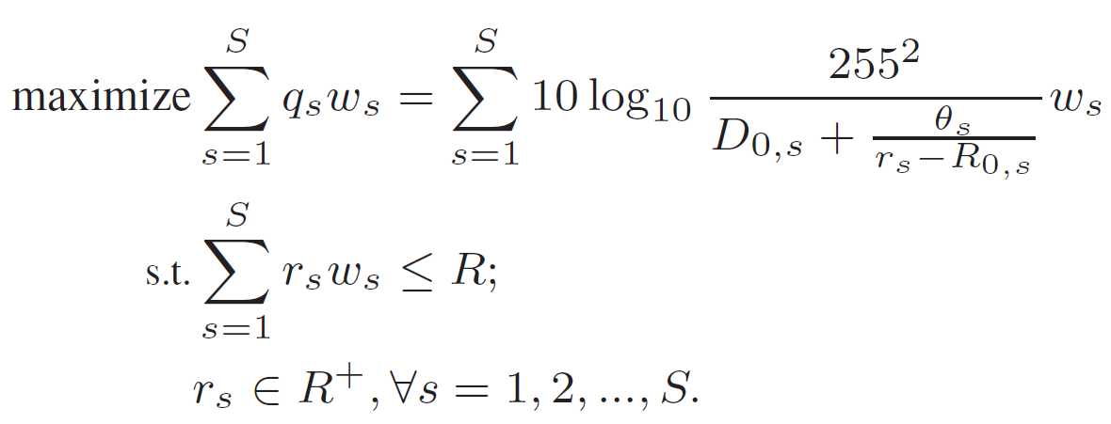
Problem Formulation

Slide 66
Problem Formulation
Objective: Maximize the viewing quality of all the viewers in SoI

Slide 67
Problem Formulation
Under the constraint that the total bandwidth usage is under R

Slide 68
Derive Closed Form Formula
Leverage Lagrangian Multiplier method
Added λ
We get Lagrangian function L
Take partial derivative of L
In order to get the extreme value of L
S of them

Slide 69
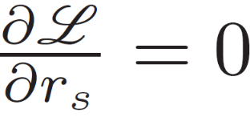
Solving the Formula
Let
After derivation
Combine the results above with
= 0
We can obtain the optimal λ
Then derive the optimal bitrates for streaming to each viewer v of streamer s
Slow to solve
The result of the other partial derivative
There are S + 1 formulas

Slide 70
A Real-Time Approximation Algorithm
Solve the problem efficiently
With a controllable error of ε
Called SoI-based R-D Optimized Algorithm (SoI RDO)

Slide 71
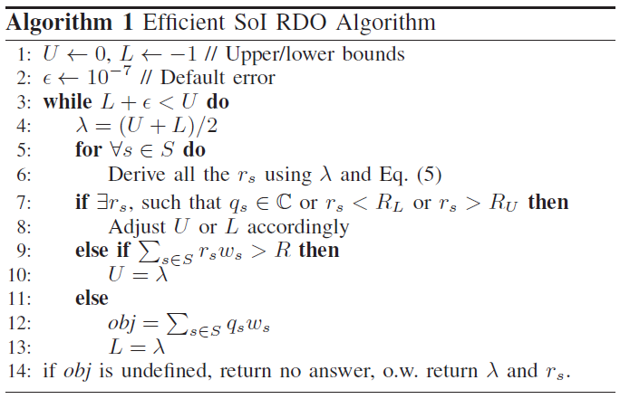
SoI RDO Algorithm
Binary search on proper λ value
Derive all r_{s} & q_{s} using λ this round
Check if all r_{s} and q_{s} are valid
Check if use too much bandwidth
Calculate objective function

Slide 72
Lemma 1
Reason why the quality metrics need to have monotonically increasing property.
Lemma 1 (Approximation Gap). SoI RDO algorithm always finds $λ$ within a gap of $ε$to the optimal $λ^{∗}$ under the given bandwidth constraint R.

Slide 73
Lemma 2
$\log{\text{ε}\text{−1}}$ round of search in worst case
Each round need to do
Derive r_{s}, q_{s} for every streamer s O(S)
Check if r_{s} is valid for every streamer s O(S)
Calculate the total consumed bandwidth O(S)
Calculate the objective value O(S)
O($\log{\text{ε}\text{−1}}$) x (O(S)) = O(S $\log{\text{ε}\text{−1}}$)

Slide 74
Outline
Introduction & Motivation
System Overview
SoI Detector
Resource Allocator
Evaluation
Conclusion

Slide 75
Outline
Introduction & Motivation
System Overview
SoI Detector
Resource Allocator
Evaluation
Conclusion

Slide 76
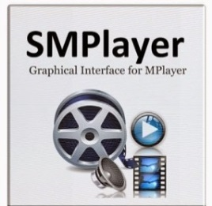
Open Source Testbed
Streaming software: OBS [1]
Streaming server: NGINX [2] with RTMP plug-in
Viewer: SMPlayer [3]
Viewers
Video Servers
Streamers
RTMP/HLS Streams
RTMP/HLS Streams
[1] https://obsproject.com/
[2] http://nginx.org
[3] http://smplayer.sourceforge.net/

Slide 77
Collected Features on OBS
GPU usage
With NVidia API
CPU usage & Context Switch
With Windows Performance Counter
Keyboard/mouse event
With GetAsyncKeyState function
System & Microphone sound amplitude
With Direct Show framework
Webcam face detection
With OpenCV VideoIO Module
Streaming bitrate
Reported by OBS
Foreground window title
With GetActiveWindowTitle function

Slide 78
Collected Features on SMPlayer
Webcam face detection
With OpenCV VideoIO Module
Foreground window title
With GetActiveWindowTitle

Slide 79
SoI detector Experiment Setup

Slide 80
Collecting the Dataset
Collected at a League of Legend tournament
50 participants, 10 matches
100 video & trace
207004 seconds in total
81 valid video & trace
162842 samples

Slide 81
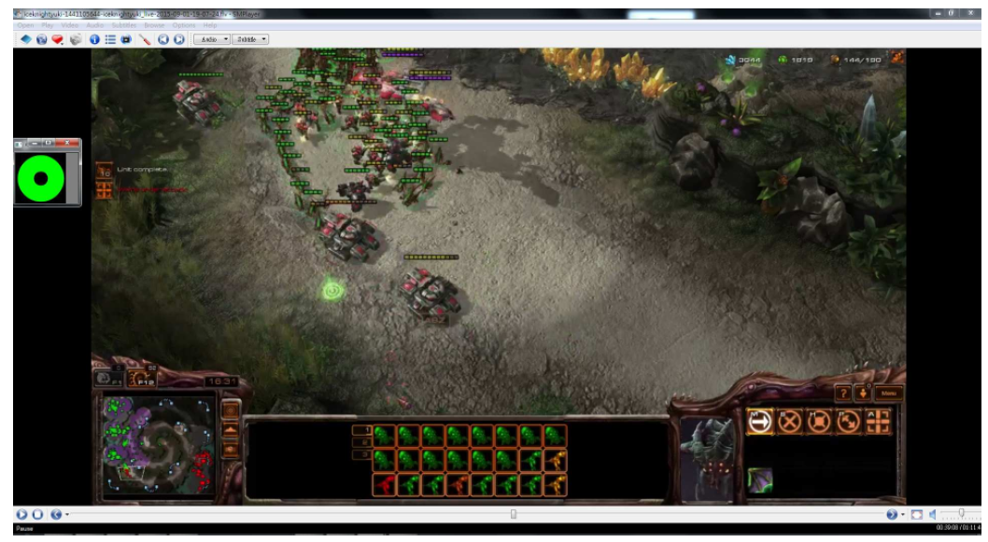
Marking SoI Ground Truth
We recruited 17 viewers to mark SoI manually
10 videos
With a modified video player
Collected 74 logs
Cover 27010 samples

Slide 82
Partition the Dataset
90% as training dataset
Used in hyperparameter tuning
18677 samples
The rest 10% as evaluation dataset
2076 samples

Slide 83
Performance Metrics
Classification
F-measure = $2 ∙\frac{precision ∙ recall}{precision + recall} ε [0, 1]$
Training Time
Regression
R-squared score $∈[1, −∞]$
Training Time

Slide 84
Hyperparameter Tuning
10-fold cross validation
Grid search
RF-based
N: [30 ,60, 120, 240, 480]
X: [5, 10, 20, 40]
H: [10, 20, 40, 80, 160]
GBT-based
N: [5, 10, 20, 40, 80]
E: [0.01, 0.05, 0.1, 0.2, 0.4]
H: [5, 10, 20, 40, 80]
M: [0.5, 0.6, 0.7, 0.8, 0.9]

Slide 85
The Optimal Hyperparameter
RFR-based algorithm
N: 240, X: 5, H: 40
GBTR-based algorithm
N:80, E: 0.2, H: 10, M: 0.9
RFC-based algorithm
N: 480, X: 5, H: 80
GBTC-based algorithm
N: 80, E: 0.2, H:80, M: 0.7
Use them in evaluation

Slide 86
SoI Detector experiment result

Slide 87
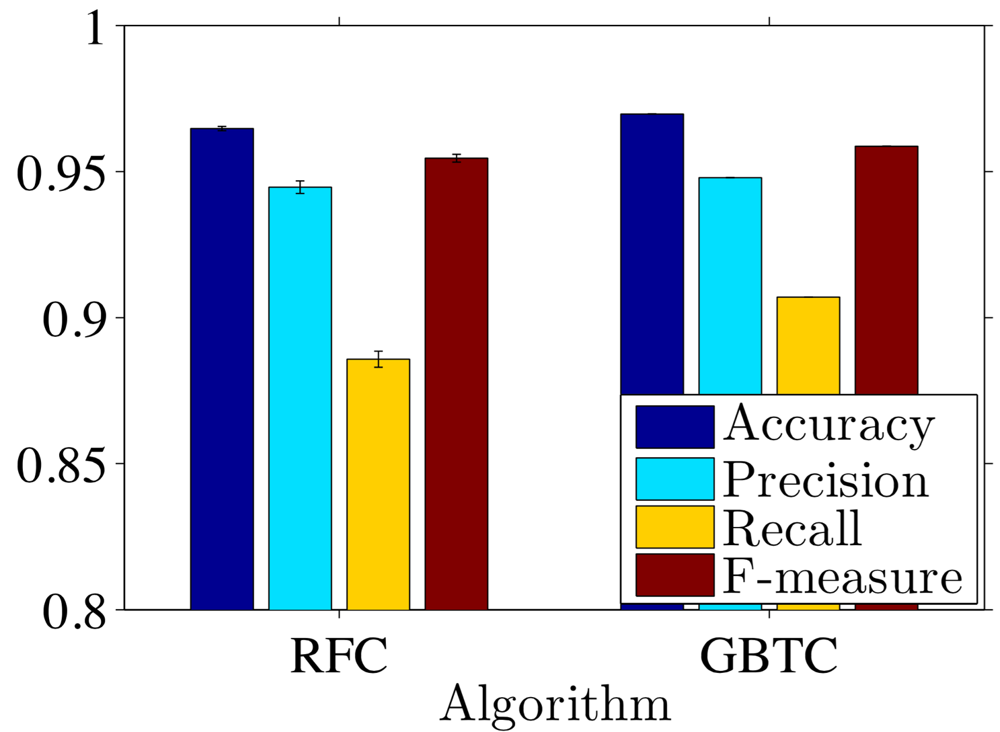
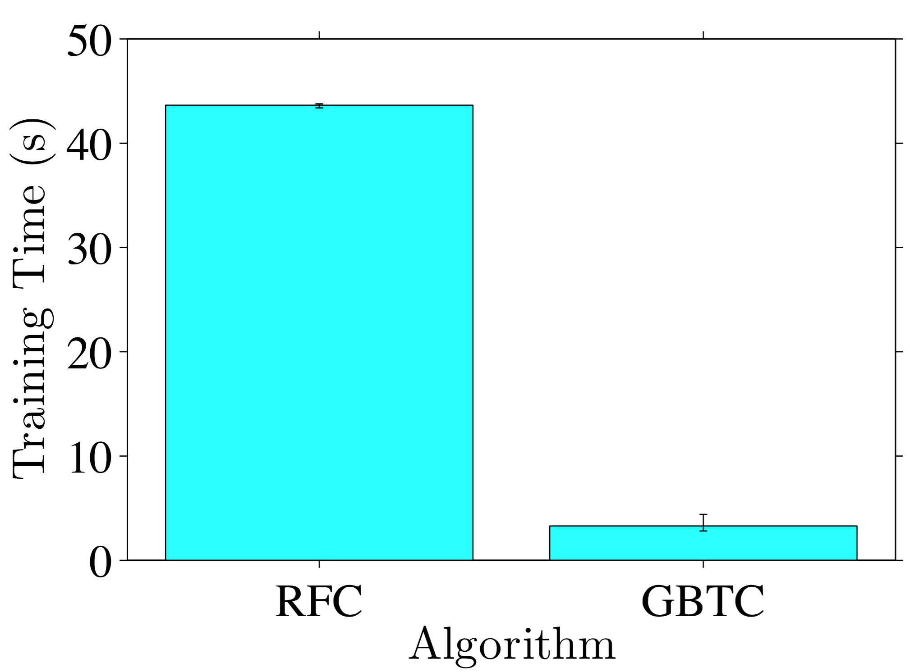
RFC-based & GBTC-based Algorithm
Over 0.95 F-measure score
Both terminated under 42 seconds
Less than 5 seconds for GBTC

Slide 88
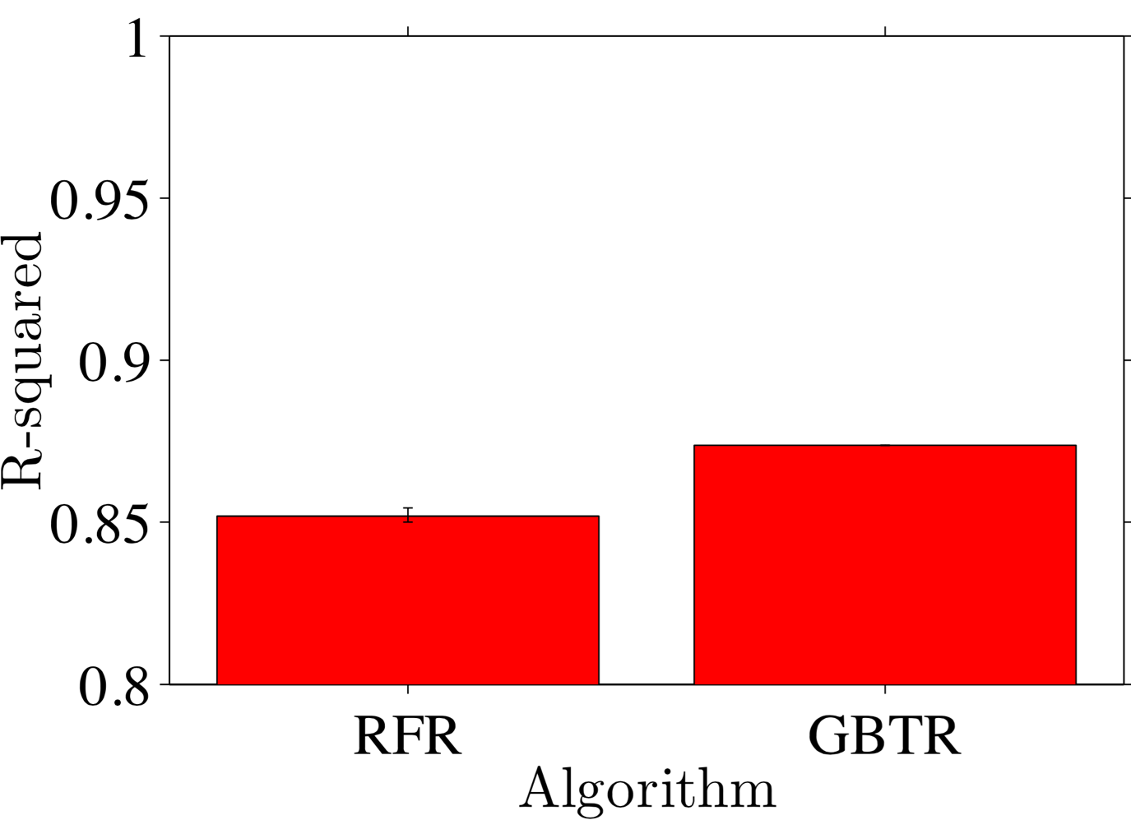
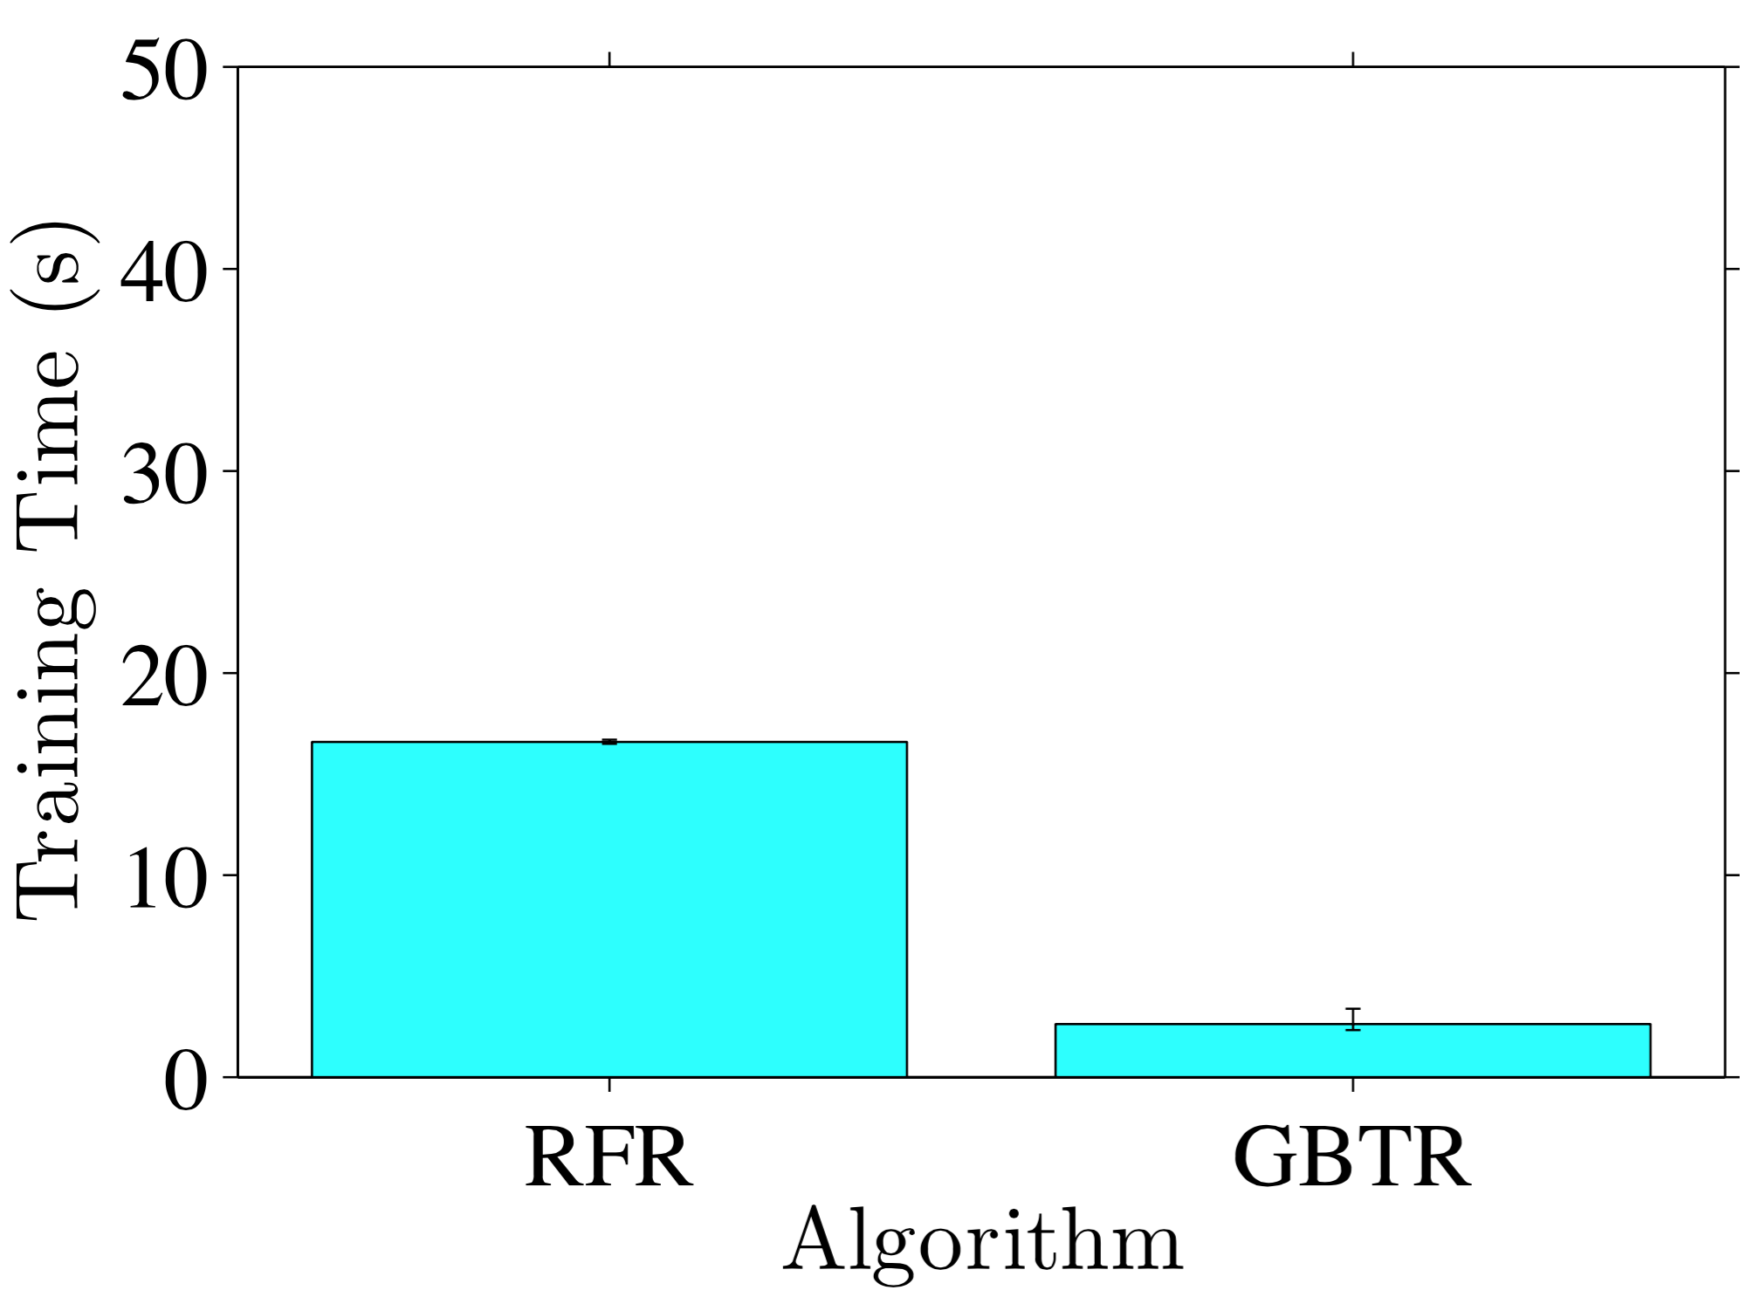
RFR-based & GBTR-based algorithm
Over 0.85 in R-squared
Both algorithm terminated under 20 seconds

Slide 89
Observation
All algorithms provide good result
GBT-based algorithm generally gives better result
GBT-based algorithm have shorter training time
Not what we expect
XGBoost leverage up to 62 cores in our experiment
Scikit-learn’s RF implementation only use single core

Slide 90
Resource Allocator Experiment Setup

Slide 91
Allocator Simulation Setup
We captured 8 game streamed on our testbed
Age of Empires II
Spellweaver
Hearthstone: Heros of Warcraft
Minecraft
Starcraft II
Resolution between 720p and 1080p

Slide 92
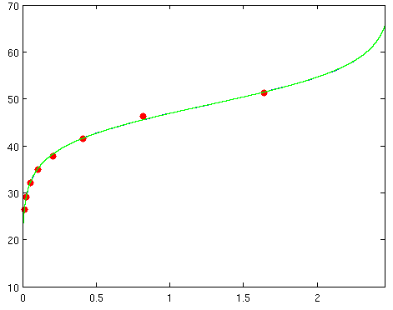
Allocator Simulation Setup (cont.)
Transcode them into different bitrates
Obtain the PSNR value
Perform non-linear regression to get the R-D model parameters
PSNR (dB)
Bitrate ( 10⁴ kbps)

Slide 93
Allocator Simulation Setup (cont.)
We recruited several viewers to watch the recorded live stream session
Mark SoI
14 logs in total

Slide 94
Simulator & Baseline
Simulator is implemented in Python
SoI RDO algorithm is implemented in C
Two baseline solution
Equal Share (ES): equally divides bandwidth between all viewers
R-D Optimized (RDO): optimized in R-D sense, but does not take SoI into consideration
Also an implementation of optimal algorithm
In Matlab, as a benchmark of SoI RDO
State-Of-The Art live game streaming solution
Quantify the benefit of SoI driven allocation

Slide 95
Performance Metrics
Expected quality
The objective value reported by algorithm
Actual quality
The objective value reported by simulator
Running time
Runtime of solving the resource allocation problem
Expected consumed bandwidth
Reported by algorithm
Actual consumed bandwidth
Reported by simulator
Network overhead
Network traffic generated by feature senders

Slide 96
Experiment Parameters
6 hour long simulations
Poisson arrival rate of viewers in each stream
{2, 4, 6, 8, 10} per minutes
Number of stream
{16, 32, 64, 128, 256}
Total outbound bandwidth
{10, 20, 40, 80, 160} Gbps
Interval of invoking resource allocator
{1, 2, 5, 10, 60} seconds

Slide 97
Resource Allocator Results

Slide 98
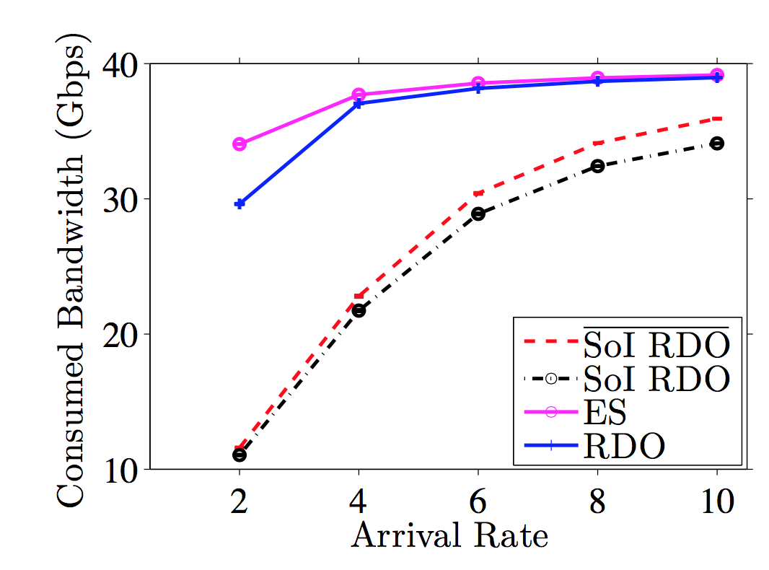
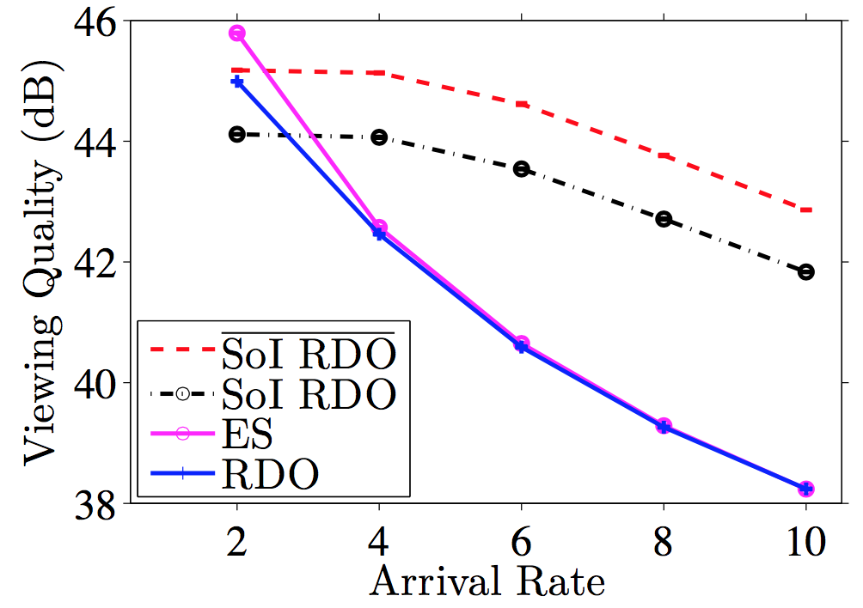
Our Algorithm Outperforms RDO and ES
Different viewer arrival rate
With less consumed bandwidth
Up to 5 dB improvement in viewing quality

Slide 99
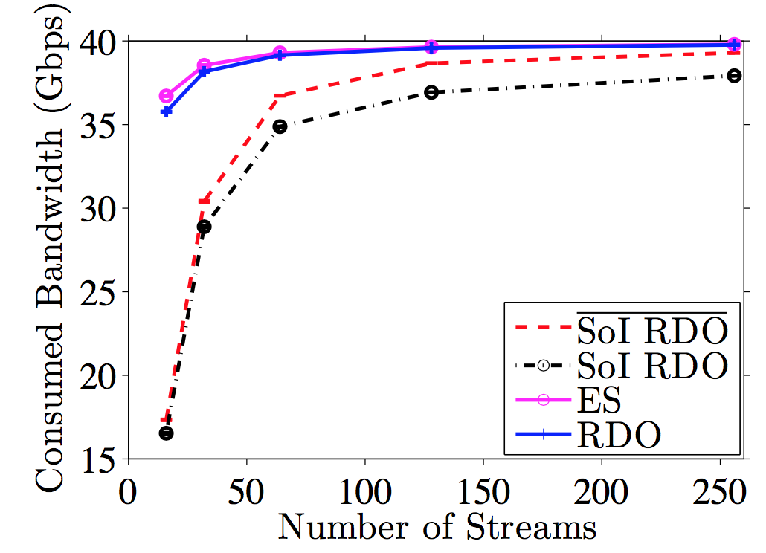
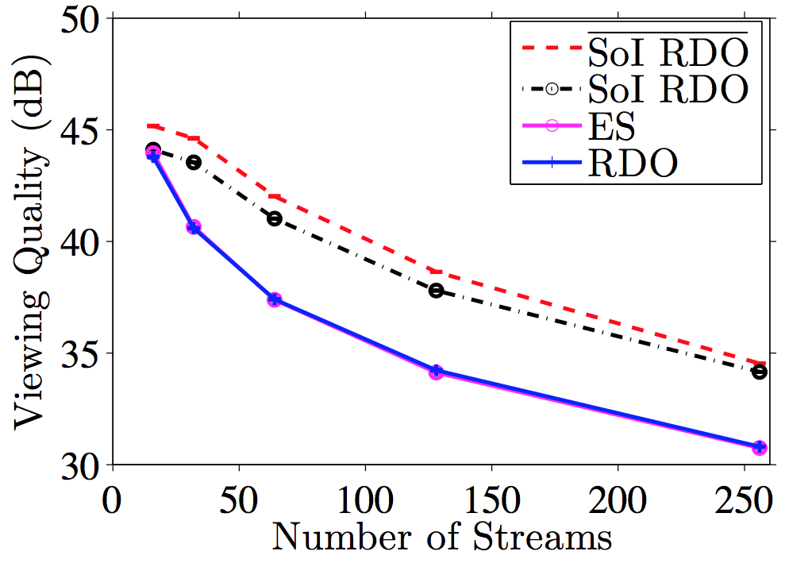
Our Algorithm Outperforms RDO and ES
Different number of stream
With less consumed bandwidth
Up to 5 dB improvement in viewing quality

Slide 100
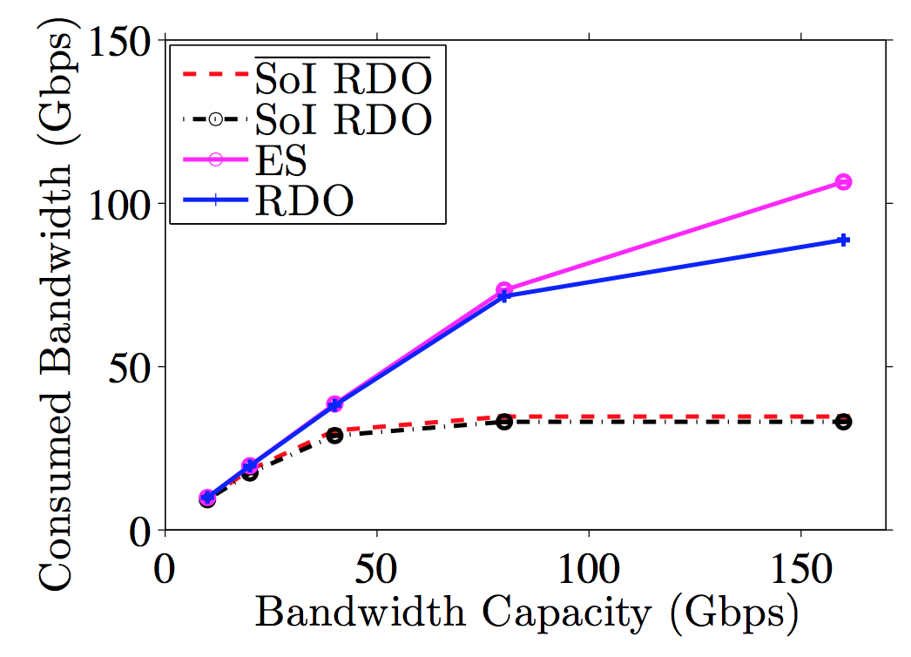
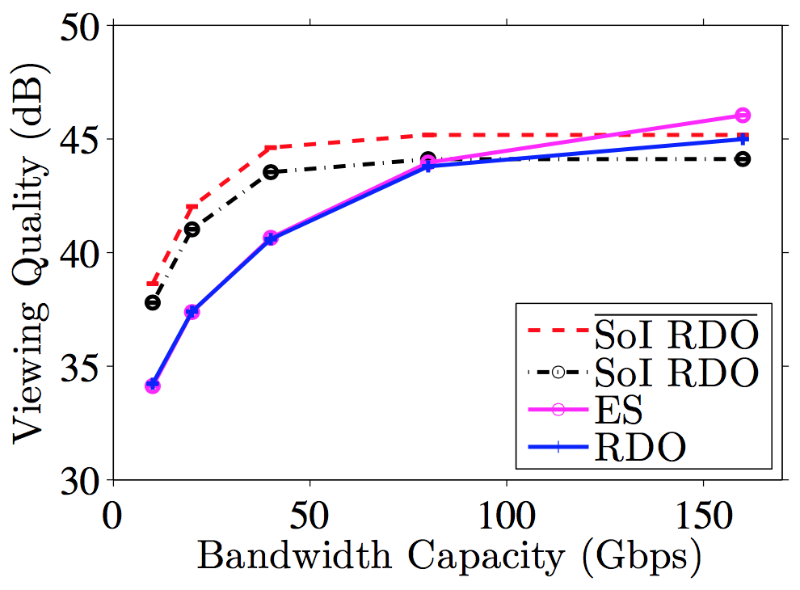
Our Algorithm Outperforms RDO and ES
Different bandwidth capacity
Better quality under the same bandwidth usage

Slide 101
Our Algorithm Outperforms RDO and ES
Different bandwidth capacity
Slightly outperformed by ES and RDO, but that was with significantly larger bandwidth consumption

Slide 102
Our Algorithm Scales Well
Always below 1.5 ms
100+ thousand viewers
Matlab solution may take over 6 minutes
With 58% chance of feasible solution

Slide 103
Outline
Introduction & Motivation
System Overview
SoI Detector
Resource Allocator
Evaluation
Conclusion

Slide 104
Outline
Introduction & Motivation
System Overview
SoI Detector
Resource Allocator
Evaluation
Conclusion

Slide 105
Conclusion
We proposed the concept of Segment of Interest (SoI)
New possibility for optimization
We build an open source testbed
Collect real world traces
We develop accurate SoI detector for MOBA game
Up to 0.95 F-measure and 0.87 R-squared score
Efficient SoI driven resource allocation algorithm
Outperforms the current solution up to 5 dB

Slide 106
A short live demo of our system

Slide 107
Future Work
Consider device capability in SoI detector
Only homogeneous device in evaluation
Leverage features collected from viewers
More fine-grained optimizations
Resource allocator with finer transcoder control
Not only bandwidth, e.g., with FPS, resolution options
Integrate with a real transcoder
Provide API for deep integration with game engines

Slide 108
Research Highlight
T. Fan-Chiang, H. Hong and C. Hsu, “Segment-of-Interest Driven Live Game Streaming: Saving Bandwidth Without Degrading Experience”, in Proc. of ACM Annual Workshop on Network and Systems Support for Games (NetGames ’15)
Y. Huang, M. Lee, T. Fan-Chiang and C. Hsu, “Minimizing Flow Initialization Latency in Software Define Networks”, in Prof. of Asia-Pacific Network Operations and Management Symposium (APNOMS’15)
H. Hong, T. Fan-Chiang, C. Lee, K. Chen, C. Huang and C. Hsu, “GPU Consolidation for Cloud Games: Are we There Yet?”, in Proc. of ACM Annual Workshop on Network and Systems Support for Games (NetGames ’14)
C. Mao, T. Fan-Chiang, M. Lee and C. Hsu, “Taming Flow Initialization Delay in Multi-Site Software Defined Enterprise Networks”, in preparation for IEEE/ACM Transaction on Networking (TNET)
TMM submission (based from this thesis)

Slide 109
Thank you

Slide 110
Q & A
tyfanchiang92@gmail.com

Slide 111
Backup slides

Slide 112
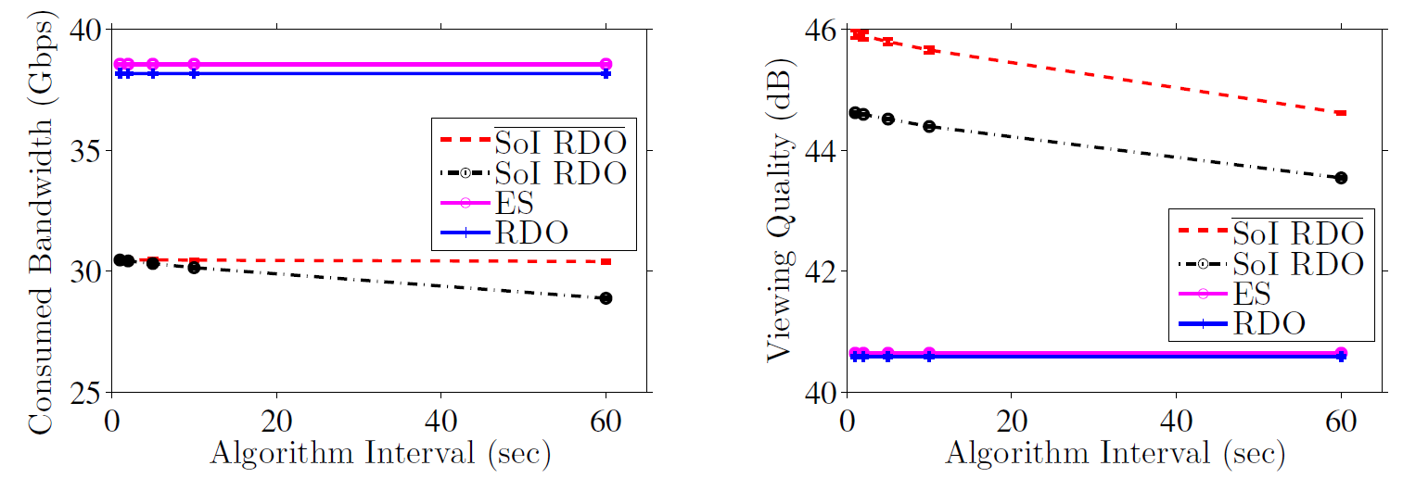
Implication Of Calling Interval
Slightly better quality and more bandwidth consumption

Slide 113
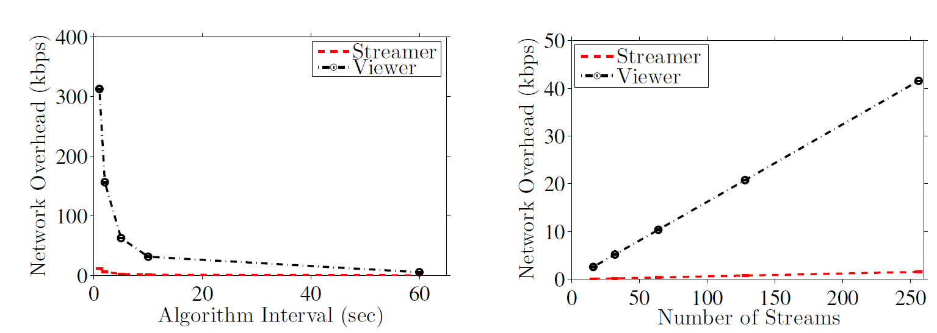
Negligible Network Overhead
Just around 300 kbps with 12000+ viewers

Slide 114
SoI-Driven Streaming Platform
Develop SoI-driven streaming platform
Answer three question
How to detect SoI efficiently?
How to allocation resources among channels?
How to perform transcode on the streaming videos?

Slide 115
Notations
The system collects
A set of features F_{s} from streamer s
A set of features F_{s,v} from viewer v of streamer s
SoI detector take F_{s} and F_{s,v} as input
Output SoI weight w_{s} for current segment

Slide 116
Notations
Resource allocator take all the w_{s} and bandwidth capacity R as input
Output r_{s} as the bitrate for video segment v_{s} from s
Transcoder use r_{s} as parameter to transcode v_{s}
Output o_{s} stream to viewers

Slide 117
WHY do lag happens?
Viewers
Content Delivery Networks
Video Servers
Content Delivery Networks
Streamers
RTMP/HLS Streams
RTMP/HLS Streams
RTMP/HLS Streams
RTMP/HLS Streams

Slide 118
Reason 1: Server Too Busy
Viewers
Content Delivery Networks
Video Servers
Content Delivery Networks
Streamers
RTMP/HLS Streams
RTMP/HLS Streams
RTMP/HLS Streams
RTMP/HLS Streams

Slide 119
Reason 1: Server Too Busy
Too many viewers
Viewers
Content Delivery Networks
Video Servers
Content Delivery Networks
Streamers
RTMP/HLS Streams
RTMP/HLS Streams
RTMP/HLS Streams
RTMP/HLS Streams

Slide 120
Reason 1: Server Too Busy
Too many viewers
Viewers
Content Delivery Networks
Video Servers
Content Delivery Networks
Streamers
RTMP/HLS Streams
RTMP/HLS Streams
RTMP/HLS Streams
RTMP/HLS Streams

Slide 121
Reason 1: Server Too Busy
Too many viewers
Too many streamers
Too many transcode workload
Viewers
Content Delivery Networks
Video Servers
Content Delivery Networks
Streamers
RTMP/HLS Streams
RTMP/HLS Streams
RTMP/HLS Streams
RTMP/HLS Streams

Slide 122
Reason 1: Server Too Busy
Too many viewers
Too many streamers
Too many transcode workload
Viewers
Content Delivery Networks
Video Servers
Content Delivery Networks
Streamers
RTMP/HLS Streams
RTMP/HLS Streams
RTMP/HLS Streams
RTMP/HLS Streams

Slide 123
Reason 2: Outbound Bandwidth
Too many viewers
Viewers
Content Delivery Networks
Video Servers
Content Delivery Networks
Streamers
RTMP/HLS Streams
RTMP/HLS Streams
RTMP/HLS Streams
RTMP/HLS Streams

Slide 124
Reason 2: Outbound Bandwidth
Too many viewers
Viewers
Content Delivery Networks
Video Servers
Content Delivery Networks
Streamers
RTMP/HLS Streams
RTMP/HLS Streams
RTMP/HLS Streams
RTMP/HLS Streams

Slide 125
Possible Solution
Add more resource
Reduce the video quality

Slide 126
Add More Resource
Twitch upgraded it’s transcoding server in 2014
Also doubled it’s CDN bandwidth in Europe region
~
~
~
Viewers
Content Delivery Networks
Video Servers
Content Delivery Networks
RTMP/HLS Streams
RTMP/HLS Streams
RTMP/HLS Streams
Streamers
RTMP/HLS Streams
RTMP/HLS Streams
RTMP/HLS Streams
RTMP/HLS Streams

Slide 127
Add More Resource
Twitch have avg 1Tbps bandwidth usage in 2014 [1]
May cost as much as $ 11.34 million per month
Bad for business
~
~
~
Viewers
Content Delivery Networks
Video Servers
Content Delivery Networks
RTMP/HLS Streams
RTMP/HLS Streams
RTMP/HLS Streams
Streamers
RTMP/HLS Streams
RTMP/HLS Streams
RTMP/HLS Streams
RTMP/HLS Streams
[1] K. Pires and G. Simon. DASH in Twitch: Adaptive bitrate streaming in live game streaming platforms. In Proc. of ACM Workshop on Design, Quality and Deployment of Adaptive Video Streaming (VideoNext’14)

Slide 128
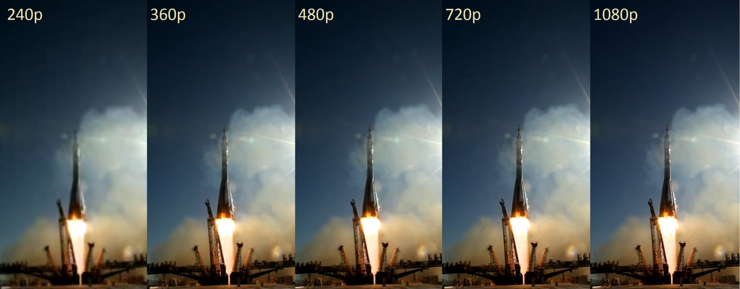
Lower Video Quality

Slide 129
Lower Video Quality
How to do this without degrading user experience?

Slide 130
How To Leverage SoI
Devote more resource into streaming SoI
Lower the quality of non-SoI if necessary
Higher user experience
Lower bandwidth consumption

Slide 131
How To Leverage SoI
Devote more resource into streaming SoI
Lower the quality of non-SoI if necessary
Higher user experience
Lower bandwidth consumption
Wait, how to determine SoI?

Slide 132
Detecting SoI
The game is running on the machine of streamer
Unlike other kind of live streaming
Collect features in the system
CPU/GPU usage, keyboard input event…e.t.c.
Use these features to help us determine

