Slide 1
Keyword-aware Optimal Route Search
Xin Cao, Lisi Chen, Gao Cong, Xiaokui Xiao
School of Computer Engineering, Nanyang Technological University, Singapore

Slide 2
Outline
Introduction
Problem Statement
Algorithm
Conclusion And Future Work

Slide 3
Introduction
Keyword-aware Optimal Route (KOR)
Plan a trip within a city
Keyword
Shopping mall, restaurant, and pub
Travel time
To and from his hotel is within 4 hours

Slide 4
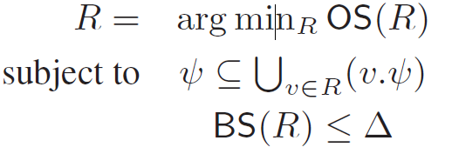
Problem Statement
The KOR query:
To find a route:
Example:

Slide 5
Pre-processing
Use Floyd-Warshall to find all pairs shortest path
.
.
.
Use an “inverted file” to organize the word information of nodes
B⁺-tree

Slide 6
Definition
Node Label :
Label Domination
Label Treatment
Label Order

Slide 7
Algorithm: OSScaling

Slide 8
Analysis
Lemma 1:
Complexity:
Lemma 2:
OSScaling finds the smallest OS from feasible routes
Theorem:

Slide 9
Proof: .

Slide 10
Lemma and Definition
Lemma 3: =
Definition: Label Buckets
:
.
Lemma 4:
If all buckets (i = 0 to r) are empty, and no feasible solution is found yet.

Slide 11
Algorithm: BucketBound

Slide 12
Anaysis

Slide 13
Conclusion And Future Work
Conclusion
They devise two approximation algorithms to answer KOR queries efficiently.
Future Work
Improve the current preprocessing approach
They compute and store the best objective and budget score between every pair of border nodes
Discovering popular routes from trajectories (2011)

Slide 14
END

