Slide 1
Cloud-Assisted Live Streaming for Crowdsourced Multimedia Content
Fei Chen, Member, IEEE, Cong Zhang, Student Member, IEEE, Feng Wang, Member, IEEE, Jiangchuan Liu, Senior Member, IEEE, Xiaofeng Wang, and Yuan Liu
IEEE TRANSACTIONS ON MULTIMEDIA, VOL. 17, NO. 9, SEPTEMBER 2015

Slide 2
Introduction
The Internet has witnessed a significant increase in the popularity of media streaming with multi-source channels.
multi-source system:
2012, NASA Television’s Public and Media channels
2014 Sochi Winter Olympics
2014 FIFA World Cup

Slide 3
Situation
Global streaming imposes high demand on end device capabilities and network connections
Crowdsourced videos are geo-distributed
The crowdsourcers are often much more dynamic than dedicated content providers
Massive server capacity is necessary to deal with online video synchronization, processing, and transcoding for highly heterogeneous video contributors and consumers.

Slide 4
Related work
For large scale distribution, many existing systems rely on content distribution networks (CDNs) or peer-to-peer (P2P) , or hybrid solutions.
Netflix migrated its entire infrastructure to the powerful Amazon AWS cloud in 2012
CALMS (Cloud-Assisted Live Media Streaming) to lease and adjust cloud server resources in a fine granularity, meeting with the temporal and spatial dynamics of demands from online users

Slide 5
Motivation
Crowdsourced live streaming demands efficient content collection, processing, and distribution with stringent delay constraints.
But none of existing algorithms can simultaneously satisfy these design requirements of the resource allocation in the global scale.
Dynamic viewers and sourcers
Balance the trade-off between the streaming performance and the system cost.

Slide 6
Twitch.tv
One-week trace from July 6 to July 12, 2014
14 geo-distributed ingest servers:
1 from Asia area
6 from European area
7 from United States area

Slide 7
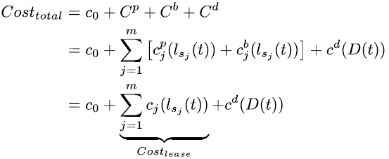

Problem formulation
$C_{0}$: $\text{bootstrapping} \text{server}$cost.
$C^{p}$: total cloud site cost
$C^{b}$: cost of out-bound traffic from the cloud servers to the CDN
$C^{d}$: cost of the CDN

Slide 8
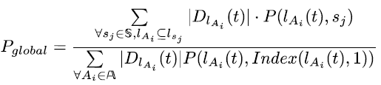

Preference value
Generally, the preference value can be quantified according to the RTT, jitter or packet loss.
$P\left(l_{A_{i}}\left(t\right), s_{j}\right)$: Preference value of Area i to cloud site j at time t

Slide 9
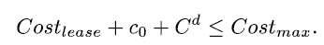
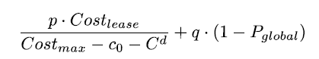
Minimize cost

Slide 10
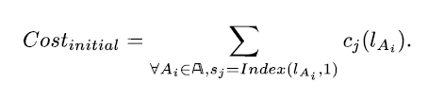
Equivalent problem

Slide 11
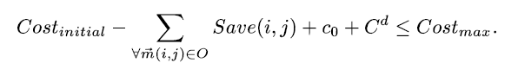
Cost saving constraint

Slide 12
Optimal solution
each spanning tree can provide a local optimal solution, and the global optimal solution can be achieved by exploring all the spanning trees
uses backtracking and a method for detecting bridges based on the depth-first search

Slide 13
Evaluation
398 PlanetLab nodes
21 cloud sites :Amazon Cloud & Microsoft Azure Cloud
opensource VLC/VLM coder
VIDEOS SOURCE FOR LIVE STREAMING

Slide 14
Streaming delay reduction

Slide 15
Lost frame reduction

Slide 16
Cost

Slide 17
Result
Comparing with TOP strategy, our proposed solution OM (p/q=0.1) saves 8.34% cost, and improves 9.1% video quality on average.

Slide 18
Future work
Continue enhancing our design by conducting more evaluations on our prototype with larger scale experiments
Live videos for 3D immersive environment
Distributed server instances can cooperate
With CDNs

Slide 19
Progress update
Done:
Setup Sprak & read tutorial.
Todo:
Connet pokemon app to server & add UI.
Discuss with Brain that if I can let his demo machine connect to the server.
Design cloud manager using Spark streaming .

