Slide 1
Keyword-aware Optimal Route Search
Xin Cao, Lisi Chen, Gao Cong, Xiaokui Xiao
School of Computer Engineering, Nanyang Technological University, Singapore

Slide 2
Outline
Introduction
Problem Statement
Algorithm
Conclusion And Future Work

Slide 3
Introduction
Keyword-aware Optimal Route (KOR)
A user plans a trip within a city
Keyword
shopping mall, restaurant, and pub
Travel time
to and from his hotel is within 4 hours
Two Hard Constraint
Keyword
Budget

Slide 4
Keyword-aware Optimal Route (KOR)
Object: Find an optimal route
The objective score is optimized (minimized)
Objective score comes from route popularity
GPS trajectories or Flickr photos
Discovering popular routes from trajectories (2011)
Solution: Three approximation algorithm
OSScaling
BucketBound (revised by OSScaling)
Greedy

Slide 5
Compared To Detour Planning Problem
 | KOR | DP
Same | They want to use the free time well
 | Specifying the source and destination
 | Visiting specific spots
 | The travel time or deadline must be observed
Difference | To visit popular spots for fun | To perform requests for rewards
 | The keyword must be concerned | The time-window of each request must be concerned

Slide 6
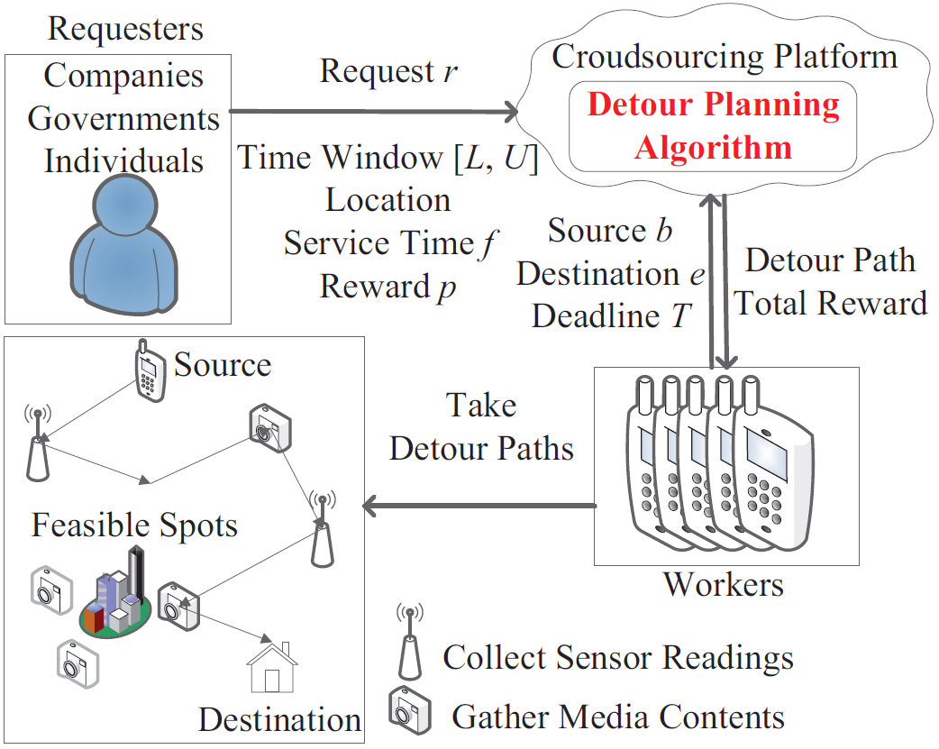
Detour Planning Problem

Slide 7
Algorithm1: OSScaling
It’s very like dynamic programming
Step
Set the source with a label and put into min-heap
Extract the label from min-heap
If it is empty, go to 4
Extend the label to adjacent node. Go to 2
If the new label isn’t be dominated, put into min-heap
If some labels were dominated by the new label, remove it from min-heap
Pick the best route from the destination’s labels

Slide 8
Algorithm 2 & 3
BucketBound
It will be more faster then Alg1. But it will use the result from Alg1.
Greedy
The minimal objective score has the most priority.

Slide 9
Conclusion And Future Work
Conclusion
They devise two approximation algorithms to answer KOR queries efficiently.
Future Work
Improve the current preprocessing approach
They compute and store the best objective and budget score between every pair of border nodes
Discovering popular routes from trajectories (2011)

Slide 10
Potential Research of the detour planning

Slide 11
Potential Research (1/2)
Maximize the overall productivity in the format of the total worker profit.
Guide the workers to shoot the photos or videos from the right spots and angles for usable results.
Adapt to misbehaved or lost workers who deviate from the assigned detour paths.
Facilitate a quality assurance mechanism to determine the quality of the completed tasks.

Slide 12
Potential Research (2/2)
Add more kind of geo-spatial and temporal-dependent tasks to full our system. It will motivate more workers to join our system.
We need to concern the different traffic condition for computing the detour route.
The internet isn’t smooth all the time. So we must figure out a method to let our system and workers to be in touch with each other.

Slide 13
END

