Slide 1
Interworking in heterogeneous wireless networks
Comprehensive Framework And Future Trends

Slide 2
Abstract
Interworking mechanisms are of prime importance to achieve ubiquitous access and seamless mobility in heterogeneous wireless networks
I-WLAN and GAN approaches for WLAN and cellular integration, solutions for WiMAX and 3GPP LTE/SAE interworking, and the forthcoming IEEE 802.21 standard are discussed from the common point of view provided by the elaborated framework.
Notes:
(1)無線網路的重要性，可以隨時隨地的存取
(2)本文中，制定了框架，並且定義了一個互通的機制
(3) I-WLAN和GAN在WLAN與cellular integration的應用, WiMAX 與3GPP LTE/SAE interworking的解決方案

Slide 3
Introduction
RATs : radio access technologies
It is expected that mobile users could eventually enjoy truly seamless mobility and ubiquitous service access in an always best connected mode, employing the most efficient combination of available access systems at any time and anywhere.
In this context an appropriate interworking of different wireless access systems is crucial to meet mobile users’ expectations while making possible the coexistence of diverse RATs.
Notes:
(1)RATs : radio access technologies (無線接取技術)
(2)沒有單一的RAT可以優化且cover所有不同的無線通訊方案
(3) “ radio technology optimized“ 優化 : 在戶外移動率高的使用者&在室內傳輸率較低的使用者容易失敗
(4)最終，希望移動用戶可以使用無縫的網路存取，永遠都是最好的連接模式
(5)所以不同網路之中的互通是很重要的，使用並存的多元化RATs來達成

Slide 4
Introduction
Interworking WLAN (I-WLAN) and generic access network (GAN) are discussed
WiMAX and 3GPP networks interworking
IEEE 802.21 interworking
Notes:
(1)大多數的文章著重於特定的無線網路互通，本文章建立一個全面性的架構，目的在於分類及分析互通的解決方案

Slide 5
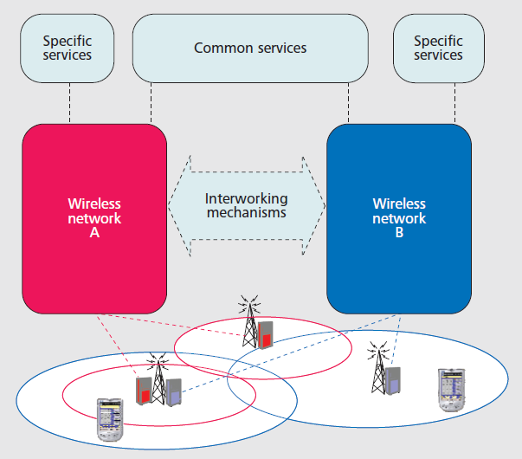
Wireless Heterogeneous Interworking Scenario
Concerning service provisioning
Network access rights
Notes:
(1)兩個共存的無線網路有部分重疊，本文推測，每個無線網路中所使用的RAT可以不同，而且終端機擁有multimode capabilities
(2)一套服務可同時透過兩種無線網路，例如 voice call
一套服務只能連到一個無線網路，例如 instance messaging & presence services
(3)兩個不同的無線網路可能是不同的管理域(不同的網路商)

Slide 6
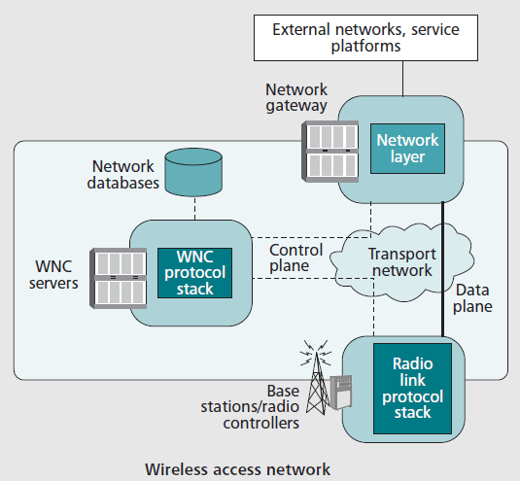
Wireless Networks Characteristics
2
1
4
3
Notes:
(1)Network layer : 透過NG連接到外部網路或服務，IP的連接
(2)Network gateway : 可動態配置QoS
(3)Radio link protocol stack : 分配 base station，包含了physical, medium access control, and radio link control layers
radio resource management (RRM) 無線網路管理機制，有效使用無線網路
(4) wireless network control (WNC) : 控制整體的連接，例如認證、授權，安全上的管理

Slide 7
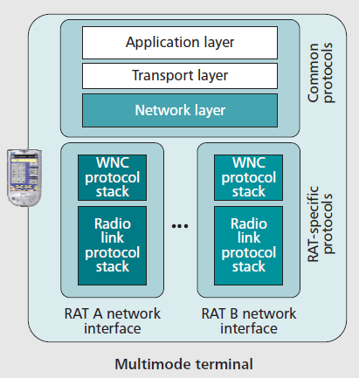
Multimode Terminal Characteristics
Data Transfer
Notes:
Network layer 已經有統一的規格(TCP,UDP)，所以可以獨立運行
Application layer 也有統一(SIP)

Slide 8
Interworking Levels
Network architecture aspects
The level of support for specific service
Operational capabilities
Four interworking levels are distinguished
Notes:
網路架構方面、支援服務、運作能力
分成四種level

Slide 9
Level A Visited Network Service Access
Allow a user to get access to a set of services available in a visited network while relying on his/her home network credentials.
The user could be charged for service usage in the visited network through its own home network billing system.
Notes:
(1)允許使用者去存取服務(在別人的網路)
(2)使用者可以使用自己原本的網路付費

Slide 10
Level B Intersystem Service Access
The cellular subscriber using a cellular/WLAN laptop would also enjoy his/her cellular IMS services while attached to the public WLAN hotspot.
Neither level A nor level B would support service continuity when the user moves between networks.
Notes:
IMS : IP Multimedia Sub-system
IMS是第三代行動通訊協定組織(3GPP)所制定提供多媒體服務的架構，利用IP網域的概念，實現行動管理、多媒體訊號發射與傳輸服務

Slide 11
Level C Intersystem Service Continuity
This level extends the previous ones so that the user is not required to re-establish active session(s) when moving between networks.
A temporary QoS degradation can be tolerated during the transition time.
Notes:
(1)切換網路時，不用重新開啟活動
(2)可以容忍短暫的QoS退化
(3)可以切換網路，不用使用者的干預

Slide 12
Level D Intersystem Seamless Service Continuity
To offer a seamless mobility experience
Enabling mobile terminals to conduct seamless handovers across diverse access networks.
Less than 300 ms could be required for real-time services in intertechnology handovers
Consistency of QoS
Notes:
(1)提供無縫網路體驗
(2)利用可移動的終端機進行切換到多元的網路
(3)要在300ms之內完成切換，相當困難
(4)不只是互相連通，品質也要好

Slide 13
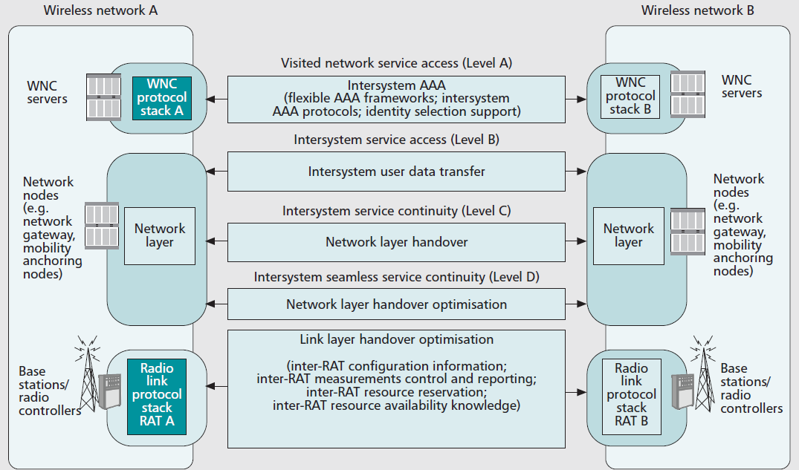
Interworking Levels and Related Interworking Mechanisms

Slide 14
Interworking Machine Level A : Intersystem AAA
Extending authorization, authentication, and accounting(AAA)
The deployment of one bill solutions advocates for the existence of mechanisms to transfer accounting and charging data between wireless networks.
Adoption of flexible AAA frameworks able to support multiple authentication methods
Deployment of additional functionality such as AAA proxy/relay functions and related signaling interfaces between networks
Enhanced network discovery mechanisms for identity selection
Notes:
(1)認證，從單一個體進入到另一個體時的認證流程
(2)授權，進入到個體的使用者所擁有的權力，如讀、寫等
(3)帳戶，個體權力的範圍介定，如網路流量使用量上的限制
(4)無線網路之間，允許用戶進行身分認證和授權過程
(5)用戶切換網路要收費-------(1)擴展認證協議 (2)配置附加功能，3A有關的信號網路接口 (3)移動的終端機可以事先知道，在visit的網路中，是否他們的 home network 是有效的 for AAA control

Slide 15
Interworking Machine Level B : Intersystem User Data Transfer
These mechanisms enable the transfer of user data between networks in order to give access to specific services provided in a network other than the serving one.
A common approach to enforce user data transfer between networks relies on tunneling protocols such as the Layer 2 Tunneling Protocol (L2TP)
Notes:
使用者資料傳輸，使用Layer 2Tunneling Protocol (L2TP)

Slide 16
Interworking Machine Level C : Network Layer Handover
Relies on the maintenance of a permanent mobile terminal IP address
Mobile IP (MIP)described in RFC 3344
MIP is based on a redirection approach achieved by a home agent(HA) functionality
Within the MIP solution, the mobile terminal itself is in charge of updating the address binding of its HA as the care-of address(CoA) changes
Notes:
(1)無線網路中，服務的連續仰賴於移動終端機的IP保留
(2)MIP會重新定向，連接全球的IP位址分配給終端機，臨時的IP會分給臨時的網路服務
(3)當CoA改變的時候，移動的終端機會負責更新HA的連接

Slide 17
Interworking Machine Level D:Network Layer Handover Optimization
Latencies related to radio link layers and network layer operation can turn into a period during which the terminal is unable to send or receive packets.
Solution :
RFC 4068 defines fast handover extensions for MIPv6 so that terminals can acquire a new valid CoA before a handover occurs
Pre-authentication
Network discovery mechanisms
Notes:
(1)簡單的網路交換，可以達到連續性，但是卻無法滿足無縫隙移動的要求
(2)建立無線Link & 網路層的操作(偵測新的IP並連接)，都會產生延遲
(3)在交換無線網路時，就偵測到新的IP(放在tunneling)
(4)先認證，可以減少認證授權的延誤時間
(5) Network discovery mechanisms 在無線網路切換當中，也扮演著優化的角色

Slide 18
Interworking Machine Level D:Link Layer Handover Optimization
Radio link layer operations could also introduce delays in the handover process.
Solution :
Provision of inter-RAT configuration information about neighboring BSs.
Inter-RAT measurements control and reporting to improve handover initiation.
Notes:
(1)Radio link layer 在交換無線網路時，也會有延遲(基地台)
(2)提供給RAT之間，有關附近基地台的資料，可以提高無線掃瞄
(3)內部的RAT互相交換資訊，還有資源保留

Slide 19
Discussion On Relevant Interworking Approaches
According to previous interworking levels and related mechanisms, in this section we analyze some of the most relevant proposed solutions.
I-WLAN (Interworking WLAN)
GAN (Generic Access Network)
WiMax and 3GPP
Notes:
機制的相關解決方法---3種model

Slide 20
I-WLAN
I-WLAN architecture, commonly referred to as loose coupling interworking, is targeted to cover interworking levels A and B for packet services.
3GPP UMTS and WLAN networks
Diameter-based interface
IPsec-based interface
Notes:
鬆散耦合，主要是Level A & B
Diameter-based protocol : 主要定義了AAA需要的基本功能，為各種認證、授權、計費提供基本框架
Ipsec-based interface : 是一個安全通道，在終端機連接WLAN和3GPP裡的PDG之間

Slide 21
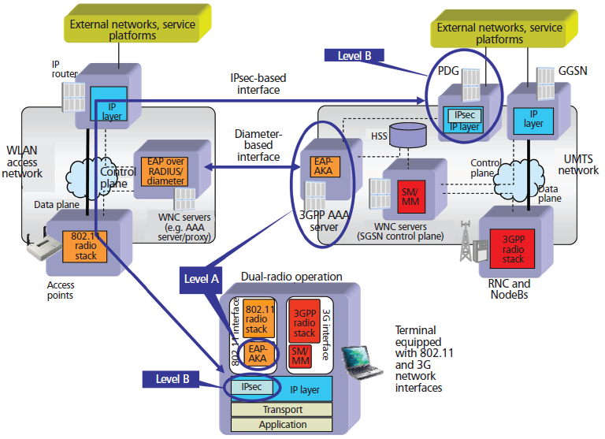
I-WLAN interworking model

Slide 22
GAN
Also referred to as tight coupling interworking, provides a solution to extend cellular circuit and packet services over IP broadband access networks.
Unlicensed mobile access(UMA)
GAN controller (GANC) located within the 3GPP network
A UMA-enabled terminal
A new interface between both elements specified by 3GPP.
Notes:
(1)緊密耦合的網路架構 ， Level B C D
(2)UMA的網路架構，即為GAN
(3)GANC，很像RNC，對核心網路使用傳統的3GPP接口
(4) UMA-enabled terminal，是一個3GPP的終端機，擁有802.11通訊

Slide 23
GAN
Interworking level B is provided by the fact that GANC actually constitutes a gateway toward 3GPP services.
level C is built up on legacy 3GPP handover procedures so that established data sessions or calls could be transferred between the GANC.
Concerning level D, UMA-enabled terminals support dual-radio operation.
Notes:
LEVEL B : 3GPP的服務口
LEVEL C : 建立在傳統的3GPP，找相對應的RNC避免斷線
LEVEL D : 讓終端機有雙無線

Slide 24
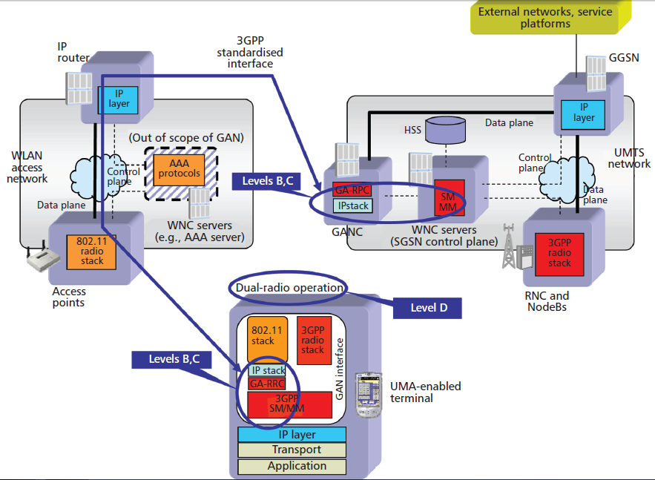
GAN internetworking model

Slide 25
WiMAX And 3GPP Networks Interworking
the WiMAX Forum and 3GPP is based on the IWLAN architecture by 3GPP.
Architecture enhancements are being specified for providing IP connectivity using non-3GPP accesses
Support for MIP and PMIP-based mobility is being introduced to achieve level C.
Access network discovery and selection function(ADDSF)
Notes:
(1)和第一個model較像
(2)提供IP連接，使用non-3GPP存取
(3)提供MIP和PMIP-based 來達成 Level C
(4)會發現網路和選擇功能

Slide 26
WiMAX And 3GPP Networks Interworking
Level A : specific EAP authentication mechanisms
Then levels Band C are built up on MIP-based mobility solutions
Level D : to add support for inter-RAT measurement control and reporting along with the delivery of inter-RAT BS information.
Notes:
Level A 採用3GPP AAA認證 -----EAP

Slide 27
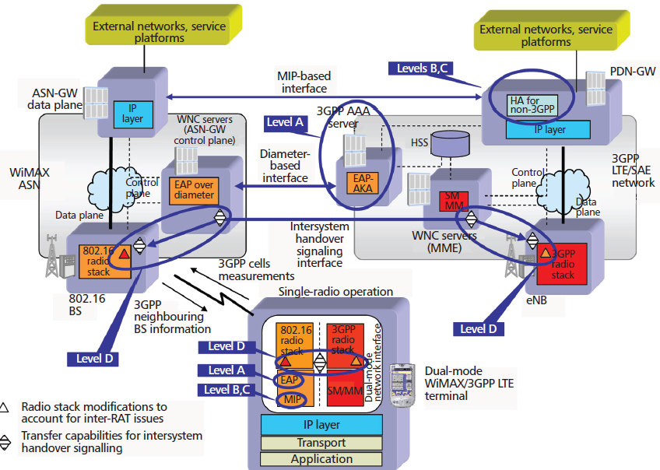
WiMAX and 3GPP LTE/SAE interworking model

Slide 28
IEEE 802.21 Interworking
Media-Independent Handover (MIH) Services
An enabler of interworking level D and across IP subnet boundaries.
The standard defines a new link layer functionality (i.e., MIH Function [MIHF]) to be added within terminals and networks together with the protocol required for message exchanging between them.
Notes:
(1)媒體獨立交換服務

Slide 29
Concluding Remarks And Future Trends
Currently, I-WLAN interworking architecture is being extended to handle mobility between I-WLAN and 2G/3G by means of adding support for MIP-based mobility

