Slide 1
Completing The Convergence Puzzle
A Survey And A Roadmap

Slide 2
Abstract
This article surveys different technologies which offer seamless handover and converged access to mobile voice, video, and data services.
We present the main features of these technologies and discuss their limitations and potentials to enable convergence in heterogeneous networks.
Notes:
融合網路(異質)

Slide 3
Introduction
Cellular networks such as Global System for Mobile Communications/General Packet Radio Service (GSM/GPRS) and UMTS provide wide area coverage and support high mobility at a higher cost (when assessing the bandwidth cost).
Notes:
大部分都在介紹seamless convergence目前的發展

Slide 4
Seamless Convergence : A Long-Term Vision
The beyond third generation (B3G) network is a multitier hierarchical system that supports IP-based mobile multiparty multimedia services over heterogeneous wired and wireless networks.
Seamless mobility is expected for voice services, whereas some resuming or bookmarking features without seamless mobility can be satisfying for streaming services.
Four network levels
Notes:
(1)是以Mobile IP為架構基礎下所開發之異質網路換手系統，本系統包含Home Agent、Foreign Agent及Mobile node，並可支援Mobile node進行有線網路(Ethernet)與無線網路(WiFi、WiMax...)間的異質網路切換，以提供使用者行動化資通訊之漫遊服務功能。
(2)無縫網路主要是作語音服務
(3)4種異質融合

Slide 5
Home Network Convergence
The user can access different types of services from the same terminal.
A service is available on more than one handset.
Diverse communication technologies are expected within the home network sphere.
Notes:
(1)終端機專用於給定的服務
(2)使用者可在同一個終端機上使用不同的服務
(3)一個服務可以提供給很多手機
(4)不同的通訊技術要被加入到家庭網路領域

Slide 6
Access Network Convergence
Access network convergence can either be achieved with convergence focusing on the transport layer and/or convergence involving the service control layer on the access network
The first one is mainly driven by the reduction in operational expenditure (OPEX) costs.
Allows access to the same service
Notes:
(1)主要在transport layer 或是 service control layer
(2)減少營運成本，聚集移動存取的點分享固定的access network
(3)不管是哪種網路架構都可以存取相同的服務

Slide 7
Core Network Convergence
IMS : Conversational services with multimedia components such as voice and video, instant messaging , Audio-visual services
Notes:
(1)核心網路﹝Core Network﹞所指的就是各系統業者用來連結各無線基地台與後端大眾電話網路﹝PSTN﹞或是其它資料網路的Intranet。透過Core Network系統業者可以讓手機用戶的語音資料，經由業者的Core Network網路傳遞到目前通訊的目的端。因此在Core Network的架構中，除了包含語音媒體資料的轉換外，還包括了紀錄使用者資訊與計費機制的系統。
(2)語音，即時訊息，視聽服務

Slide 8
Application Server Level Convergence
Service platform level
To offer differentiated quality of service (QoS) to end users.

Slide 9
MIH : IEEE802.21
MIH function (MIHF) : provides an intermediary or a unified interface between the lower-layer heterogeneous ANs and higher-layer components.
Media independent event service (MIES)
Media independent command service (MICS)
Media independent information service (MIIS)
Notes:
低層的信號狀態變化
由高層的控制
提供鄰近網路與自己能力的訊息

Slide 10
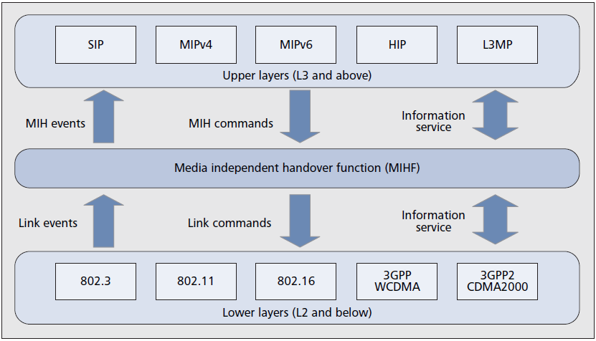
MIH Architecture And Functional Components

Slide 11
MIH Function Components MIES
It notifies the upper layers of the occurrence of lower-layer events (triggers) in order to optimize handover performance.
link events
MIH events
Notes:
由低層觸發，通知上層，為了要提升切換的效能
MIH event會送出command作反應

Slide 12
MIH Function Components MICS
MICS refers to commands sent from higher layers to lower layers in the MIH framework.
Gathering information about the status of connected links
Execute higher-layer mobility and connectivity decisions at the lower-layers
MIH commands
link commands
Notes:
收集連接狀態的訊息，讓低層去執行高層做的決定

Slide 13
MIH Function Components MIIS
It is used by a mobile node or network entity to discover and obtain information about neighboring networks.
Acquire a global view of the heterogeneous networks to facilitate seamless handover across those networks
Notes:
利用mobile node或網路，去發現附近的網路資訊，以達到無縫網路的切換

Slide 14
Limitations And Potentials
UMA(GAN)
Significant overhead due to the complexity of the protocol stack at the terminal.(GSM/GPRS)
UMA also suffers from poor performance in packet mode(EGAN)
I-WLAN
Like GAN, I-WLAN suffers from certain limitations on QoS handling due to an always activated IPSec tunnel that hides the nature of each encrypted data packet along with the fixed access network.
Notes:
UMA : 終端機上的protocol stack較複雜
I-WLAN : 每個封包都要加密

Slide 15
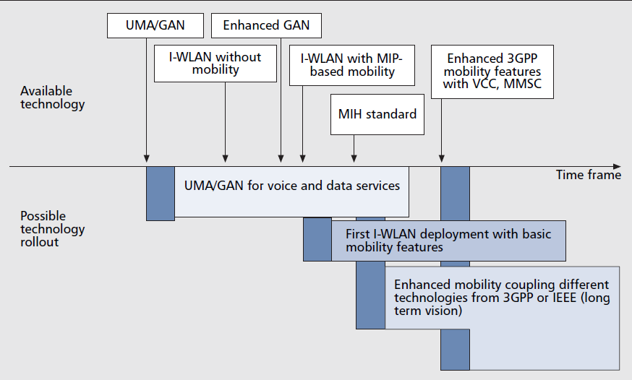
Timeframe proposal for fixed/mobile convergence solution deployment
VCC : Voice Call Continuity
MMSC : Multimedia Messaging Service Center

