Slide 1
CloneCloud: Elastic Execution between Mobile Device and Cloud
Byung-Gon Chun, Mayur Naik, Sunghwan Ihm, Petros Maniatis, Ashwin Patti
EuroSys’11

Slide 2
Outline
Introduction
Partitioning
Distributed Execution
Evaluation
Discussion and future work

Slide 3
Motivations and features
Applications need more and more resources
It is a big problem for developer to split their application
CloneCloud is a flexible architecture, can boost the unmodified applications by offloading
Static analysis and dynamic profiling to choose migration points
Notes:
對開發者來說要將一個應用程式切割成適合每一種型號的手機來執行
是很困難的事

Slide 4
Outline
Introduction
Partitioning
Distributed Execution
Evaluation
Discussion and future work

Slide 5
Partitioning analysis framework
Migration constraints
Partitioned binary
Location-constrained methods
Application binary
Static analyzer
Optimization solver
Profiling inputs
Dynamic profiler
Cost-annotated executions

Slide 6
Static analyzer: constraints
Identify choices for placing migration and re-integration points in the code
These points must be method entry and exit points
Only allow migration at the boundaries of application methods, not core-system library methods
Only allow migration at VM-layer method boundaries, not native method boundaries
Notes:
為了簡化實作的困難
他們對這些points做了一些限制

Slide 7
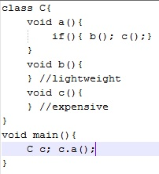
Static analyzer: example
C.a.entry
C.a.entry
C.b.entry
C.b.entry
Mobile device
C.b.exit
C.b.exit
C.c.entry
C.c.entry
Clone
C.c.exit
C.c.exit
C.a.exit
C.a.exit
(a) Static control-flow graph
(b) partitioned graph
Notes:
Control flow 只是一個推估的近似值
因為實際的control flow沒有辦法準確的掌握
最右邊的圖示其中一種partition方式
根據前面說的那些限制
Method c不能為system library或native method
但他本身可以呼叫system library 或native method

Slide 8
Static analyzer: property 1
Methods that access specific features of a machine must be pinned to the machine
E.g. a method uses a local resource such as GPS or sensor in a mobile device the method must be executed on the mobile device
These methods are marked with a special annotation M
The set contains such methods
Notes:
任何合法 partition 都符合三個特性
使用到某個機器上的功能的method必須在該台機器上運作

Slide 9
Static analyzer: property 2
Methods that share native state must be collocated at the same machine
E.g. method 1, method 2, method 3 access native state they need to be collocated at the same machine
We assign a unique annotation to all native methods declared in the same class C
The set contains all such methods
Notes:
會存取到native state 的method 必須在同一個機器下執行

Slide 10
Static analyzer: property 3
Prevent nested migration
Suspend → suspend → resume → resume (X)
Suspend → resume → suspend → resume (O)
The static analysis builds the static control-flow graph and capturing the caller-callee method relation and exports two relations
: method 1 directly calls method 2
: method 1 transitively calls method 2
Notes:
不能有nested的migration
用前面的那個範例來說明的話
如果partition point放在a就不能放在b或c
其他的partition方式可以為
Partition point在b, c 或同時存在於b和c

Slide 11
Dynamic profiler
The cost metric uses execution time and energy consumed at the mobile device
The profiler is invoked on multiple executions of the application, each using a randomly chosen set of input data, and each executed once on the mobile device and once on the clone in the cloud
The profiler outputs a set S of executions, and for each execution a profile tree T and T’, from the mobile device and the clone
Notes:
Dynamic profiler會使用隨機選取的input data來建立多個profiling tree
Cost可以是execution time或energy consumption

Slide 12
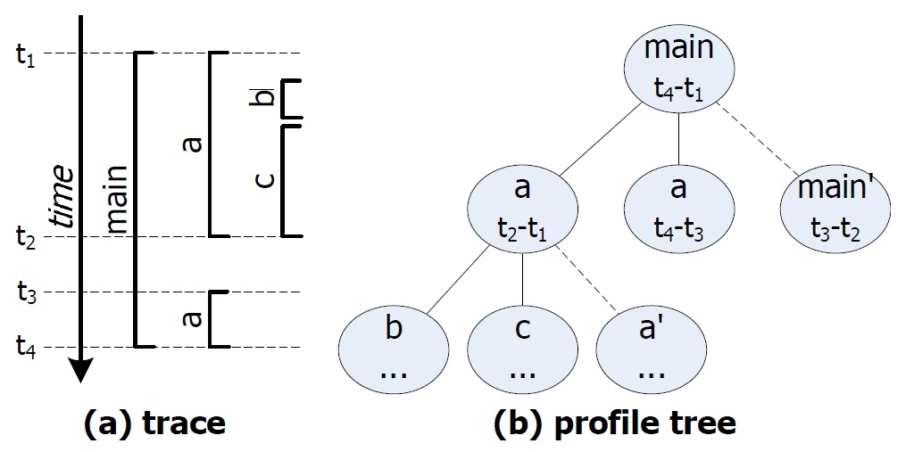
Dynamic profiler: example
Notes:
這個範例中的cost是用execution time 當作標準
每條edge代表invocation發生時的state size加上invocation 結束時的state size
虛線代表沒有ocst
因為migration不可能發生在虛線所代表的兩個node之間

Slide 13
Dynamic profiler: notations ( execution time)
: computation cost , i is the invoked method and l is the location of the invocation
It is filled from the profile tree
If i is a leaf profile tree node then fill in the node value
If i is not a leaf node then fill in i’
: making invocation i a migrant invocation

Slide 14
Dynamic profiler: notations ( energy consumption)
Execution time

Slide 15
Optimization Solver
R(m) : the output of the optimizer with each execution, m is every method in the application. If R(m) = 1 then the migration point and re-integrated point will be placed in the entry into the method and the exit from the method. If R(m) = 0 the application binary is unmodified.
L(m) : auxiliary decision indicating the location of every method m
Notes:
R(m) 是optimizer得出的結果
但並非所有的R(m)都是合法的結果
所以多加了一個L(m)來幫助決策

Slide 16
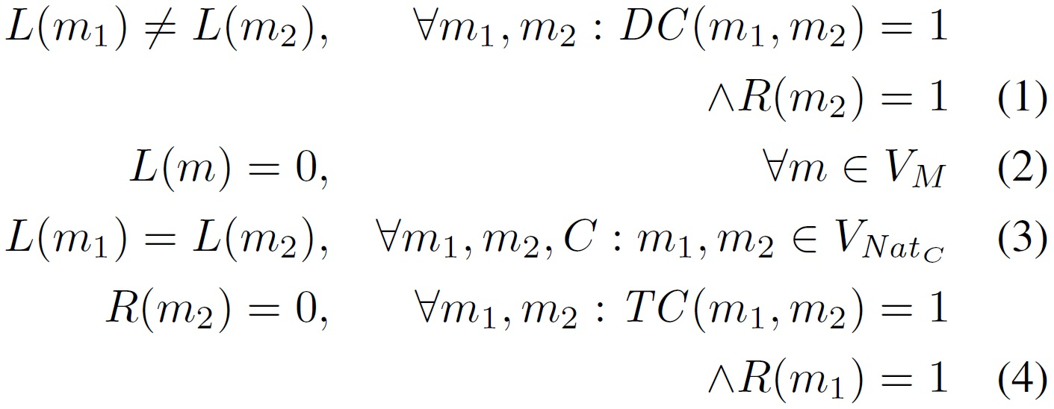
Optimization Solver: constraints
Notes:
第一個constraint是
如果某個method會被migrate到遠端執行
那麼他的caller不可能跟他在相同的機器上執行
2,3,4分別對應static analysis的三個properties
Prop1 存取特定machine上功能的method必須放在該machine上執行
Prop2 存取native state的methods必須在相同的機器執行
Prop3 不能有nested migration

Slide 17
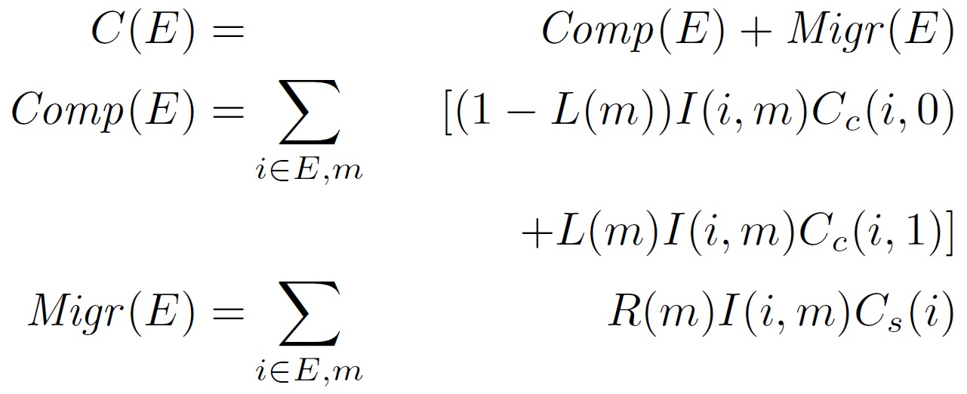
Optimization Solver: equation
: i is an invocation of m
To choose R() so as to minimize
Notes:
Comp(E)是computation cost
Migr(E) 是 migration cost

Slide 18
Outline
Introduction
Partitioning
Distributed Execution
Evaluation
Discussion and future work

Slide 19
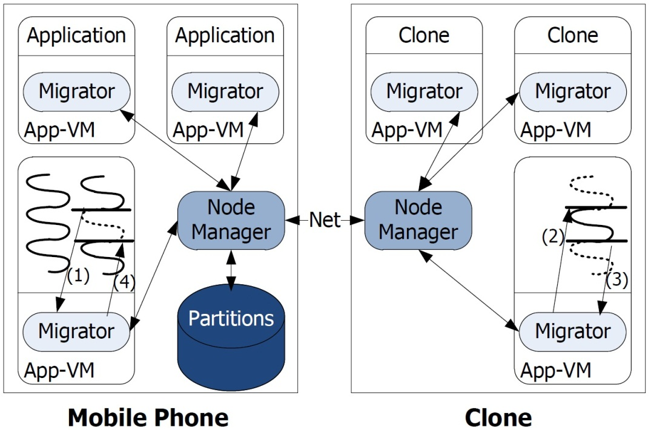
Distibuted execution
Pick a partition configuration file → if reaches a migration point → suspend and send state → if reaches re-integration point → suspend and send state → update the state in mobile
Notes:
Partition configuration 是solver所決定的partition方式
Migrator負責suspend, package, resume, merge thread state
Node manager 負責node and node communication, 包含傳送封裝好的thread和clone image同步

Slide 20
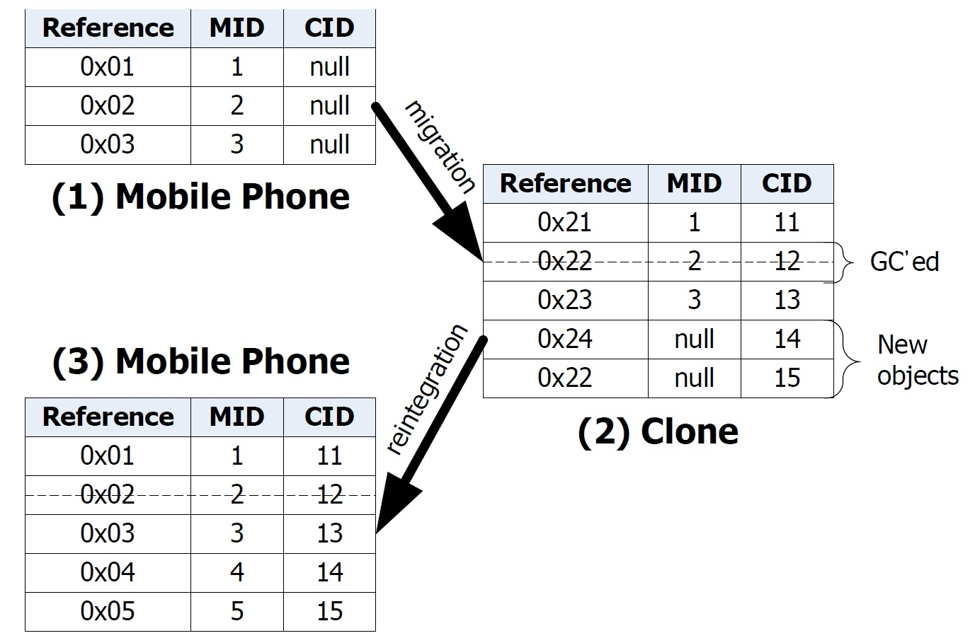
Object mapping table
Notes:
Migrate 過去的時候只要直接把memory直接覆蓋就可以了
但是回來的時候要需要update原來的state
所以他們用了mapping table
他們指定每個object一個id
MID是在mobile device 上的id
CID 是在Clone 上的id

Slide 21
Outline
Introduction
Partitioning
Distributed Execution
Evaluation
Discussion and future work

Slide 22
Environment
Mobile: Android device (HTC G1)
WiFi and 3G
Server: 3.0 GHz Xeon, android x86
Monsoon power monitor to profile energy consumption

Slide 23
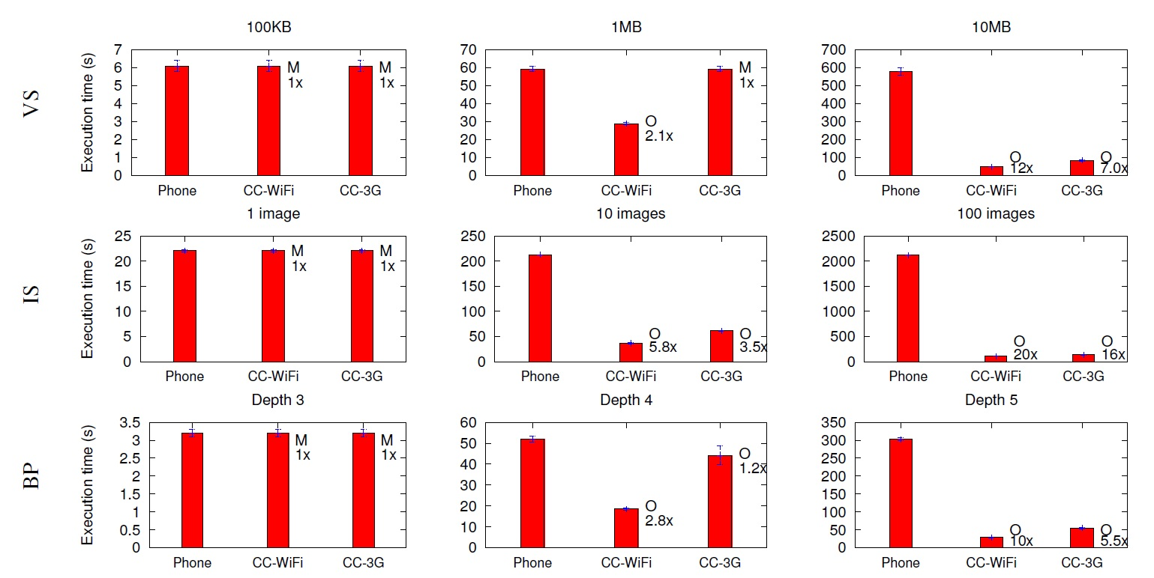
Execution time
Notes:
CC-WiFi: clonecloud with WiFi
Virus scanner
Image search
Behavior profiling

Slide 24
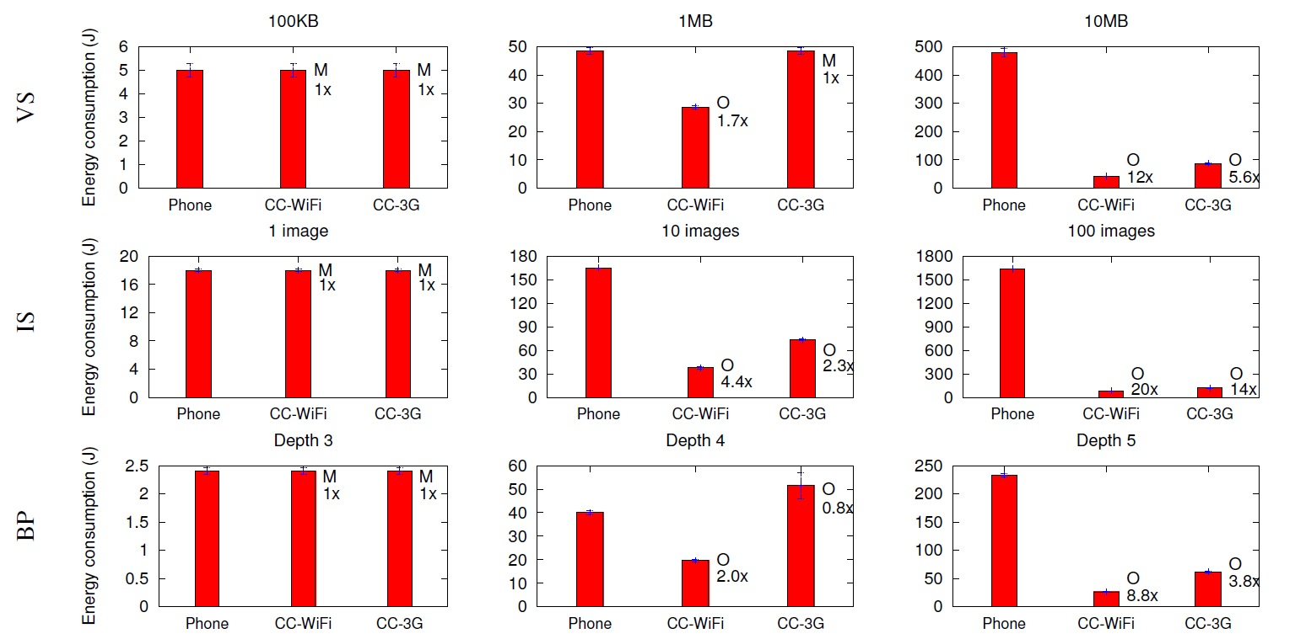
Energy consumption

Slide 25
Outline
Introduction
Partitioning
Distributed Execution
Evaluation
Discussion and future work

Slide 26
Future work
CloneCloud cannot enable native resources that are not virtualized(e.g. camera on mobile)
May enable those access via RPC-like mechanism
Perfunctory concurrency
Extend this architecture to support full concurrency
Assume the environment in which they run clone VMs is trusted
Plan to extend the basic system to check that the execution done in the remote machine is trusted

Slide 27
Comparing table

Slide 28
ThinkAir
Method A source
Execution controller
Execution solver
Method A remote
Notes:
Profiler 的啟動和設定都會在execution controller裡面弄好
利用execution solver來決定是否該offload到cloud
不管事在遠端執行還是在本地端執行
都是由execution controller來控制

