Slide 1
Manticore: a Framework for Partitioning Software Services for Hybrid Cloud
Nima Kaviani, Eric Wohlstadter, Rodger Lea

Slide 2
Outline
Introduction
Approach
Evaluation
Conclusion and future work

Slide 3
Types of cloud service
Public cloud
Can be access by anyone (cost is low)
Private cloud
Can only be access by some people (cost is high)
Hybrid cloud
Combine two of them

Slide 4
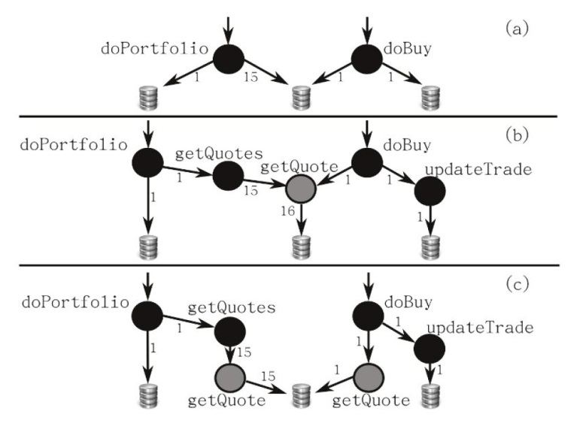
Application dependency analysis
Request-based Model
Each node represents a request type or data object
Static structure model
Each node represents the definition of a function of data object
Context-sensitive model
Each node represents the execution of a function in a distinct calling context
Notes:
Daytrader

Slide 5
Cost model
Notes:
他會用一個XML檔把相關的參數自動吃進去
Cpu source 是跑profiling的machine的cpu capability
Cpu target 是真正要架設這個service的機器
T comm的第一項是假設request for data transfer是以poisson分佈所得到的queuing delay
Alpha 是system parameter 在private上跑的cost和在public上跑的cost的ratio
Gamma是一個developer自定義的參數，數值越大表示越不能容忍delay

Slide 6
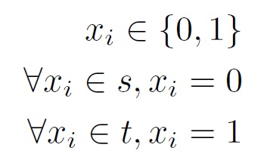
Partitioning
Notes:
S代表在private
T代表在public
下面那個是objective function

Slide 7
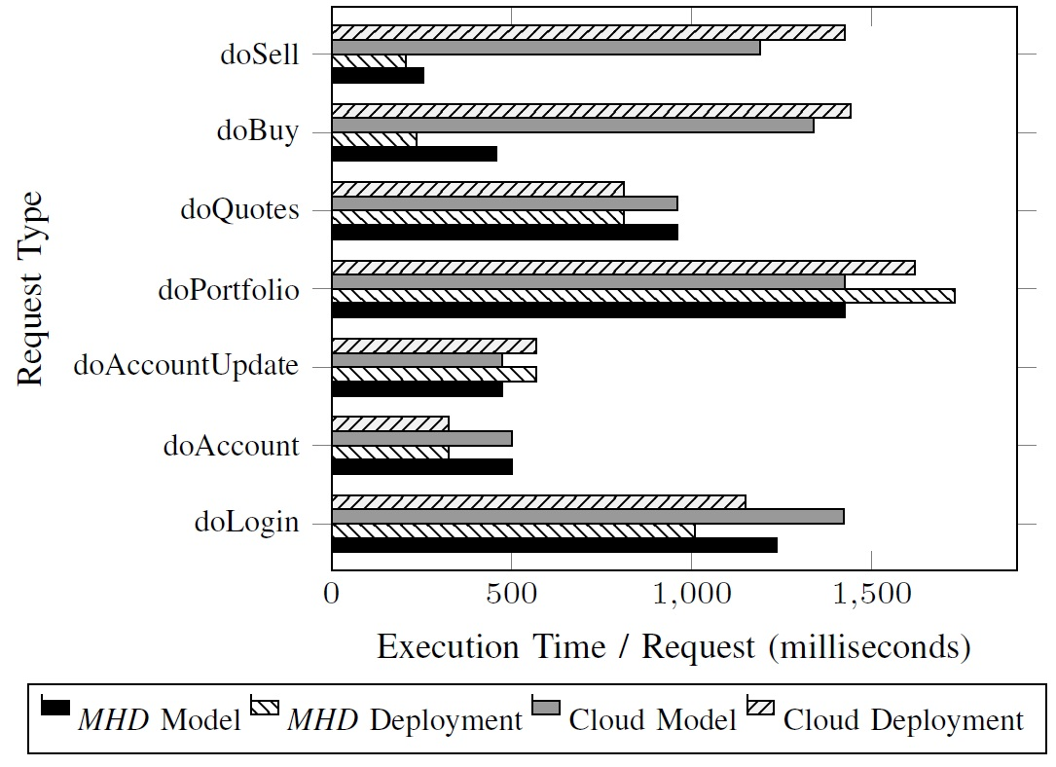
Model versus real deployment
Notes:
MHD: manticore-hybrid deployment
這裡主要是證明他的model的準確性

Slide 8
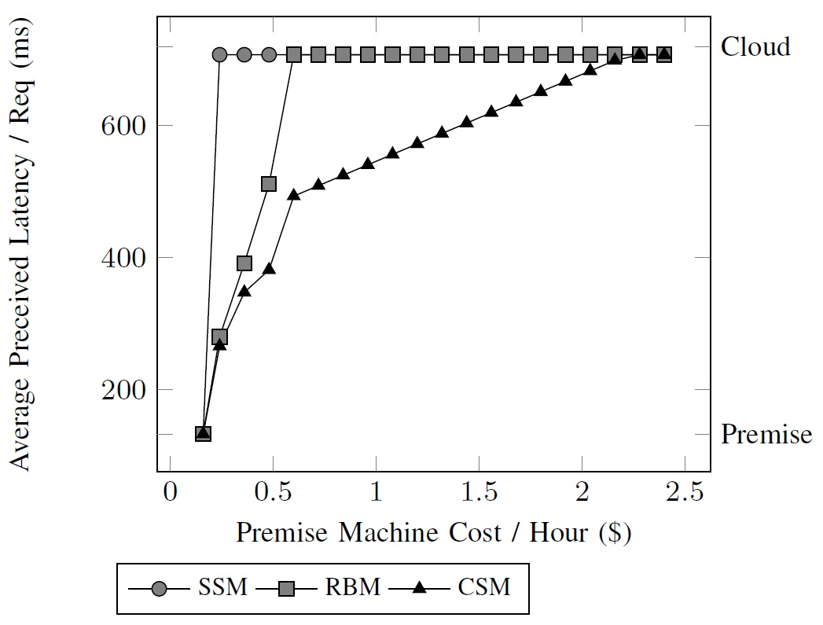
Evaluation of context-sensitive modeling

Slide 9
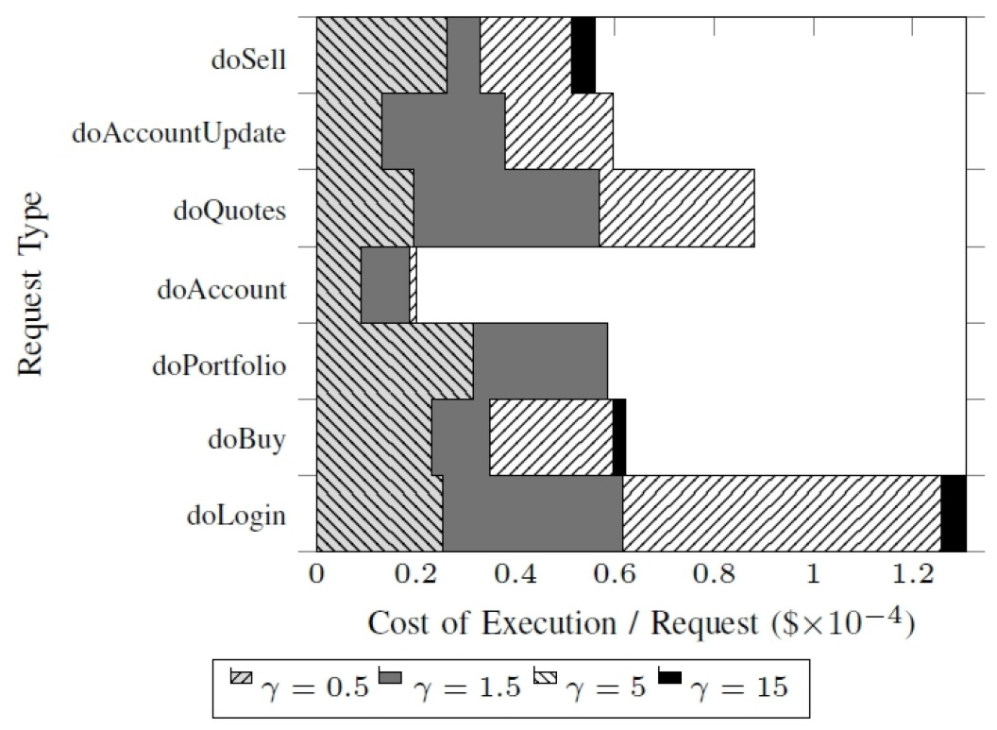
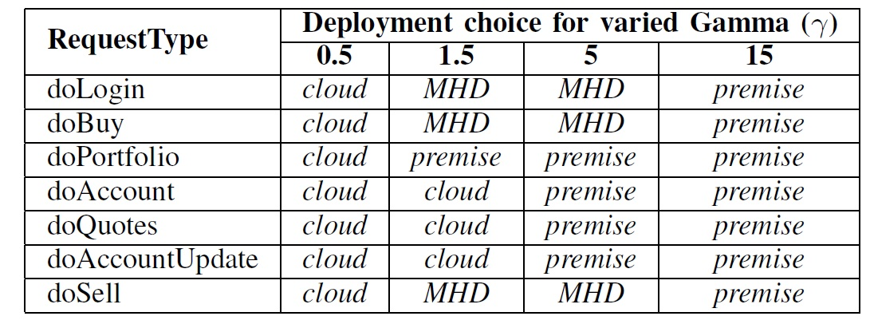
Evaluation of flexible cost modeling
Notes:
Gamma越高表示對delay的容忍度越低
因此越容易被放在private執行
因此就會造成cost提升 (自行架設的成本)

Slide 10
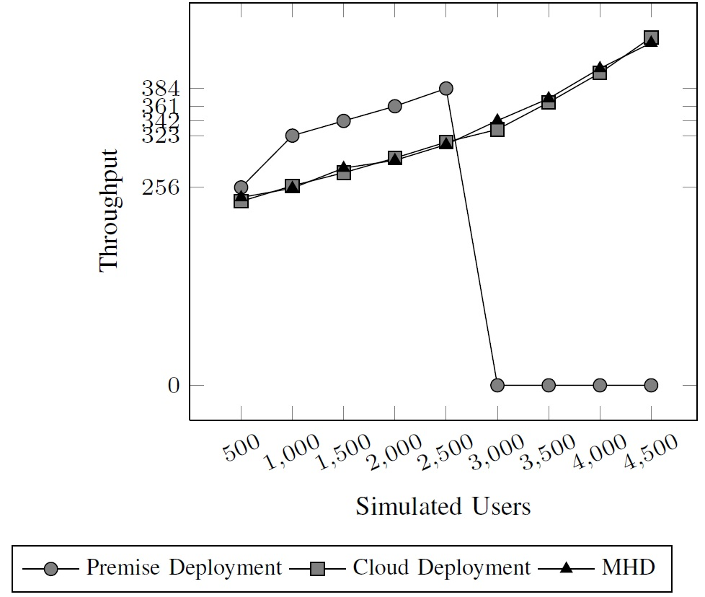
Evaluation of scalability
Notes:
在這裡能看到超過一定的user數目後cloud 的throughput比較高
而這個系統的throughput和cloud 差不多但是從前面的實驗數據知道delay比cloud小

Slide 11
Conclusion
Low delay than pure public cloud service (similar to offloading)
It must run once in a premise machine to profile the data and generate the dependency graph
can be tradeoff between cost and delay
Notes:
大多數的work都專注在cost上面
對於delay的問題不是很關心

Slide 12
Future work
Partition the data
Cloud can have subset of the data, the premise will only have sensitive data.
The partition decision can be dynamic
The partition is done before deployment, they want the system can dynamically change the partition while executing.

