Slide 1
Towards Peer-Assisted Dynamic Adaptive Streaming over HTTP
Stefan Lederer, Christopher Muller, Christian Timmerer
PV’12

Slide 2
DASH
A chuck-based HTTP streaming.
Dynamically adapts the stream to the users’ bandwidth
Wise to leverage existing HTTP-based CDN and proxy cache

Slide 3
P2P streaming
P2P:
Asymmetric internet connection
Not able to share the same HD video to other peers
Not possible to guarantee a smooth playback at best quality for all peers
Combine client-server and P2P system to be a promising approach

Slide 4
Related Work
Spotify server
Only 8% stream from server
Measurements on the Spotify Peer-Assisted Music-on-Demand Streaming System
Adobe Cirrus
Combine with Adobe HTTP Dynamic Streaming
UDP as transport layer
Unreliable transfer
NAT traversal issues

Slide 5
pDASH

Slide 6
pDASH Client
Peer needs a local HTTP Web server
Split up requests for a segment in several smaller requests and send to different peers
Clients have to limit the number of incoming connections
Reach the maximum, all other incoming requests will be discarded

Slide 7
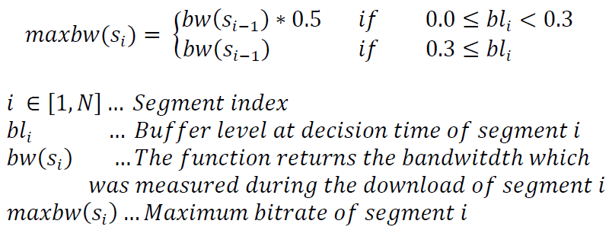
pDASH Client (Cont.)
Initial: bitrate of 50% of the clients’ bandwidth
Select based on the maximum bandwidth

Slide 8
pDASH Client (Cont.)
Clients download chucks from other peers
Handling two segments in parallel:
Peer-segment
Request Randomly from one of the other peers
Accepted request if peer has not reached its limit incoming connection
Server-segment
All missing chuck requests are combined in the server-segment

Slide 9
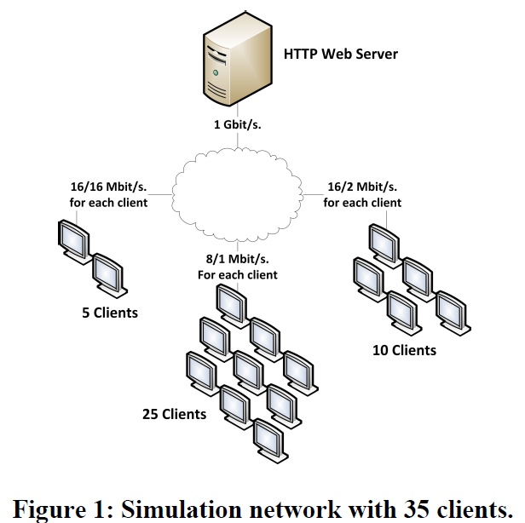
HTTP Web Server and Segment-tracker
Central Segment Tracker:
Monitor the segment requests and MPD requests for each client
IP and timestamp stored in a database
Generate MPD:
All clients requested segments

Slide 10
Simulation Environment
OMNeT++ 4.2
Arbitrary number of clients having different characteristics
OMNeT++-based INET framework
Provide the full TCP/IP stack and network component

Slide 11
Simulation Environment (Cont.)
8/1: start at 15s, every 10s add one client
16/2: start at 22s, every 20s add one client
16/16: start at 17s, every 30s add one client

Slide 12
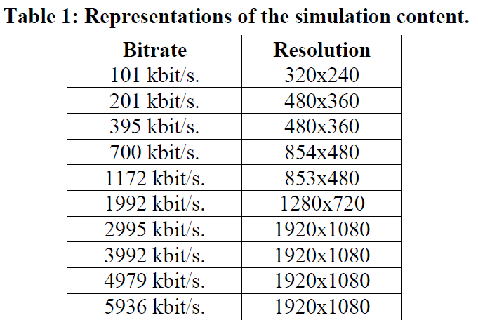
Simulation Environment (Cont.)
Segment length: four seconds

Slide 13
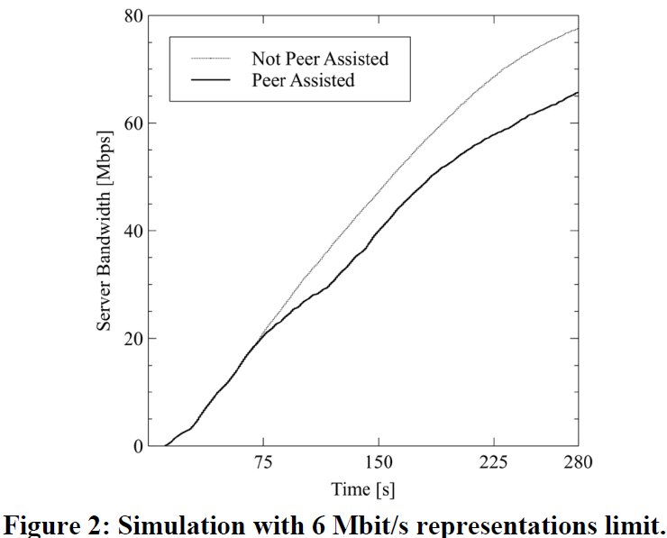
Evaluation Results
Reduce 15% server bandwidth

Slide 14
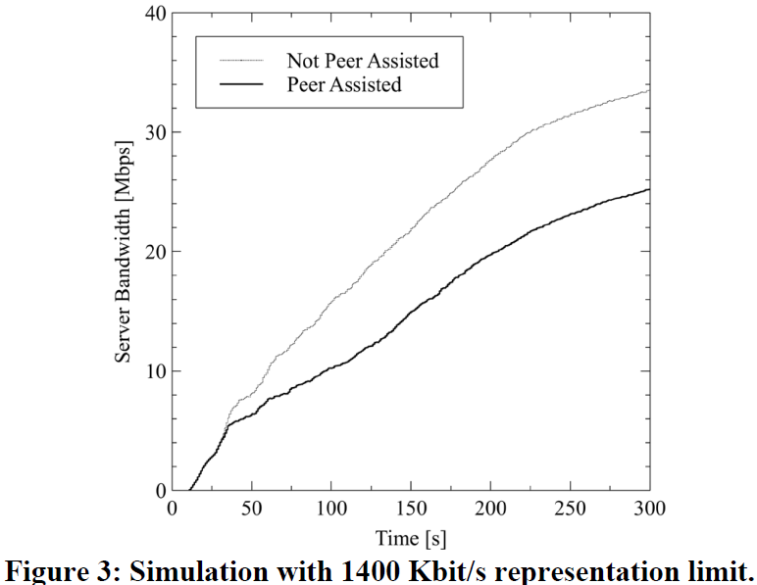
Evaluation Results (Cont.)
Reduce 25% server bandwidth

Slide 15
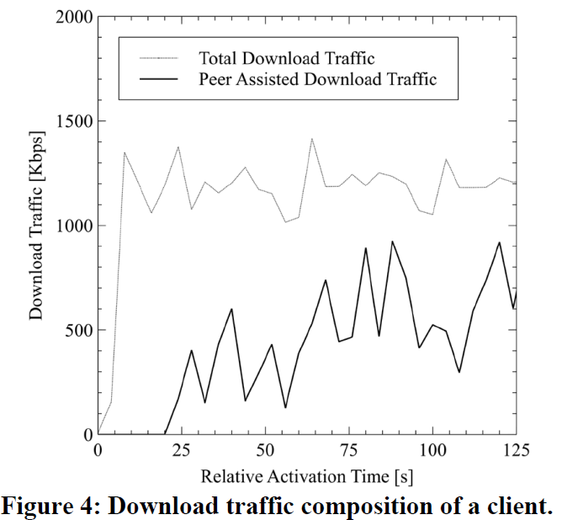
Evaluation Results (Cont.)
P2P traffic contributes up to 50% of total traffic

Slide 16
Conclusion and Future Work
Conclusion:
Reduce the server bandwidth up to 25%
Can be directly converted to infrastructure costs
Future Work:
More sophisticated peer selection algorithms
Regular update of the MPD during streaming
Handle more chucks in parallel than two

