Slide 1
A Proxy Effect Analyis and Fair Adaptation Algorithm for Multiple Competing Dynamic Adaptive Streaming over HTTP Clients
Christopher Mueller, Stefan Lederer, and Christian Timmerer
VCIP’12

Slide 2
Introduction
DASH or DASH-like
Streaming logic is located at the client
Multiple version of the content
Logic is located ate the client → clients are not aware of each other and the network infrastructure
Negative effects when clients are competing for a bottleneck
Wrong adaptation decision

Slide 3
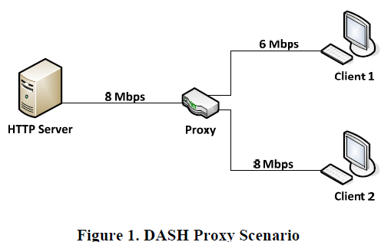
DASH-based Proxy Effects
Base quality bitrate: 5 Mbps
Enhancement quality bitrate: 7 Mbps

Slide 4
DASH-based Proxy Effects (cont.)
Client 1 start the streaming slightly before client 2
Base quality be cached on the proxy
Client 2 try to adapt to the maximal available bandwidth
Proxy has to maintain two connections to content server
Base quality and enhancement quality
Assume connections in a fair way

Slide 5
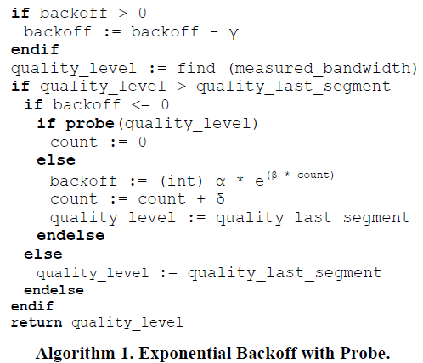
Fair Adaptation
For simplicity, set α and β to 1
probe(): identify the effective available bandwidth for next segment

Slide 6
Experiments
Content:
Big Buck Bunny
Video codec: X264
GOP: 48 frames
Length: 2 sec.
Metrics:
Average bitrate
Number of quality switches
Buffer level

Slide 7
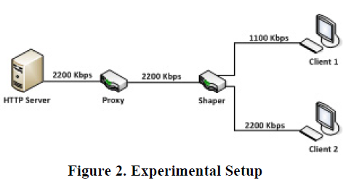
Experiments (cont.)
Big Buck Bunny at 700 kbps and 1300 kbps

Slide 8
Experiments (cont.)
Microsoft Smooth Streaming
Server: Microsoft Windows Server 2008
Client: Windows 7 with Sliverlight 5
MPEG-DASH
Server: Ubuntu 10.04 Apache
Client: VLC media player

Slide 9
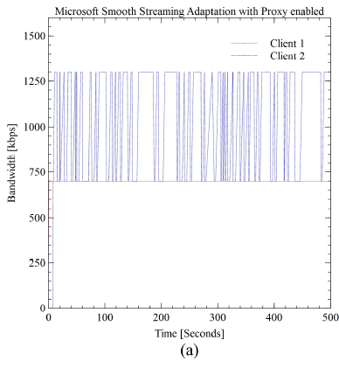
Microsoft Smooth Streaming
Adaptation process

Slide 10
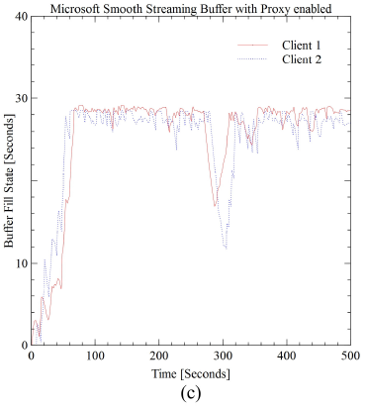
Microsoft Smooth Streaming (cont.)
Buffer fill status

Slide 11
MPEG-DASH
1000 Kbps
1700 Kbps
1700 Kbps
1700 Kbps

Slide 12
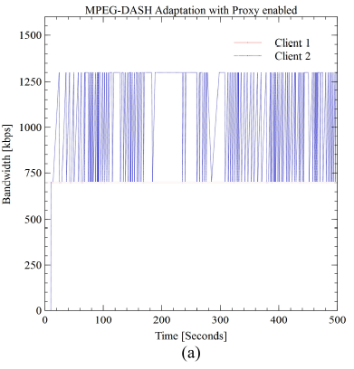
MPEG-DASH (cont.)
More frequently at client 2

Slide 13
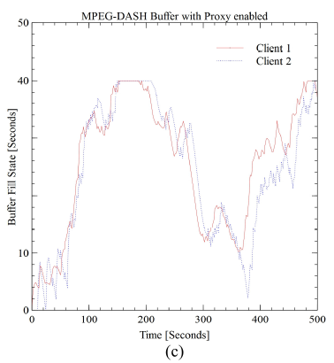
MPEG-DASH (cont.)
Client 2 has an unsmooth playback at second 20

Slide 14
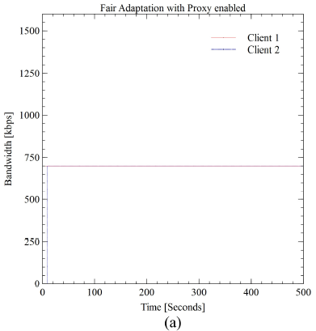
MPEG-DASH with Fair Adaptation
Eliminate frequent switching effect at Client 2

Slide 15
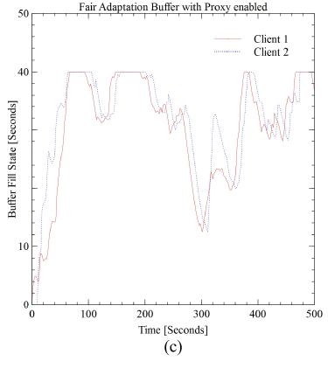
MPEG-DASH with Fair Adaptation (cont.)
Both clients are maintaining a more stable buffer

Slide 16
Conclusion
Described negative effects that could occur when multiple DASH clients are competing for a bottleneck.
Evaluation of major industry solutions and our own fair adaptation logic under dynamic bandwidth conditions.

