Slide 1
Streamloading: Low Cost High Quality Video Streaming for Mobile Users
Ayaskant Rath, Sanjay Goyal, and Shivendra Panwar
MoVid’13

Slide 2
Introduction
Cellular data traffic will grow by over 8 times in the next four years.
A user located closer to a base station experiences a higher data rate.
Data rate available to a user almost instantaneously reflects on the quality of video.
Streamloading:
SVC
Streaming base layer
Downloading enhancement layers

Slide 3
Streaming V.S. Downloading
Streaming:
Cache short period of video data
Downloading:
Cache as much of the video as network bandwidth allows
Streaming drawback:
Cannot cache future chucks of video
Video quality drops as soon as they move away from the base station

Slide 4
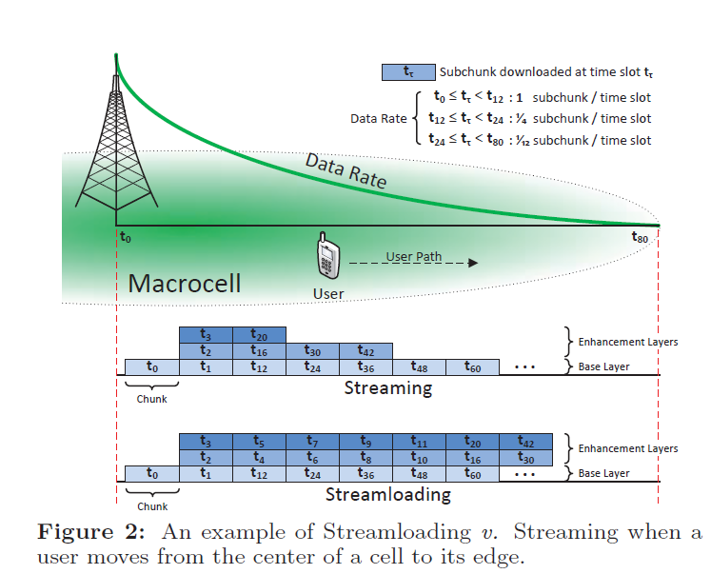
Streamloading
Stream the base layer data
Download the enhancement layer data

Slide 5
Implementation
c_{i} : ith chunk, 0 <= i <= N
Each c_{i} is encoded in M layers
s_{ij} : subchunk of chunk c_{i}, s_{i0} is base layer, 0 <= j <= M
b : buffer size in term of chunk

Slide 6
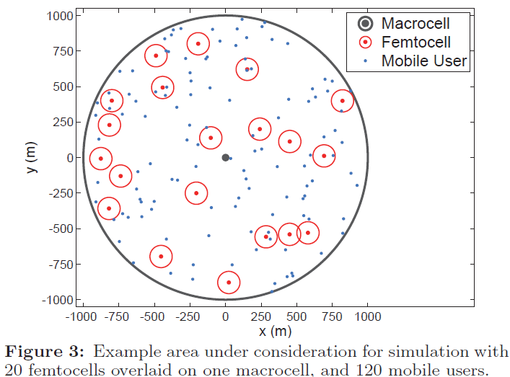
Simulation Model
Macrocell: WiMAX
Femtocell: WiFi hotspot
Transmission Scheduling: TDMA, 2ms

Slide 7
Video Data
Chunk length: 1.2s
Videos length: 100m → N = 5000
M = 4

Slide 8
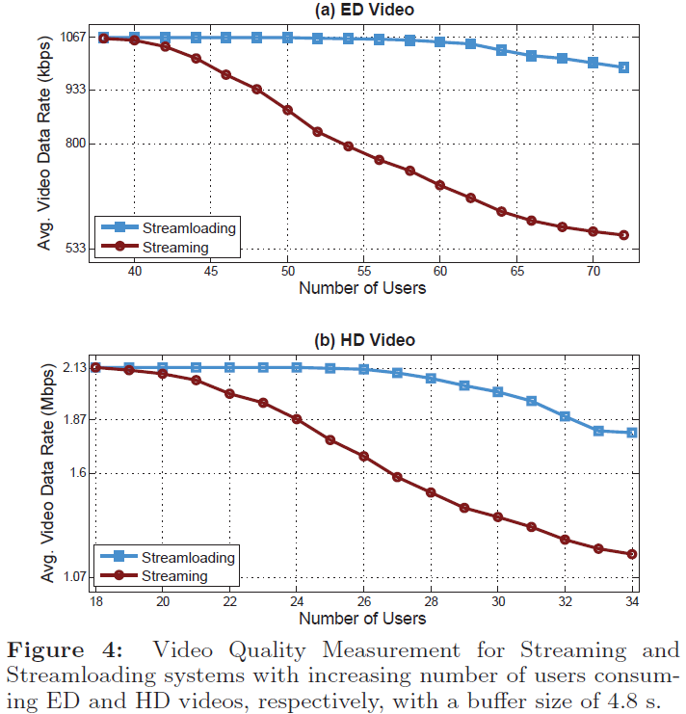
Results and Analyses
Average speed of 11 mph
b = 4 chunks
Streamloading service provides more than two enhancement layers of video the users on the average

Slide 9
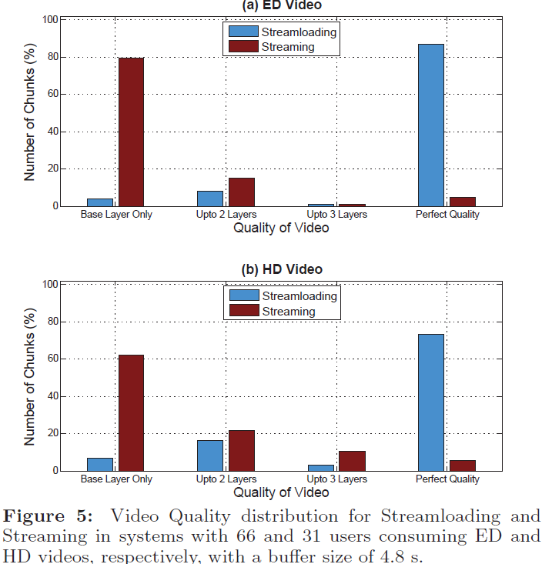
Results and Analyses (cont.)
66 users consuming ED videos
31 users consuming HD videos

Slide 10
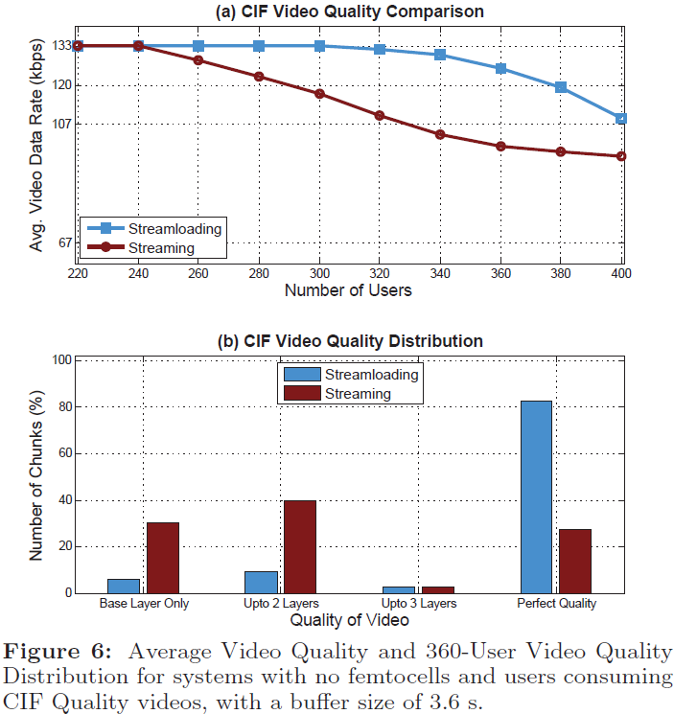
Results and Analyses (cont.)
Without fetmocell
b = 3 chunks
Only CIF video
(a) At 340 users, streamloading delivers up to two additional layers of video
(b)streamloading: more than 82% were perfect quality

Slide 11
Conclusion
With 20 femtocells:
Streamloading can serve more than 50% additional users with near perfect video quality
Without femtocells:
This number is found to be as high as 35%
They proposed a novel video delivery service, streamloading:
Streaming base layer
Downloading enhancement layers
In the worst case is no worse than streaming
In the best case is as good as downloading

