Slide 1
The Controller Placement Problem
B. Heller, R. Sherwood and N. McKeown
Proceeding of HotSDN ’12
Presenter: YiRen

Slide 2
Guideline
1. Introduction & Motivation
2. Placement Metrics
3. Analysis of INTERNET2 OS3E
4. Analysis of more topologies
5. Discussion & Conclusion

Slide 3
Introduction & Motivation
Motivation example:
1) network operator
2) controller application writers
3) network management software design
Two questions to improve performance of SDN like network:
1) number of controller
2) position of controller
Compare controller placement using node to node controller delay imposed on:
1) reaction delay
2) fault discovery
3) event propagation

Slide 4
Placement metrics
NP-hard problem with input the number of controller: k
Average case latency:
Worst case latency:
Within latency limit: maximize the number of nodes within a latency bound (they do not consider this question)

Slide 5
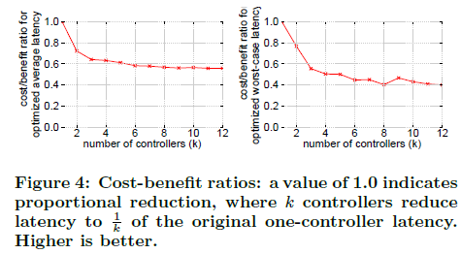
Analysis of INTERNET2 OS3E
how many controllers are needed?
Tradeoff: must choose between optimizing for worst-case latency
or average-case latency

Slide 6
Analysis of INTERNET2 OS3E (cont.)
(a) both latency metrics for all combinations of up to five controllers
(b) Points that are on the pareto frontier of lower-left region of (a)
(c) normalizes the pareto frontiers

Slide 7
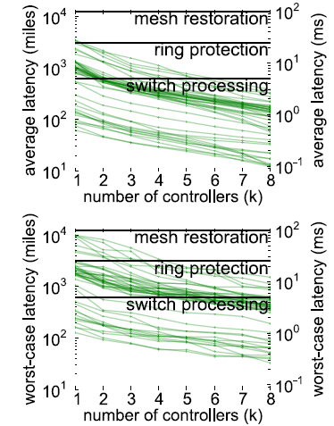
Analysis of more topologies
More analysis to topologies in Internet Topology Zoo
Surprisingly, one controller location often suffices
switch processing: 10ms from the time a packet is sent, to the time a response is received
Ring protection: 50ms the time from fault detection to when traffic is flowing in the opposite direction along the ring
Shared-mesh restoration: 200-250ms voice calls start to drop, or ATM circuit rerouting may be triggered

Slide 8
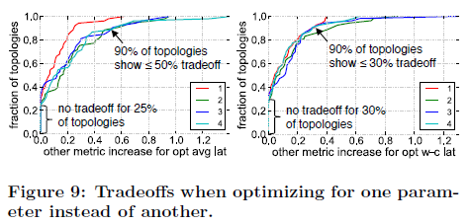
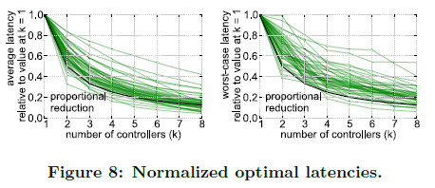
Analysis of more topologies (cont.)
For most topologies, adding controllers yields slightly less than proportional reduction
k controllers reduce latency nearly to 1/k of the baseline latency with one controller
Larger topologies generally require more controllers to see the same fractional reduction in latency

Slide 9
Discussion & Conclusion
Availability: decoupled network control planes exchange these concerns for other failure modes such as controller failure or disconnection
State Distribution: Decoupling potentially enables stateoriented methods to replace more traditional message-oriented approaches in wide-area network control planes
Controller Selection: place controllers to minimize latency, as a starting point, then use another algorithm to (possibly dynamically) balance switches among available controllers

