Slide 1
A collaborative model for routing in multi-domains OpenFlow networks
2013 International Conference on Computing, Management and Telecommunications
Author: Xuan Thien Phan, Nam Thoai and Pierre Kuonen
Presenter: Yi-Ren Chen

Slide 2
Guideline
1. introduction
2. background & related works
3. RMOF model
Main component of RMOF model
Discovering cross-domain network links
Computing routing-costs between cross-domain switches
4. conclusion & future work

Slide 3
introduction
The OpenFlow definition v1.2 only consider network that consist of one controller (but OpenFlow org. done this work now), this will be the lack of scalability.
For network only one controller, the response time fro request in large network environment is slow due to latency if control bandwidth
Current OpenFlow controller & switch apply flooding mechanism to handle “cross-domain” packets, it is not a good solution!

Slide 4
background & related works
Some Approach like FlowVisor and HyperFlow do support multi controllers in network but they actually let every controller work independently or use distributed file system to manage network (unreliable)
The new version 1.3 add concept of multiple controllers in network, switch can establish connection with single or multi-controllers
But controllers still can not share their management information or collaborate together

Slide 5
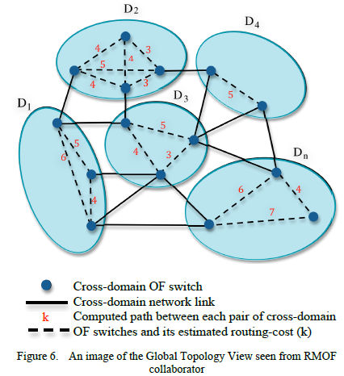
RMOF model
Main component:
RMOF collaborator maintain global topology view by Global routing App
Belong two different network domain
Cost of shortest path
Route-Ins Table contain routing instructions for controller to route cross-domain packets
Instruction for controller

Slide 6
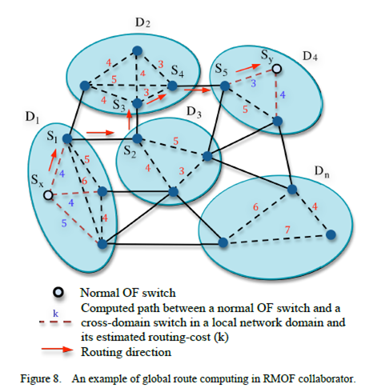
RMOF model (cont.)
RMOF local routing APP discovers cross domain link in its domain and routing cost that will be sent to RMOF collaborator, and handle Route-Ins table
RMOF global routing App is responsible for global topology view
Discover cross-domain network link:
Use LLDP packets to neighbor switches with switch ID and output port
Compute routing-costs between cross-domain switches
Compute shortest path route and routing cross-domain packet

Slide 7
conclusion & future work
RMOF allows controllers in multiple domain cooperate together to share topology message or routing path
But this module need more test in large test-bed to evaluate efficiency, performance and scalability (not show this paper)
Their future work:
Extend topology view and allow controller share more information like traffic load
Reduce the frequency that controllers communicate with collaborator which will be the bottleneck of response time

