Slide 1
USense - A Smartphone Middleware for Community Sensing
Vikas Agarwal, Nilanjan Banerjee, Dipanjan Chakraborty, Sumi Mittal
Mobile Data Management 2013

Slide 2
Introduction
USense – A novel smartphone middleware for executing community-driven sensing tasks.
Application aware
User aware
Situation aware
Goals:
Reducing human burden
Adapt operations based on available resources
Aware of user’s preferences
Contribute meaningful data to reduce redundant updates to application server
Programmable abstractions for crowdsening tasks

Slide 3
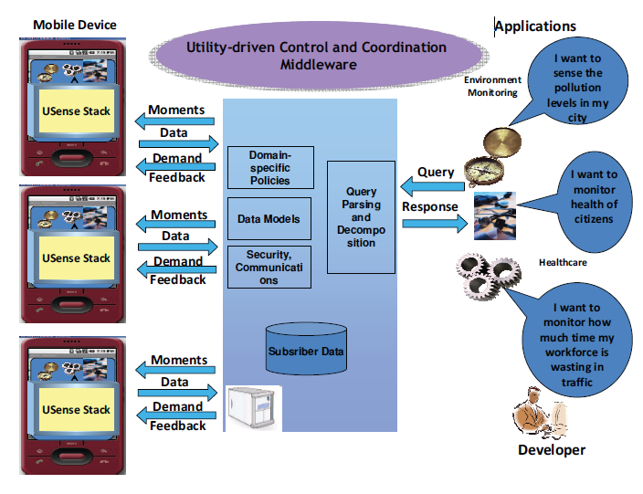
BlueZen Platform Framework
Could-based scalable platform
Producer-Consumer ecosystem
Pay attention to:
Cognitive load of user
User’s preferences
Application’s demands
Network load

Slide 4
USense middleware
Technical challenges:
Design of the expressivity constructs to specify sensing tasks
Design of the middleware components that execute these tasks on the smartphone

Slide 5
Moment Specification in USense
Moment:
An abstract data type
Specifies the processing requirements
Using XMLRPC
Contain Three main constructs:
Trigger
Utility Function
Callback

Slide 6
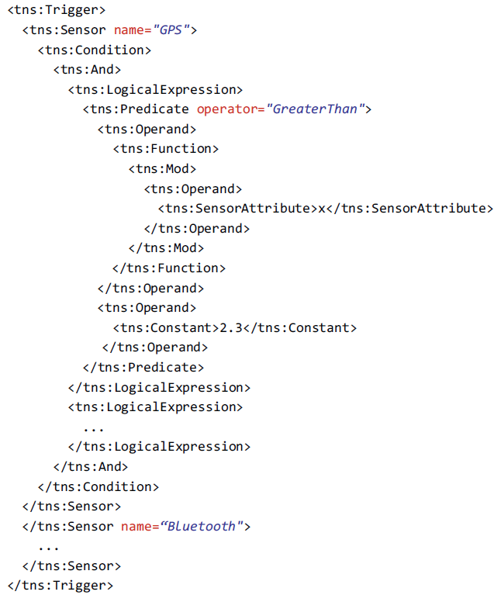
Trigger
Moment Occurrence Criteria, has two constructs
A Schedule: Get some data periodically
A Condition: When some condition is true
If (Mod(x) > 2.3 && …) get GPS data
Auxiliary Occurrence Criteria
Time-based
Toggle-based
Persistence-based

Slide 7
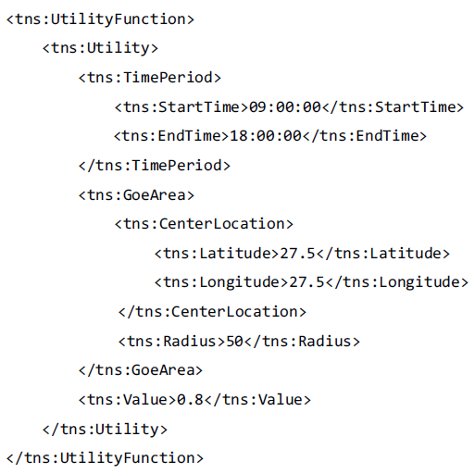
Utility Function
Utility value between 0 - 1
Associated time period or user location or both

Slide 8
Callback

Slide 9
USense Middleware Architecture

Slide 10
Interaction Layer
User preferences:
Time-based
Location-based
Resource-based
Moment Repository
Collect the list of moments
Binding callback
Event Dispatcher
Use of the callback information

Slide 11
Computation and Analysis Layer
For devising efficient management policies for executing the moments.
Moments Evaluator
Implement logic required to compute of the moments
Rule-based: “high noise” → MIC: decibel > 80
Learning-based: using pre-build machine learning tools
Maintain a buffer for each of the sensors
Sensor and Moment Profiler:
Store the historical data for Sensing Planner
Sensing Planner:
Provide the intelligence for the sensing strategy or policy

Slide 12
Sensor Control Layer
Acts as the interface to the sensor hardware
Schedule the sensor duty cycle and sampling frequency
On-demand: start(sensor s, time t, frequency f)
Periodic: register(sensor s, cycle c, frequency f)

Slide 13
Implementation
Have implemented a USense middleware on the Android platform
USense: Activity
Sensor Control Layer: Service
Data Collection
Collect ground truth data from 10 volunteers
Each phone was charged to 100% battery level at the beginning of sensing
Focus on Bluetooth and Microphone
Bluetooth: every 1 minute
Microphone: every 10 second

Slide 14
Sensing Policies
Additive Back-off Multiplicative Advance (ABMA)
Multiplicative Back-off Exponential Advance (MBEA)
Additive Back-off Exponential Advance (ABEA)
Constant Sleep Time (CST)

Slide 15
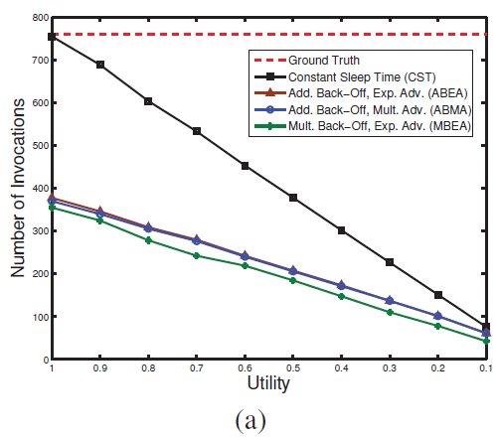
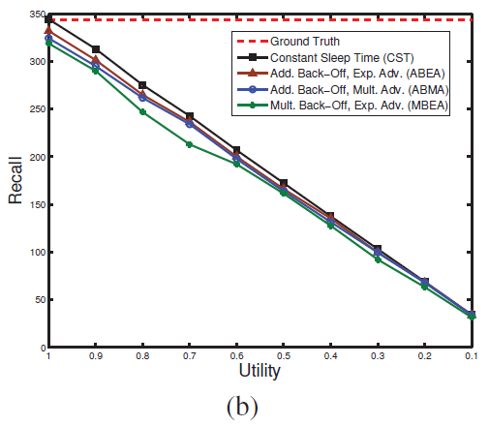
Experimental Evaluation
Bluetooth with varying utility value

Slide 16
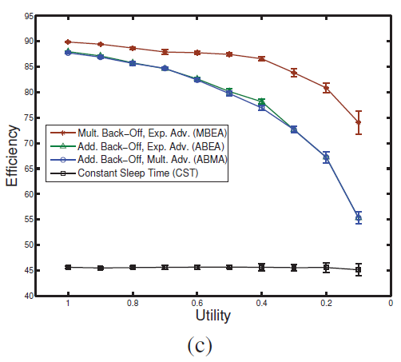
Experimental Evaluation (cont.)
MBEA is most efficient for Bluetooth

Slide 17
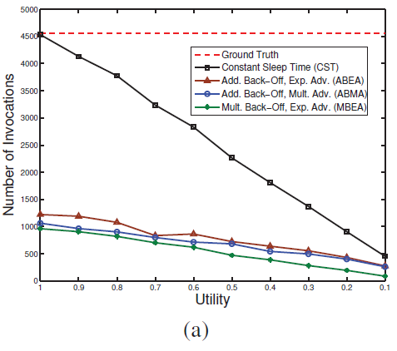
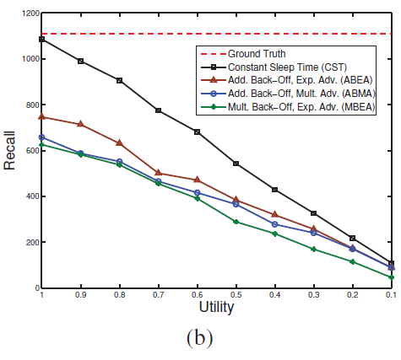
Experimental Evaluation (cont.)
Microphone with varying utility value

Slide 18
Experimental Evaluation (cont.)

Slide 19
Future work
Research on cross-device sensing policies to improve data fidelity of crowdsensing applications.
Investigate machine learning tools
Study how to integrate localized analytics-oriented logic into Usense middleware

