Slide 1
Game Design Guided by Visual Attention
Li Jie James J Clark
Centre of Intelligent Machines
McGill University
Entertainment Computing–ICEC 2007

Slide 2
Introduction
Better understanding of allocation of visual attention can benefit design of game scenarios
Studies of visual attention can inform game designers how to attract and avoid players’ attention, which enables designers to control different game levels
The authors propose a way to estimate task-dependent attention allocation based on eye movement information with image information

Slide 3
Methods
First experiment: detect if image complexity at fixation point affected disengagement of attention during fixation and pursuit conditions
Environment: a computer, a screen of 1280*1024 pixel at distance of 18 inches (1 degree of visual angle corresponded to about 30 pixels), 500 images (640*480) from different categories were used as background
Fig. 1. Examples of images used as background for the experiment. Each column represents one category of images. From left to Right: city scene, landscape, building, animal, and interior scene.

Slide 4
Methods
Each trial:
- a fixation point of size (0.26*0.26 deg) appeared at the center of the monitor and background is black
- when subjects are ready, they push a key
- An image was shown and a green square (0.26*0.26 deg) appeared and started moving at a speed of 1.4 deg/s (subjects can either purse the square or freely view images)
- About 2 seconds after every trial, a square object of 0.65*0.65 deg in green or blue will appear at random positions and subjects need to press mouse buttons ASAP

Slide 5
Methods
5 males and 1 female participate in the experiment
A chin rest was used to minimize head movements
An eye tracker (ISCAN RK-726PCI) was used to record subject left eye positions at 240HZ
Eye tracker is calibrated in every trial
Trials with blinks, missed pursuits, or missed executions were excluded from further analysis

Slide 6
Methods
The authors refer to entropy of images as the information quantity
The authors compute a segmentation of the image at the fixation point [1]
The color pixel data were converted into graylevel
Entropy was computed based on the luminance values according to the formula: $\text{Y}\text{ = 0.299}\text{R}\text{ + 0.587}\text{G}\text{ + 0.114}\text{B}$
[1] Felzenszwalb, P.F. and Huttenlocher, D. P. Efficient Graph-Based Images Segmentation. International Journal of Computer Vision, Vol. 59, Number 2, Sept, (2004).
Notes:
The segmentation is a process to classify each image pixel to one of the image parts, and reduces noise

Slide 7
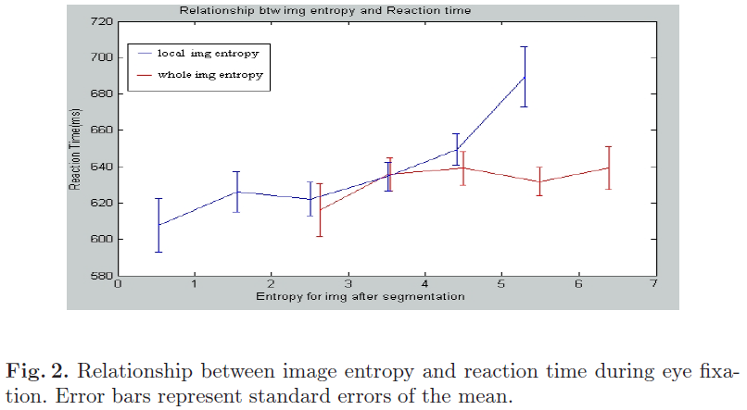
Results
For the free viewing condition
- Effects of local image entropy around fixation area and global image entropy of whole image were both checked
Notes:
Fig. 2 shows the mean reaction time to the flashed square object
As expected, the reaction time increased when the local image entropy increased
This indicated that the local entropy at the fixation area is potentially one factor related to the time of disengagement of attention at fixation points

Slide 8
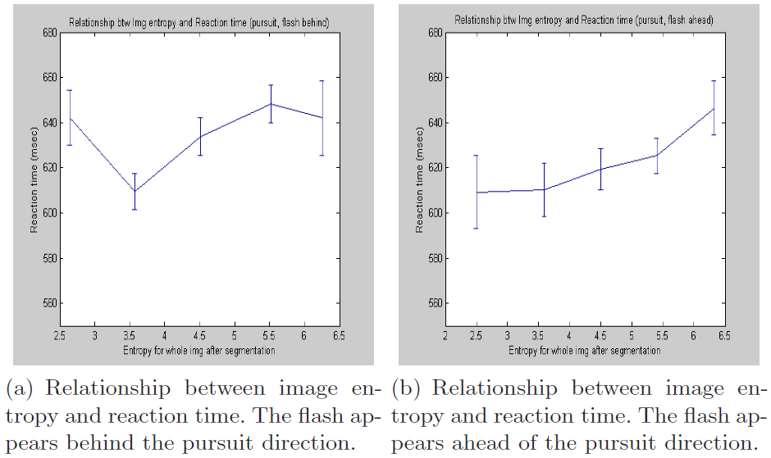
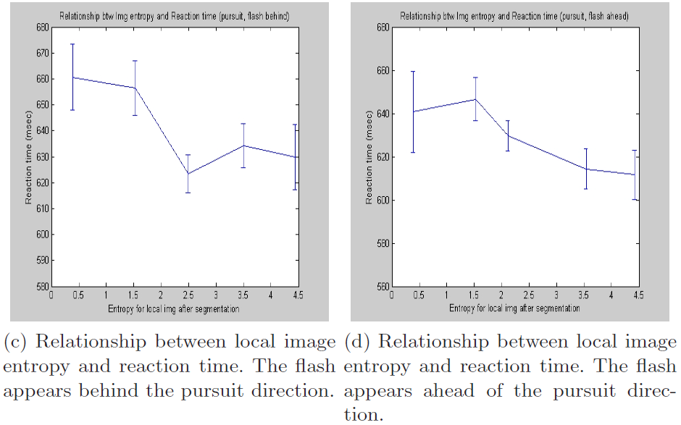
Results
For the pursuit condition
- No consistent relationship was found between image entropy and reaction time
Fig. 3. Relationship between image entropy and reaction time during eye pursuit.

Slide 9
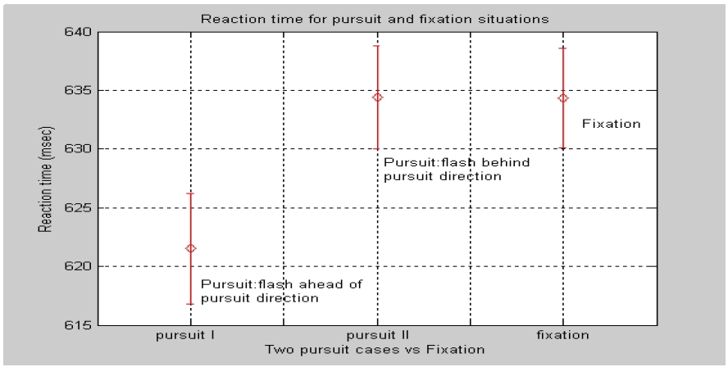
Results
Follow the experiments in [2][3], the authors checked subject’s reaction time for fixation and pursuit situations and got consistent result with the papers
Image content at fixation points is more important in affecting attention allocation for fixation than for pursuit
Fig. 4. Comparison of reaction time under the pursuit and fixation conditions.
12. van D., P. and Drew, A.S. The allocation of attention during smooth pursuit eye movements. Prog. Brain Res. 140: 267-277. (2002)
13. Jie, L. and Clark, J.J. Microsaccadic Eye movements during ocular pursuit. Vision Sciences Society Annual Meeting (VSS), Vol. 5, Number 8, Abstract,pp. 697a (2005).

Slide 10
Game Application
The authors applied the experimental results and designed a pc shooter game with two levels
- hard: enemies appeared when eye was fixated at location of image with high entropy, or a location in the direction opposite to pursuit
- easy: enemies appeared when eye was fixated at location of image with low entropy, or if eye was in visual pursuit, enemies appeared at location in the same direction as pursuit
Eye tracker information was used to determine whether the eye was fixated or in visual pursuit

Slide 11
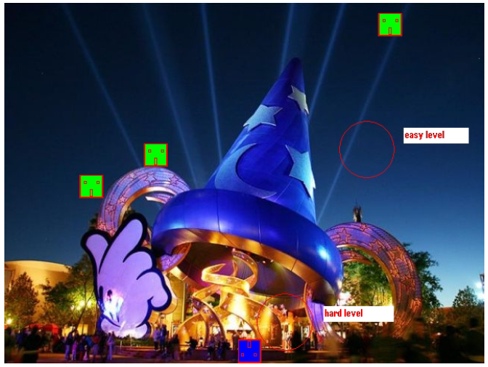
Game Application
Fig. 5. Screenshot for the game. Green figures are the three shooters. Blue figure represents players. Red circles show the fixation areas with low and high entropies (low entropy corresponding to easy level, high entropy corresponding to hard level.

Slide 12
Game Application
Four types of enemies: all shooters, either with bullets, bombs, fireballs, or missiles
Shooters were displayed from the beginning of the games and moved horizontally and shot during moving
Besides shooters, other enemies appear continuously
Type of enemies and their locations depended on the eye movement information during playing
Game background were images selected from different categories (landscape, city scene, building, animal, etc)
Image background changes about every 10 seconds

Slide 13
Game Application
5 subjects: 3 females and 2 males
Each session of the game lasted about 6 minutes
In total, each subject played for about 3 hours
Game levels were alternated randomly for each player without notification
Reaction times and scores were analyzed after the experiment

Slide 14
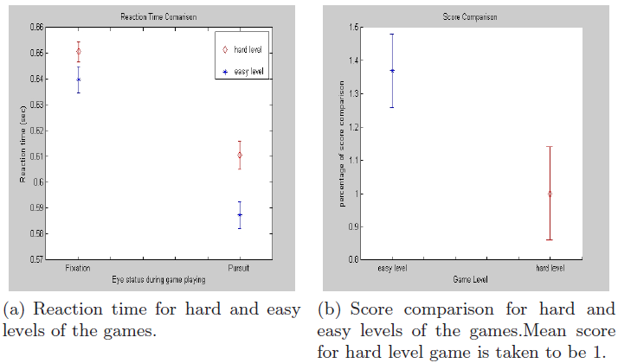
Game Application
Longer reaction times and lower scores were observed for hard games
This indicates the game was successfully designed into two difficulty levels based on consideration of attention allocation
Fig. 6. Comparison of RT and Scores for hard and easy games.

Slide 15
Discussion and Conclusion
The main contribution is its novel consideration of eye movement types: fixation and pursuit into game design
Based on a model of attention allocation, game designers can make a game harder by placing important items in regions with less attention

