Slide 1
Data Fusion Improves the Coverage of Wireless Sensor Networks
Guoliang Xing, Rui Tan, Benyuan Liu, Jianping Wang, Xiaohua Jia, Chih-Wei Yi
MobiCom’09

Slide 2
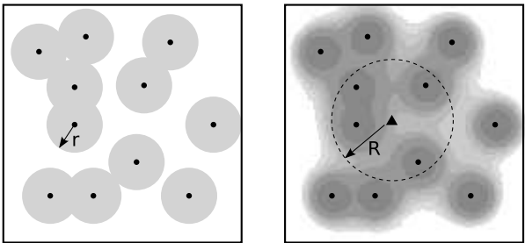
Introduction
Develop a data fusion (value fusion) model to improve sensor coverage by exploiting the collaborations among multiple sensors
Present the probabilistic disk model which applies the stochastic nature of sensing on the classical disk model
Clarify limitations of the probabilistic disk model and comparisons between the disk model and their data fusion model

Slide 3
Problem Definition
Goal: determine the presence of a target emitting signals that follow the power law decay
Wireless sensors perform detection by measuring the signals emitting from the target
The sensor measurements are contaminated by additive random noises from sensor hardware or environment
Depending on the hypothesis that the target is absent $(H_{0})$ or present $\left(H_{1}\right)$, the measurement of sensor $i$, denoted by $y_{i}$, is given by $H_{0}:y_{i}=n_{i}$ $H_{1}:y_{i}=s_{i}+n_{i}$ where $n_{i}$ is the energy of noise experienced by sensor $i$

Slide 4
Assumptions
They assume the noise $n_{i}$ at each sensor $i$ follows the normal distribution, $i.e., n_{i}\sim 𝓝\left(μ, σ^{2}\right)$, where $μ$ and $σ$ are the mean and variance of $n_{i}$, respectively
They assume the noises, $\left\{n_{i} | ∀i\right\}$, are spatially independent across sensors, so the noises at sensors are independent and identically distributed $(i.i.d.)$ Gaussian noises
In the presence of the target, the sensor measurements $y_{i}$ also follow the normal distribution, $i.e., y_{i}\sim 𝓝\left(s_{i}+μ, σ^{2}\right)$
Sensor positions are uniformly distributed in the region and can be modeled as the Poisson Point Process

Slide 5
Performance Metrics
Detection performance metrics is characterized by the false alarm rate $P_{F}$ and the detection probability $P_{D}$
A physical point $p$ is $\left(α, β\right)$-covered if $P_{F}≤α$ and $P_{D}\left(p\right)≥β$, where $α∈\left(0, 0.5\right)$ and $β∈\left(0.5, 1\right)$
The $(α, β)$-coverage of a region is defined as the fraction of points in the region that are $\left(α, β\right)$-covered
The full coverage of a region refers to the case where the $\left(α, β\right)−coverage$ of the region approaches 1

Slide 6
Research Problems
Are the results on coverage under classical disc model applicable under the definition of $(α, β)$-coverage which captures the stochastic nature of sensing
How to quantify the $(α, β)$-coverage when sensors can collaborate through data fusion
What are the scaling laws between coverage, network density, and signal-to-noise ratio (SNR) under both the disc and fusion model

Slide 7
Coverage under Probabilistic Disc Model
We choose a sensing range $r$ such that
The probability of detecting any target within the sensing range is no lower than $β$
The false alarm probability is no greater than $α$
The optimal Bayesian detection rule for a single sensor $i$ is to compare its measurement $y_{i}$ to a detection threshold $t$
If $y_{i}$ exceeds $t$, sensor $i$ decides $H_{1}$
Otherwise, sensor $i$ decides $H_{0}$
Therefore, $P_{F}$ and $P_{D}$ of sensor $i$ is given by $P_{F}=ℙ\left(y_{i}≥t | H_{0}\right)=Q\left(\frac{t−μ}{σ}\right)$ $P_{D}=ℙ\left(y_{i}≥t | H_{1}\right)=Q\left(\frac{t−μ−s_{i}}{σ}\right)$ $where Q\left(.\right)$ is the complementary CDF of the standard normal distribution

Slide 8
Coverage under Probabilistic Disc Model (cont.)
$P_{D}$ is the non-decreasing function of $P_{F}$, so it is maximized when $P_{F}$ is set to be the upper bound $α$
Therefore, $t_{opt}=μ+σQ^{−1}\left(α\right)$, and the sensing range $r$ is given by $r=ω^{−1}\left(\frac{Q^{−1}\left(α\right)−Q^{−1}\left(β\right)}{δ}\right)$ $where ω()$ is the signal decay function and $s_{i}=S∗ω(r)$, and $δ$ is the peak-signal-to-noise ratio, $δ=S/σ$
When the network is deployed according to a Poisson point process of density $ρ$, the coverage of a region is given by $c=1−e^{−ρπr^{2}}$

Slide 9
Coverage under Data Fusion Model
$Y=\sum_{i∈F(p)}{y_{i}}$ denotes the fusion statistics, where
$p$ is an arbitrary position
and $F(p)$ is the set of sensors within fusion range $R$ from the position $p$
The coverage of a region is given by $c=ℙ\left(\frac{\sum_{i∈F\left(p\right)}{s_{i}}}{\sqrt{N\left(p\right)}}≥σ\left(Q^{−1}\left(α\right)−Q^{−1}\left(β\right)\right)\right)$
$N\left(p\right) is the number of sensors in F\left(p\right)$
$N\left(p\right)\sim Poi(ρπR^{2})$
Difficult to derive CDF of $\frac{\sum_{i∈F\left(p\right)}{s_{i}}}{\sqrt{N\left(p\right)}}$, so the coverage of a region can be approximated by $c≈Q(\frac{γ\left(R\right)−ρπR^{2}}{\sqrt{ρπR^{2}}})$, where $γ\left(R\right)=\frac{Q^{−1}\left(α\right)σ−Q^{−1}\left(β\right)\sqrt{σ_{s}^{2}+σ^{2}}}{μ_{s}}$
$μ_{s}$ and $σ_{s}^{2}$ denote the mean and variance of $s_{i}|i∈F(p)$
The approximation is accurate when $N\left(p\right)≥20$
p

Slide 10
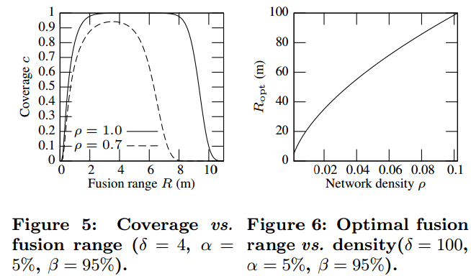
Numerical Examples
Numerical examples of coverage under data fusion model

Slide 11
Comparisons between Data Fusion and Disc Models
Full coverage using fixed fusion range
Let $ρ_{d}$ and $ρ_{f}$ denote the minimum network densities required to achieve the full coverage under disc and fusion models, respectively
$ρ_{f}=O\left(\frac{2r^{2}}{R^{2}}ρ_{d}\right), c→1$
In order to achieve full coverage, $ρ_{f}$ is smaller if $R>\sqrt{2}r$
Full coverage using optimal fusion range
$ρ_{f}=O\left(ρ_{d}^{1−\frac{1}{k}}\right), c→1$
Data fusion model can significantly reduce the network density
Impact of signal-to-noise ratio
For fixed fusion range $R$, we have $\frac{ρ_{f}}{ρ_{d}}=O\left(δ^{\frac{2}{k}}\right), c→1$
The fusion model requires fewer sensors to achieve full coverage when PSNR is low, and the disc model suffices only when PSNR is sufficiently high

Slide 12
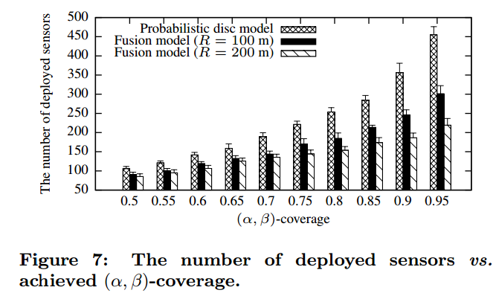
Simulations
Fusion model is more effective for achieving high coverage than the disc model

Slide 13
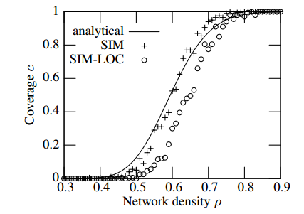
Simulations (cont.)
Analytical and measured coverage versus network densities
SIM and SIM-LOC represent the measured results with and without accounting for localization error

Slide 14
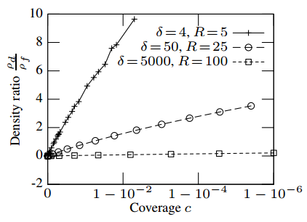
Simulations (cont.)
Impact of SNR on the network densities
Figure shows the relationship between network density ratio $ρ_{d}/ρ_{f}$ and coverage

Slide 15
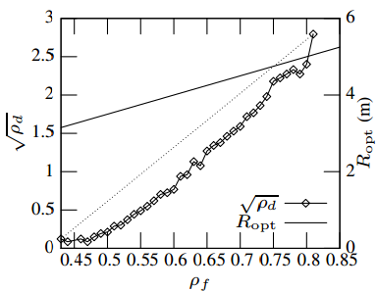
Simulations (cont.)
The relationship between network densities under disc and data fusion models when the fusion range is optimized

Slide 16
Conclusions
Discussion
Other decay laws to be addressed in the future work
Efficiency of fusion model on network densities to achieve a certain coverage
Contributions
Propose the data fusion model that can significantly improve sensing coverage by exploiting collaborations among sensors
Analytical results can help understand the limitations of the disc model and provide a key insight into the design and analysis of WSNs to adopt data fusion models

