Slide 1
“Can you SEE me now?” A Measurement Study of Mobile Video Calls
Chenguang Yu, Yang Xu, Bo Liu and Yong Liu
Department of Electrical and Computer Engineering
Polytechnic Institute of New York University
Brooklyn, New York, 11201
Email: fcyu03, yxu10, bliu01g@students.poly.edu, yongliu@poly.edu

Slide 2
Introduction
Users prefer to make untethered video calls using their mobile devices instead of sitting in front of their desktop computers.
Can you SEE me now?
FaceTime, Google Plus Hangout, Skype

Slide 3
Focus on
How they encode and decode video in real-time under tight resource constraints on mobile devices?
How they transmit the encoded video smoothly in face of various wireless network impairments?
What is their delivered video conferencing quality under different real mobile network conditions?
How different system architectures and design choices adopted by each system contribute to user-perceived video conferencing quality?

Slide 4
Measurement
Heterogeneity and volatility of wireless networks
A controlled network emulator
A campus WiFi network with strong and weak signal receptions
A cellular network of one top-three US carrier with and without user mobility
Collect extensive measurement traces at packet level and video level

Slide 5
Findings
With a strong WiFi/Cellular connection, modern smartphones are capable of encoding, transmitting and decoding high quality video in real-time
Mobile video call quality is highly vulnerable to bursty packet losses and long packet delays, which are sporadic on wireless links with weak receptions

Slide 6
Findings(cont.)
While FEC can be used to recover random packet losses, the inability to differentiate congestion losses from random losses can trigger vicious congestion cycle, and significantly degrade user video call experience
Conservative video rate selection and FEC redundancy schemes often lead to better video conferencing quality, compared with more aggressive schemes

Slide 7
Findings(cont.)
End-to-end video delay is highly correlated to end-to end packet delay in Cellular networks, regardless of the signal strength

Slide 8
Related Work

Slide 9
Measurement Methods
Black boxes
Perform IP-level packet sniffing
Application-level information window capturing
Video-level quality analysis
2-party video calls

Slide 10
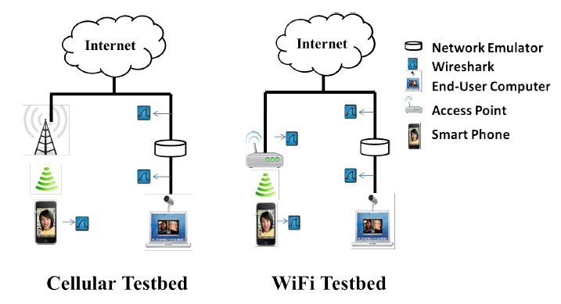
Testbed
Overall Platform
wireless user side ⟷ wireline user side
Software-based network emulator
Wireshark
Akiyo

Slide 11
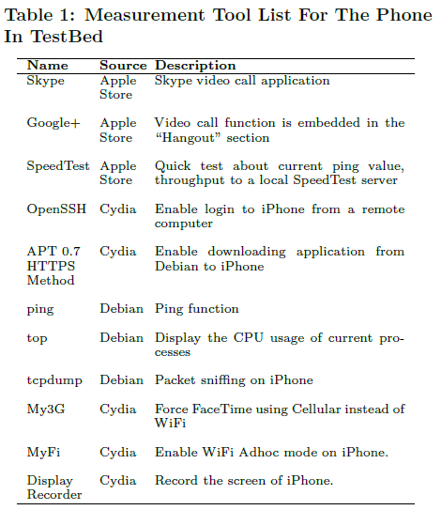
Testbed(cont.)
Smartphone Hacks(iPhone 4s)
Privilege escalation
RedSn0w(jailbreak)
Measurement tool installation
Collect CPU and network statics
Remotely login
Remote phone control(via ssh)
USB (computer)
Set iPhone to WiFi ad-hoc mode(phone)

Slide 12
Testbed(cont.)
Wireless network setting
Conduct WiFi and Cellular experiments at several locations with Strong & weak signal
Use SpeedTest to verify the actual upload throughput
NEWT(Network Emulator for Windows Toolkit)
Propagation delay, random packet loss, available bandwidth, ……
 | Strong | Weak
WiFi | 10mbps | 200-300kbps
Cellular | 1000kbps | 100-150kbps

Slide 13
Information Collection
IP Packet Traces
Packet delay, packet loss(wireshark, tcpdump)
Video Quality Logs
Video rates, frame rates, RTT
End-to-End Video Delay Samples
Sender side generate video frame → display on the receiver side
Video capturing, encoding, transmission, decoding, rendering delays

Slide 14
Information Collection(cont.)

Slide 15
Information Collection(cont.)

Slide 16
How Do They Work?
Architecture and protocol
System | P2P or Server | UDP or TCP | RTP | RTT
Skype | Relay server or P2P | UDP, may use TCP | No | 14ms
Google+ | Server-centric | UDP, only use TCP when UDP is blocked | Yes | 4~37ms
FaceTime | WiFi: mostly P2P Cellular: relay server | Always use UDP | Yes | 2~20ms

Slide 17
How Do They Work?(cont.)
Video rate ranges and encoding parameters
Google+ : layered video coding
CPU utilization → 100%
Consumes 40% more than others
System | Range(kbps) | Resolution | FPS
Skype | 10-620 | 480*360, 320*240 | 1-12
Google+ | 20-800 | 480*360, 240*180 | 1-15
FaceTime | 10-820 | ??*?? | 1-30

Slide 18
How Do They Work?(cont.)
Loss Recovery
Inject random packet losses
Start with zero loss rate, then increase loss rate by 5% every 120 seconds
Selectively retransmission
Adaptive-but-aggressive FEC scheme
Frame-based FEC scheme

Slide 19
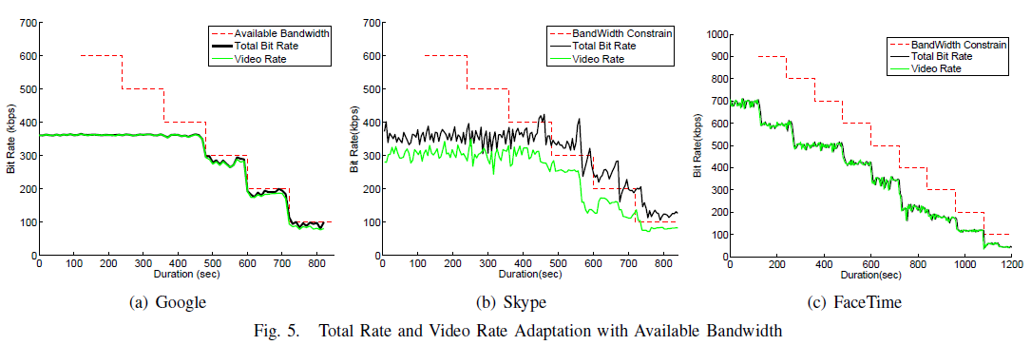
How Do They Work?(cont.)
Rate Control
Start with “unlimited” bandwidth setting
Bandwidth⟶200kbps higher than current sending rate, then Dropping the bandwidth limit by 100 kbps every 2 minutes

Slide 20
Conferencing quality over wireless
Video conferencing quality
Various encoding parameters, video frame size, frame rate, quantization level
Highly sensitive to end-to-end video delays, video playback continuity and smoothness
High rate & low delay

Slide 21
Video conferencing quality
Voice delay
The phone call service is more stable than the three systems
In Cellular network, the mean voice delay of Skype is the lowest among all applications

Slide 22
Video Quality over WiFi
Strong signal
Weak signal

Slide 23
Video Quality over Cellular
Strong signal
Weak signal

Slide 24
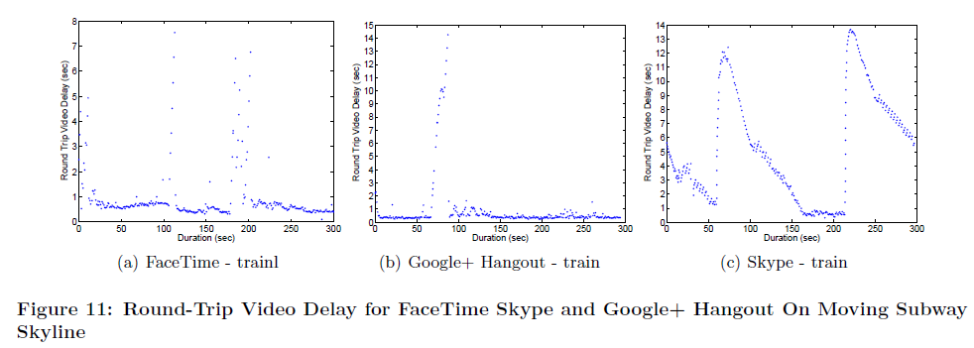
Round-Trip Video Delay On Subway

Slide 25
Impact of Packet Losses
Match packet traces collected at the sender and the receiver side

Slide 26
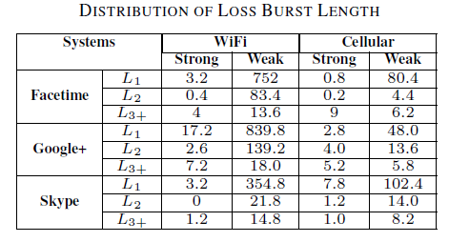
Impact of Packet Losses(cont.)

Slide 27
Impact of Packet Delays

Slide 28
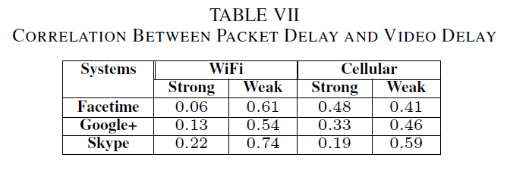
Impact of Packet Delays(cont.)
Cross-correlation function between video delay and packet delay

Slide 29
Conclusion
Mobile video call quality is highly vulnerable to bursty packet losses and long packet delays
While FEC can be used to recover random packet losses, the inability to differentiate congestion losses from random losses can trigger vicious congestion cycles
conservative video rate selection and FEC redundancy schemes often lead to better video conferencing quality

Slide 30
Conclusion
end-to-end video delay is highly correlated to end-to-end packet delay in cellular networks, regardless of the signal strength
Insights obtained in this study can be used to guide the design of new solutions to deliver high-quality video calls in wireless networks

