Slide 1
FFMPEG

Slide 2
What is FFMPEG?
An active, free software project that produces libraries and programs for handling multimedia data
Published under the GNU Lesser General Public License 2.1+ or GNU General Public License 2+
Written in C
Available for Linux, Mac OS X, Windows
Available for x86, ARM, PowerPC, MIPS, DEC Alpha, Blackfin,AVR32, SH-4, and SPARC platforms
Website : http://ffmpeg.org/
Source code handled through Git, tickets handled
by Trac

Slide 3
Applications of FFMPEG
FFMPEG is a powerful tool to handle multimedia data
Video conversion
Store data in standard format – saving space
Compress the video to smaller size
Provide data to browser with standard format
Decoding/ Encoding
Muxing/ Demuxing
Streaming
Filtering
Metadata handling
Thumbnail creation

Slide 4
Components of FFMPEG
Ffmpeg
command-line tool that converts audio or video formats
Ffserver
an HTTP and RTSP multimedia streaming server for live broadcasts
Ffplay
a simple media player based on SDL and on the FFmpeg libraries
Ffprobe
command-line tool to show media information

Slide 5
Libraries provided by FFMPEG
Libavutil - string functions, random number generators, data structures, additional mathematics functions
Libswscale - highly optimized image scaling, colorspace and pixel format conversion operations
Libavfilter - generic audio/video filtering framework, containing several filters, sources and sinks
Libavcodec – contains multiple decoders and encoders for audio, video and subtitle streams and several bitstream filters – more than 300 codecs
Libavformat – containing muxers and demuxers for audio/video container formats
Libavdevice - framework for grabbing from and rendering to multimedia input/output devices

Slide 6
Container formats and Codecs supported
Famous Container formats supported by FFMPEG
AVI
FLV
IFF
ISO base media file format (including QuickTime, 3GP and MP4)
Matroska
Ogg
WTV
Audio and Video codecs of the following groups
MPEG
JPEG
QuickTime
Microsoft
RealNetworks

Slide 7
Workflow of Multimedia Data
Input
Output
Packets
libavcodec
Frames
libavformat
libavformat
Stream 1
Decoder
Video data
File
Demuxer
Stream 2
Decoder
Audio data
Stream 3
Decoder
Subtitle data
libswscale
libavutil
Packets
libavcodec
Frames
libavfilter
libavformat
libavformat
Stream 1
Encoder
Video data
File
Muxer
Stream 2
Encoder
Audio data
Stream 3
Encoder
Subtitle data

Slide 8
SDL(Simple DirectMedia Layer)
A cross-platform development library designed to provide low level access to audio, keyboard, mouse, joystick, and graphics hardware via OpenGL and Direct3D
Written in C
Used to write computer games and multimedia
applications that runs on many operating systems
Manages video, events, digital audio, CD-ROM, threads, shared object loading, networking and timers
Complements OpenGL by setting up the graphical output and providing mouse and keyboard input, which are not supported by OpenGL

Slide 9
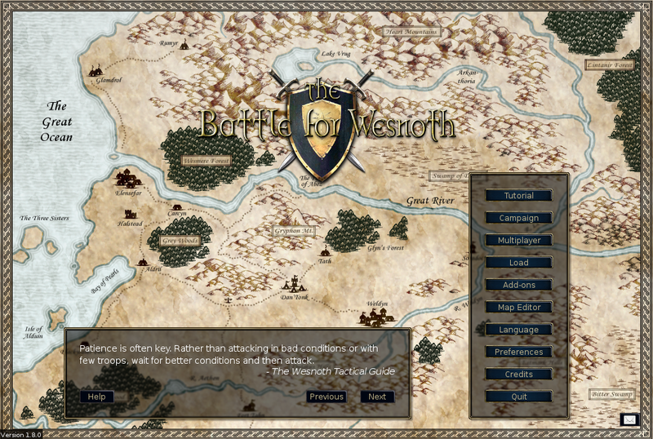
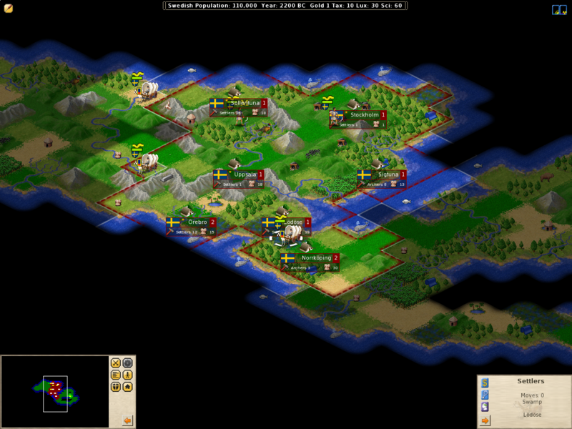
SDL(Simple DirectMedia Layer)
Versions:
SDL v1.2
SDL v2.0 – Android support is provided in this version
Has language bindings for C, C++, Pascal, Python, Vala and Genie(GNOME)
Applications created using SDL:
Angry Birds
Battle for Wesnoth
Freeciv

Slide 10
My work/contribution so far…
Read tutorials on how to use FFMPEG (http://dranger.com/ffmpeg/), JNI(Java Native Interface) and Make
Understood how ffplay, a default- video player provided by FFMPEG, works
Understood the working of SDL in Linux
Made documentation on
How to compile and run JNI programs
How to compile FFMPEG for Android( thanks to Jargo )

Slide 11
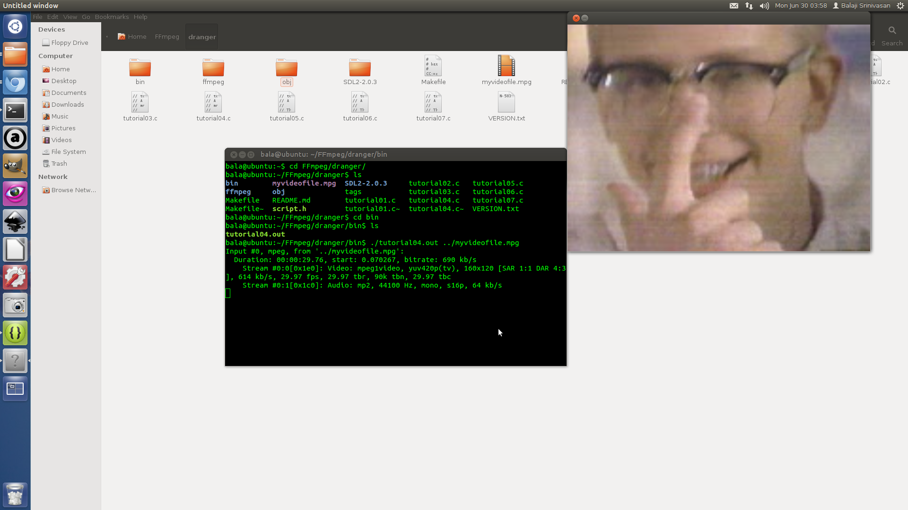
Screenshots from a simple video player using SDL in Linux

Slide 12
Current and Future Work
Currently, making documentation on
How to compile SDL for Linux
How to compile SDL for Android
Porting from SDL1 to SDL2 as Android support is only provided only in SDL2
Future Work
Ultimate Aim: Build a complete video player in Android that uses FFMPEG and SDL, for use in News4All project
A live demo of the Android app described above

