Slide 1
New Media Art Projects, Panoramic Image and Live Video as Interface between Real and Virtual Worlds
Computer Vision Laboratory, Faculty of Computer and Information Science, University of Ljubljana
DESIDOC Journal of Library & Information Technology, Vol. 34, No. 2, March 2014, pp. 110-124

Slide 2
Outline
The improvement of the virtual gallery
  Introduction
  Tools for creation of web
  Live video system (LVS)
New media production
  15 Seconds of Frame
  Smart Wall
  Virtual Skiing and Dance
  Dynamic Anamorphosis
Adaptive digital signage

Slide 3
Introduction
A overview of work related to art presentation and production of new media in the Computer Vision Laboratory at University of Ljubljana.

Slide 4
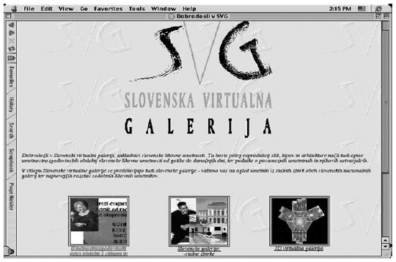
Slovenian Virtual Gallery
Slovenian Virtual Gallery, also called SVG and developed in the first half of 1995, is one of the first virtual gallery.

Slide 5
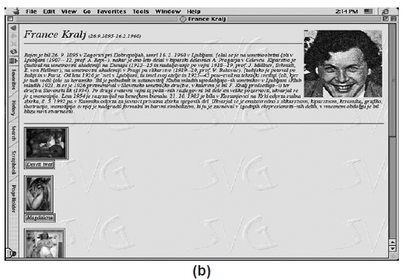
Slovenian Virtual Gallery (cont.)
SVG supports search of authors or works of art by using different keys (name, years, art techniques).

Slide 6
Tools for creation of web
There are four tools mentioned in the paper, including Drupal, Jooma, Typo 3, and Wordpress.
All of them are open source content management system (CMS) and free for use and .

Slide 7
Tools for creation of web (cont.)
The following are some advantages of all of them,
  Flexibility and Extendibility
    Rich plugin architecture
    Open source
  Do not need much programming skill
    However, for more advanced customisation, we can try to edit the PHP and HTML code.

Slide 8
Tools for creation of web (cont.)
Both Typo 3 and Wordpress have template system, and it let customs arrange the website more easily.
Typo 3 supports many platforms, such as Linux, Microsoft Windows, OS/2, and Mac OS X.

Slide 9
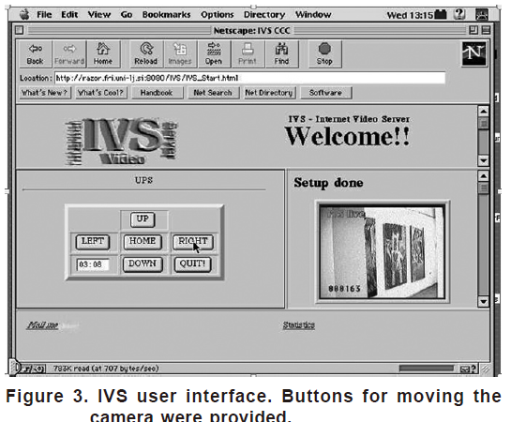
Live video over the Internet
In 1996, system for active remote video observation over the internet which was named Internet Video Server (IVS) was developed by author.

Slide 10
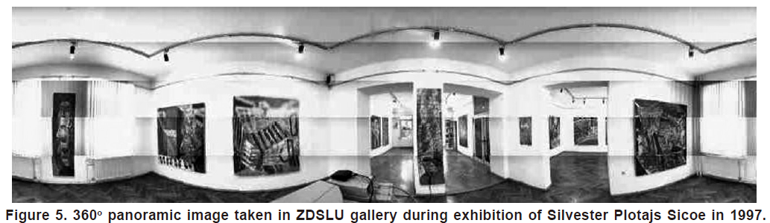
Live video over the Internet (cont.)
From the current position of the IVS platform, however, a web user could receive live video as well as control the camera to observe not only the sterile static exhibition, but also the visitors moving through the gallery.

Slide 11
New media production
ArtNetLab teams up fine-art students with computer science students to produce art projects involving internet, new media, interaction and other new information technologies.

Slide 12
15 Seconds of Frame
“In the future everybody will be famous for 15 minutes” ------ Andy Warhol
The selection by chance out of all people in front of the installation allude that frame tends to only short-lived but also random.

Slide 13
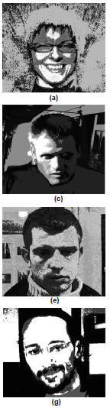
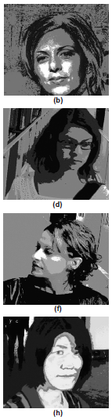
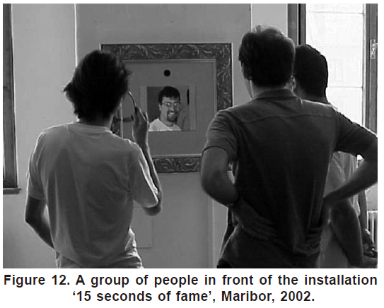
15 Seconds of Frame (cont.)

Slide 14
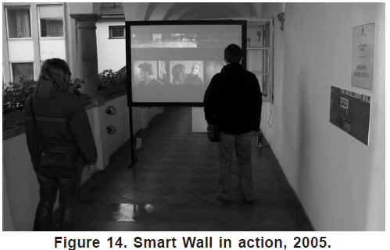
Smart Wall
The main goal of the Smart Wall project is to provide a platform for a rapid prototyping of computer supported interactive presentations that sense human motion.

Slide 15
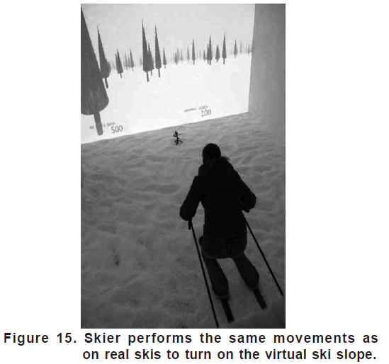
Virtual Skiing
Sporting games in general are an attractive area for using virtual technology.
Real-time interaction of people with virtual environments is a well-established concept but finding the right interface to do it is still a challenging task.

Slide 16
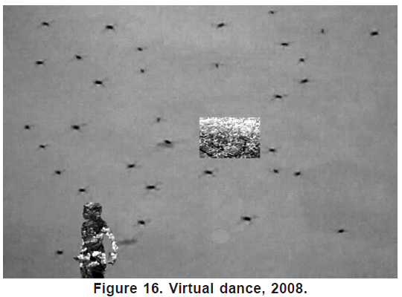
Virtual Dance
The Virtual Dance project presents a system that is able to track dance movements and integrates the motion in an interactive video.
Dancer can produce a brand new story and movement in the virtual world.

Slide 17
Dynamic Anamorphosis
The concept of dynamic anamorphosis can be defined as a classical or static anamorphic image requires a specific, usually a highly oblique view direction, from which the observer can see the anamorphosis in its correct form.
Wherever the observer moves, he sees the same image.

Slide 18
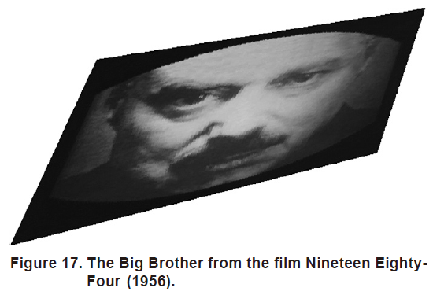
Dynamic Anamorphosis (cont.)

Slide 19
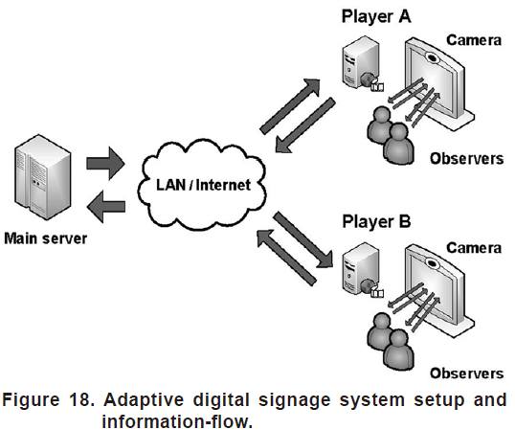
Adaptive digital signage
Due to larger size, better quality and lower cost digital flat-panel displays are slowly replacing static displays in commercial and public use.

Slide 20
Conclusions
Several art-related websites and art installations, ranging from classical presentations of picture galleries to interactive art installations using computer vision have been built in cooperation with the new media artists.
Contemporary arts interact with science and technology in many ways.

Slide 21
Conclusions (cont.)
New media art projects offer a stimulating environment to experiment freely so that a new generation of artist-researchers and researcher-artist can emerge which will hopefully develop meaningful art for our times and set new agendas in science and technology that address today’s real human needs.

Slide 22
Conclusions (cont.)
New educational programs are sorely needed to combine the knowledge of technology with design skills.

