Slide 1
Cooperative Spectrum Sharing and Scheduling in Self-Organizing Femtocell Networks
Hsi-Lu Chao, Sau-Hsuan Wu, Yu-Han Huang, and Shang-Chen Li NCTU, Hsinchu, Taiwan
IEEE ICC ,2014

Slide 2
Introduction
Background:
Global mobile data traffic has been growing at a rate of 150 percent yearly
Power consumption is also becoming a challenging issue.
Solution:
deploy large numbers of low-power and low-cost femtocell base stations or access points (APs) in metropolitan areas
Coordinate these in a self-organizing manner using a cloud-based radio access network (C-RAN)

Slide 3
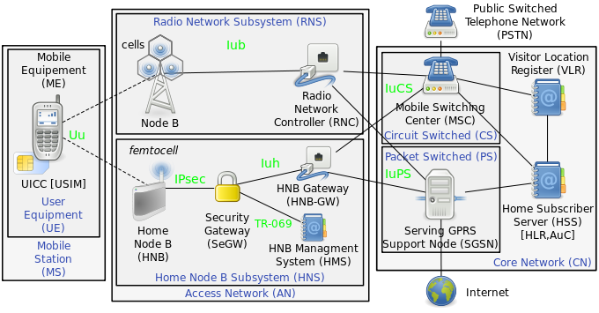
Femtocell
A femtocell is a small, low-power cellular base station (毫微微蜂巢式基地台)
Femtocell

Slide 4
Goal
In a downlink LTE-A femtocell self-organizing networks(SON).
Handle the radio access requests from Mobile Users(Mus)
Perform channel and power allocation (CPA)
User scheduling (US)

Slide 5
System Model

Slide 6
SON Service Model in C-RAN
In the geographical area of an SON
Home cache database keep all the APs-MUs list.
Divided the area of AP into 12 sectors
Each AP in a sector fisrt transform channel access requests into a number of sector utility (SU) requests and corresponding signal to interference-plus-noise ratios (SINR),
then send these message to CPA unit
CPA unit collect all these message and reallocate frequency bands and controls the transmission power of each AP
Some AP-Mobile User(MU) list may be reallocated by CPA .
Update Aps-MUs list
AP schedules the channel access requests of its MUs by sector

Slide 7
Channel and power allocation (CPA)
Downlink CPA criterion to best utilize the channel resources as follows
X Allocation valuable
Consider a simple multiple access scheme in system where each
channel of an AP can be assigned to one SU only
Each SU can be allocated to one channel of an AP at most
The transmit power on each channel is limited to $P_{k}^{max}$

Slide 8
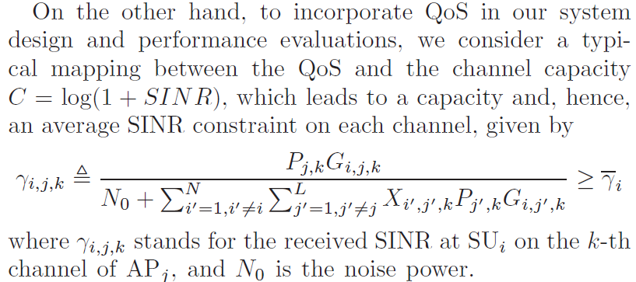
SINR constraint on the channel
Each sector’s SU request is associated with an SINR requirement

Slide 9
Propagation Pathloss G
measured at a close-in reference distance $d_{0}$
n is the pathloss exponent that indicates the rate at which the pathloss increases with distances

Slide 10
SINR constraint
The SINR constraint can be rewritten as
the equality holds for the optimum solution

Slide 11
Optimal solution of CPA
Inner sectors of APs and have small SINR requirements.
SUs are less likely to seriously interfere with each other.
CPA scheme will lead to a larger number of SUs
Outer sectors of APs or with larger SINR requirements will need more power to meet their SINRs
Solution : Find the link combination that can support the largest number of SU

Slide 12
Scheme
SUs are chosen from different groups according to their percentages in the groups.
To avoid early terminations of this search procedure, SUs in inner sectors are tested first.
And the process starts with SUs in the group of the lowest SINR requirement.
if an SU cannot be allocated to any link to satisfy the constraint, it will be discarded in the subsequent searches.

Slide 13
Complexity Problem
The complexity of such a scheme still grows exponentially.
SINR constraints for all possible link combinations of all the SUs need to be rechecked
Solution:
consider only the combinations between the current states and the best link combination that ends at each state of the previous step.
Time complexity :
Sliding windows
Notes:
如果考慮AP範圍 可以簡化

Slide 14
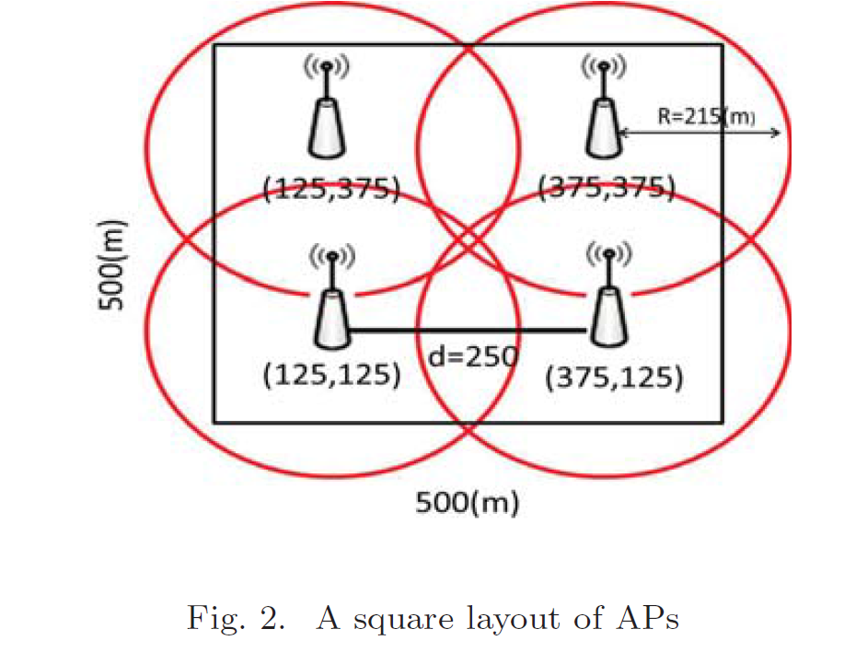
Simulation
16 APs and 6 channels
the signal coverage ranges of APs are the same to what shows in Fig. 2
radii of the inner and outer sectors being 108m and 216m
maximum transmit power is 50mW
SNR at the boundary of the outer sector is 18
Noise power is set at -106.07 dBm

Slide 15
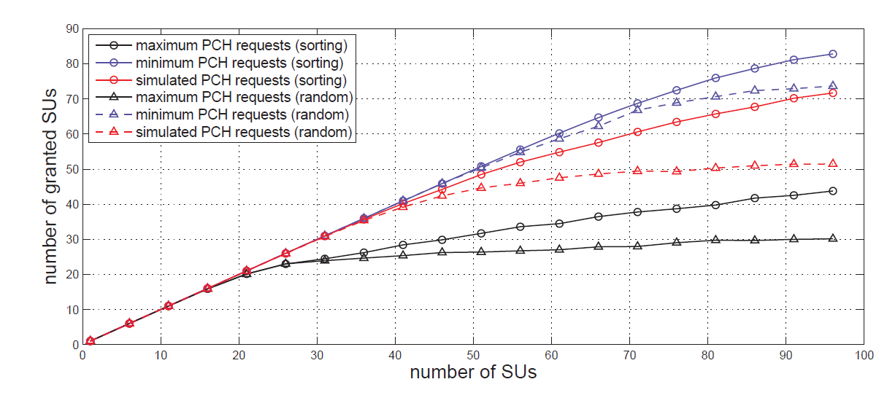

Slide 16
The feasibility of CPA algorithm for SON
SUs have the same SINR constraints of min = −3.83 dB, the percentage of granted SUs can reach 87 %
SUs have the same SINR constraints of max = 13.35 dB, the percentage of granted SUs reduces to around 45 %.
When SUs have different levels of SINR constraints , the percentage can be maintained at 75%.

Slide 17
A QoS-based User Scheduling in SON
The objective of the designed user-level resource scheduling algorithm is
maximize the sum utility of all sessions
provide service and resource blocks(RB) occupancy guarantees.
Note: In a LTE-A femtocell system, the available spectrum per channel is divided into resource blocks (RBs).
Notes:
QoS 或者是根據應用程式的要求，保證資料流的效能達到一定的水準

Slide 18
Heuristic User-level Scheduling Algorithm
AP first performs RB allocation to each flow to achieve minimum service guarantee.
Remaining RBs are allocated to flows to further improve the sum of system utility performance.

Slide 19
User-level Scheduling Scheme
Step 1 : Calculations of feasible data rates and utilities
femto AP first get the feasible data rates and the corresponding utilities for all served flows.
Step 2: Phase 1 scheduling
providing minimum service guarantees to served flows
Step 3: Phase 2 scheduling
increasing the sum of system utilities through allocating the remaining resources to served flows

Slide 20
Phase 1 scheduling
Femto AP
Searches the feasible RB combinations which meet both the desired RB rate and RB utilization requirement.
If there are several combinations, the femto AP chooses the one which utilizes the least number of RBs
Updates the corresponding utility and the remaining available RBs.

Slide 21
Phase 2 scheduling
For the sorted flows, the femto AP searches the feasible RB combinations, chooses the one that utilizes the least number of RBs
Performs parameter updates.

Slide 22
Each flow shares the granted resources at least with the proportion of α.
Per RB utilization must be larger than a predefined threshold β
This is to avoid the case of allocating high capacity channels to low rate flows

Slide 23
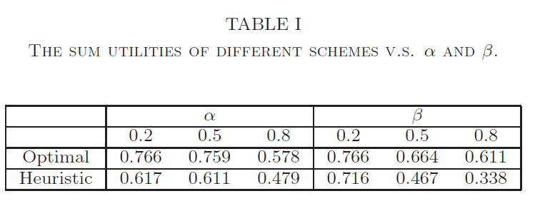
20%
20%
20%
50%
Some flows have high utility gradients, the resources cannot be granted to those flows due to the constraint of minimum per-RB utilization.
Only 20% of the RBs are allocated to the flows that have high utility gradients to improve the sum utility.

Slide 24
Conclusion
Making use of Dynamic channel and power allocation, and interference control inside an SON
the percentage of granted channel access requests can reach 75%.
Utility-gradient based user scheduling algorithm
achieves the minimum service guarantee for served flows as well as maximizes the sum of utilities.
These results clearly demonstrate the feasibility of randomly deploying large numbers of femto APs in a wireless metropolitan area network based on the concept of SON.

