Slide 1
A 3D Tele-Immersion System Based on Live Captured Mesh Geometry
1Rufael Mekuria, 2Michele Sanna, 2Stefano Asioli, 2Ebroul Izquierdo, 1Dick C.A. Bulterman and 1Pablo Cesar

Slide 2
Introduction
Previous geometry based compression schemes
aimed mostly at efficient rendering
generally deal with remote downloading of stored objects
doesn’t handle real-time requirements of 3D Tele-Immersion

Slide 3
Introduction
Complete media pipeline with
Novel fast local compression algorithm
Rateless packet protection scheme that satisfies real-time transmission of live-captured mesh geometry

Slide 4
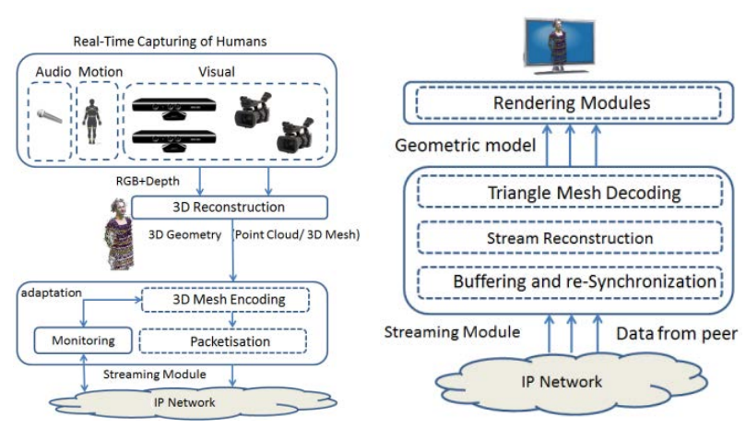
3D Immersive Media Pipeline

Slide 5
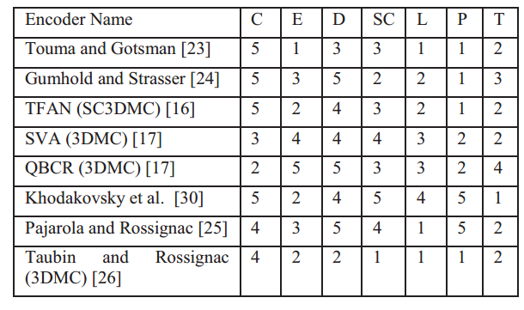
Qualitative Comparison of Triangle Mesh Compression Methods
C Compression Rate
E Encoding speed
D decoding speed
SC scalable complexity
L tolerance to loss
P progressive transmission
T shape topology independence

Slide 6
Compression
Algorithm that takes advantage of properties in meshes reconstructed from depth images
Subsequent coordinates in the list of vertices are co-located
The face indices resulting from triangulation on multiple depth images are highly structured and show repetitions that can be exploited

Slide 7
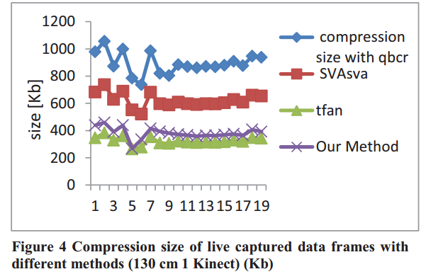
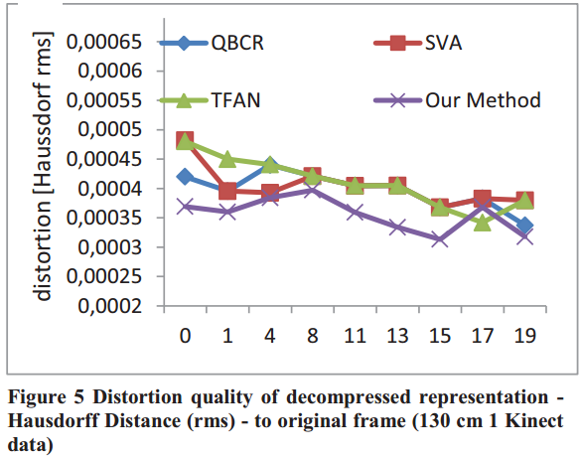
Experimental Results

Slide 8
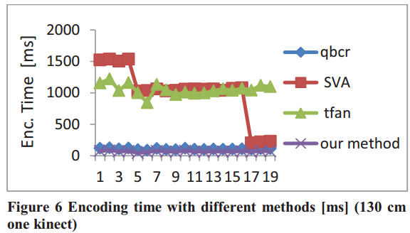
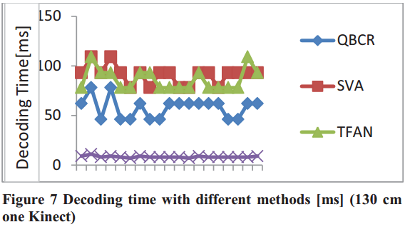
Experimental Results
encode in 70ms and decode below 10ms
over 100% speedup compared to MPEG 3DGraphics encoder

Slide 9
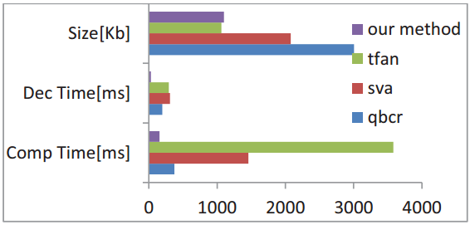

Slide 10
Real-Time Transmission
Triangular mesh compression not resilient to information losses
Cost of packet loss is high
Retransmitting packets yield to untrollable delays
Skipped frame means wasted bandwidth
Rateless code implemented
Achieve minimal end-to-end delay
Protection against packet losses

Slide 11
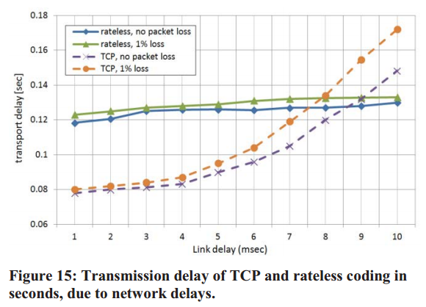
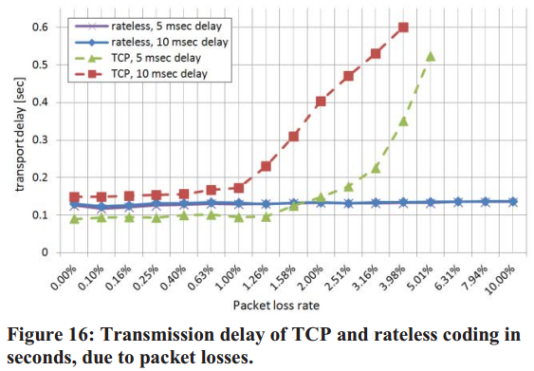
Experimental Results

Slide 12
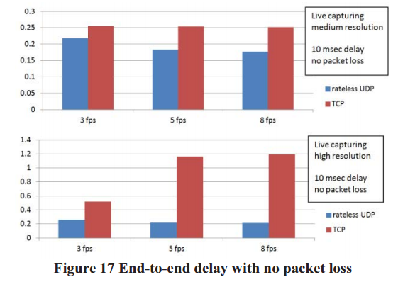
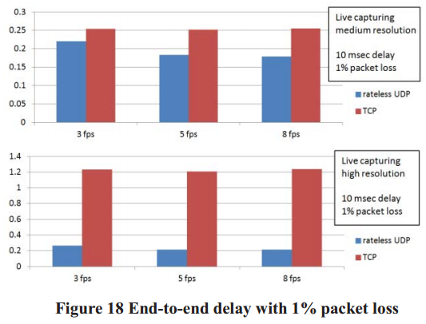
3D Tele-Immersion System

Slide 13
Conclusion
Developed a local fast compression method that takes advantage of the specific properties of real-time captured/reconstructed meshes
Implemented a streaming mechanism based on a rateless code that allows robust transmission required for the loss-sensitive mesh
Integrated with state of the art rendering and capturing components

