Slide 1
PRAN: Programmable Radio Access Networks
Wenfei Wu, Li Erran Li, Aurojit Panday, Scott Shenkery
Bell Labs, Alcatel-Lucent UW-Madison UC Berkeley
ACM Workshop

Slide 2
Problems in current RAN architecture
Distributed coordination with unplanned and dense deployment makes radio resource allocation very inefficient and makes managing interference harder
current RAN data plane at layer 1 and layer 2 (L1/L2) is not programmable and only offers a small number of QoS classes.
Base stations are provisioned for peak demands and the excess capacity is idle at other points.

Slide 3
Introduction
PRAN, a Programmable Radio Access Network.
centralize the L1/L2 processing of base stations into a cluster of commodity servers.

Slide 4
Feature
Coordinates radio resource (time, frequency, location) and enables each operator to flexibly control its radio resources.
Offers programmability to configure different data paths
easily upgraded and replaced.
Resources sharing and scheduling among base stations' processing
increase the utilization of the infrastructure.
Based on real traces of more than 3000 base stations from a national cellular operator, our initial evaluation shows PRAN reduces CPU requirements by a factor of 30.

Slide 5
PRAN Architecture

Slide 6
PRAN 4 planes
Radio plane : isolates radio resources among different operators
Data plane : includes data paths of UEs’ data streams
Control plane : configures the data plane and directs each data stream
The management plane assigns computational resources to tasks.

Slide 7
Challenges 1: Satisfy Time Constraint
Many Data operations in L1/L2 have very strict time constraints.
Transport block of a sub frame (1ms in LTE)
Received transport block (4ms in LTE)
Solutions :
we can allocate computation resources to the processing operations to satisfy a given deadline.
most processing operations in L1/L2 take time proportional to length of the input and are independent of the exact input (e.g. turbo coding, FFT).
Future : offload to hardware reducing processing time.

Slide 8
Challenge 2: Handle Bursty Traffic
When bursty traffic comes, it is hard to reallocate computational resources to busy base stations
Solution:
Different UE's L1/L2 data block processing can be performed independently.
Offloading at the granularity of per UE per data block makes it easier to use dynamic resources to meet deadline requirements.

Slide 9
Challenge 3: Provide Programmability
RANs should support the need for rapid change of L1/L2 functions and per operator customization of data paths.
Solution:
PRAN modularizes L1/L2 processing into blocks which are used to implement basic processing.
PRAN provides mechanisms for operators to program and implement their own processing blocks.
Further, we envision providing a compiler that is capable of targeting multiple back ends (i.e., x86, DSPs, FPGAs, etc.) and can use this compiler to allow the scheduler to place processing blocks on a variety of hardware.

Slide 10
Radio Plan
Isolation of radio resources among different operators applying the technique in RadioVisor
Operator controls its own match-action table at the radio slicing tier which performs iFFT and demaps the I and Q samples of resource blocks to their relevant operators.
An operator can match on RRH, one or more resource blocks and direct the I and Q samples to a specific server for further processing.

Slide 11
Data Plan
The data streams are segmented into fixed sized data blocks.
These data blocks are called transport blocks in MAC, code blocks in PHY.
In the downlink, an IP packet experiences header compression in Packet data convergence protocol, segmentation in Radio link control, coding, scrambling and modulation in PHY.
Reverse in uplink
PRAN attaches meta data to each block which are used to select specific data path

Slide 13
Control Plane
The control plane of a base station consists of a scheduler and a base station information base (BIB).
BIB is used to share information between the scheduler and the processing blocks in the data plane.
cell (each base station has multiple cells) specific information
UE specific information
network-wide configuration information

Slide 14
Control Plane : Base station scheduler
In an LTE control plane, each base station scheduler basically implements the following logic:
Setup per-flow data path.
Receive channel condition estimation from UEs and determine their Modulation and coding schemes and transmission modes (e.g. MIMO or not).
The RAN scheduler may make partial decisions on resource block (time and frequency) allocation in order to reduce interference.
The base station scheduler assign resource blocks to UEs within the constraints made by the RAN scheduler.
Schedule retransmission of failed data blocks (no acknowledgement or validation failure).

Slide 15
Management Plane
The management plane is in charge of allocating computational resources to these tasks.
PRAN dedicates computational resources to each base-station task adaptively and periodically, and it also reserves a share resource pool.
When a task receives bursty traffic whose processing requirement increase and the task offloads computation onto a shared-pool of idle resources.

Slide 16
Management
We can predict the resource utilization of a base station in a sub frame in terms of CPU cores.
Simple greedy bin packing algorithm are used that leaves sufficient slack times at each core.

Slide 17
Simple greedy bin packing algorithm

Slide 18
Resources reallocation
it is not feasible to dynamically allocate resources for every sub frame.
when a base station task is reallocated to another server, the state migration consumes a significant amount of its sub frame duration, and the remaining time is little for data processing.
Solution
We propose to use historical data to reallocate resources periodically
Notes:
a base-station task always
exceeds its dedicated resources, it should be assigned
more dedicated resources in the next period.

Slide 19
Dynamic resource pooling
We propose to reserve a shared resource pool for bursty traffic
The resource pool can be an idle core in each server, or a few idle servers.
E.g. When a scheduler predicts that it would miss deadline based on current dedicated resources, it would offload a part of its workload to the shared resource pool.

Slide 20
Simple greedy bin packing algorithm

Slide 21
Evaluation
OpenAirInterface LTE implementation to restructure the downlink processing into our data plane blocks.
We measure base station traces from a national cellular operator and estimate the resource requirements in sharing and dedicating modes
Testbed:
Dell T5500 servers connected via Ethernet, each with 8 cores and 16GB memory.

Slide 22
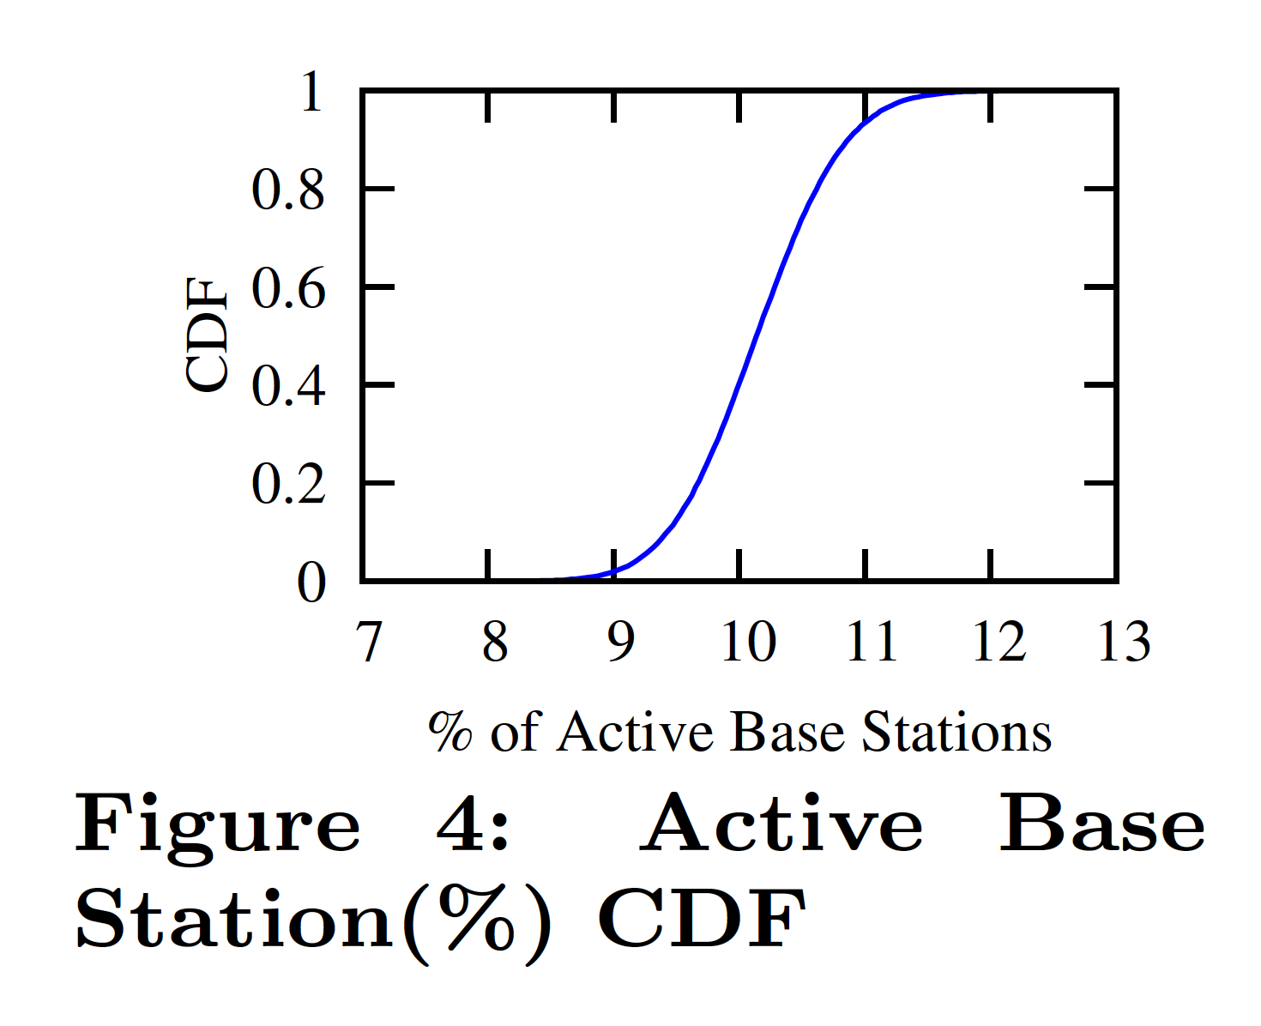
Figure 4 is the distribution of active base stations every 1ms.

Slide 23
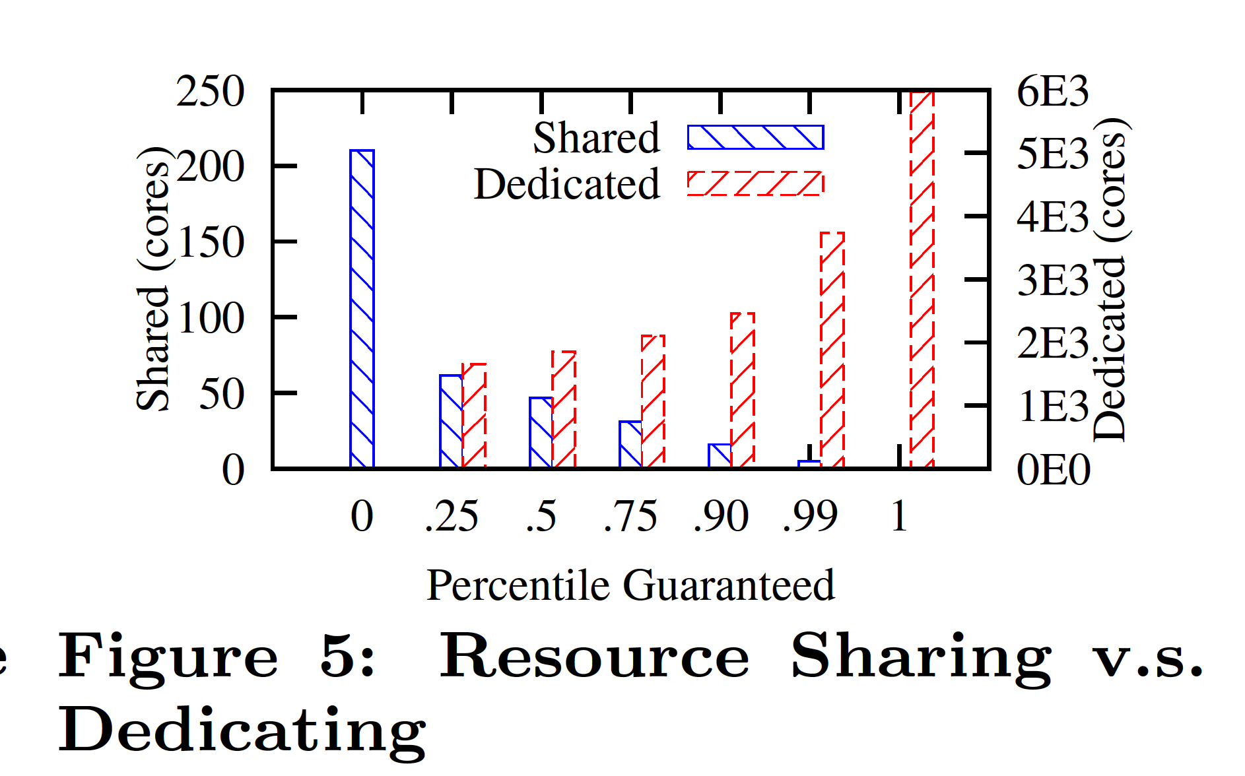
In the experiment, we guarantee P % of each base station's sub frames can be processed by the dedicated resource, and the remaining sub frames processed by the resource pool.
Notes:
We
vary P and draw the shared and dedicated resource
utilization in Figure 5

Slide 24
Resource using
When P = 0, the shared resource is 210 cores,
When P = 1, the dedicated resource is 5972 cores
if each base station is provided resources for its peak-time workload, they need 5972 cores in total.
As shown in Figure 4, in our traces, only 12% (400) base stations have data to transmit for more than 99% of subframes. Therefore, P = 0 is optimal in terms of total resources used.
Notes:
When P = 0, the shared
resource is 210 cores, which means all the base stations
processing can actually be handled by 210 cores. When
P = 1, the dedicated resource is 5972 cores, which
indicate if each base station is provided resources for its
peak-time workload, they need 5972 cores in total.

Slide 25
Control Speed
We run a down-link processing pipeline, which includes turbo encoding, scrambling and OFDM modulation. The scheduler dynamically changes the encoding scheme
Overhead: Schedule between
Threads of the same process which is about 0.01us
The same server but different processes which takes about 5us
Different servers, network delay is introduced, which is about 23us.

Slide 27
Dynamic resource allocation validation
The base station is sending data to 4 UEs, in each subframe (1ms) the total processing time of all 4 UEs' data is about 800us
Scheduler start to use another core and 3 Ues’
processing is dedicated to 1 core
misses the deadline
Another 2 UEs join the RAN

Slide 28
Related Work
CloudRAN [7, 20] statically associates each base station to a base band unit (BBU), is not programmable and does not provide centralized control.

Slide 29
Conclusion
With the rapid evolution towards an untethered and connected mobile world, radio access networks can no longer remain monolithic and inflexible.
PRAN, a programmable radio access network architecture, can meet the changing requirements of RANs.

Slide 30
Progress Update
Final Projects

