Slide 1
EarlyBird: Learning-based Mobile Prefetching through Content Preference and Usage Pattern
Yichuan Wang, Xin Liu, David Chu, and Yunxin Liu
Mobihoc 2015

Slide 2
Goal and Motivation
Goal
Prefetch URL links embedded in social networks
Maximize user experience (delay reduction)
Motivation
Social network is the most engaging application on mobile devices
Most existing work is network-condition-aware
Social network

Slide 3
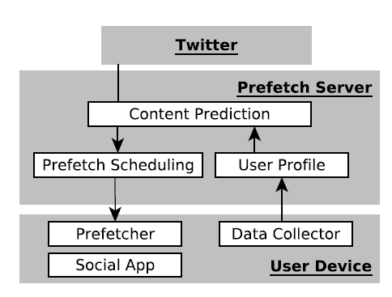
System Architecture

Slide 4
Dataset Collected from Twitter App
300 million tweets
6000+ users
71 languages

Slide 5
Insights from the Dataset
Users download tweets before reading them
25 tweets per download
may not read all downloaded tweets
30% of tweets contain URL links and the average size is 1.13 MB
40% of downloaded tweets are subscribed
Only 11% of links are clicked
70% of clicked tweets are clicked in one hour

Slide 6
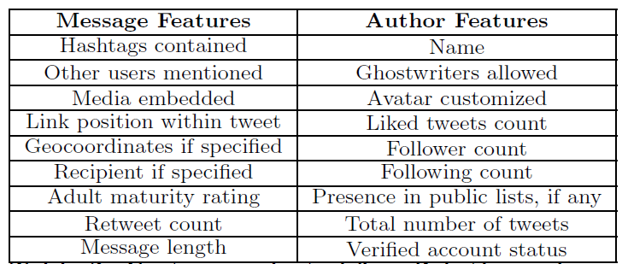
Approach to Achieve the Goal
Feature selection
Linear regression model to predict the user interests
Scheduling prefetching

Slide 7
Predict the Probability of Clicks
C is the real value (click through score) in range [0,1]
f is features of tweet i
W and e are derived using linear regression

Slide 8
Feature Selection
Balanced accuracy
accuracy of clicked tweets (sensitivity)
accuracy of unclicked tweets (specificity)
For each iteration, they add one more feature until the balanced accuracy stops to increase

Slide 9
Scheduling Prefetching
Just-in-time-Prefetching
costly as it consumes cellular data
once the user launch twitter app
Opportunistic Prefetching
using WiFi
need to consider the access pattern

Slide 10
Just-in-time-Prefetching
Best time to fetch fresh content
70% of click-through are within one hour
Click-through score threshold

Slide 11
Opportunistic Prefetching
Consider the access pattern Pt
probability of a user accesses twitter at time t
Click-through score under opportunistic prefetching
Set a threshold and download the tweets which has the score higher than the threshold

Slide 12
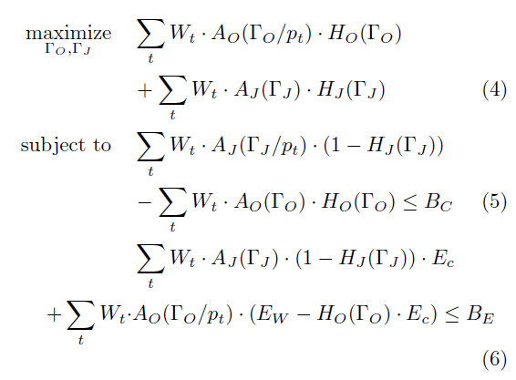
How to select the threshold
Decision variable is threshold
Objective: maximize the delay reduction
Constraints
cellular data budget
energy budget

Slide 13
Evaluation Setup
Networks
Wifi: 200 KB/s
Cellular: 100 KB/s
Trace
224 heavy users collected from the application
Battery:
2100 mAh
28800 J

Slide 14
Baselines
WiFi-only: periodically prefetch every 30 mins
On-launch: Early bird using cellular without threshold
30-mins: Early bird using WiFi without threshlod

Slide 15
Evaluation Results (comparing with baseline)
Under different budgets
(0.5%, 600MB) (3%, 300MB) (6%, 0MB)
early bird is better (do not show the numbers)
Different threshold (click through score)
0.1, 0.5, and 0.9
Early bird saves energy and cellular data consumption, but the baseline has higher delay reduction

Slide 16
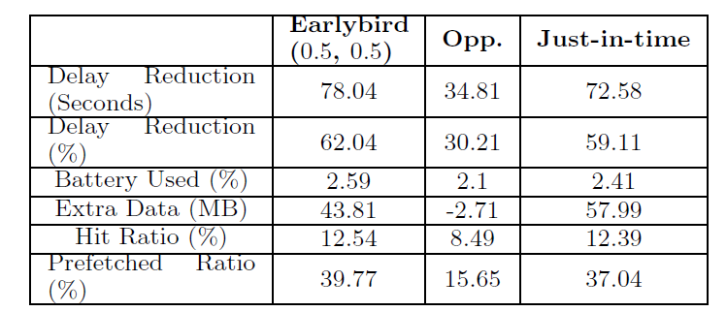
Evaluation Results (without baseline)
Earlybird vs Opportunistic only and Just-in-time only

Slide 17
Limitations
Just-in-time prefetch is affected by network condition (might be very poor while we launches apps)
The energy and delay reduction are from small-scale lab measurement

Slide 18
Conclusion
Earlybird levery content preference, user behavior pattern and dynamic network conditions
propose two scheduling approach to maximize the delay reduction
Collect the dataset and figure out the features

