Slide 1
Cognitive Passive Estimation of Available Bandwidth (cPEAB) in Overlapped IEEE 802.11 WiFi WLANs
Shahnaza Tursunova, Khamidulla Inoyatov and Young-Tak Kim
Dept. of Information and Communication Engineering, Graduate School, Yeungnam University Gyeongsan, Korea
Email: {sh tursunova, kinoyatov}@ynu.ac.kr, ytkim@yu.ac.kr
Network Operations and Management Symposium (NOMS), 2010 IEEE

Slide 2
Introduction
Available bandwidth estimation → efficient network resource management、QoS-guaranteed applications
active probing -> extra traffic load
passive measurements -> not considering the overhead of control messages
mathematical model -> highly dependent on the network topology
cognitive passive estimation of the available bandwidth
the proportion of waiting and backoff delay
packet collision probability
Acknowledgement delay
channel idle time compared to measurement period

Slide 3
Cognitive Passive Estimation of Available Bandwidth
Channel usage ration considering
possible overhead by control messaging which may occur in future
impacts from hidden/exposed terminals
observed channel information considering different packet size

Slide 4
Possible Overhead by Control Messaging
the proportion of bandwidth consumed by the DIFS and backoff mechanism
Channel idle time
Maximum capacity
Measurement period
Maximum number of retransmissions

Slide 5
Impact of Hidden/Exposed Nodes and Packet Size
data frame transmission depends on the frame size
frame size has direct impact to the packet collision rate
consider the impact from hidden/exposed terminal
Total data flow of the hidden nodes
Total data flow of the exposed nodes
data flow information is provided through IEEE 802.21 Media Independent Handover (MIH) [15] and IEEE P1900.4 [16] architecture

Slide 6
Evaluation of Bandwidth Estimation Approaches
use PCs equipped with IEEE 802.11 a/b/g Atheros 5212 chipset based wireless NICs which run on Linux OS with the open source MadWiFi WLAN driver [18]
AAC [6], ABE [7], and IAB [8]
RTS/CTS message exchanging is disabled
channel idle time, current transmission rate, and ACK timeout values are obtained by reading the specific information registers of Atheros HAL

Slide 7
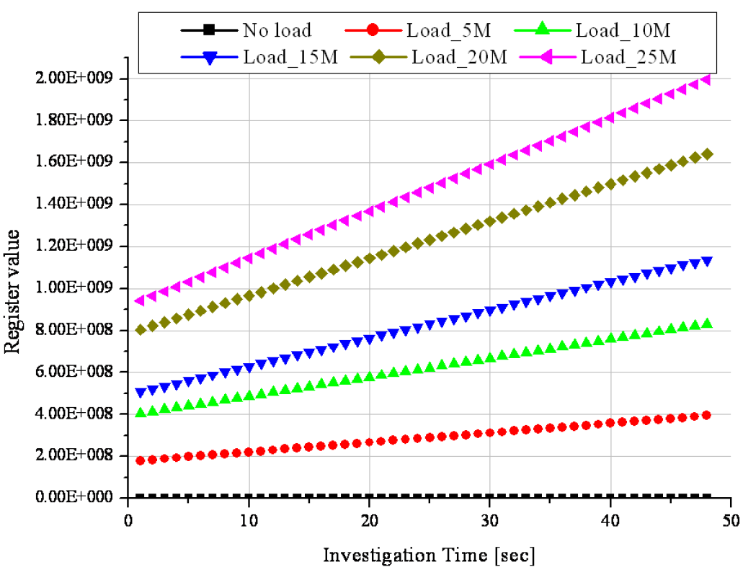
Transmission Counter Register
the amount of time spent for the frame transmission
while the load is increasing, the node spends more portion of the given time for the transmission

Slide 8
Testbed and Parameters

Slide 9
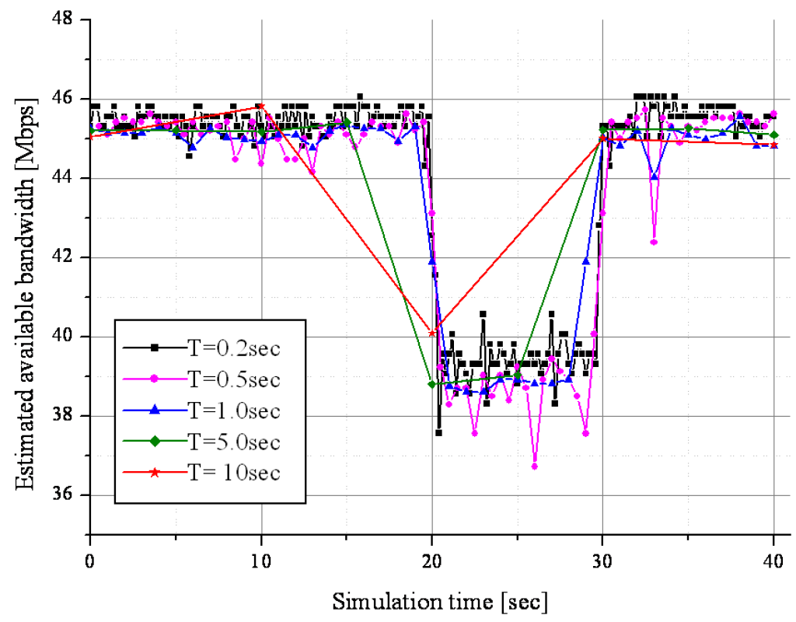
Effect of Different Measurement Period on the Correctness of the Bandwidth Estimation
the value of T directly affects the correctness of the estimated available bandwidth
send 5 Mbps UDP traffic from one node, while estimating the available bandwidth by the second node

Slide 10
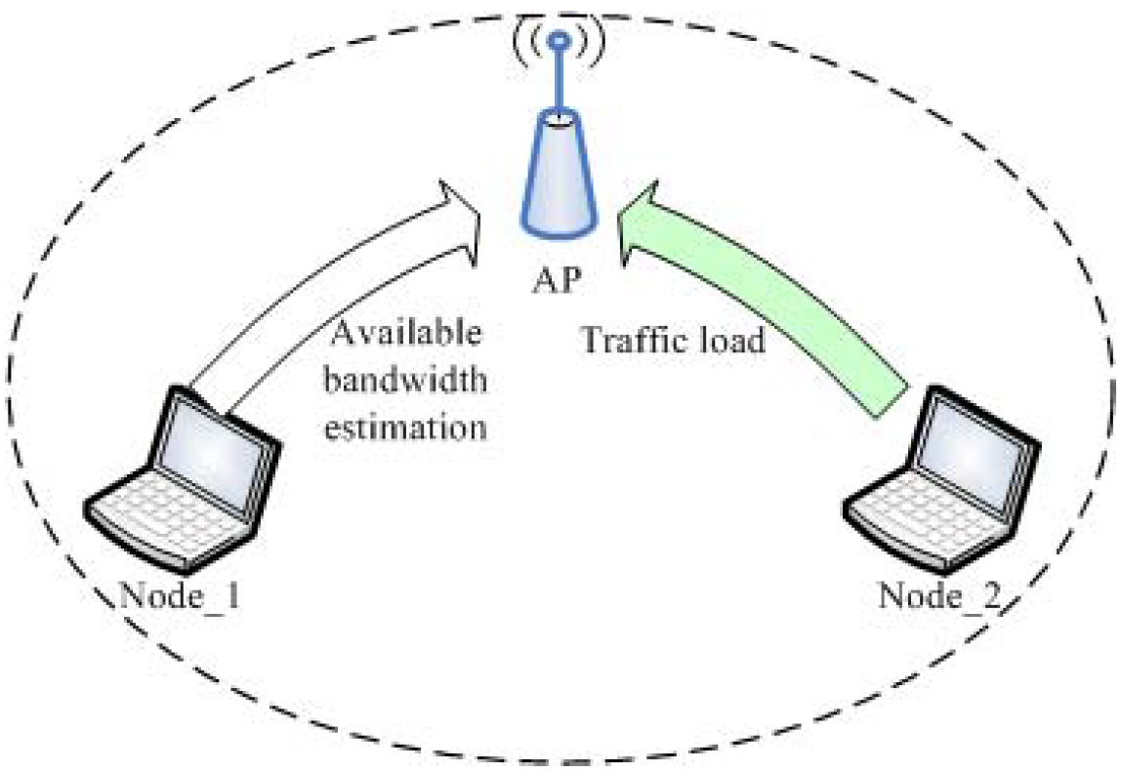
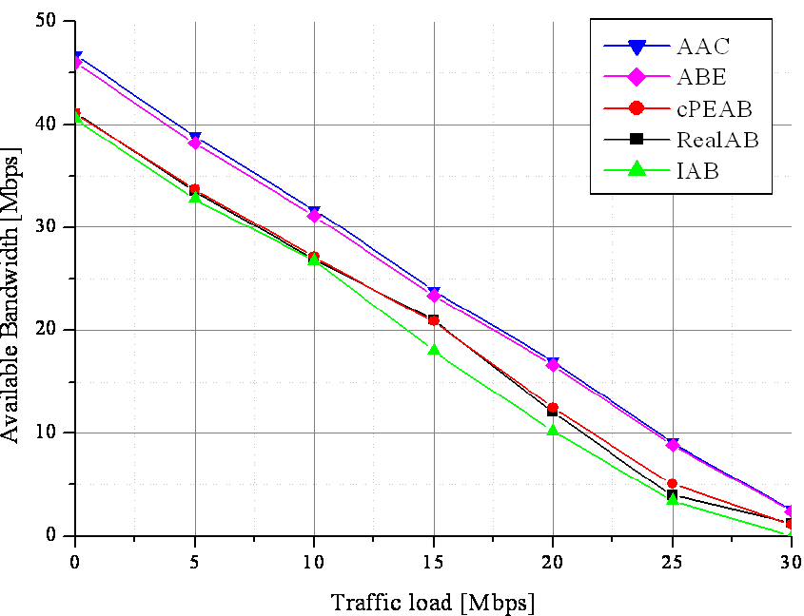
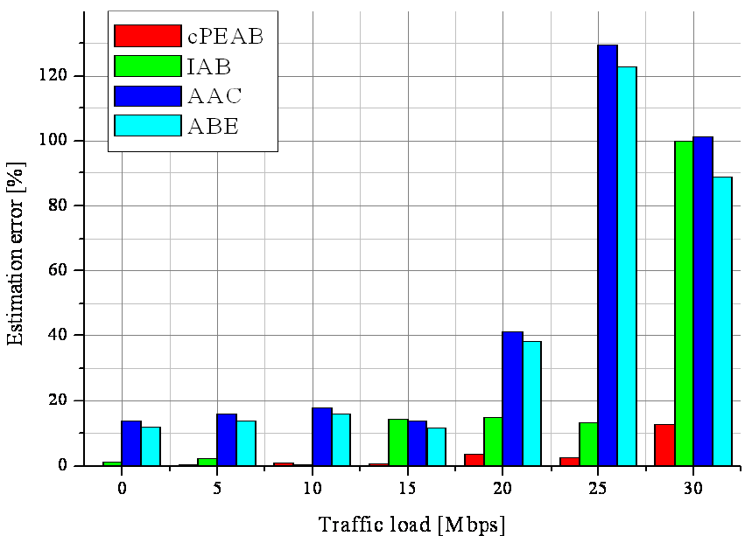
Scenario without hidden/exposed nodes

Slide 11
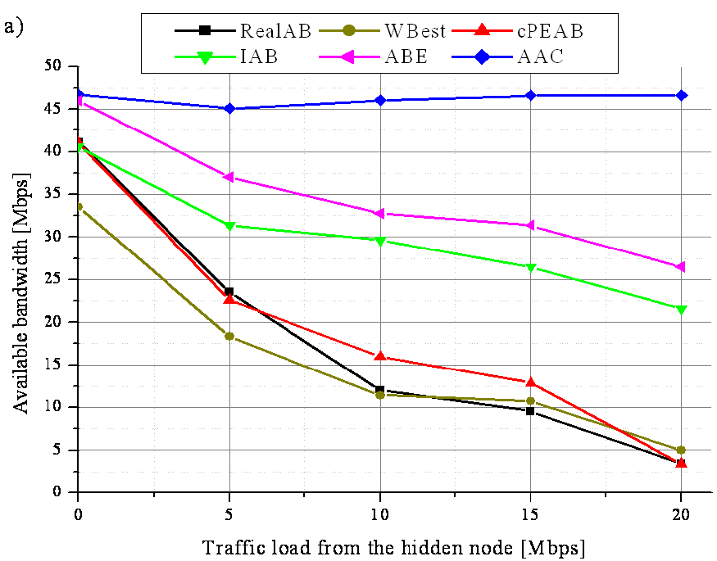
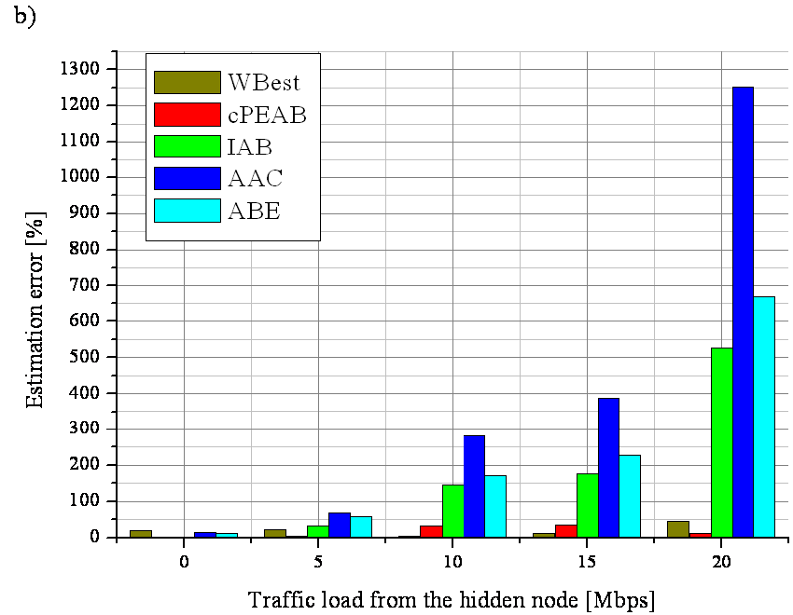
Scenario with hidden/exposed nodes

Slide 12
Conclusion
proposed a new cognitive passive estimation of available bandwidth (cPEAB)
Passive measurement
open source MadWiFi WLAN driver
Compare with AAC, ABE, IAB, and Wbest
provide more accurate estimation in overlapped IEEE 802.11 WiFi WLANs

Slide 13
Progress
Current
Build ga client and server for screencasting
Trying mark DSCP field for the video packets at server
Next
Compare bandwidth estimation in GA to others
Implement rate adaptation
GA Server
Access point
GA Client

