Slide 1
BeHop: A Testbed for Dense WiFi Networks
2015/08/10

Slide 2
BeHop
A wireless testbed for dense WiFi networks
Goals:
provide insights on the operation of dense deployments
evaluate how different WiFi management strategies affect user experience and network behavior

Slide 3
Motivation
Most users install WiFi APs with default settings
Multiple networks run independently and share the same airtime resources
Leads to poor channel selection, poor coverage, and unsatisfying user experience

Slide 4
Motivation
Interested in studying and evaluating new ways of controlling WiFi networks
Research testbeds often leads to impractical assumptions or overlooked factors
specific usecase
static traffic and clients
hiding the complexity of a real network
They built a general-purpose WiFi testbed in Stanford university.
Notes:
While we have a rough sense of useful approaches for managing a network (such as channel, power and association control),
we do not have good intuition on how these will work in practice, and their implications.
Research testbeds are often built around a specific usecase, and they are limited in terms of static traffic and clients, hiding the complexity of a real network ,
which can lead to impractical assumptions or overlooked factors.

Slide 5
Contributions
Design and prototype an SDN WiFi framework to realize a wide set of management techniques for channel, power and association control
Virtual-AP abstraction
Per-client WiFi control
BeHop runs in parallel with and is indistinguishable from the production network for users

Slide 6
Architecture
BeHop APs as the wireless dataplane
A collector that gathers necessary data for monitoring and evaluation
A centralized controller where they implement the WiFi management logic

Slide 7
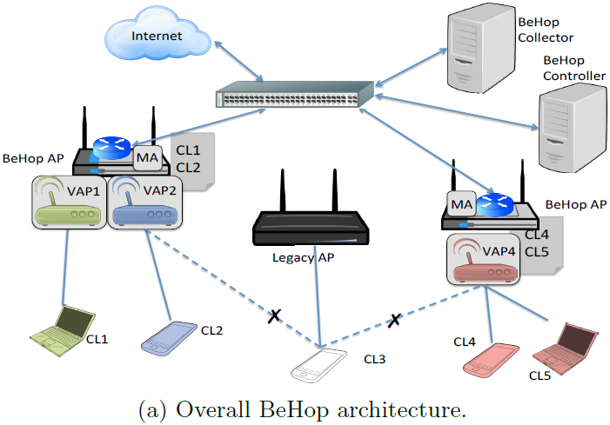
Architecture
APs are centrally managed from a controller

Slide 8
BeHop APs
Virtual-AP (VAP): Logical access point
Identified by an unique BSSID
Clients only see VAPs, not the true physical Aps
VAPs decouple the operation of an AP from the underlying infrastructure
Client Table:
Each AP maintains a client table
An entry in this table contains necessary state so that the AP can serve the client
Notes:
A BSSID is a 48-bit address

Slide 9
BeHop APs
Forward WiFi managment traffic:
Forward WiFi management traffic to the controller
The controller is responsible for processing and responding to Probe, Authentication, and Association Requests
WiFi Configuration:
BeHop APs expose a configuration API for channel and power allocation

Slide 10
Collector
The information plane of the testbed
Gather raw data from different sources to construct higher-level statistics
Collector is separated from controller (fig. 1) to maintain the flexibility to collect and process large amounts of data without sacrificing the responsiveness and stability of our controller

Slide 11
Controller
It orchestrates the testbed to realize different WiFi management strategies
Implement channel and power allocation mechanisms using the relevant APIs
Apply association control by mapping VAPs to physical Aps

Slide 12
Implementation
Datapath
commodity dual radio WiFi Aps running OpenWRT BeHop APs run Open vSwitch (OVS)
APs connect to the backbone campus network through a 48-port, OpenFlow enabled switch
To forward WiFi management traffic, they add a monitor interface for each radio and forward packets of interest

Slide 13
Related Work
DenseAP argues that dense deployment of APs can significantly improve performance
TFA is a wide-area mesh WiFi deployment. Their testbed facilitates unique experiments that can eventually benefit large scale deployments such as TFA
WiSe is a residential deployment with a similar goal of conducting in-line measurements

Slide 14
Related Work
OpenRoads uses OpenFlow WiFi APs and WiMax basestations to experiment with flow mobility and use of multiple networks and interfaces
ODIN , a framework for enterprise WiFi, exposes a BSSID for every client, which is then treated as a port by an SDN controller
Orbit is a radio-grid emulator open to researchers and focuses on reproducible experiments

Slide 15
Related Work
Commercial WiFi systems use centralized controllers to optimize network management and performance; but they are closed and proprietary

Slide 16
Conclusion
BeHop provides a general-purpose framework to experiment with a wide range of techniques for channel, power, and association control
BeHop is an open testbed based on off-the-shelf hardware, OpenWRT and OpenFlow

