Slide 1
Mobile Fog: A Programming Model for Large–Scale Applications on the Internet of Things
Hong, Kirak, et al.
ACM SIGCOMM workshop on Mobile cloud computing. ACM, 2013.

Slide 2
Outline
Motivation
Programming model
Structure
API
Applications
Evaluation
Discussion and future work

Slide 3
Motivation
1. The growing ubiquity of mobile and sensor devices.
2. Platform as a Service clouds are attractive for developing large-scale
applications.
However, existing PaaS programming models are designed for
traditional web applications, rather than future Internet applications.
3. Cloud computing can’t support highly latency-sensitive applications.
4. no applications support widely distributed geospatial.

Slide 4
Programming model
Two design goals:
1. Provide a high–level programming model that simplifies development
on a large number of heterogeneous devices distributed over a wide
area.
2. Allow applications to dynamically scale based on their workload using
on–demand resources in the fog and in the cloud.

Slide 5
A logical structure of an application
While running, each process performs application specific tasks such as sensing and aggregation with respect to its location and level in the network hierarchy.

Slide 6
Mobile Fog API : handler
Handler | Description
void on_create (node self) | Called when a new node is created.
void on_sense(type t, data d) | Called upon a new sensor reading from a passive sensor (e.g., a camera).
void on_message (tag t, node sender, message m) | Called when a new message arrived at a node. A tag specifies an application specific type of the message. A sender specifies the identifier of the source node.
void on_new_child(node child) | Called at a parent node when a new child node is connected.
void on_new_parent(node parent) | Called at a child node when a new parent node is connected.
void on_child_leave(node child) | Called at a parent node when a child node is leaving.
void on_parent_leave(node parent) | Called at a child node when a parent node is leaving.

Slide 7
Mobile Fog API : programming interface
Programming Interface | Description
void send_up (tag t, message m) | Sends a message from a child node to its parent node.
void send_down (tag t, message m, set<int>index) | Sends a message from a node to its child nodes.
void send_to (tag t, message m, node destination) | Sends a message to a specific destination node.
data sense (type t) | Retrieve a sensor data from an active sensor (e.g., temperature sensor).
int num_children() | Get the number of children of the calling node.
Location query_location() | Get the location of this device.
int query_level() | Get the level of this device in the network hierarchy

Slide 8
Mobile Fog API : programming interface
Programming Interface | Description
CapDesc query_capability(type t) | Query a specific type of capability such as sensing and actuation functionality on a device.
ResDesc query_resource (type t) | Query a specific type of resource (e.g., CPU and memory) on a device.
set<object> get_object(key k, location-Range lr, timeRange tr) | Get application context data that matches a key, location range, and time range.
void put_object(object o, key k, location l, time t) | Put application context data associated with a key, location (range), and time (range).

Slide 9
Mobile Fog API
1. When node move
2. Dynamic scaling
3. start_app()
Appkey
Region
Level
Capacity

Slide 10
Applications
1. Vehicle Tracking using Cameras

Slide 11
Applications
2. Traffic Monitoring using MCEP(Mobility-driven distributed Complex Event Processing)

Slide 12
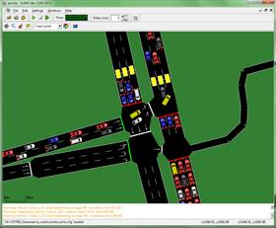
Evaluation
Setup:
1. network simulation : OMNet++
2. traffic patterns generated : SUMO
3. thousand randomly moving vehicles over fifteen minutes on the road network of an urban area (7.7 × 3.5 km).
4. 1 cloud as root & 4 core fog computing nodes & 16 edge fog nodes.
5. network latency between each pair of nodes : 20ms
OMNet++
SUMO

Slide 13
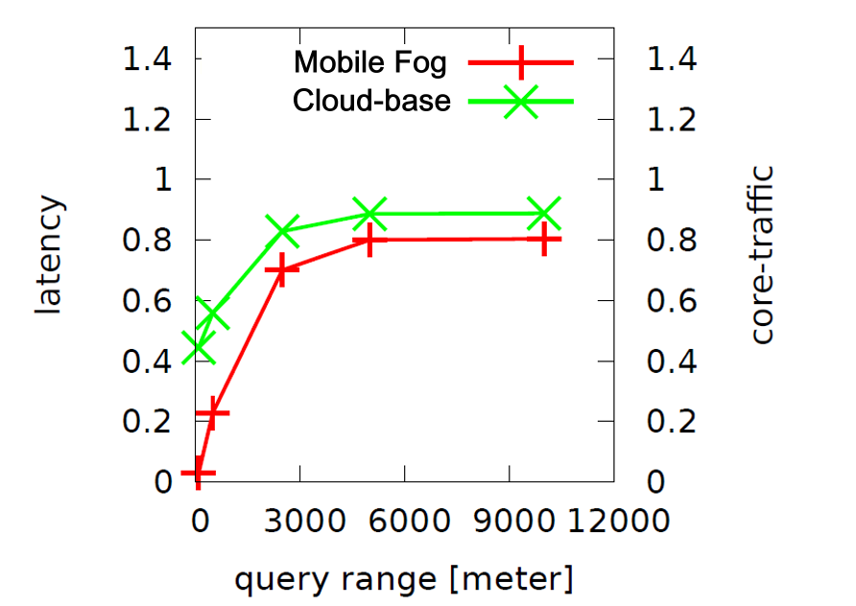
Evaluation
They simulated two large–scale application scenarios requiring low end-to-end latencies:
1. vehicle-to-vehicle video streaming.

Slide 14
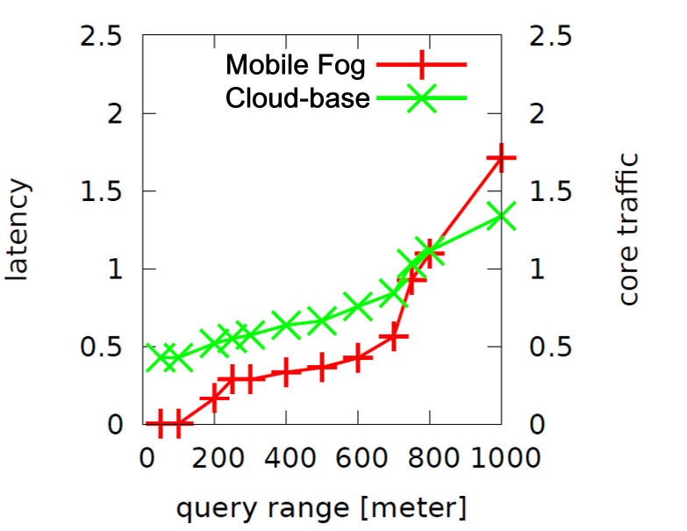
Evaluation
2. Mobile CEP, where a vehicle requests processing sensor data from a certain query range.
Cumulative Fraction of Nodes

Slide 15
Discussion and future work
1.Runtime system implementation
2.Process placement algorithm
Bandwidth utilization
Latency
Load balance

