Slide 1
A Survey of Cloud Database Systems
Ganesh Chandra Deka, Ministry of Labor & Employment, Government of India

Slide 2
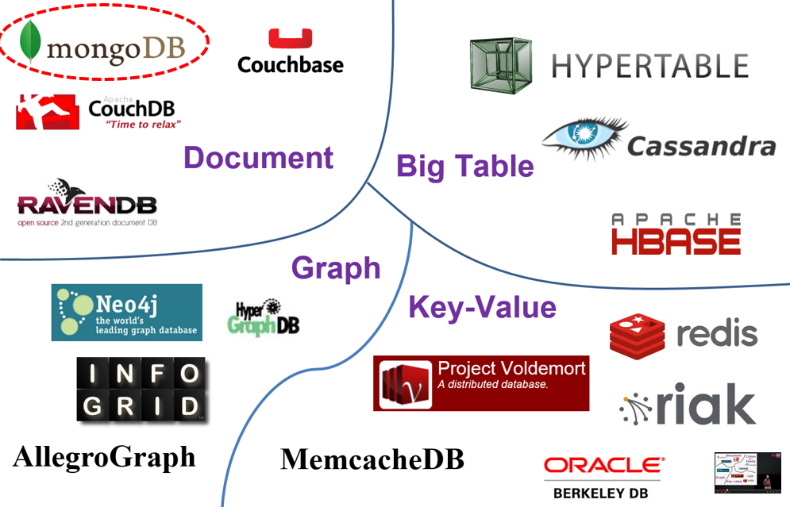
What is NoSQL?
Not Only SQL
Not RDBMS
data structures:
  key-value
  Column
  Document
  Graph

Slide 3
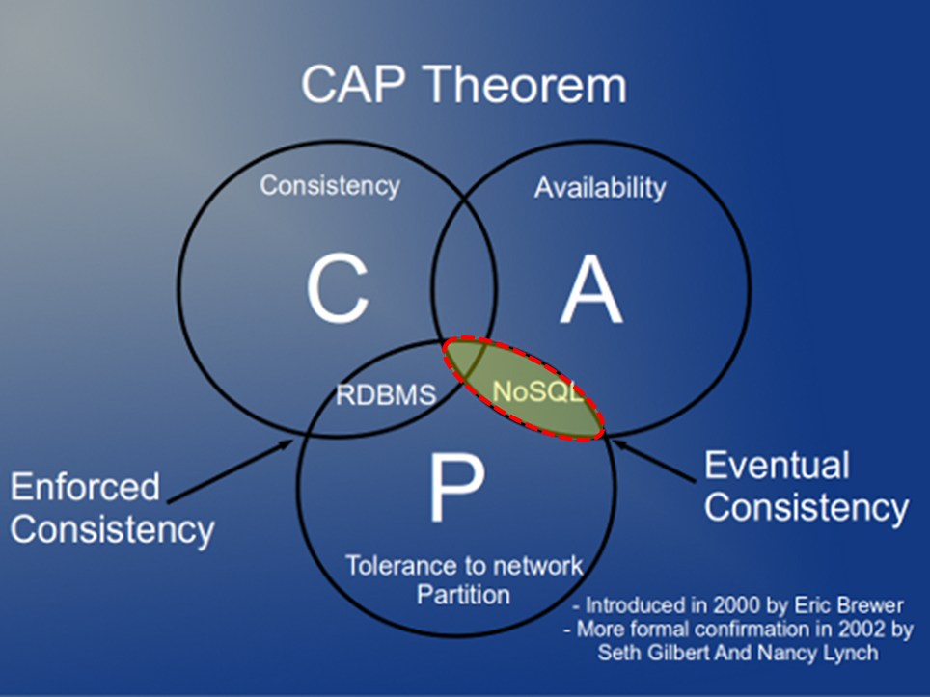
NoSQL
Schema-less
Elasticity
Sharding
Asynchronous replication

Slide 4

System-Cassandra
Apache
Wide Column Stores
  row key
  column key
Good scalability and high availability without compromising performance.
DB-Engines Ranking : 8th (Aug 2015)

Slide 5
System-BigTable
Google
3D mapping
  Row key
  Column key
  Timestamp
Google File System
a light, distributed, multidimensional sorted map
compress

Slide 6

System-Hbase
Apache
column-oriented
  Row key
  Column key
Basically, it’s a clone of BigTable.
Apache Hadoop distributed file system.
DB-Engines Ranking : 15th (Aug 2015)

Slide 7

System-MongoDB
MongoDB .Inc
document-oriented
  Binary Json
GridFS (a MongoDB file format for storing files larger than 16MB)
DB-Engines Ranking : 4th (Aug 2015)

Slide 8

System-Redis
Key-Value
key can contain strings, hashes, lists, sets and sorted sets
In-memory
DB-Engines Ranking : 10th (Aug 2015)

Slide 9
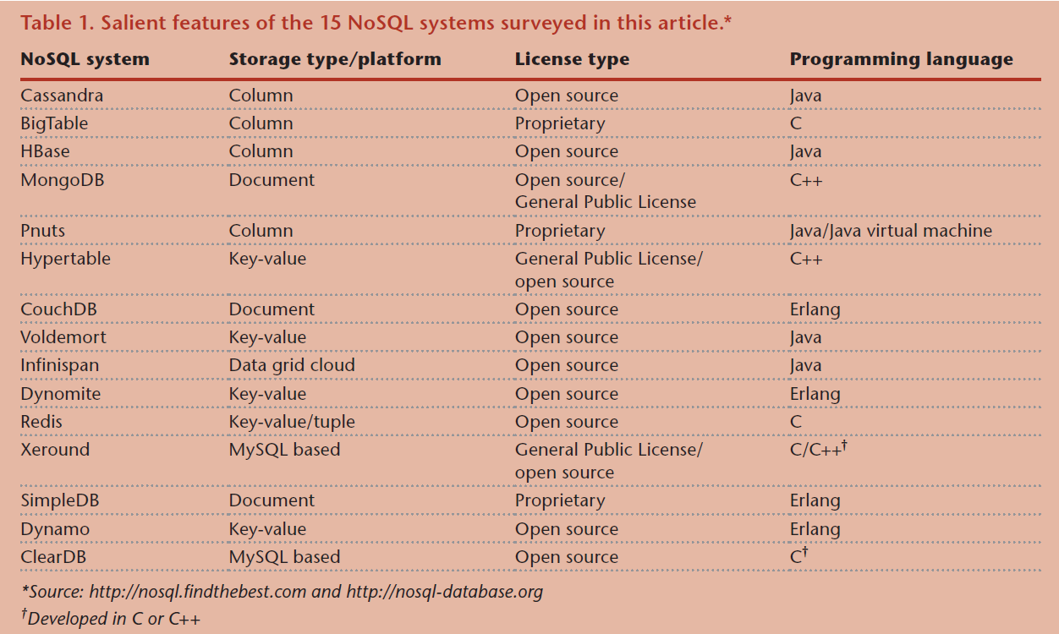
System list

Slide 10
Data-Handling
Never overwrites records on a disk: BigTable, Cassandra and Hbase...
write are fast, but reads are correspondingly deoptimized.
traditional buffer-pool architecture overwrites records when they’re updated.

Slide 11
Selecting database
Addressing the workload requirements.
Weighing latency versus durability

