Slide 1
Containerisation and the PaaS Cloud
Claus Pahl
IEEE CLOUD COMPUTING MAGAZINE
[IN PRESS - ACCEPTED FOR PUBLICATION, 6 MAY 2015]

Slide 2
Introduction
Container is a lightweight virtualization concept
Less resource and time consuming
Tools for delivering software in a portable way
PaaS (Platform-as-a-Service) focus
Basic ideas of containerization are
Lightweight portable runtime
Capability to develop, test, and deploy apps to a large number of servers
Capability to interconnect containers

Slide 3
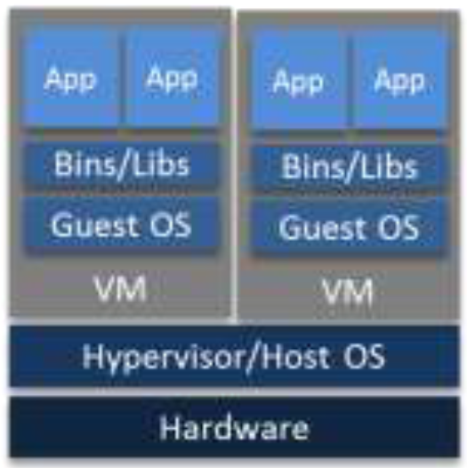
Virtualization Architecture of VM
Core virtualization construct of the cloud
Scheduling, packaging, and security problems are improved
VM instances use large files on the host to store entire file system and run typically a single, large process
It needs full guest OS images for each VM
Low on startup (booting might take from one to more than 10 mins)

Slide 4
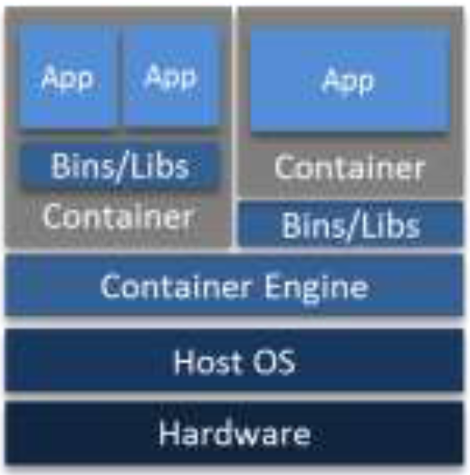
Virtualization Architecture of Container
A container holds packaged self-contained, ready-to-deploy parts of apps and, if necessary, middleware to run apps
A container covers an app tier or node in a tier
Result in the problem of managing dependencies between containers
Require a plan agent (container engine)

Slide 5
Linux Container
Linux containers provide kernel mechanisms to isolate processes on a shared OS (supported through LXC)
Namespace isolation allows groups of processes to be separated, not allowing them to see resources in other groups
cgroups (control groups) manage and limit resource access for process groups, e.g., limiting memory available to a specific container

Slide 6
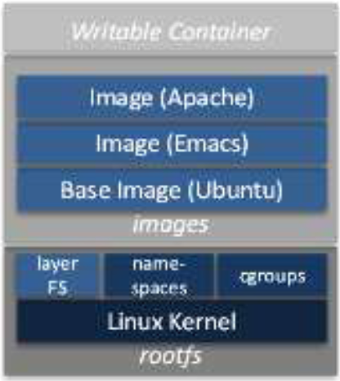
Docker Container Images
Docker image is made up of file systems layered over each other, similar to Linux virtualization stack
Docker uses a union mount to add a writable file system on top of the read-only file system
Multiple read-only file system may stack on top of each other
Each file system is a separate image loaded by container engine
The approach is lightweight as single images can be changed and distributed easily

Slide 7
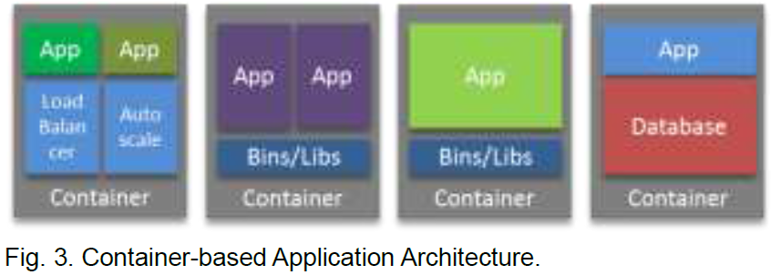
Containerizing Apps and Managing Containers
The container API allows creating, defining, composing, distributing containers, running/starting images, and running commands in images
Containers can encapsulate multiple app components
Different user apps and platform components can be combined in a container

Slide 8
Containerizing Apps and Managing Containers
Docker manages data storage using:
Data volume: a designated directory within one or more containers to provide features for persistent or shared data
Data volume container: enable sharing persistent data between app containers
Docker manages network using:
Network port mapping: apps can connect to a service or app running inside a Docker container via a network port
Container linking: Docker links containers relying on the unique names of containers; linked containers can transfer data via environment variables

Slide 9
Different Container Models
Linux: Docker, LXC Linux containers, OpenVZ, and others for variants such as BSD, HP-UX and Solaris
Windows: Sandboxie
Cloud PaaS: Warden/Garden (in Cloud Foundry), LXC (in Openshift)

Slide 10
Containerization in PaaS Clouds
PaaS provide mechanisms for
Deploying apps
Designing apps for the cloud
Pushing apps to their deployment environment
Using services
Migrating databases
PaaS have features like built farms, routing layers, or schedulers that dispatch workloads to VMs
A container solution supports these problem through interoperable, lightweight, and virtualized packaging

Slide 11
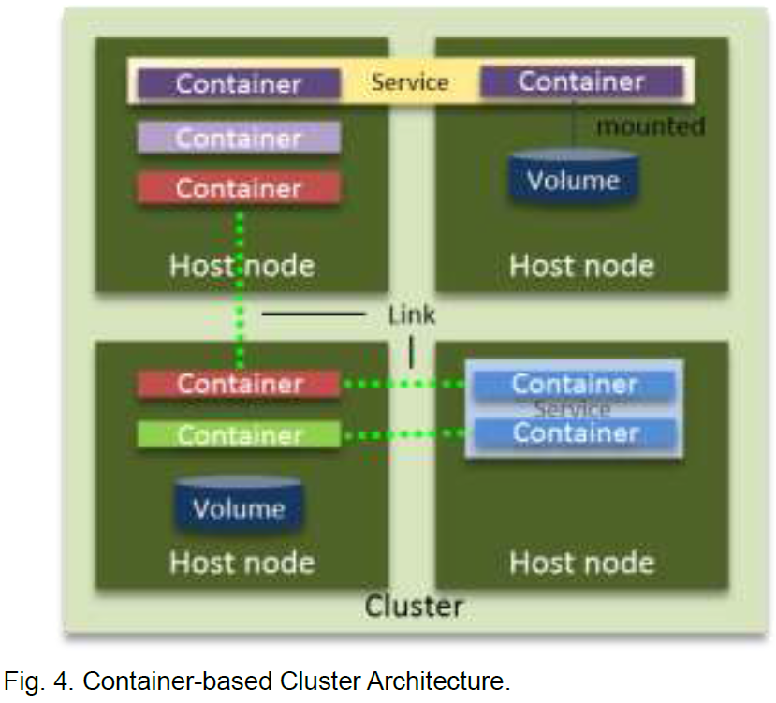
Container Orchestration and Clustering
Each cluster consists of several (host) nodes
Each container can hold continually provided jobs
Volumes are used for apps requiring data persistence
Links allow containers to connect and communicate
A sample clustering management solution is Kubernetes architecture
Orchestrate Docker containers at scale

Slide 12
Network and Data Challenges
In k8s, each pod receives its own unique IP address, reachable from any other pod in the cluster
Require advanced routing features based on network virtualization
Storage management in k8s is hampered in terms of flexibility and efficiency by the need for pods to co-locate with their data

Slide 13
Progress
Buy Arduino WiFi shield and camera module
=> Port Smartcity’s system to Arduino
Crowdsourcing app
=> Build server and connect the app to the database
Fog computing writeup
=> Deploy kubernetes with salt stack testbed

Slide 14
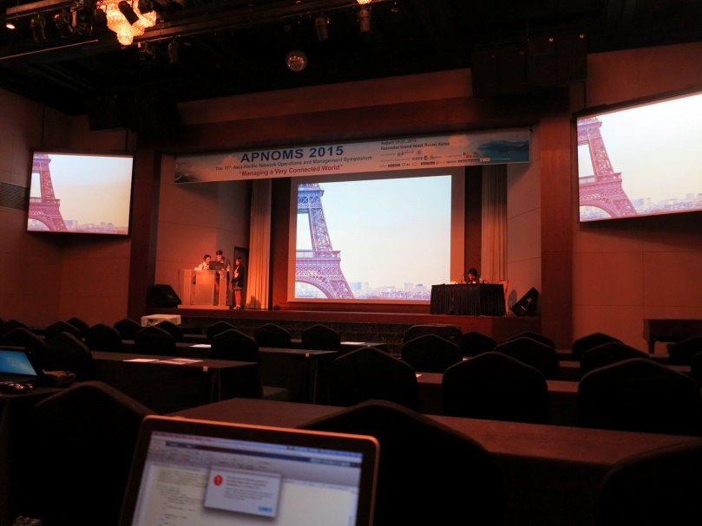
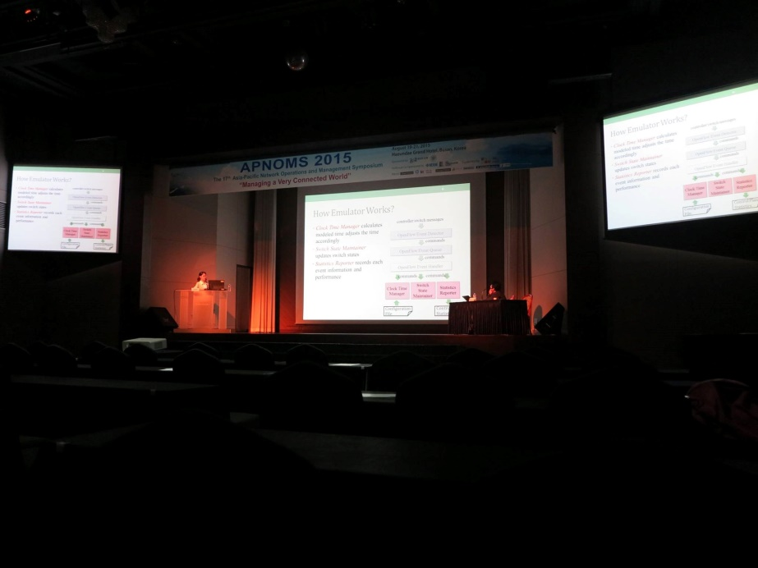
Busan, Korea

Slide 15
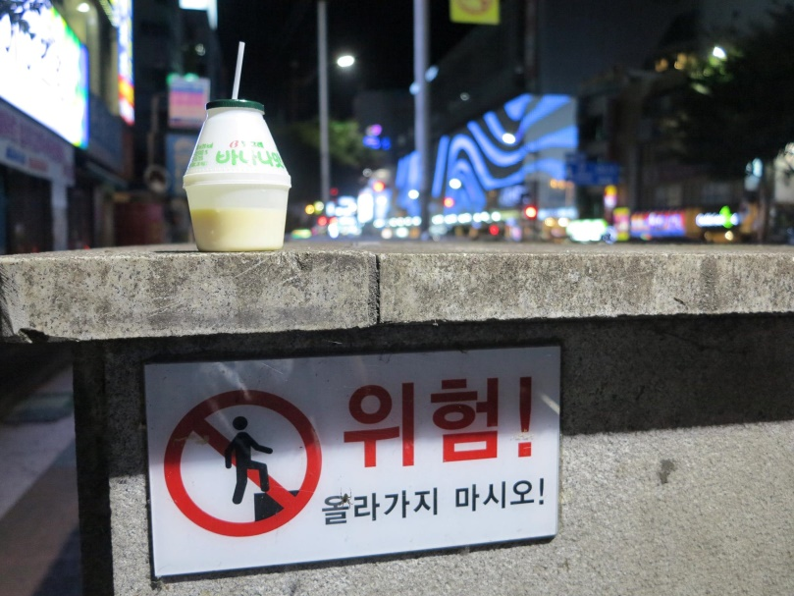
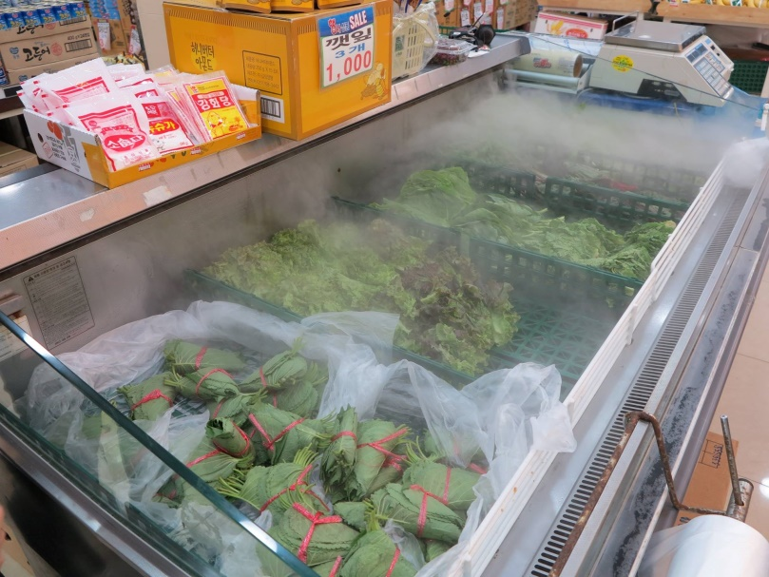
Busan, Korea

Slide 16
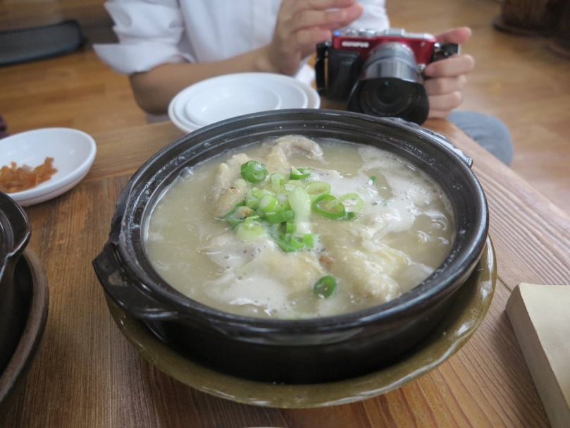
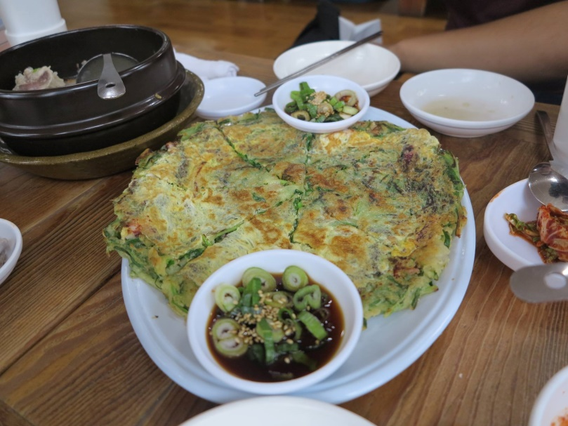
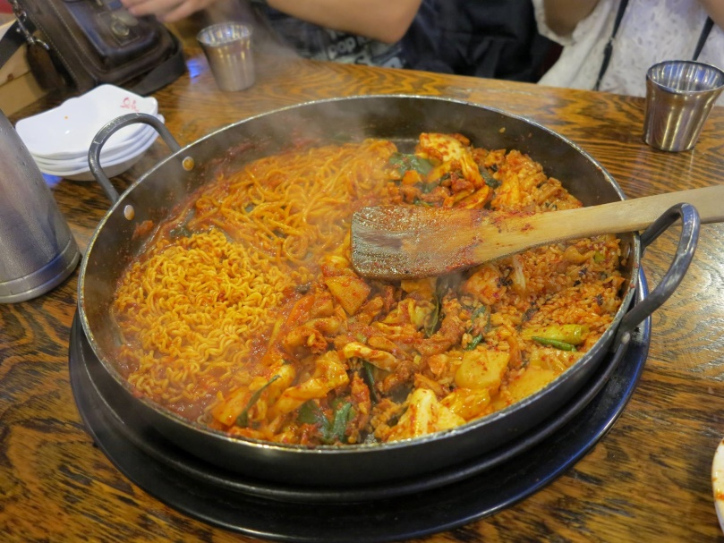
Busan, Korea

Slide 17
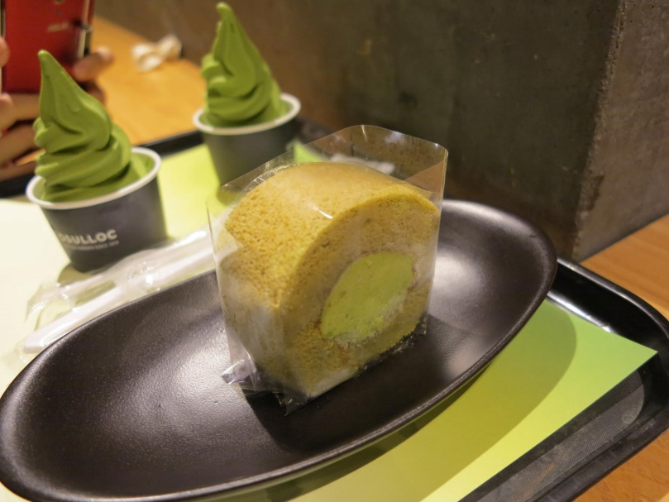
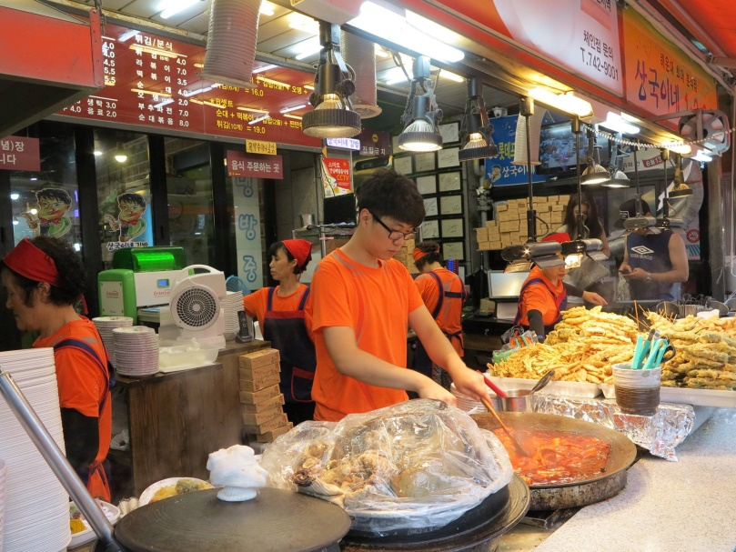
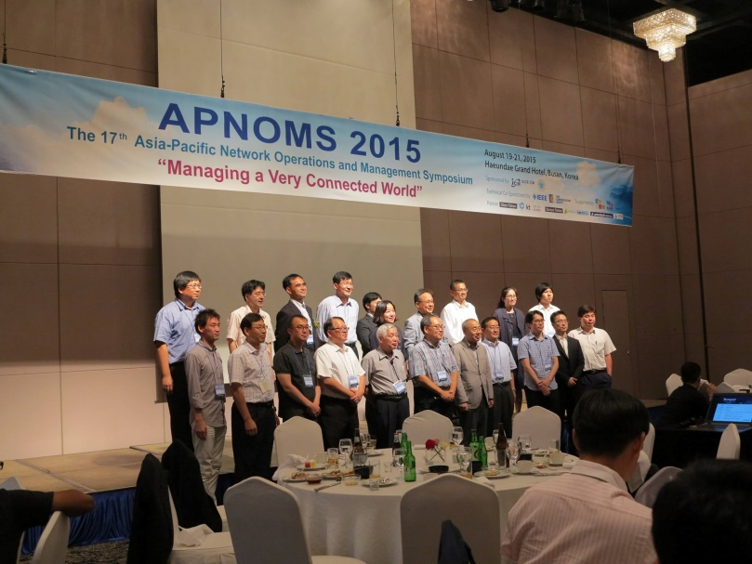
Busan, Korea

Slide 18
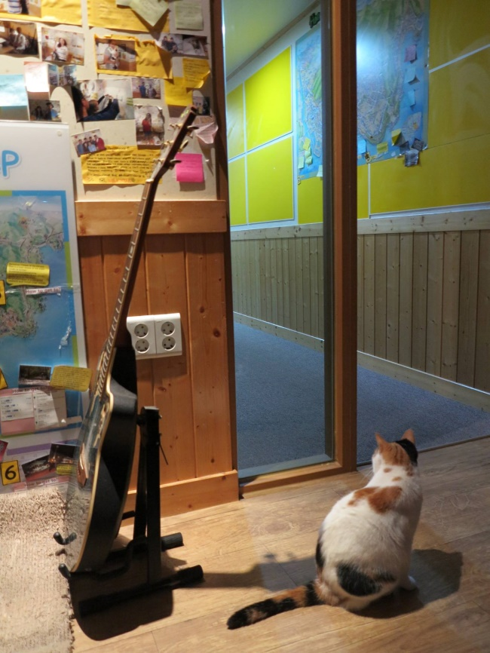
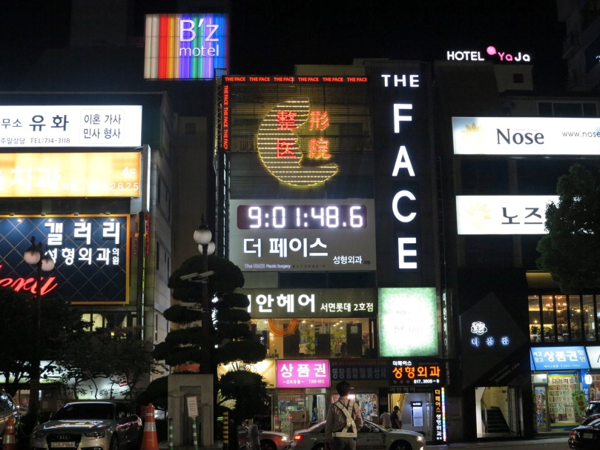
Busan, Korea

