Slide 1
Viewable Scene Modeling for Geospatial Video Search
Sakire Arslan Ay, Roger Zimmermann, and Seon Ho Kim

Slide 2
Introduction
video clips are being collected from various devices and stored for a variety of purposes
georeferenced video search will play a prominent role in many future applications
index the video data based on the human viewable space and therefore to enable the retrieval of more meaningful and recognizable scene results for user queries

Slide 3
Contributions
Automatic annotation of video clips with the camera viewing direction
Modeling of the viewable scene
Prototype feasibility study
Demonstration of benefits
Approaches
1) modeling of the viewable scene
2) data acquisition
3) indexing and querying

Slide 4
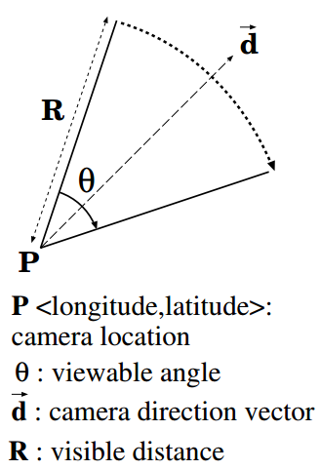
Modeling of Viewable Scene
field-of-view ( )
The camera position P is the <latitude, longitude> coordinates read from a positioning device (e.g., GPS)
The camera direction vector d is obtained based on the orientation angle provided by a digital compass
The camera viewable angle θ describes the angular extent of the scene imaged by the camera
The far visible distance R is the maximum distance at which a large object within the camera’s field-of-view can be recognized

Slide 5
Meta-Data Acquisition (1/2)
In order to keep track of the FOVScene of a moving camera over time
Camera, digital compass, and GPS
records the updates along with the current computer time and coordinated universal (UTC) time
each video data packet received from the camera is processed in real time to extract frame timecodes
Size of image sensor
the height of the target object

Slide 6
Meta-Data Acquisition (2/2)
Timing and Synchronization
Using satellite time
different data output rates
processes data in a sliding time window centered at the current time ex. f_{GPS} = 1 sample/sec, f_{compass} = 40 samples/sec, f_{video} = 30 samples/sec → match each GPS entry with the temporally closest video frame timecode and compass direction
estimate missing data items in low frequency data streams by applying an interpolation technique

Slide 7
Indexing and Querying (1/3)
extract the video segments that capture a given area of interest
for a given area of interest Q, we can extract the sequence of video frames whose viewable scene overlap with Q

Slide 8
Indexing and Querying (2/3)

Slide 9
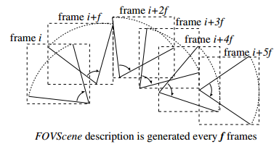
Indexing and Querying (3/3)
define the FOVScene in the spatial domain with a pie-slice-shaped area and then estimate it with a Minimum Bounding Rectangle (MBR)
R-tree

Slide 10
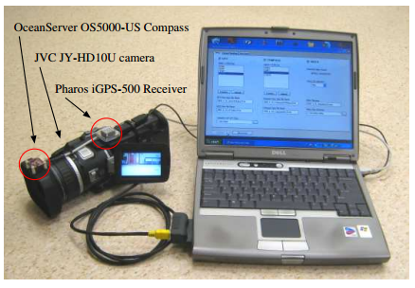
Data Collection and Methodology
high-resolution (HD) camera, a 3D compass and a GPS receiver
each video frame is associated with its viewable scene information

Slide 11
Analysis and Results
selected 250 random query regions (Q), of size 300m by 300m within the 6km by 5km area of total video coverage
randomly chose 40 videos and had a student analyze them and mark the query regions that appear in any of these 40 videos
removed the videos which are reasonably far away from each query region

Slide 12
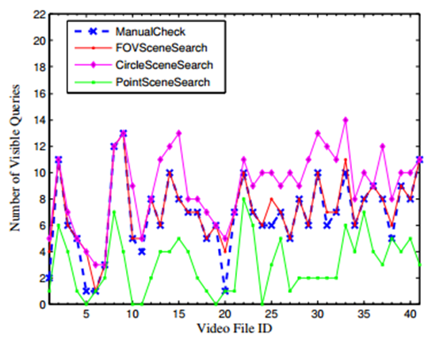
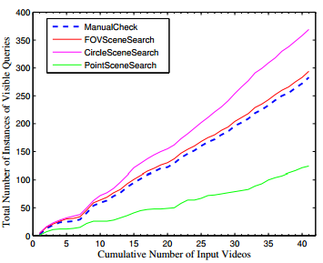
Completeness of Result Video Set
Given 250 random queries, through manual scan, we created the list of query regions that are visible within each video in the dataset of 40 videos
CircleSceneSearch, PointSceneSearc

Slide 13
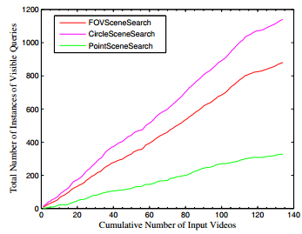
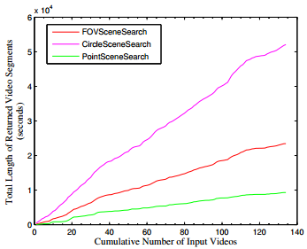
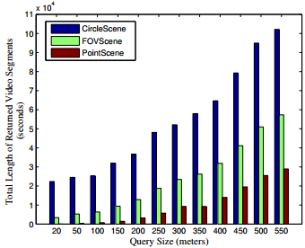
Accuracy of Search Result

Slide 14
Conclusion
automatic annotation of video clips with a collection of meta-data → viewable scene model
implemented prototype which demonstrates the feasibility of acquiring, storing, searching and retrieving metadata enhanced georeferenced video based on the proposed viewable scene model

Slide 15
Future Work
a better index structure that would specifically target georeferenced annotations of video data
elaborate on video ranking in our future work
a standard format for georeferenced video annotations must be established and issues for enabling automated integration with other providers’ data have to be investigated

