Slide 1
MediaQ: Mobile Multimedia Management System
Seon Ho Kim, Ying Lu, Giorgos Constantinou, Cyrus Shahabi,
Guanfeng Wan and Roger Zimmermann

Slide 2
Introduction
it is challenging to index and search video data at the high semantic level preferred by humans
current online mobile video applications mainly focus on simple services
MediaQ
Video frames automatically annotated by objective metadata that (what, where, when, who)
Tagging -> enhances the search effectiveness panoramic image generation -> provides an immersive user experience

Slide 3
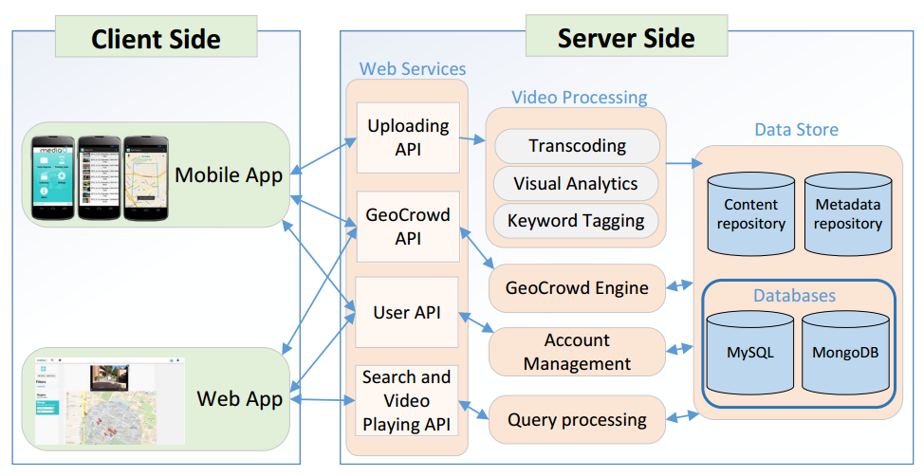
Overview of MediaQ

Slide 4
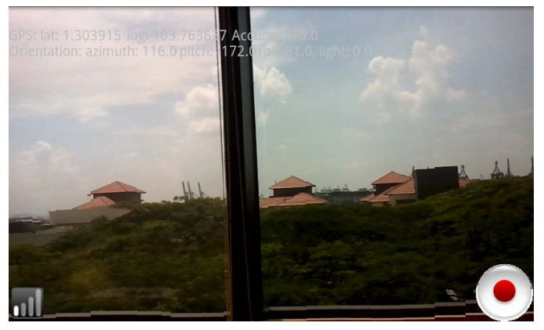
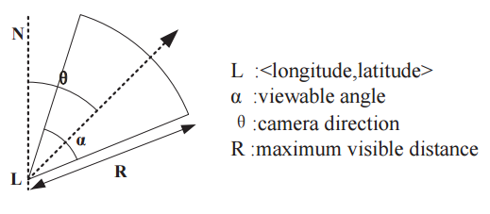
Media Collection with Metadata
record H.264 encoded videos at DVD-quality resolution
employs the GPS, digital compass and accelerometer sensors

Slide 5
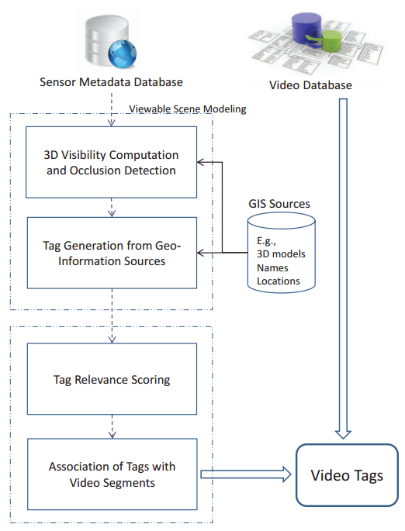
Automatic Keyword Tagging
humans are not familiar with such numeric data (sensing data)
→ textual keywords (e.g., street name)
1. generate tags
2. tags relevance ranking
Closeness to the FOV Scene Center
Distance
Horizontally and Vertically Visible Angle Ranges
Horizontally and Vertically Visible Percentages

Slide 6
GeoCrowd
provides the mechanisms to support spatial tasks that are assigned and executed by human workers
Task: <id, location, start_time, end_time, k, query>
Task inquiry : <id, R(SW,NE), maxT>
Goal
assign as many tasks as possible to workers while respecting their constraints

Slide 7
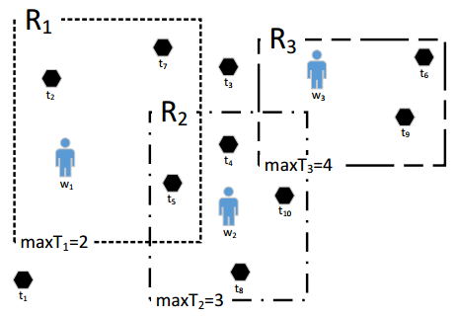
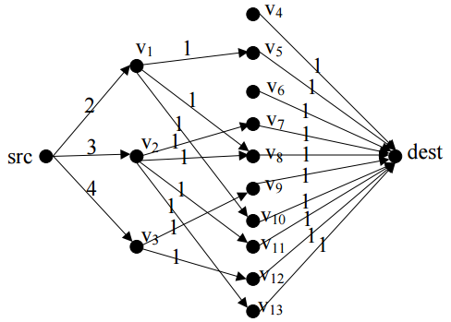
Maximum Task Assignment (MTA)
tasks
works
K
maxT

Slide 8
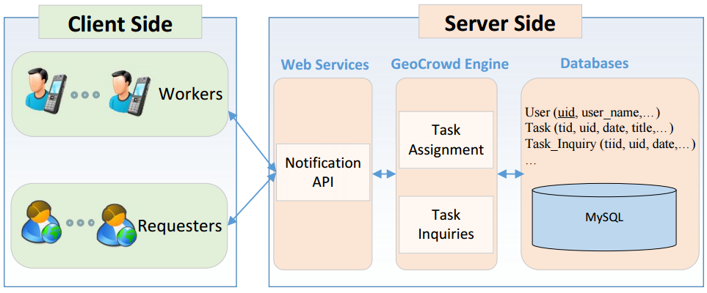
GeoCrowd Architecture

Slide 9
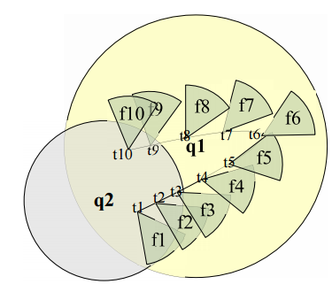
Query Processing
Region Queries
Range Queries
Directional Queries
Keyword Queries
Temporal Queries
Presenting Query Results

Slide 10
Panoramic Image Generation
Panoramas are useful for monitoring systems, virtual reality and image-based rendering
Acceleration of panorama stitching
Improving the quality of the generated panoramic images
The key video frame selection criteria
whose camera locations are as close as possible to the query location
every two spatially adjacent FOVs should have appropriate overlap
whose corresponding FOVs cover the panoramic scene as much as possible

Slide 11
Social Networking
Group Sharing
public, private, and group
Region Following
e.g., follow the hometown

Slide 12
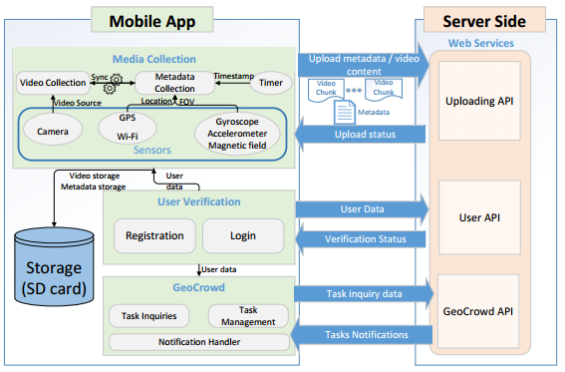
Mobile App

Slide 13
Experiments - Nato Summit 2012 Coverage
real-time video data collection and searching of videos
more than 250 videos were recorded and uploaded
stored in smartphones and uploaded (480p)
streaming manner for real-time viewing (360p)
Lack of cellular network bandwidth
two directional antennae at the corner roofs of the Columbia College campus to cover two target areas
the performance of the server significantly depended on the transcoding time of uploaded videos

Slide 14
Experiments - PBS Inaugblog 2013
focused on video data manipulation and presentation, e.g., panoramic
selecting the 17 “best” video frames (the 17 frames were from 3 different videos) among 69,238 candidate frames
takes 11.8 seconds

Slide 15
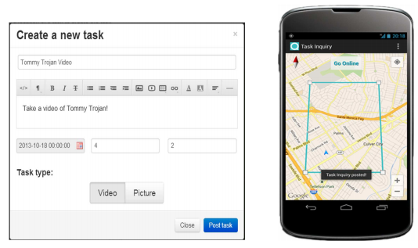
Experiments- GeoCrowd
Proof-of-concept
geospatial tasks were created through the MediaQ web application
The GeoCrowd algorithm was scheduled to solve an MTA instance every one minute
new workers’ assignments were inserted into the database
10 workers

Slide 16
Conclusion and Future Directions
online mobile media management framework
media collection with geospatial metadata, keywords extraction, innovative content browsing and search capabilities, and media content sharing
Future directions
working on including indoor geo-tagging with indoor localization techniques
adding more visual analytics, such as facial recognition, to annotate people

