Slide 1
Activity-aware adaptive compression: a morphing-based frame synthesis application in 3DTI
Proceedings of the 21st ACM international conference on Multimedia. ACM, 2013

Slide 2
Outlines
Introduction
System components
Activity-Aware Adaptive compression
Evaluation
Conclusion

Slide 3
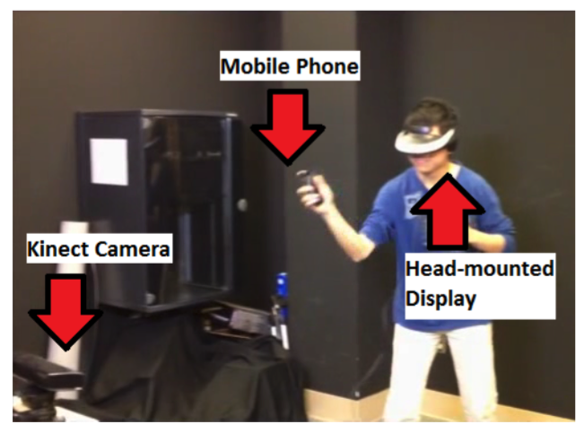
Introduction
3DTI platform : the TEEVE Endpoint
  Kinect camera, head-mounted display, user’s mobile phone
Different types of user activities, different tolerance
Activity-Aware Adaptive Compression (A3C)
  Activity recognition + Morphing-based Frame Synthesis (MBFS)
Evaluation
  Objective compression
  Subjective user study
Notes:
https://www.youtube.com/watch?v=3fke-Mm-5Vo

Slide 4
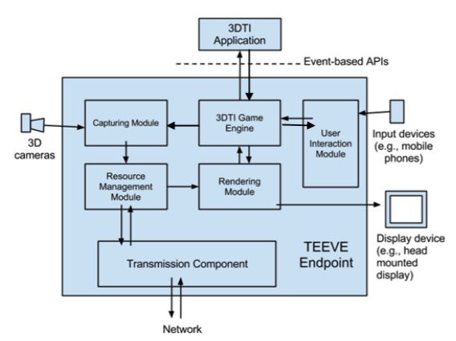
System Components
TEEVE Endpoint
  Handles the 3DTI data and
  provides APIs to developers

Slide 5
Activity-Aware Adaptive Compression
Activity recognition
Frame deduction
Frame amendment

Slide 6
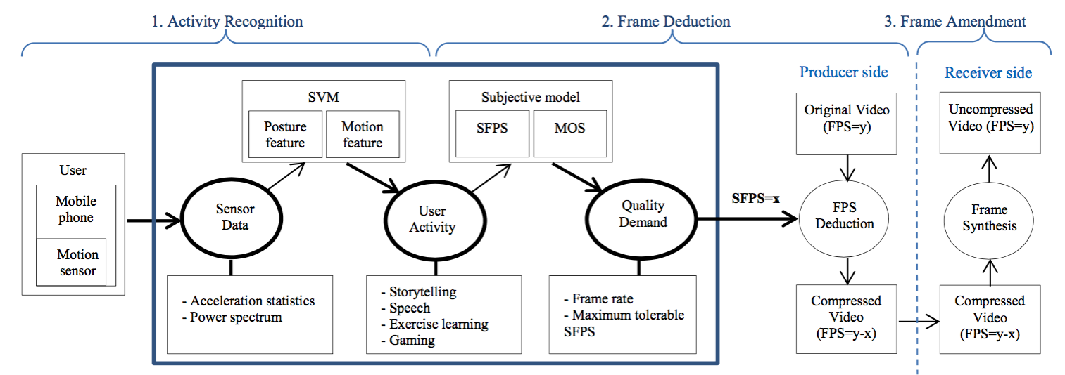
Overview

Slide 7
Activity Recognition
Storytelling : sitting in the center of the 3DTI
Speech : standing in the center of the 3DTI
Exercise learning : slow movements
Gaming : fast movements
Notes:
10 participants

Slide 8
Frame deduction and amendment
Morphing-based Frame Synthesis (MBFS)
Activity-Aware Frame Deduction
  Participants give Mean Opinion Score (MOS) to represent Quality of Experience (QoE)
  Just Noticeable Difference (JND) perceptual thresholds of synthesized frames per second (SFPS)
Notes:
JND對於某一特定的感官刺激所能察覺的最小改變

Slide 9
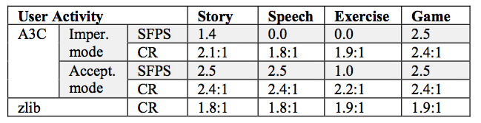
Evaluation
Objective Metric : Compression Ratio
  Imperceptible mode (90% of QoE)
  Acceptable mode (80% of QoE)
Notes:
CR = uncompressed / compressed

Slide 10
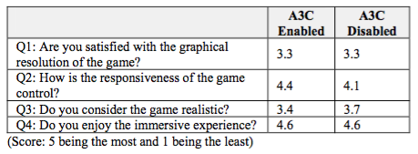
Evaluation
Subjective Metric : Gameplay Experience

Slide 11
Conclusion
A3C brings 25% more bandwidth saving comparing to existed compression scheme of 3DTI without compromising the user experience

Slide 12
Progress update
Done
  Test for recording videos on Arduino
  Smart Bike’s ppt file
Todo
  Clean up the codes
  Classify papers I found

