Slide 1
Acceptability-Based QoE Models for Mobile Video
Song, Wei, and Dian W. Tjondronegoro. "Acceptability-based QoE models for mobile video." Multimedia, IEEE Transactions on 16.3 (2014): 738-750.

Slide 2
Outlines
Introduction
User study
Acceptability Based QoE Models
Objective video quality assessments versus subjective acceptability
Conclusion

Slide 3
Introduction
MOS-based measurement are unable to indicate whether video quality is acceptable or not
Develop QoE models based on user-centered acceptability
Examine the performance of some video quality assessment (VQA) metrics

Slide 4
User Study
Test tool
Iphone 3GS
480x320 pixel resolution at 163 ppi
Iphone4
960x640 pixel resolution at 326 ppi
Test videos
7 standard videos
8 real-world videos
Notes:
Standard video: uncompressed YUV format video
Real-world video: compressed videos at high bitrate(>3500 kbps)
Separate them into study1 and study2

Slide 5
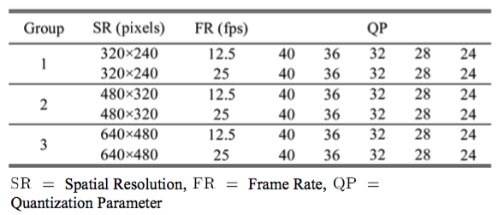
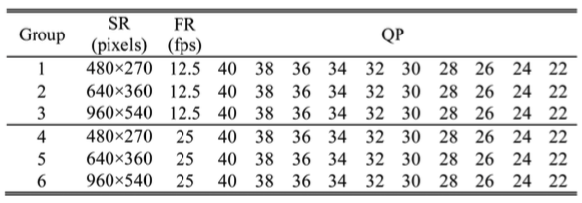
User Study

Slide 6
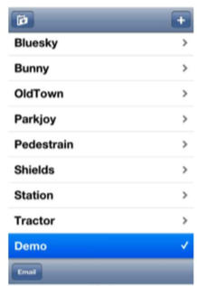
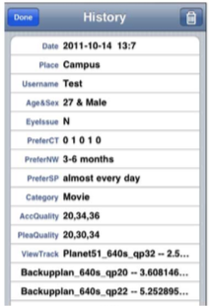
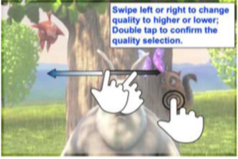
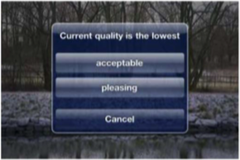
User Study
Select the lowest acceptable quality and the lowest pleasing quality
Notes:
Lowest acceptable quality : the quality below which one is not willing to watch
Lowest pleasing quality : the quality that one feels good enough for regular watch

Slide 7
User Study
Unacceptable => 0
Acceptable => 1
Notes:
the GAcc score ( ) means the possibility of a video quality being generally accepted by viewers and the PAcc score ( ) means the possibility of a video quality making viewers pleasant or comfortable

Slide 8
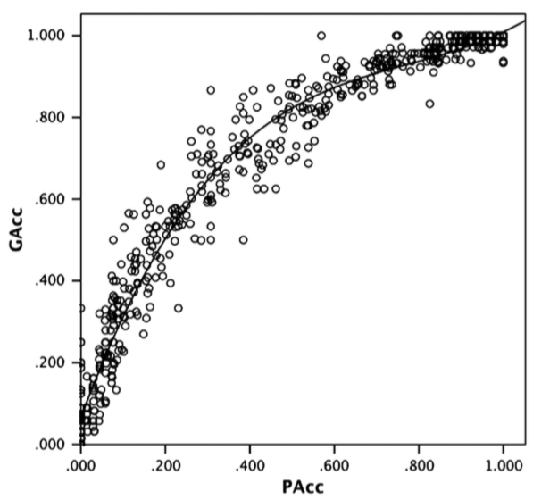
Acceptability Based QoE Models
Relationship between QGAcc and QPAcc
Notes:
Due to their strong correlation, we only need to build QoE models for the pleasant acceptability. We don’t have to consider GAcc
Another reason for using is that the pleasant ac- ceptability was investigated for both iPhone 3GS and iPhone 4 devices

Slide 9
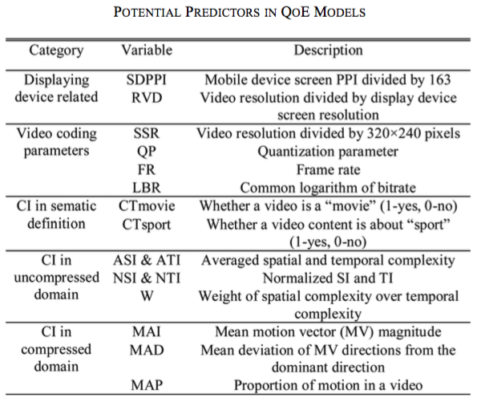
Acceptability Based QoE Models
Model predictors
Notes:
QoE modeling is the process of establishing the relationship between the QoE indicator (like Qpacc) and a series of independent variables ( like predictors)

Slide 10
Impact of QP, SR and RVD on pleasant acceptability

Slide 11
Impact of LBR and FR on pleasant acceptability for news and Soccer videos

Slide 12
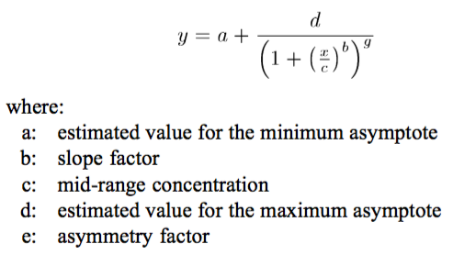
Curve Fitting
5 parameter logistic model (5PL)
Chosen for the asymmetric curves
Notes:
After introducing predictors, we have to map the relation ship between the QoE indicator and the predictors
They choice of predictors depends on the curve fit and the usage situations of QoE models
Because with acceptablity data, the curves are not symmetrical, so we introduce 5 parameter logistic model

Slide 13
Curve Fitting

Slide 14
Curve Fitting
The quality of the curve fit
Close to 1 means a good curve fit

Slide 15
A-QoE Models

Slide 16
A-QoE Models

Slide 17
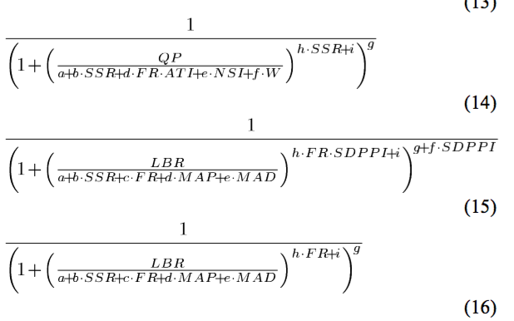
A-QoE Models

Slide 18
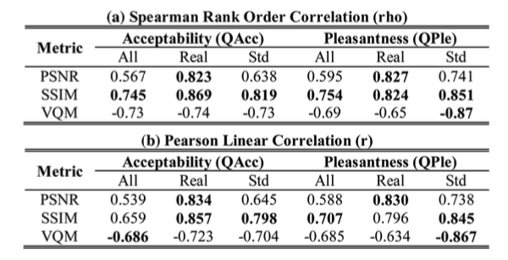
Objective video quality assessments versus subjective acceptability
PSNR
SSIM
VQM

Slide 19
Combine objective assessment to 5PL

Slide 20
Conclusion
The proposed QoE models can achieve high prediction accuracy (R>0.9 R2>0.85)
The predictions given by objective assessment (i.e. PSNR SSIM) can be improved by involving other influencing factors such as SR, FR into the model.

