Slide 1
Reducing delays related to NAT traversal in P2PSIP session establishments
Camarillo, Gonzalo, et al. "Reducing delays related to NAT traversal in P2PSIP session establishments." Consumer Communications and Networking Conference (CCNC), 2011 IEEE. IEEE, 2011.

Slide 2
Overview
Introduction
Host Identity Protocol (HIP)
Interactive Connectivity Establishment (ICE)
Architecture
Implementation
Evaluation
Conclusions

Slide 3
Introduction
Peer-to-Peer Session Initiation Protocol (P2PSIP)
Design a communication systems based on P2PSIP to minimize session establishment delays
NAT traversal in P2PSIP is based on Interactive Connection Establishment (ICE)
Use Host Identity Protocol (HIP) to perform connection management in P2PSIP

Slide 4
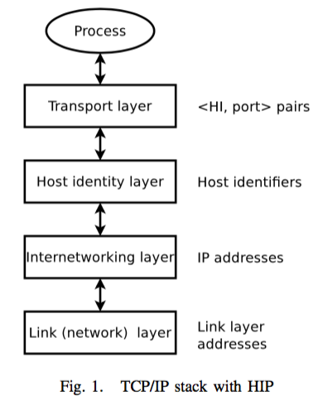
Host Identity Protocol (HIP)
Introduce a new Host Identity layer in the Internet Protocol stack
Notes:
Since transport layer connections are no longer statically bound to network interface addresses, the connections can be dynamically bound to different IP addresses
HIP implementations at the endpoints automatically discover and negotiate new addresses automatically

Slide 5
Host Identity Protocol (HIP)
Four-way handshake, called HIP base exchange (BEX)
Provide protection against DoS attacks and allows hosts to prove their identity
The identity is the public key of an asymmetric cryptographic key pair
Notes:
Hosts can prove that they own their identity during the base exchange using the private key of the key pair.

Slide 6
Interactive Connectivity Establishment (ICE)
Utilize the functionality of Session Traversal Utilities for NAT (STUN) and Traversal Using Relays around NAT (TURN) protocols
Use STUN to learn the address
Use TURN for relaying data
Notes:
the host uses STUN to learn the address assigned to it by a NAT (if any) and TURN for allocating an address on a TURN server that can be used for relaying data.

Slide 7
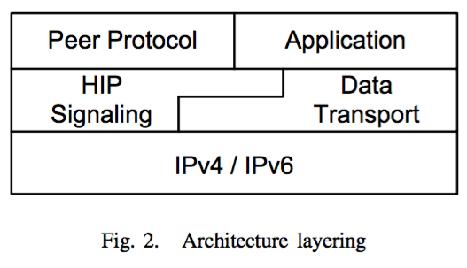
Architecture
Overlay maintenance
Building and maintaining the routing tables of the overlay
Data storage and retrieval
Storing and searching for objects in the overlay
Connection management
Includes the functionality provided by HIP
Notes:
Connection management->mobility and security of HIP
HIP signaling is used to establish connections between nodes

Slide 8
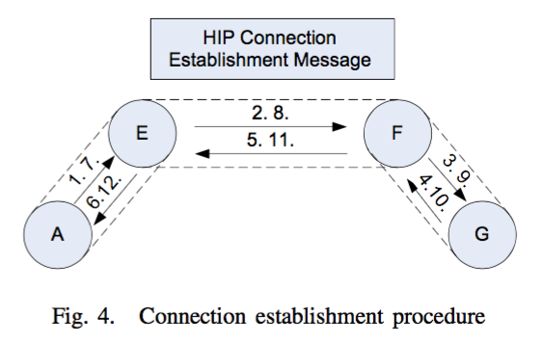
Architecture
Notes:
Assume that the application is SIP telephony application
Node A wants to establish a voice call with node G. In order to do that, Node A needs to discover Node G’s location
The overlay’s routing system routes the message to Node D, which is the node responsible for storing Node G’s location.
Once Node A has Node G’s location, Node A uses the overlay network to send a HIP connection establishment message to Node G , and then Noda A and G can connect with each other in directly.

Slide 9
Implementation
Notes:
The SIP module consists of a SIP stack and SIP B2BUA implementation. The RTP module is a simple media proxy that relays RTP packets to and from the SIP client. The Chord module implements the Chord DHT algorithm [9] used to organize the topology of interconnections amongst peers in the P2PSIP overlay and to maintain the overlay. The Chord module can use two different peer protocols, P2PP and RELOAD

Slide 10
Implementation
HIP module is enabled
Use HIP for establishing connections for the SIP, RTP, P2PP protocols
No need to implement NAT traversal in the other protocol modules
HIP module is disabled
Each protocol module needs to implement NAT traversal functionality separately

Slide 11
Implementation

Slide 12
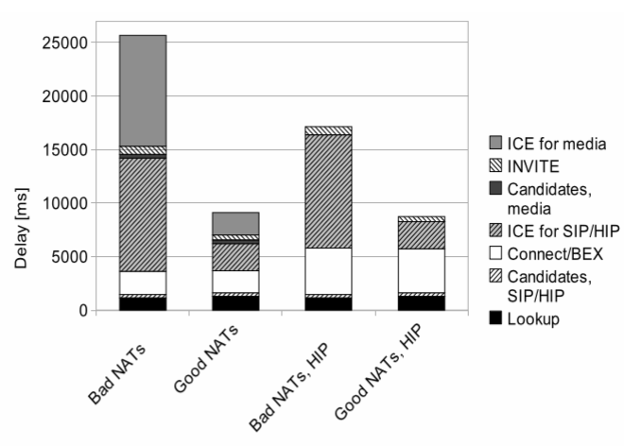
Evaluation
Use the same peer protocol to analyze the performance with HIP and without HIP
Notes:
Bad NATs means using TURN relay for communication
Without HIP, each of them running on a separate transport-layer port
The use of multiple transport layer ports in a non-HIP case (one for SIP plus several for media) increases the amount of messages and time needed for the ICE processing compared to the single-port approach used by HIP.

Slide 13
Conclusion
ICE procedures performed for one connection can be reused when establishing connections
In good NATs, the overall effect of HIP is not apparent
In bad NATs, the use of HIP results is sigificant

