Slide 1
First Person Omnidirectional Video: System Design and Implications for Immersive Experience
TVX 2015

Slide 2
Introduction
Recording and sharing own experience completely has been an ultimate goal of media technology
Omni-Directional Video (ODV)
Capturing, displaying, interaction and control interface
First person Omni-Directional Video (FODV) play important role in various applications
E.g., entertainment, sports viewing, education and simulation training, news casting and therapy

Slide 3
Difficulties
Design of capturing device for FODV
wearable omnidirectional camera attached to the head
no existing solution to satisfy all of robustness, wearability and eye-level position
Quality of the first-person video from wearable cameras
often shaky due to the body movement during capturing → viewers often feel dizzy
gets worse when the visual experience is immersive on a large screen or HMD
Cybersickness

Slide 4
Contributions
System design including capturing device and image processing for stabilizing FODV
An investigation of cybersickness and user experience of the system
Design implications for FODV from series of demo and workshop with their proposed FODV system

Slide 5
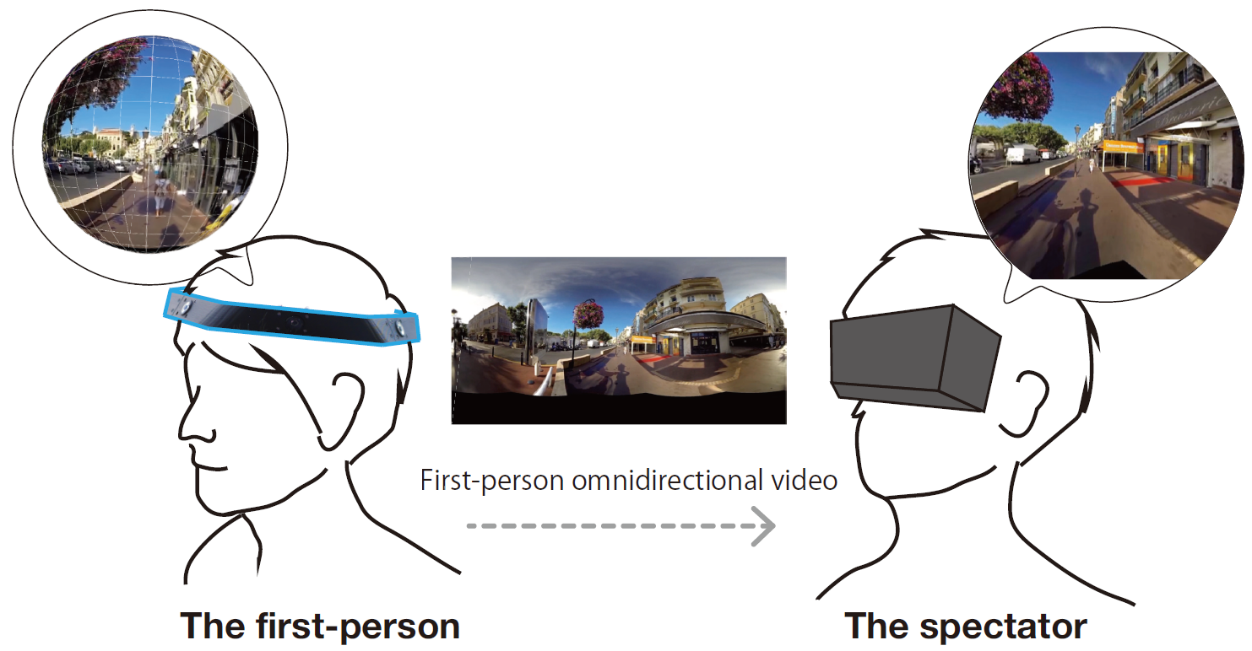
System Design
JackIn Head system
headgear with multiple cameras to capture omnidirectional video
image processing for FODV stabilization
the streaming video data and a playback system with screen or HMD

Slide 6
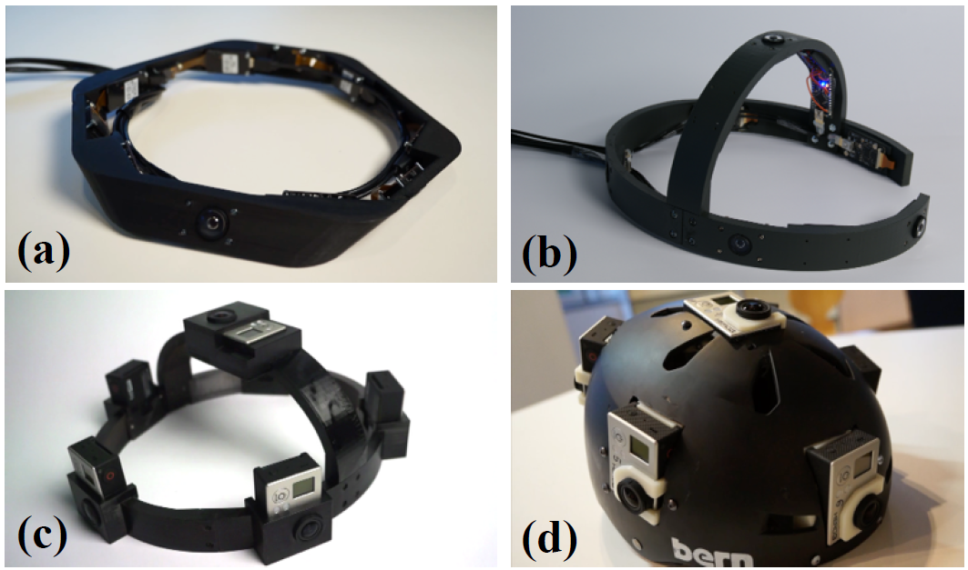
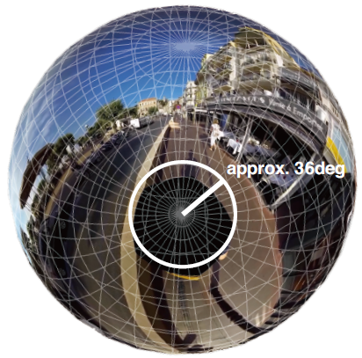
Headgear with Omnidirectional Camera
Design considerations
lower center of balance
Captured environment should be close to the first person viewpoint
Existing USB camera module has limitation in terms of image quality and video frame rate
Each camera capture 960x1440 pixel, 100 fps

Slide 7
Image Stabilization for First Person ODV
Calculates rotation then eliminate its rotation
Re-produce smoothed rotation to follow the wears head direction with variable parameter
Parameter depends on video context
zero or quite small → independent view (intense motion)
larger value → smoothed view (daily activities)

Slide 8
Image Stabilization for First Person ODV
Calculates rotation then eliminate its rotation
Re-produce smoothed rotation to follow the wears head direction with variable parameter
Parameter
parameter is zero or quite small → independent view
parameter is larger value → smoothed view

Slide 9
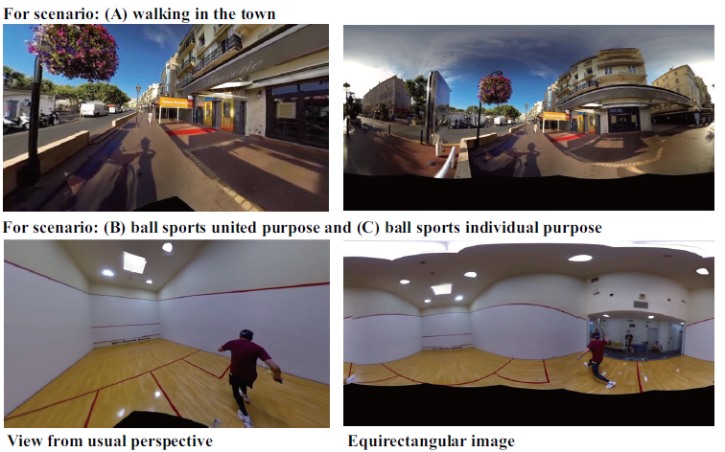
Evaluation of Cybersickness
Scenarios
Scenario (A): Walking in the town
Scenario (B): Ball sports, watching to trace the ball
Scenario (C): Ball sports, watching to trace another player

Slide 10
Experiment setup
Participants perform six tasks in total (non-stabilization/stablization)
A-N, A-S, B-N, B-S, C-N, C-S
Each task is two minutes with a recovery time of 30 minutes interval
Before and after each task, filled out a simulator sickness questionnaire (SSQ)
the degree to which the participant felt nausea, oculomotor discomfort, disorientation, and general cybersickness
12 volunteers aged 20-38

Slide 11
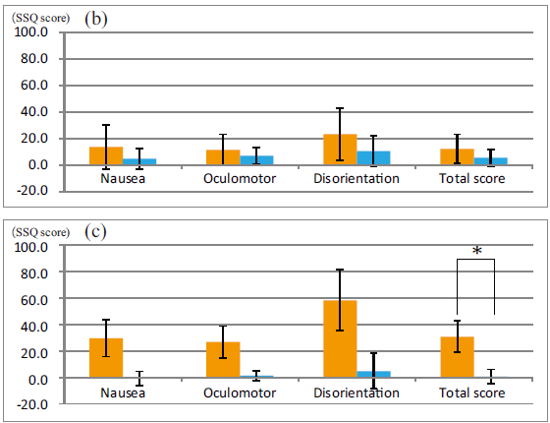
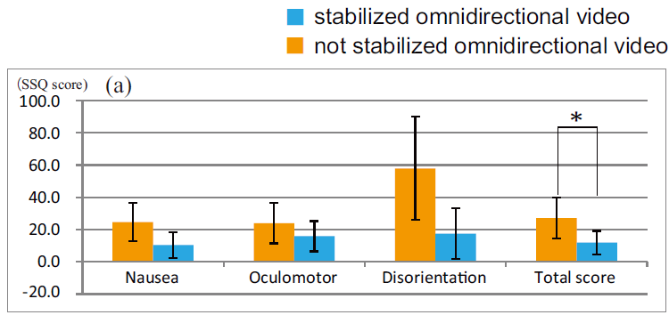
Experiment Results
The stabilization lessened the instances of cybersickness in each scenario
There was a significant difference, between A-N and A-S, also between C-N and C-S

Slide 12
Analyses and Observations
Active viewing behavior or not
Without stabilization, strong disorientation when sudden motion in the direction opposite to their intention occurred (A, C)
Stabilization would be a beneficial feature in FODV application
Synchronization and asyncronization
synchronization in motion of FODV and the spectator will lead lessen cybersickness, and also produce more realistic sensations (B)

Slide 13
Analyses and Observations (cont.)
Existence of first person
head direction is an important indication of awareness, and was eliminated by stabilization
visualization of the wearer’s head direction in the immersive view can address this problem
Cybersickness induced by translational movement even after stabilization
the viewer expects to experience acceleration from the visual motion caused temporal cybersickness
vertical translational motion, which cannot be eliminated by current stabilization process

Slide 14
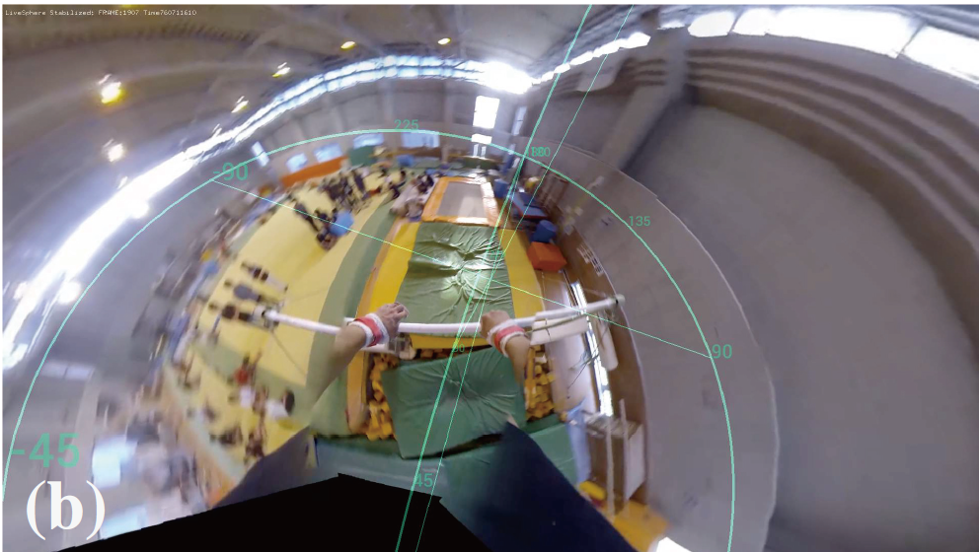
Setup of Workshop
50 people
HMD with head tracking and 15 inch laptop screen
Activities
Virtual travel: realistic feeling, revisit
Virtual gymnastics: with vs. without gymnastics experience
Virtual flying experience of the paraglider: virtual tutorial

Slide 15
Technical Challenges
headgear should be less weighted and more suitable for wear, and even flexible form factor
The stabilization should be improved in terms of compensating for the translational acceleration and vibration noise
Visual gaps in the omnidirectional image also should be addressed
Realtime

Slide 16
Technical Challenges
headgear should be less weighted and more suitable for wear, and even flexible form factor
The stabilization should be improved in terms of compensating for the translational acceleration and vibration noise
Realtime

Slide 17
Design Implications
The risk of cybersickness even with footage of walking activities → stabilization
Overlaying ego-motion of the wearer in omnidirectional video will help the spectator to understand what the wearer was watching and doing

Slide 18
Design Implications
The risk of cybersickness even with footage of walking activities → stabilization
Overlaying ego-motion of the wearer in omnidirectional video will help the spectator to understand what the wearer was watching and doing
Design space for first person omnidirectional video viewing
what kind of user experience is expected, how stabilization should be applied and what other implementation matters

Slide 19
Design Implications (cont.)
Synchronization of motion will lessen the induction of cybersickness, but also will produce an immersive realistic sensation
adaptive control of stabilization will be one of possible application to increase immersion
Viewing angle information of spectators
The collected date of those information will generate meaningful information about social interest in ODV

Slide 20
Conclusion
Omnidirectional video is one of promising media and have capability to capture an immersive first person experience
Aimed to provide a solution for existing problems and to explore design implications
Capturing device and image stabilization to alleviate cybersickness
Evaluating and summarized the findings and insight into design implications
Contribute a further exploration of first person omnidirectional video and expand the eco-system of interactive experience of various media

Slide 21
Related Work
User experience in omnidirectional video
Omnidirectional camera
Cybersickness
Omnidirectional image processing and stabilization

Slide 22
Design parameter
Wider FOV wearable camera will reduce number of camera → reduce the visual gap in stitched omnidirectional video
longer shutter speed or lower frame rate produce image blur which cause error in stabilization
Stitching multiple lower frame rate videos generates not only visual gap, but also unexpected jitter through the stabilization process

Slide 23
Image Stabilization for First Person ODV (cont.)
In each equirectangular video frame I(t), image feature points p_{n}(t) are extracted by finding the visual corner in the equirectangular image
pyramidal KLT tp calculate optical flow f_{n}(t) → p_{n}(t + 1) = p_{n}(t) + f_{n}(t)
2-D image feature points → 3-D points

