Slide 1
Towards the Synchronism of Things
Marcio Ferreira Moreno, Renato Cerqueira and Markus Endler
IBM Research | Brazil, Dept. of Informatics PUC-Rio

Slide 2
Goal
Support the synchronization of media assets independent of media backend features.
=> add new players dynamically
A stable API allows third parties to create plug-ins that interact with the host application.
Notes:
ginga host device – a set up box, a digital TV set or a cell phone
interaction devices – PDA connected to GINGA platform

Slide 3
Naming
Presentation Manager : support the synchronization of media assets and control the logic of the presentation
Multimedia Backend : in charge of transporting, decoding and rendering multimedia content

Slide 4
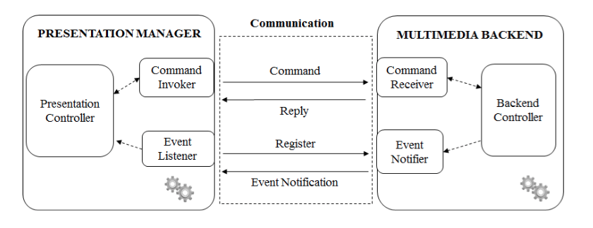
Separation of Concerns
Divide multimedia presentation support into Presentation Manager and Multimedia Backend
Ginga Architecture
<- process isolation ->
Core
* Blocks the process execution until it receives reply
Notes:
Ginga is the middleware specification for IPTV services
Decoupling tge core, ginga is modified to be PM component and the core was modified to be the multimedia backend

Slide 5
Presentation Manager
Presentation Controller : reading the specification of a application and build a presentation plan.
Command Invoker : provide inter-process communication to send the command to Multimedia Backend
The command can be a request of execution or query the variable value.
Event Listener : receive event notification and convert it into the data structure the Presentation Manager expected

Slide 6
Multimedia Backend
Backend Controller : transports, decodes, processes and renders the multimedia content
Command Receiver : parse/check requests validity and reply messages
Event Notifier : notify the registered observers about events

Slide 7
Message Format
Using TCP protocol with JSON format
Notes:
CODE-> identifies a function in multimedia backend

Slide 8
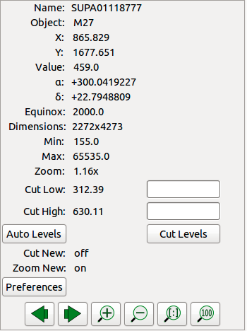
Plug-in Life-cycle
A Ginga plug-in is a media player (?)
From Ginga documentation :
Ginga is written so that most of the functionality of the program is achieved through the use of plugins.
Example: the info plugin provides a pane of commonly useful metadata about the associated channel image.

Slide 9
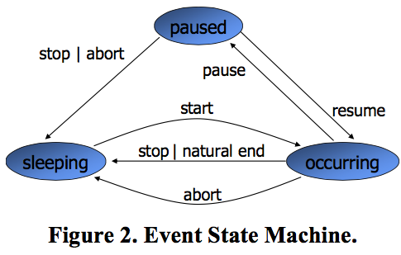
Plug-in Life-cycle
Internal events define the plug-in life cycle
Events type includes presentation event, selection event, attribution event ……
Each event defines a state machine
Plug-in must control all changes in state machine of events, having a state machine as Fig 2.
Notes:
2. when all internal presentation events are in sleeping state, the plug-in life cycle also in sleeping state
3. when pause, stop, resume comes from PM => all internal events goes to pause
4. If internal presentation events are in state different from the occuring and at least one in pause state =>plug-in goes to pause state

Slide 10
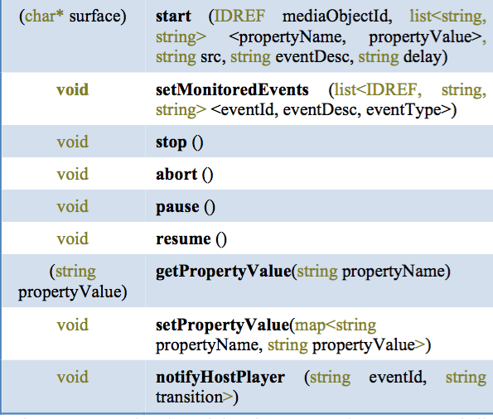
Plug-in API
Extension API allows specification of the needed parameters for synchronization.
Notes:
different type of content, different networks means can introduce distinct requirements for media synchronization
the communication API between PM and plug-in
Presentation Manager can get values of network delay, jitter, content requirements

Slide 11
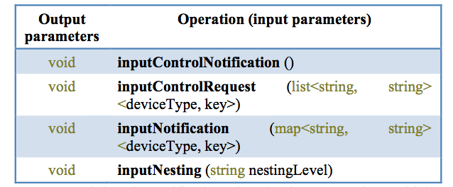
Input Device Control Model
A Ginga plug-in may gain control of the input devices that are before under control of its Presentation Manager. (benefits ?)

Slide 12
The Synchronism of Things with an NCL Application
Nested Context Language (NCL) : a declarative language for hypermedia documents and functions that specifies how multimedia component are related.
Explain each field in NCL, yet not mentioning how to synchronize by using it

Slide 13
Experiments
No environment set up
No experiments steps/scenarios
The memory consumption of the Presentation Manager is lesser than some mobile apps
The mean time of the Presentation Manager waiting is less than 0.5 ms in 97% of the request (Not knowing the requests)

Slide 14
Conclusion
Devices with scarce computational resources can execute multimedia applications.
Reuse the Multimedia Backend to process multimedia content for different Presentation Managers.
It is possible to use monitor tools in a separated device

Slide 15
Comments
Many nouns without clearly definition or explanation, such as synchronism, plug-ins
Leak of figure or text explanation about the system architecture
Not explaining the nouns in Tables
Typo in referencing Fig.2 on sec 4.1
The enhancement from previous work is not highlighted
Notes:
the relationship between plug-in and Presentation Manager
how plug-ins interact with internal events

