Slide 1
A Passive Solution for Interference Estimation in WiFi Networks
Claudio Rossi, Claudio Casetti, and Carla-Fabiana Chiasserini
Politecnico di Torino, Italy

Slide 2
Introduction
Overcrowded, arbitrary deployment of home WLANs → interference from neighboring Access Point (AP) and non-802.11 devices
Existing works
traffic injection: affect normal network operations
trace collection and subsequent analysis: offline applicability
centralized controller or specific-functional WiFi chipset
This work
MAC-layer approach (passive)
Impact of interference → saturation throughput
802.11a, b, and g, easily extended to DCF with handshake as well as to the 802.11e/n EDCA
Notes:
Overcrowded, arbitrary deployment of home wlans lead to interference from nearby access point and from other non-WiFi devices.
there are several existing works studying on interference estimation. But some of them estimate interference by traffic injection, which affect normal network operations, some of them estimate by traffic collection and subsequent analysis, which only have offline applicability, some of them needs centralized controller, which rarely fit the normal situation.
This paper propose a MAC layer approach, to passive estimate the interference. Moreover, to understand the impact of the interference, they derive the saturation throughput. This work can be apply on 802.11a, b, and g, as well as 802.11e/n EDCA

Slide 3
Inferring Interference
the AP estimates whether the channel is sensed busy because of “legitimate” ongoing transmissions or because of interference
T_{e}(k) v.s T_{m}(k) → infer whether unaccounted-for signals (interferers) are cluttering the channel
Measured time interval
Expected time interval
t_{a}(k)-t_{x}(k)
The fraction of time taken by interferers
Total number of frames transmitted by the AP
Notes:
The ap estimate the interference by comparing the Te(k) and Tm(k), which are the expected time interval and the measured time interval, respectively.
As you can see the equation, I is the fraction of time taken by interferers. K is the total number of frames transmitted by the ap. Tm is the measured time interval, which is the interval between ack notification time and starting transmitting time.

Slide 4
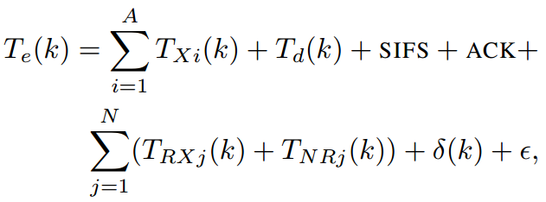
Expected Time Interval
the case where the AP repeats the transmission of a frame four times before success
S: SIFS
D: DIFS
A: ACK
F: Freeze
the transmission duration of the data frame
the retransmission timeout T_{o}
the backoff time associated with the i-th attempt
the DIFS time intervals
Failed transmissions
Successful transmission
Number of WSs
Failed transmissions
Approximation error
Successful transmissions
Non-colliding transmission
Notes:
In terms of the expected time interval, you can see the figure, S is SIFS , D is DIFS, and A is ACK.
Te(k) is as the equation shown, A is the number of failed transmissions for frame k. Txi is the duration of failed transmission, Td is the duration of successful transmission, N is the number of wifi stations of this BSS. TRX and TNR is the durations of successful transmission and failed transmission of other WS s in this BSS.
Delta is the airtime taken by non-colliding transmissions from neighboring BSSs, which operates on the same channel, and Epsilon is the approximation error
Each retransmission attempt could occur at a lower bitrate than the previous one.
Td(k) the duration of the successful transmission, which depends on the data rate and the payload size of the frame and is computed as specified in the 802.11 standard

Slide 5
Computing of the Saturation Throughput
Practical understand the impact of interference
AP computes: average size of the frame payload (P), maximum payload size (P_{max}), average data rate (data and ACK), average PER (p_{e}), and number of active WSs
the probability that a node accesses the medium at a generic time slot
The average size of the frame payload
the average duration of a time interval in which an event occurs
Notes:
To understand the impact of the interference, they further compute the theoretical saturation throughput, which is the maximum achievable throughput in this ap, considering the interference.
E[T] such as a successful transmission or a collision.
Delta:Airtime taken by non-colliding transmissions from neighboring BSSs operating on the same channel

Slide 6
System Implementation
Implement at mac80211 module of the Linux wireless driver compact-wireless 2011-21-01
implement the computation of S and S_{in} with a simple user-space program that reads the measurements from file system

Slide 7
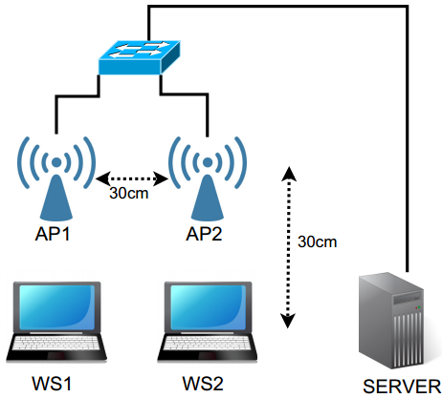
Experiment Setup
18 detectable APs
part of 6 different SSID, whose signal is received at an average strength of −83 dBm
2 stations and 2 APs
Each AP runs the modified driver for the computation of I and the application for the computation of S and S_{in}
BSS1 operates on channel 6 while BSS2 acts as an interferer
saturate BSS1’s capacity with a downlink UDP flow from the server to WS1 (through AP1), at a rate of 30 Mbps
BSS1
BSS2
Notes:
Server is a traffic sink
They are interested in the throughput loss caused by interferers, so they saturate

Slide 8
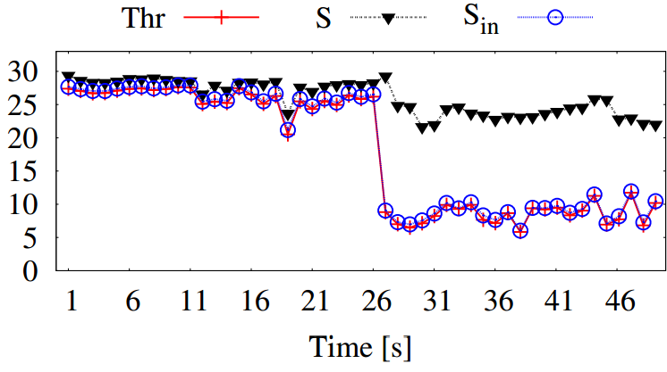
Performance on Different channel
No traffic within BSS2
30 Mbps from server to WS2
Notes:
In this experiment, they set ap2 operate on channel 11, and ap1 operates on channel 6
Thr is the actual throughput, s is the estimated saturation throughput without considering interference, sin is the throughput considering the interference
Sin closel
Delta is determined by those BSSs that operate on the same channel as BSS1 (channel 6). All these quantities are expressed as percentagesy matches the throughput measured by AP1 (T hr) before and after the interfering flow is enabled within BSS2

Slide 9
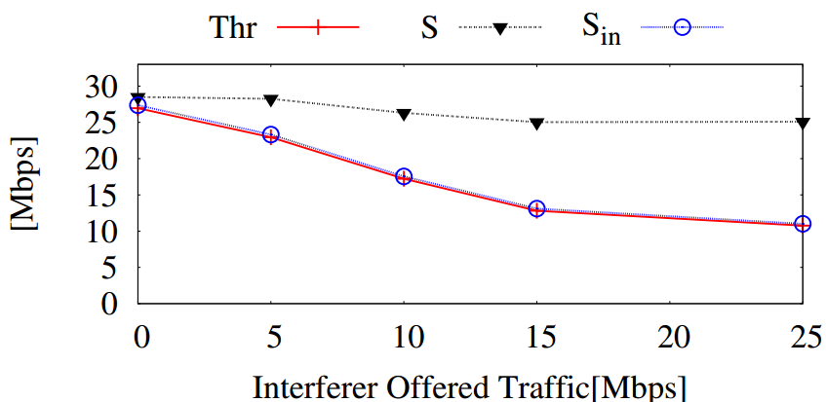
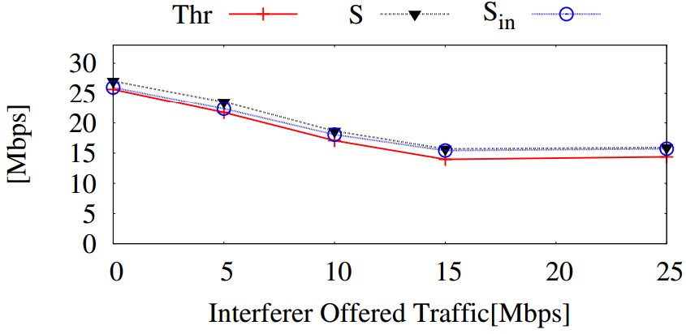
varying both the channel used by the interferer (BSS2) and its offered load
AP2 operates on channel 6, 7, 9, 11
Channel 6
Channel 11
Notes:
Fig. 4 the comparison between the throughput
measured by AP1 (T hr), S and Sin for channel 6 (top) and 11 (bottom).
T hr decreases as the interferer traffic load increases.
Again, S accurately estimates the throughput of BSS1 only in case of co-channel interference,
i.e., when BSS2 operates on channel 6

Slide 10
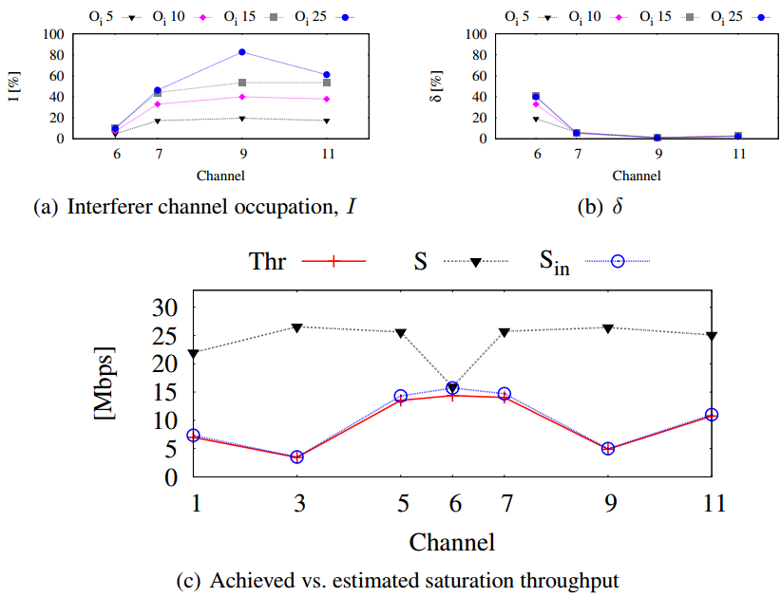
varying both the channel used by the interferer (BSS2) and its offered load
Notes:
The top left figure shows that I accurately capture the impact of different channel interference, while the top right figure shows delta accurately capture the impact of co-channel interference.
Sin closely matches the result of thr, thr changes significantly is due to the different multipat conditions affecting the channels.

Slide 11
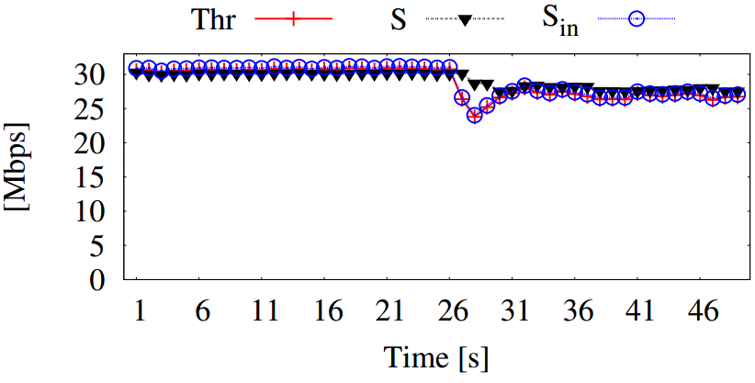
Non-WiFi Devices Interference
Bluetooth file transfer between 26-50 s
Bluetooth adaptive frequency hopping scheme
Notes:
This effect is due to the Bluetooth adaptive frequency hopping (AFH)
scheme, which tends to avoid channels characterized by high PER

Slide 12
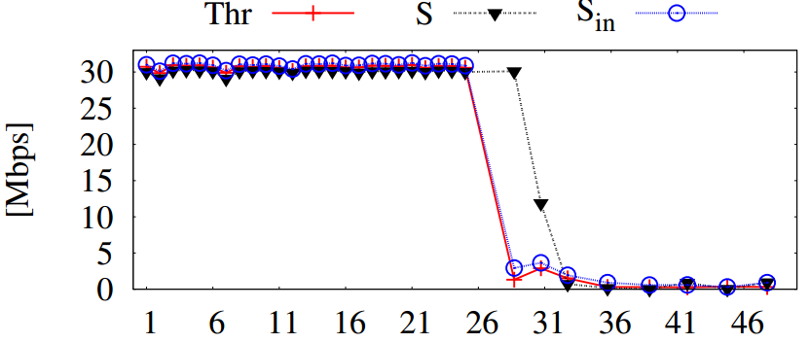
Non-WiFi Devices Interference
analog video sender as interferer from 26 s
Notes:
The interference generated is so strong that the throughput drops almost to zero after a couple of seconds

Slide 13
Conclusion
designed and implemented a technique for interference estimation in 802.11 WLANs
Implemented at the access point and does not require any specialized hardware
validated our technique in a 802.11g network with different types of interferers
Can estimate the impact of interference with excellent accuracy, under different scenarios

