Slide 1
A QoE study of different stream and layout configurations in video conferencing under limited network conditions
Simon N.B. Gunkel, Marwin Schmitt, Pablo Cesar CWI: Centrum Wiskunde & Informatica Science Park 123, 1098 XG Amsterdam, Netherlands gunkel@cwi.nl, schmitt@cwi.nl, p.s.cesar@cwi.nl
IEEE Quality of Multimedia Experience (QoMEX) 2015

Slide 2
Introduction
Wide popularity of video conferencing systems
Limited research work in the aspect of group conversation analysis in video conferencing
one to many
This paper study the relationship between QoE and three different factors: layout, video quality, and network limitations

Slide 3
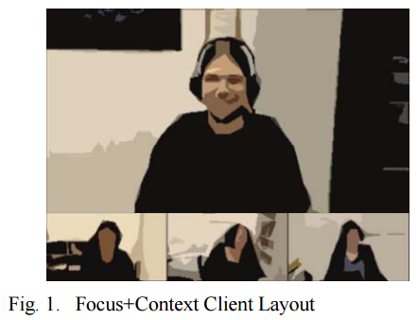
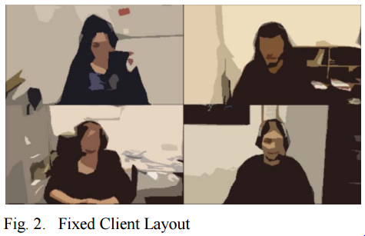
Current Video Systems

Slide 4
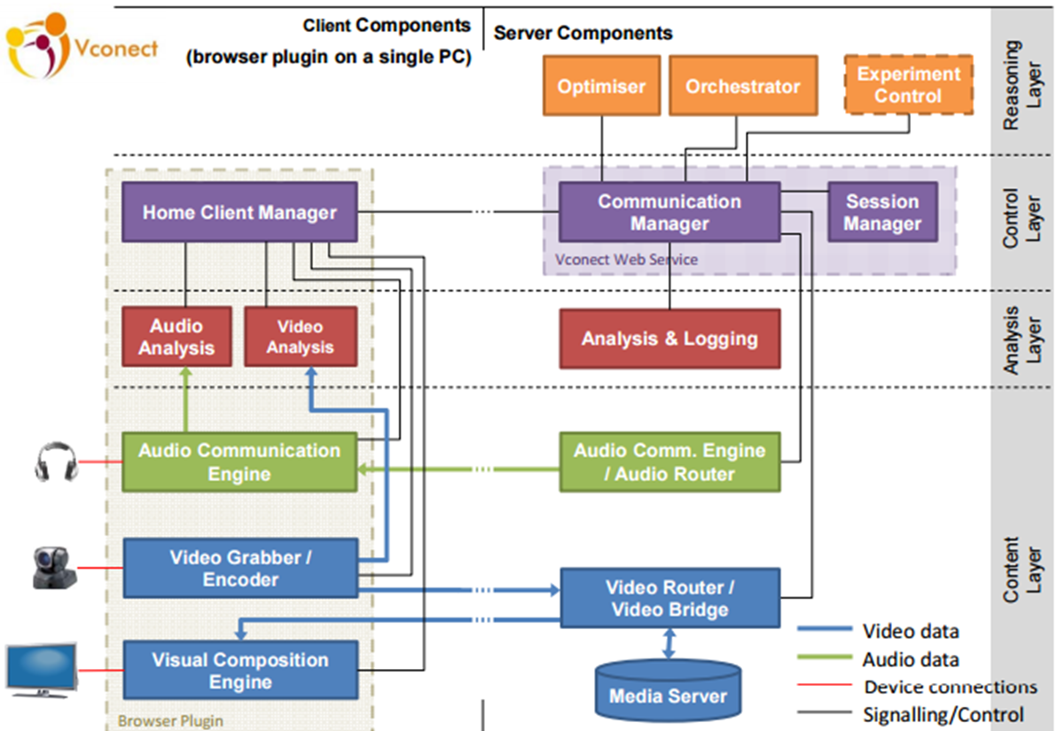
System and Architecture
European Framework 7 project Vconect
Server-centric architecture

Slide 5
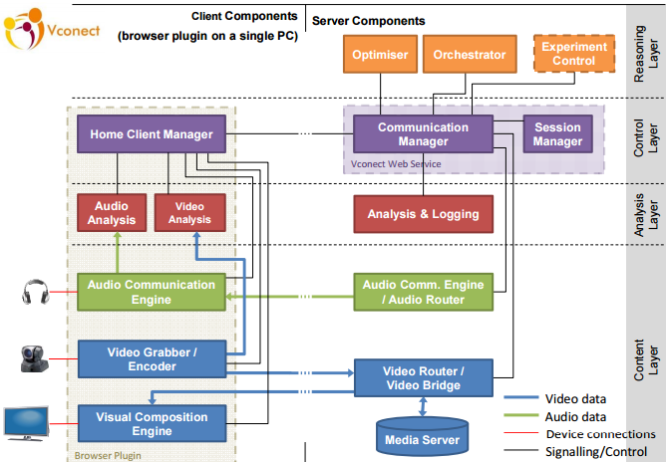
Client side
capturing, encoding and transmitting (conventional video chat)
receive, decode and compose multiple audio and video streams
automated analysis of the captured audio and video stream

Slide 6
Server side
Social communication between a large number of end points
Efficient packet switch and replicator which connects multiple source to multiple clients
Messages transmissions between components and session management

Slide 7
Reasoning Layer
The Optimiser ensures optimal use of the network at lowest cost, while maximizing the Quality of Experience for users
Orchestrator takes decisions on the visual layout and whom to show
The Experiment Control adjusts the algorithm to the different study conditions, and helps to synchronize log data from the different components

Slide 8
follow a fixed rather than dynamic optimization approach, based on there 4 study conditions
The goal here is to better understand the possible QoE impact of different strategies and client layouts

Slide 9
Study Setup and Methodology
focus on the relationship between QoE and three different factors: layout, video quality (resolution) and network limitations (packet loss)
20 participants in 5 groups
from 16 different nationalities, with an average age of 27 (SD 5), and 6 different professions
discussion about “wilderness survival”
already employed in other multi-party video conferencing studies and a similar task is suggested in ITU P.1301
4 different layout/stream configurations

Slide 10
Research Questions
RQ1. How is the relationship between individual influencing factors and the QoE?
RQ2. What is the impact of network restrictions to the choice of layouts?
RQ3. Can we improve the QoE by choosing a particular layout and stream configuration based on the network limitations?

Slide 11
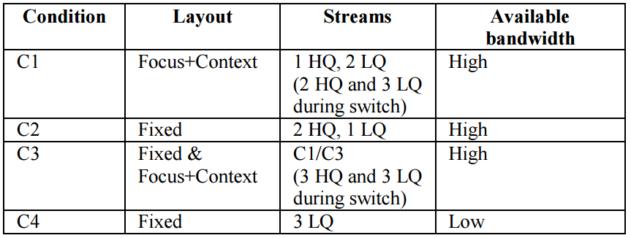
Study Conditions
LQ: 320x180, 15 fps, and 128 kbps
HQ: 1280x720, 15fps and 800kbps
C1/C2

Slide 12
Procedure
Similar PC and rooms (furniture and lighting)
12 questions, assessed on a 9-Point likert-like scale
4 questions directly concerned with QoE
Overall experience
Visual quality
Audio quality
Distortion
Collect information from the System (network data, communication data) and questionnaire data

Slide 13
Results - Questionnaire Rating and Network Loss
The Overall Experience, Video Quality and Audio Quality are rated similar across the whole study except the distortion
it is difficult for the participants to differentiate the between the different factors that influence the QoE

Slide 14
Results - Questionnaire Rating and Network Loss
The loss mainly occurs in the high resolution streams
higher data transfer rates and peaks while switching streams, as well as transmitting I-frames
the distortion rating and the loss rate follow the same pattern
the error has more impact on the QoE than the lower quality due to lower resolution and bitrate

Slide 15
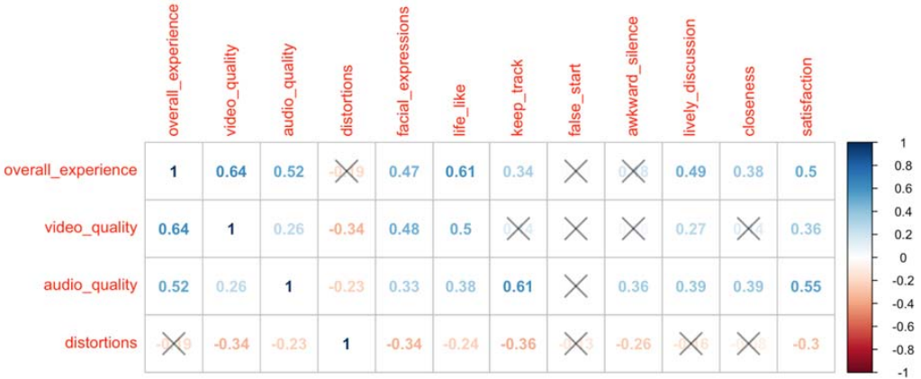
Results – Conditions and Correlations
the most values correlate (at least weak) with a negatiive correlation of distortion

Slide 16
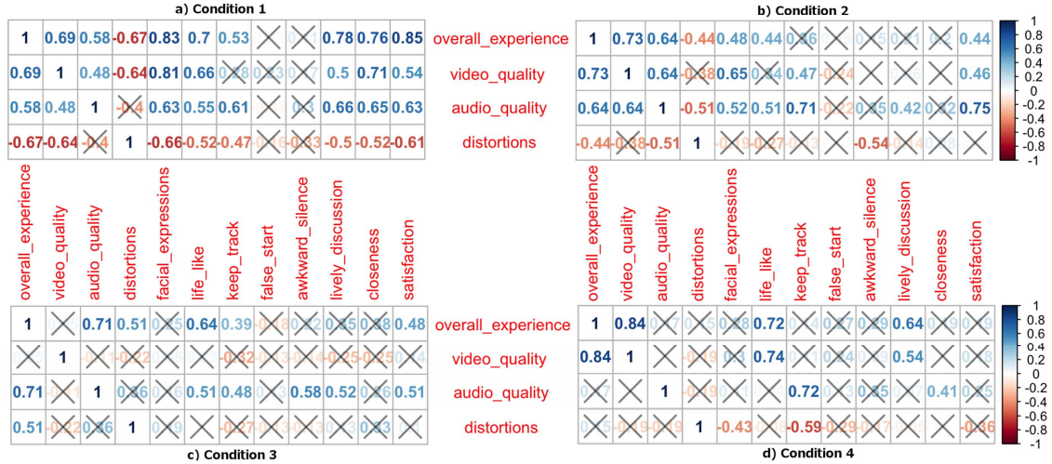
Results – Conditions and Correlations
Audio became more important than video under condition 3

Slide 17
Results – Overall ranking
a stronger tendency of users towards the tiled layout (C2 + C4)

Slide 18
Conclusion
it is difficult for participants to distinguish between the overall conversation dynamics and the different other factors (like video and audio quality) that influence the perception and QoE
the correlations between different influencing factors are different in the different conditions
our conversation task does not strongly depend on visual ques
the stability of the system and a balanced stream quality, as well as, a balanced visual layout seems most satisfying to the users

