Slide 1
A Software Defined Networking Architecture for the Internet-of-Things
Network Operations and Management Symposium (NOMS), 2014 IEEE.
Zhijing Qin∗, Grit Denker§, Carlo Giannelli‡, Paolo Bellavista‡, Nalini Venkatasubramanian∗
∗ University of California, Irvine, USA
‡ University of Bologna, Italy
§ SRI International, USA

Slide 2
Introduction
The IoT scenarios give rise to many technical and organizational challenges
Real world IoT deployments are characterized by very heterogeneous devices and connectivity capabilities
New challenges are introduced
Shared provisioning of network and sensor resources across apps
Interoperability challenge of the heterogeneous applications and devices
Contribution of this paper
Propose a novel IoT multi-network controller
Introduce and modify the Network Calculus to model IoT multi-network
Propose a multiple-QoS-constraints flow scheduling algorithm

Slide 3
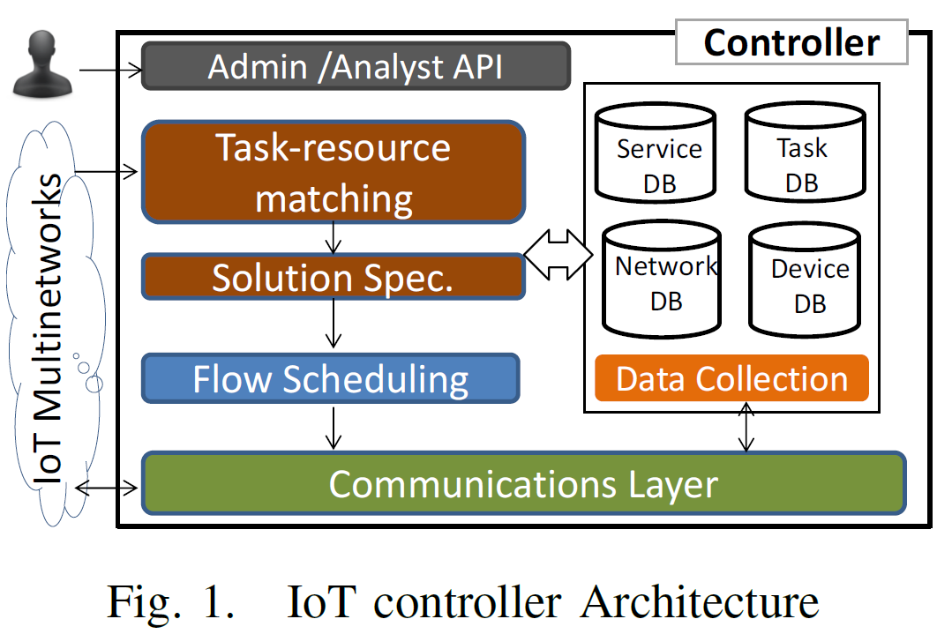
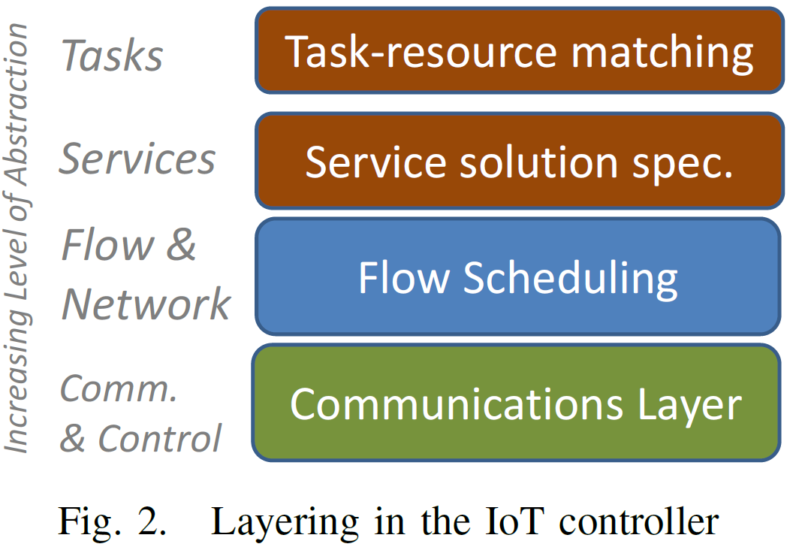
Controller Architecture
Fig. 1 shows the controller architecture
Admin/Analyst API enables control processes by humans or external programs
Fig. 2 shows the layered view
Hide details of lower layers so that tasks can be accomplished in a more flexible way
Separate abstraction levels allow dedicated algorithms for a certain layer

Slide 4
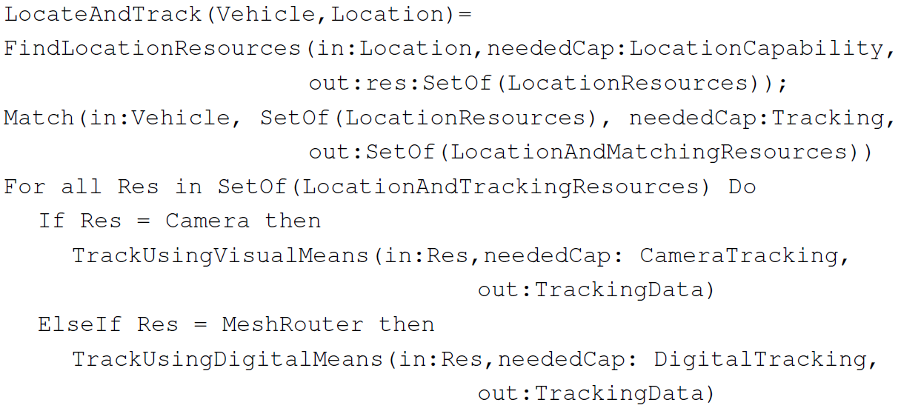
Resource Matching
A bridge between high level task descriptions and low level resource specifications is needed
Employ a semantic modelling approach to provide such bridge
Describe characteristics and capabilities of network and device resources and services
Describe IoT tasks as hierarchical semantic tasks descriptions
Example: a generic task description for “LocateAndTrack(Vehicle, Location)”

Slide 5
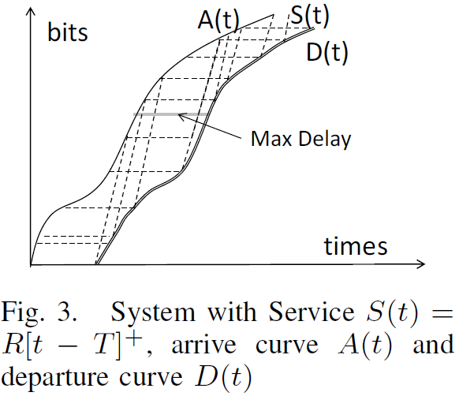
Flow Scheduling - Network Calculus-Based Model
Network Calculus [23] is a technique dealing with queueing type problems in modern packet-switched computer networks
Focus on performance guarantees, modeling arrival traffic, service capability, and departure traffic as curves
[23] J.-Y. Le Boudec and P. Thiran, Network calculus: a theory of deterministic queuing systems for the internet. Springer, 2001, vol. 2050.

Slide 6
Flow Scheduling - Network Calculus-Based Model (Cont.)
Assume each node has constant capacity $R$ and can provide a service curve $S\left(t\right)={R[t−T]}^{+}$ as Fig. 3
$T$ is the transmission delay, which depends on $R$, the length of the packet, and the amount of data in front of this packet when it hits the queue
Use min-plus convolution on arrival and service curves to generate a departure curve:
which means

Slide 7
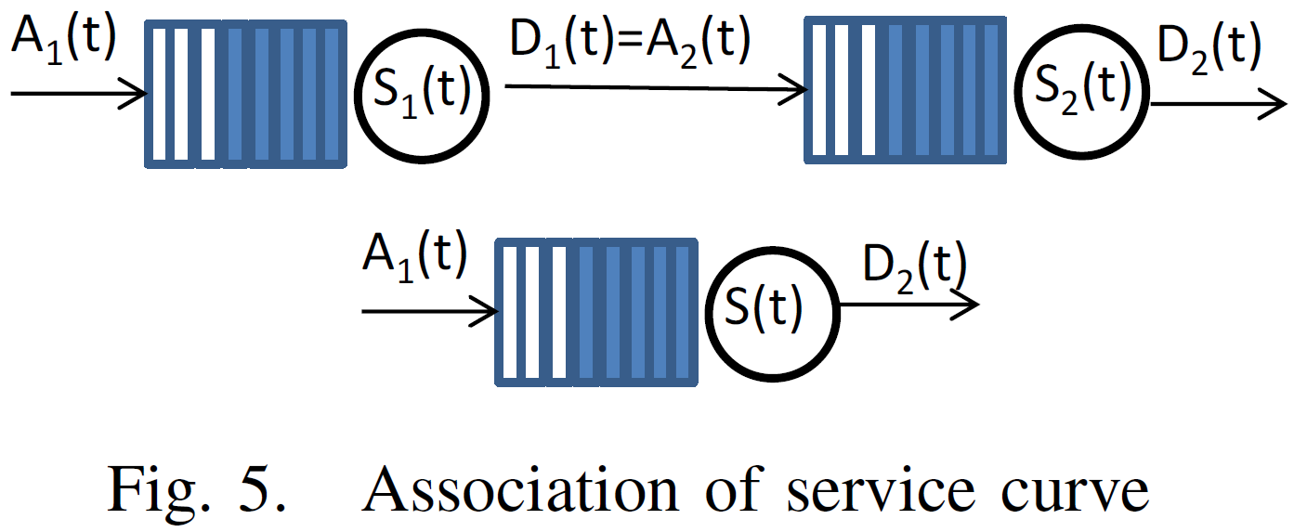
Flow Scheduling - Network Calculus-Based Model (Cont.)
Two properties enabling Network Calculus to model multiple flows in complex networks
If there’s more than one flow going through a node, all flows share the same transmission service
In a multi-hop path, the departure curve of current hop is the arrival curve of the next hop as in Fig. 5
Modify classic Network Calculus by examining the traffic as a set of discrete points, where each point represents a packet

Slide 8
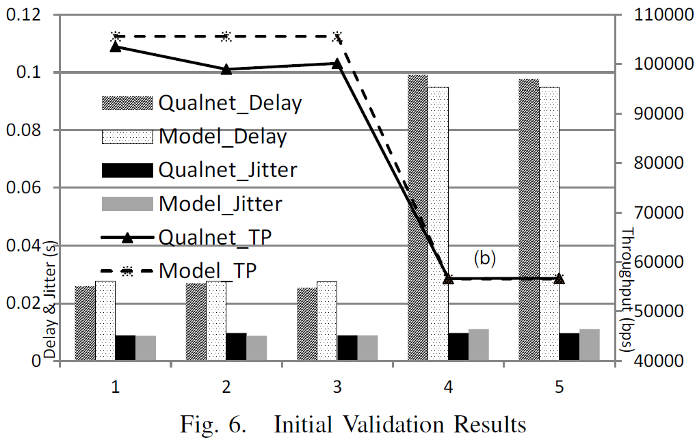
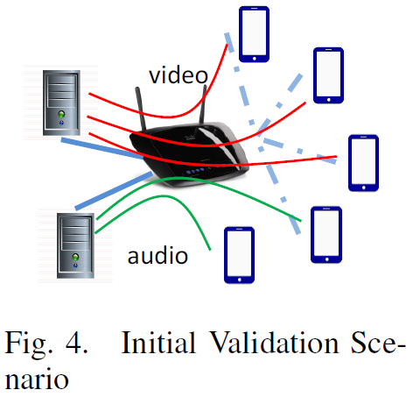
Flow Scheduling - Network Calculus-Based Model (Cont.)
Define jitter as the difference between two successive packet arrival intervals
Once get arrival curve D(t) of flow i at destination node by the modified Network Calculus model, compare it with flow i’s initial arrival curve A(t)
Each packet suffers from a delay and have a final arrival time
Validation:
Two-hop network
Qualnet simulator
Average error rate of delay, jitter, and throughput are 0.05, 0.08, and 0.03

Slide 9
GA-Based Multi Constraints Flow Scheduling
A communication path in a network perfectly matches with the chromosome concept in GAs
Nodes are the genes
Mutation and crossover can be done by replacing a sub-path and exchanging sub-paths between two paths
Fitness value is the QoS performance of the flow going through this path
Many GA-based routing protocols with multiple QoS constraints have been proposed [28], [29], [30], but this paper makes the following key contributions
Take the inter flow interference into consideration
Schedule the flows over links with different capacity
[28] R. Leela et al., “Multi-constraint qos unicast routing using genetic algorithm,” Appl. Soft Comput., vol. 11, no. 2, Mar. 2011.
[29] F. Xiang et al., “Qos routing based on genetic algorithm,” Computer Communications, vol. 22, no. 1516, pp. 1392 – 1399, 1999.
[30] A. Koyama et al. “A ga-based multi-purpose optimization algorithm for qos routing,” in Advanced Information Networking and Applications, 2004.

Slide 10
GA-Based Multi Constraints Flow Scheduling (Cont.)
Problem statement
Given a directed graph $G<V,E>$, each link $(u,v)∈E$ has a capacity $R_{u,v}$
$F$ is the set of flows and each flow $f_{i}∈F$ has several parameters: source $s$, destination $d$, start time $t_{0}$, and arrival curve $A_{i}(t)$
Each flow has a QoS requirements vector $Q_{i}=<w_{d},w_{j},w_{t}>$
The problem is to find a path $p$ from source node to destination node for each flow, such that:
Data structures and procedures: chromosome structure and Initialization
A chromosome represents a path
Each flow $f_{i}$ eventually has one chromosome
Two initial chromosomes for each flow are set by using Dijkstra’s algorithm

Slide 11
GA-Based Multi Constraints Flow Scheduling (Cont.)
Fitness Value
Crossover
choose the most two top ranked chromosomes with common genes as the parents
E.g., use (s, a, b, c, d) and (s, e, b, d) to generate two children (s, a, b, d) and (s, e, b, c, d)
Mutation
Given a path s,a,b,c,d, choose a bottleneck node, say b
Among the neighbors of its last hop, node a, randomly choose another node x which can reach destination d => get mutation path s, a, x, …, d

Slide 12
GA-Based Multi Constraints Flow Scheduling (Cont.)
Acceptance and Replacement
The top two chromosomes of the output of mutation will replace the current two chromosome parents
New parents will be the input of the Crossover procedure for the next iteration
Termination
The algorithm iteratively runs until each flow has a feasible path (with fitness value 0) or the predefined generation size is achieved

Slide 13
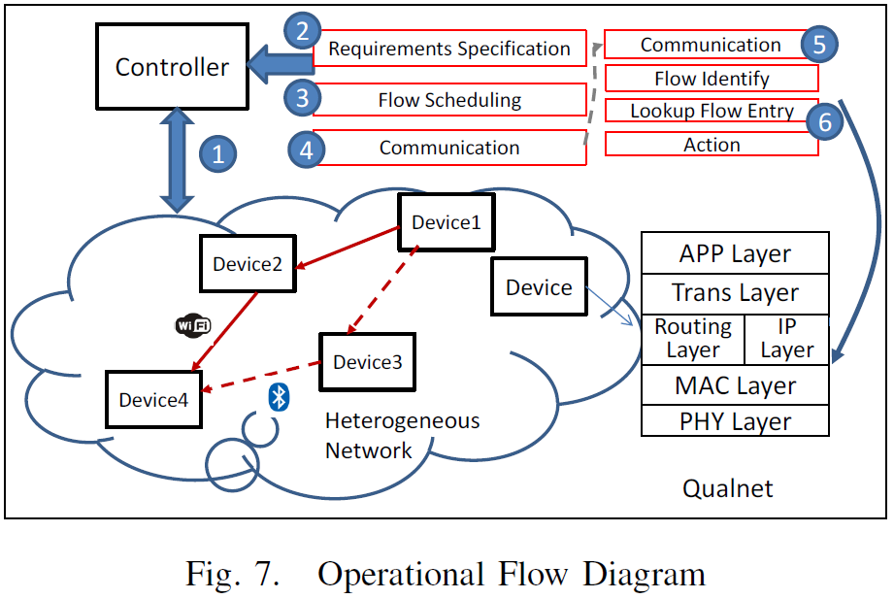
Experiment Setup
Implement the prototype of the proposed controller using Qualnet simulation platform [31]
Customized Qualnet with SDN features by injecting an OpenFlow-like protocol in IP layer
[31] “Scalable networks technologies http://www.scalable-networks.com.”

Slide 14
Experiment Setup (Cont.)
Compare GA-based flow scheduling with two common scheduling algorithms used in SDN world
Bin packing: tries to maximize the link utilization
Load balancing: let total amount of the flows is proportional to the capacity of the link
Exploit a real deployed smart campus network topology [32]
Vehicles with wireless connectivity exploit either LTE or WiFi road side units to receive data from servers
Consist of 3 data servers, 3 edge switches, 2 core routers, and 15 APs with 45 end devices
Three types of APs: WiFi, Femtocell, and Bluetooth
[32] UC Berkeley campus network maps. [Online]. Available: http://net.berkeley.edu/netinfo/newmaps/

Slide 15
Experiment Setup (Cont.)
Each of the three data servers provides either file sharing, tele audio, or video streaming services
File sharing flows are modeled by sending Constant Bit Rate with packet length uniformly distributed in [100, 1000] bytes with period T
Tele audio and video streaming flows are from real traffic traces [26, 27]
[26] Video streaming trace files. [Online]. Available: http://trace.eas.asu.edu/TRACE/ltvt.html
[27] Skype tele audio trace files. [Online]. Available: http://tstat.polito.it/traces-skype.shtml

Slide 16
Experiment Procedure
In GA-based algorithm, initially choose two paths for each flow as parents
Services have different QoS requirements
File sharing service requires large throughput
Tele audio service requires low delay
Video streaming service requires low jitter
Instead of setting particular QoS requirement in the simulation, the authors try to optimize QoS performance in a predefined amount of generations (set 10 here)
Changes in equation and the parameters
Fitness value: ${αx}_{d}\text{+}βx_{j}+γ\left(\frac{10000}{x_{t}}\right)$
 | α | β | γ
File Sharing | 0 | 0 | 1
Tele Audio | 1 | 0 | 0
Video Streaming | 0 | 1 | 0

Slide 17
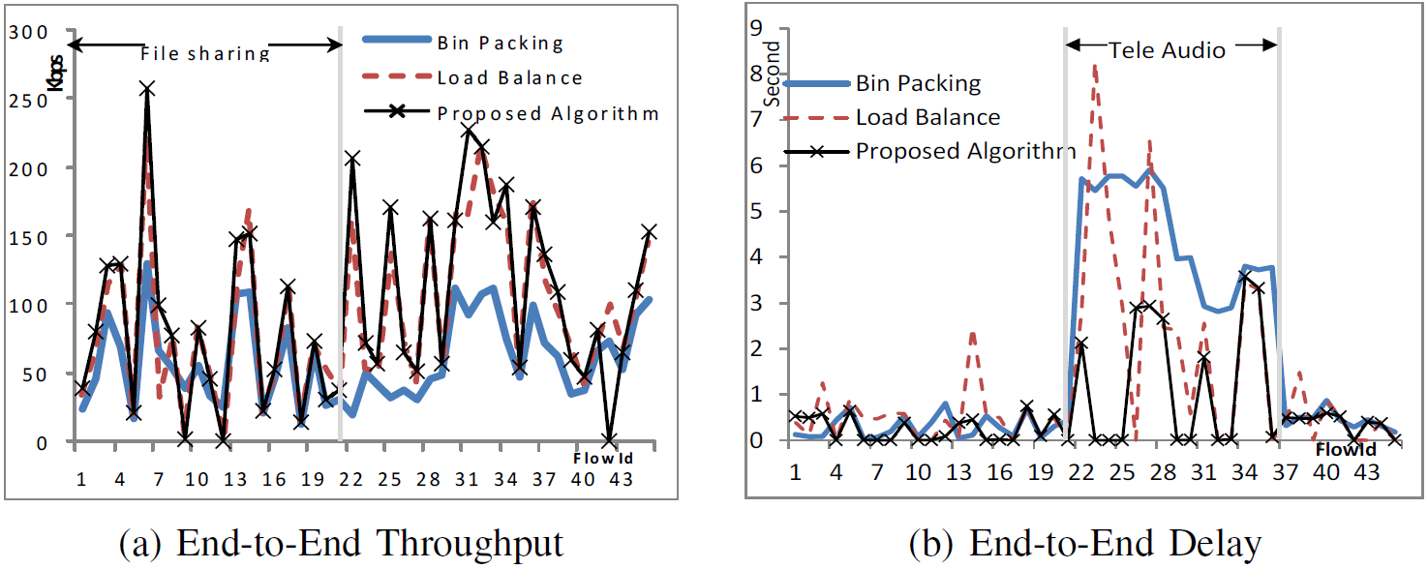
Evaluation Results

Slide 18
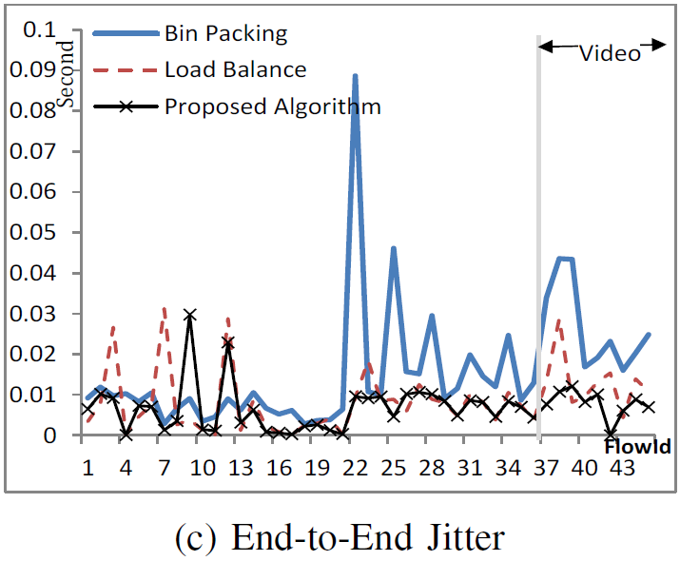
Evaluation Results (Cont.)

Slide 19
Conclusion
This paper presented an SDN controller design in IoT Multinetworks
Gave a vision on tasks and resources in IoT environments
Illustrated how to bridge the gap between abstract high level tasks and specific low level network/device resources
Developed a variant of Network Calculus to estimate the end-to-end flow performance
Simulation has shown that the proposed flow scheduling algorithm has better performance compared with existing ones
Currently in the process of integrating the layered controller design with the MINA software stack

