Slide 1
A Scheduling Strategy on Load Balancing of Virtual Mahcine Resources in Cloud Computing Environment
3rd International Symposium on Parallel Architectures, Algorithms and Programming
Jinhua Hu, Jianhua Gu, Guofei Sun, and Tianhai Zhao
NPU HPC Center
Xi’an, China

Slide 2
Introduction
On cloud computing platform, resources are provided as service and by needs
It will lead to resource waste if the resources cannot be properly distributed
Current VM resources scheduling mainly considers the current state of the system, but seldom considers system variation and historical data, which leads to load imbalance
This paper considers the historical data and current state, which tries to solve the problem of load imbalance and high migration cost by traditional algorithms

Slide 3
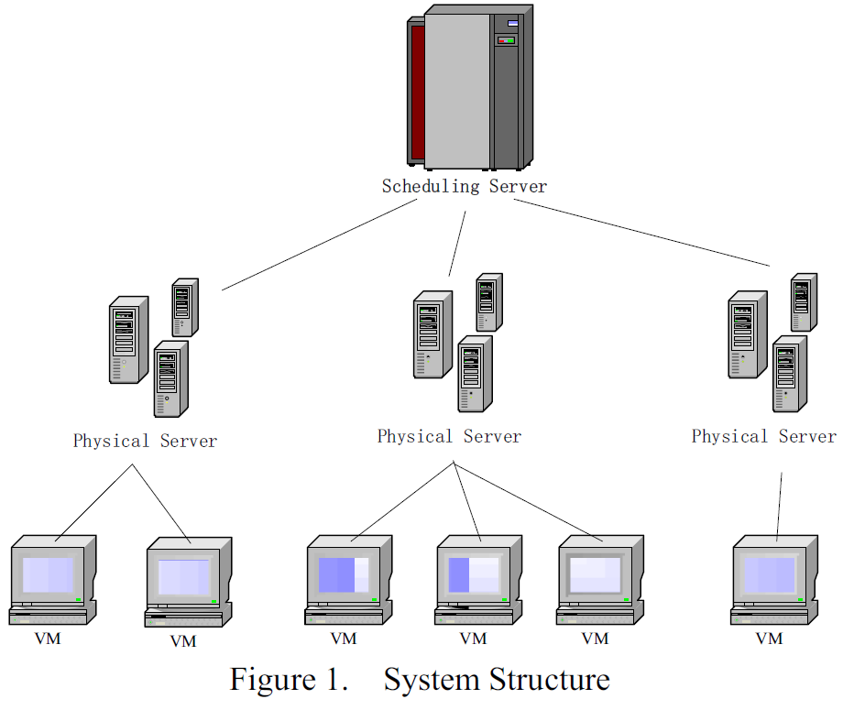
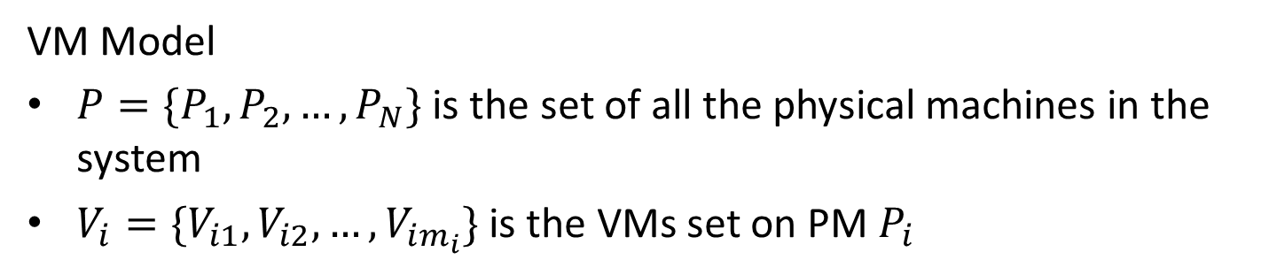
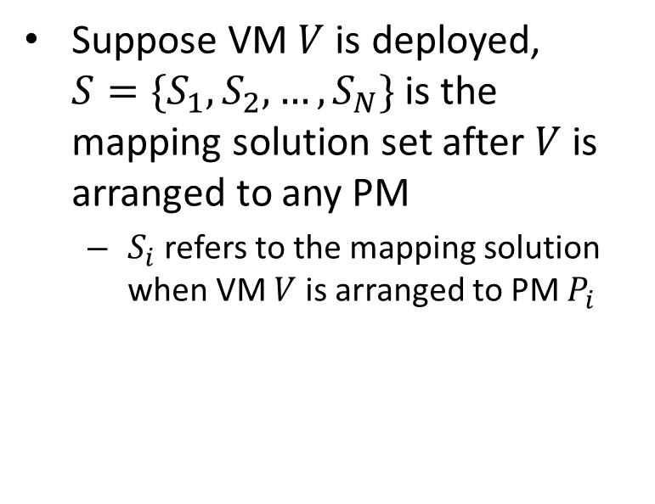
The Model Design of VM Scheduling
VM Model
$P=\{P_{1}, P_{2}, …, P_{N}\}$ is the set of all the physical machines in the system
$V_{i}=\{V_{i1}, V_{i2}, …, V_{im_{i}}\}$ is the VMs set on PM $P_{i}$
Suppose VM $V$ is deployed, $S=\{S_{1}, S_{2}, …, S_{N}\}$ is the mapping solution set after $V$ is arranged to any PM
  $S_{i}$ refers to the mapping solution when VM $V$ is arranged to PM $P_{i}$

Slide 4
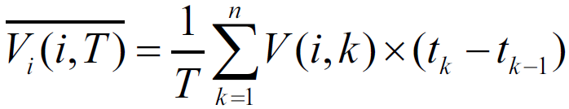
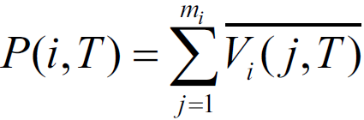
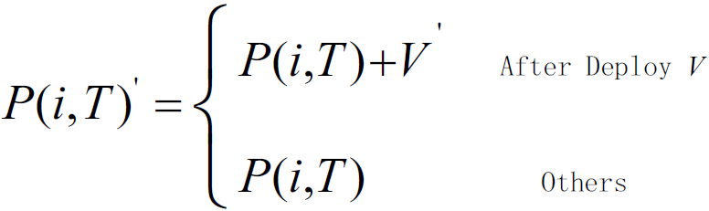
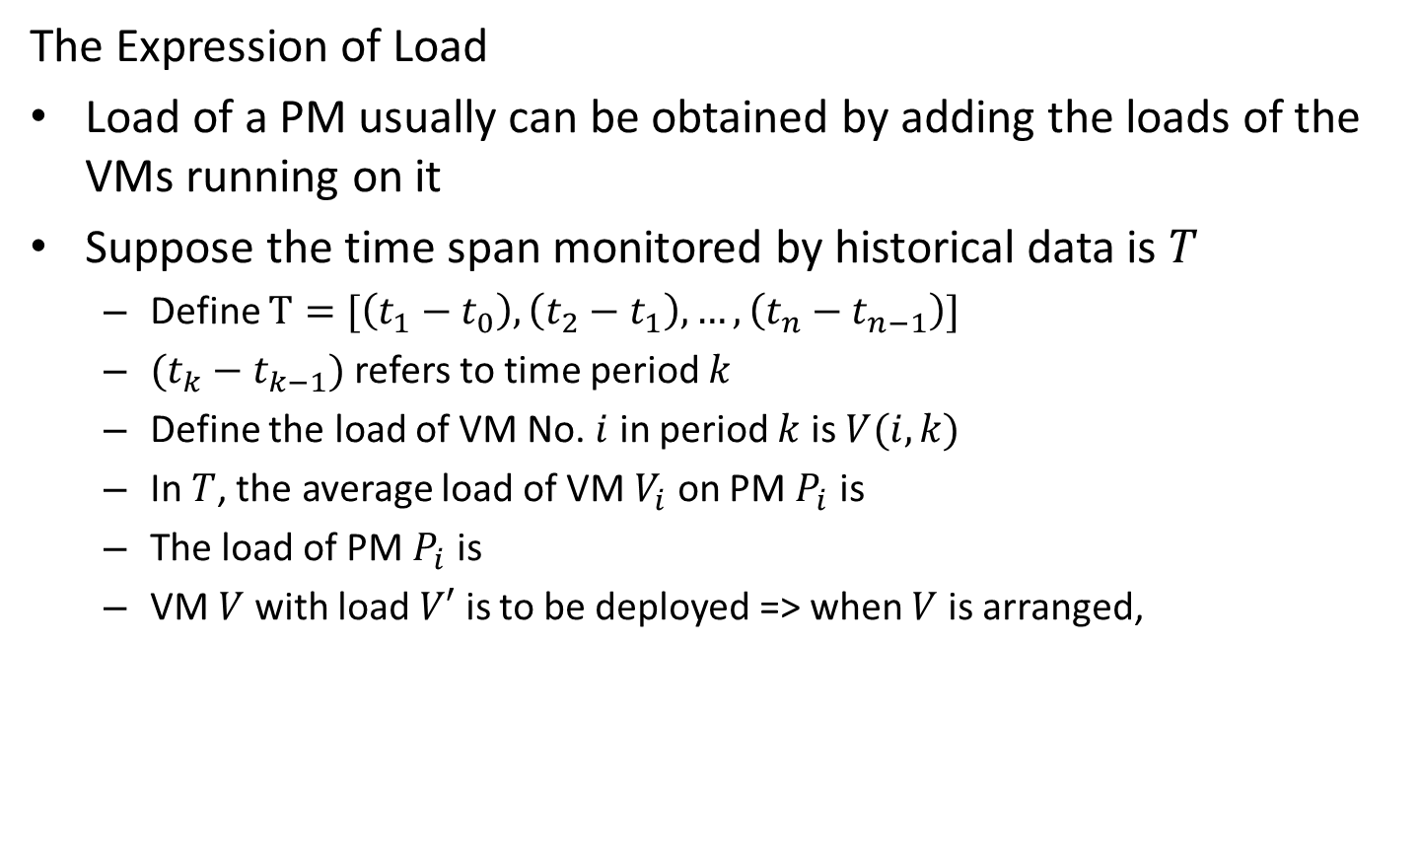
The Model Design of VM Scheduling (Cont.)
The Expression of Load
Load of a PM usually can be obtained by adding the loads of the VMs running on it
Suppose the time span monitored by historical data is $T$
  Define $T=[\left(t_{1}−t_{0}\right), \left(t_{2}−t_{1}\right), …, \left(t_{n}−t_{n−1}\right)]$
  $(t_{k}−t_{k−1})$ refers to time period $k$
  Define the load of VM No. $i$ in period $k$ is $V(i, k)$
  In $T$, the average load of VM $V_{i}$ on PM $P_{i}$ is
  The load of PM $P_{i}$ is
  VM $V$ with load $V′$ is to be deployed => when $V$ is arranged,

Slide 5
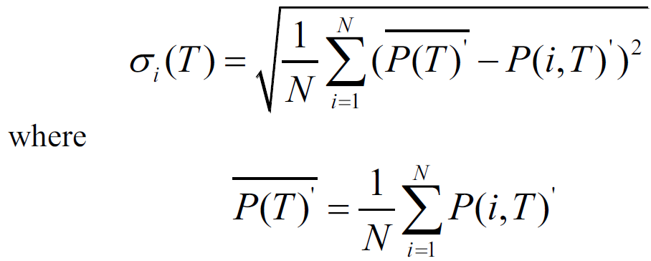

The Model Design of VM Scheduling (Cont.)
The Expression of Load (Cont.)
The load variation of mapping solution $S_{i}$ in time period $T$ after VM $V$ is arranged to PM $P_{i}$ is

Slide 6
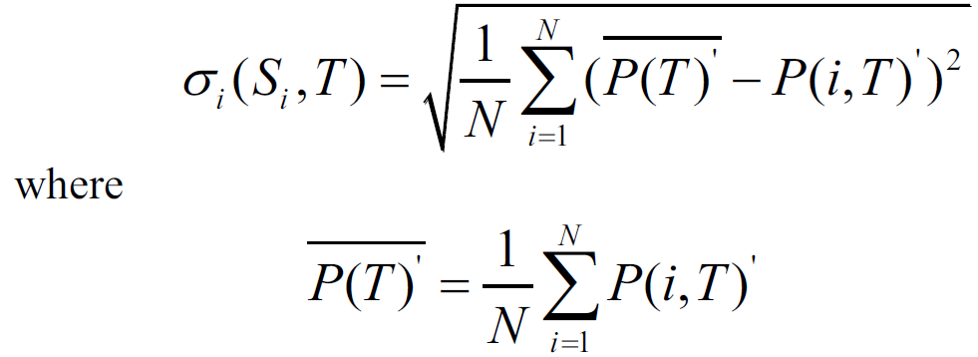
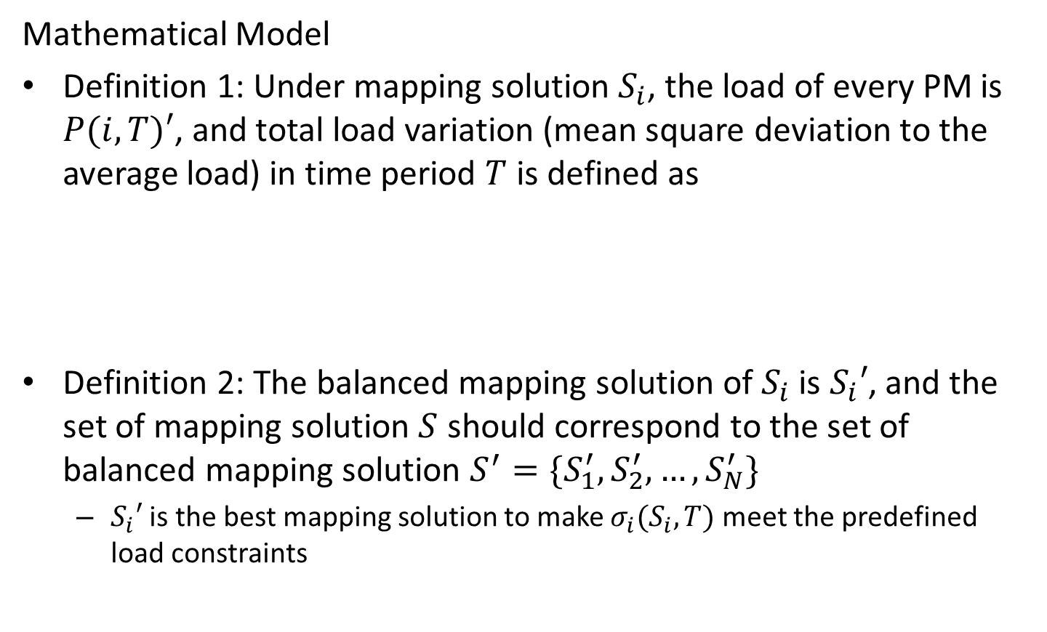
The Model Design of VM Scheduling (Cont.)
Mathematical Model
Definition 1: Under mapping solution $S_{i}$, the load of every PM is $P(i, T)′$, and total load variation (mean square deviation to the average load) in time period $T$ is defined as
Definition 2: The balanced mapping solution of $S_{i}$ is $S_{i}′$, and the set of mapping solution $S$ should correspond to the set of balanced mapping solution $S^{′}=\{S_{1}^{′}, S_{2}^{′}, …, S_{N}^{′}\}$
  $S_{i}′$ is the best mapping solution to make $σ_{i}(S_{i}, T)$ meet the predefined load constraints

Slide 7
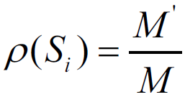
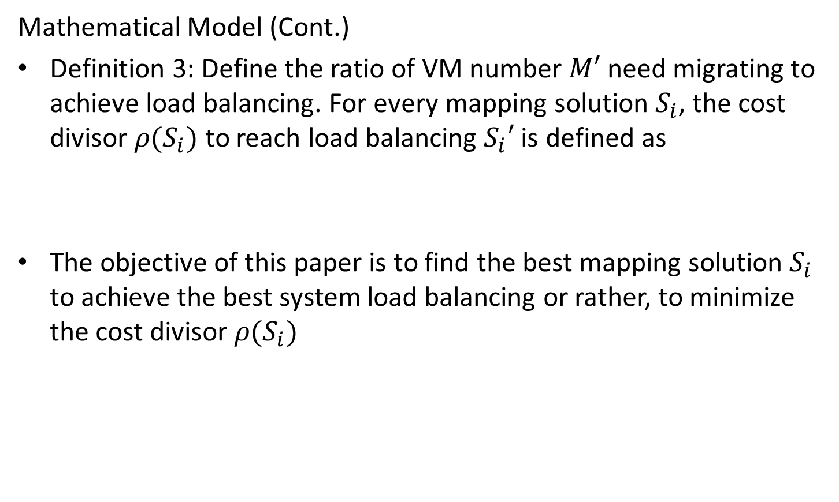
The Model Design of VM Scheduling (Cont.)
Mathematical Model (Cont.)
Definition 3: Define the ratio of VM number $M′$ need migrating to achieve load balancing. For every mapping solution $S_{i}$, the cost divisor $ρ(S_{i})$ to reach load balancing $S_{i}′$ is defined as
The objective of this paper is to find the best mapping solution $S_{i}$ to achieve the best system load balancing or rather, to minimize the cost divisor $ρ(S_{i})$

Slide 8
Realization of Balanced Scheduling through Genetic Algorithm
Genetic algorithm is a random searching method developed from the evolution law in the ecological world
  After the first population is produced, it evolves better approximate solutions based on the law of survival of the fittest and from generation to generation
  In every generation, the individual is chosen based on the fitness of different individuals in a certain problem domain
  Then the individuals combine and cross and vary by the genetic operators in natural genetics and a new population representing a new solution set is produced

Slide 9
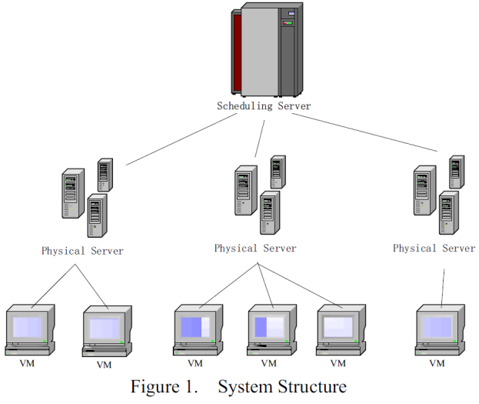
Realization of Balanced Scheduling through Genetic Algorithm (Cont.)
Population Coding
Need to do the coding for the problem
  Classic genetic algorithm marks the chromosome structure of genes by binary codes
  For this paper, it is a one-to-many mapping between PM and VMs
  This paper chooses tree structure to mark the chromosome of genes [18]
  Every mapping solution is marked as one tree
    Root nodes: the scheduling and managing node of the system on the first level
    Second level: all of the N nodes stand for PM
    Third level: M nodes stand for the VMs on the PMs
[18] Yunzhu Ni et al., “The Solution of Disk Load Balancing Based on Disk Striping with Geneti Algorithm,” Chinese Journal of Computers, 2006.

Slide 10
Realization of Balanced Scheduling through Genetic Algorithm (Cont.)
Initialization of Population
Mainly use the method of spanning tree and have the following definitions for the tree
  The tree is a spanning tree constructed by the elements in the PM set and VM set
  The root node of the tree is the predefined management source node
  All PM nodes and VM nodes are included in the tree
  All leaf nodes are VM nodes
First, compute the selection probability p (the ratio of a single VM load to the load sum of all VMs) of every VM
Based on p, all logic disks are allocated to the smallest-loaded node in the PM set to produce leaf node of initial spanning tree

Slide 11
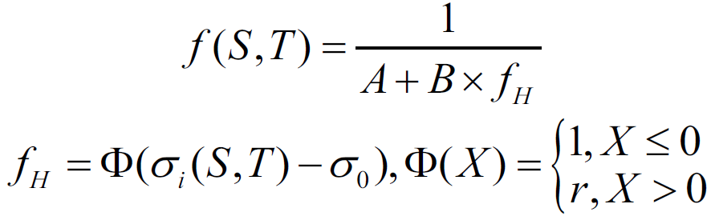
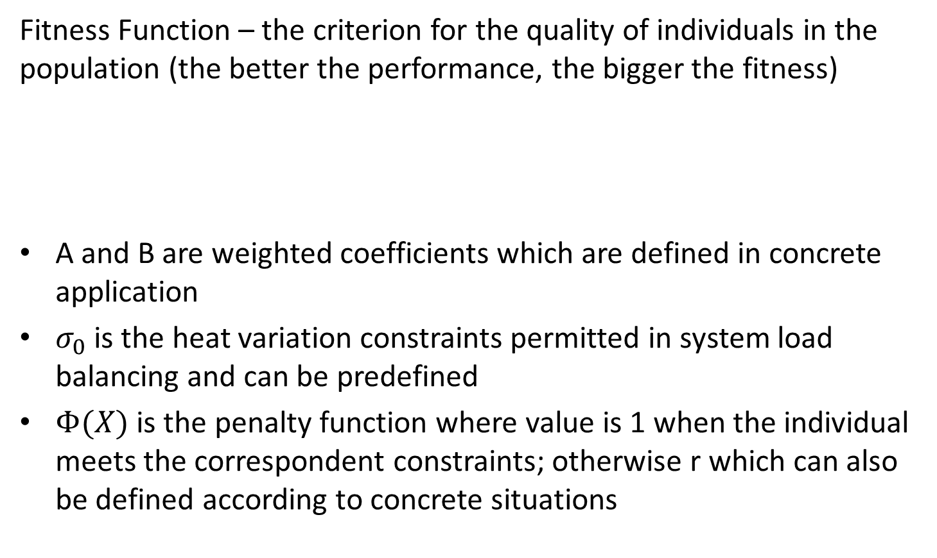
Realization of Balanced Scheduling through Genetic Algorithm (Cont.)
Fitness Function – the criterion for the quality of individuals in the population (the better the performance, the bigger the fitness)
A and B are weighted coefficients which are defined in concrete application
$σ_{0}$ is the heat variation constraints permitted in system load balancing and can be predefined
$Φ(X)$ is the penalty function where value is 1 when the individual meets the correspondent constraints; otherwise r which can also be defined according to concrete situations

Slide 12
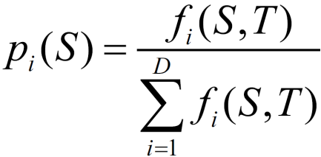
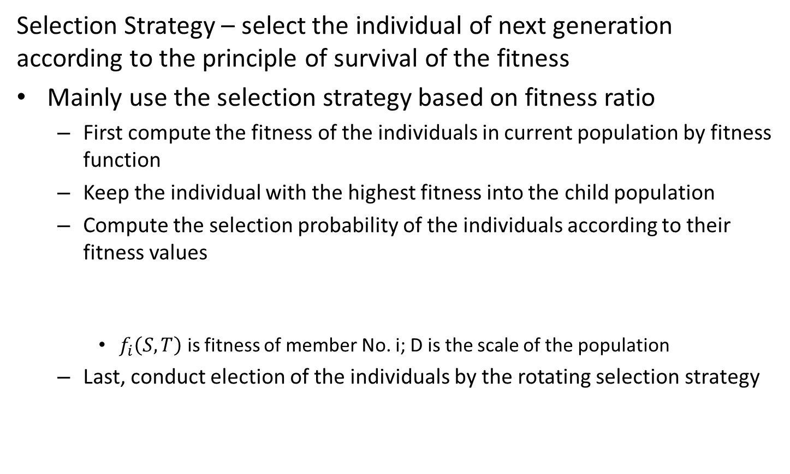
Realization of Balanced Scheduling through Genetic Algorithm (Cont.)
Selection Strategy – select the individual of next generation according to the principle of survival of the fitness
Mainly use the selection strategy based on fitness ratio
  First compute the fitness of the individuals in current population by fitness function
  Keep the individual with the highest fitness into the child population
  Compute the selection probability of the individuals according to their fitness values
    $f_{i}\left(S, T\right)$ is fitness of member No. i; D is the scale of the population
  Last, conduct election of the individuals by the rotating selection strategy

Slide 13
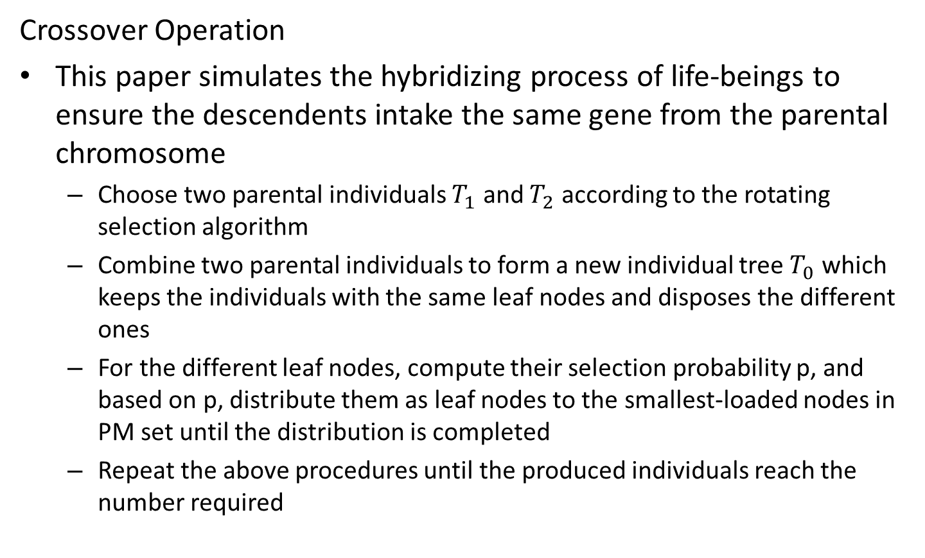
Realization of Balanced Scheduling through Genetic Algorithm (Cont.)
Crossover Operation
This paper simulates the hybridizing process of life-beings to ensure the descendents intake the same gene from the parental chromosome
  Choose two parental individuals $T_{1}$ and $T_{2}$ according to the rotating selection algorithm
  Combine two parental individuals to form a new individual tree $T_{0}$ which keeps the individuals with the same leaf nodes and disposes the different ones
  For the different leaf nodes, compute their selection probability p, and based on p, distribute them as leaf nodes to the smallest-loaded nodes in PM set until the distribution is completed
  Repeat the above procedures until the produced individuals reach the number required

Slide 14
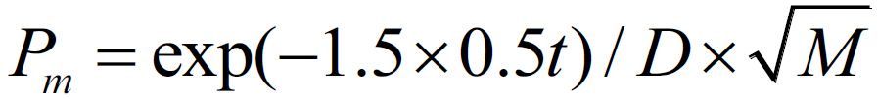
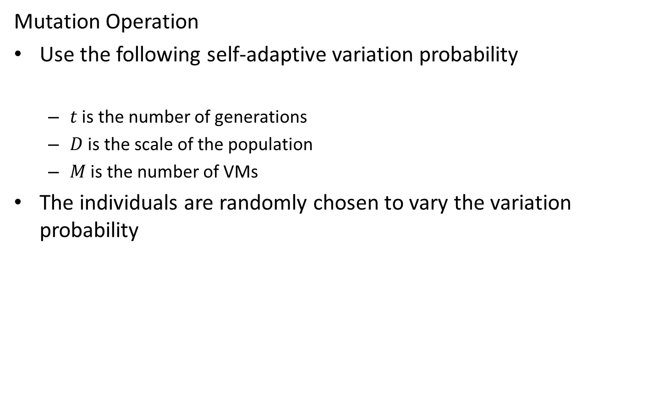
Realization of Balanced Scheduling through Genetic Algorithm (Cont.)
Mutation Operation
Use the following self-adaptive variation probability
  $t$ is the number of generations
  $D$ is the scale of the population
  $M$ is the number of VMs
The individuals are randomly chosen to vary the variation probability

Slide 15
Realization of Balanced Scheduling through Genetic Algorithm (Cont.)
Scheduling Strategy
The objective is to find the best mapping solution to meet the system load balance or to make the cost gene of load balancing the lowest
The terminating condition is the existence of a tree that meets the heat restriction requirement
First compute the cost gene through the ratio of the current scheduling solution to the best scheduling solution, and then choose the scheduling solution with the lowest cost as the final solution

Slide 16
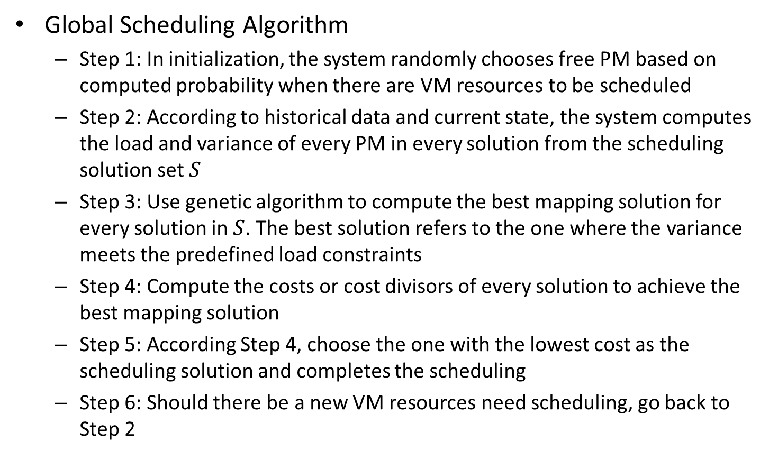
Algorithm Analysis
Global Scheduling Algorithm
  Step 1: In initialization, the system randomly chooses free PM based on computed probability when there are VM resources to be scheduled
  Step 2: According to historical data and current state, the system computes the load and variance of every PM in every solution from the scheduling solution set $S$
  Step 3: Use genetic algorithm to compute the best mapping solution for every solution in $S$. The best solution refers to the one where the variance meets the predefined load constraints
  Step 4: Compute the costs or cost divisors of every solution to achieve the best mapping solution
  Step 5: According Step 4, choose the one with the lowest cost as the scheduling solution and completes the scheduling
  Step 6: Should there be a new VM resources need scheduling, go back to Step 2

Slide 17
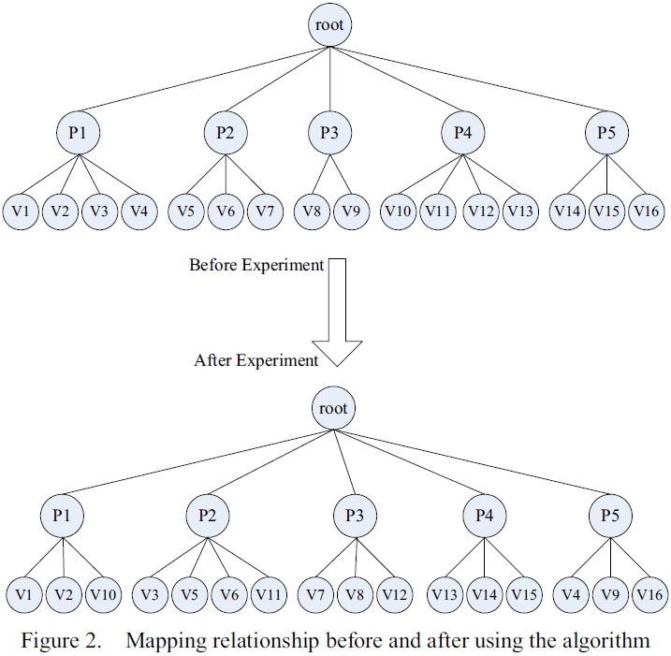
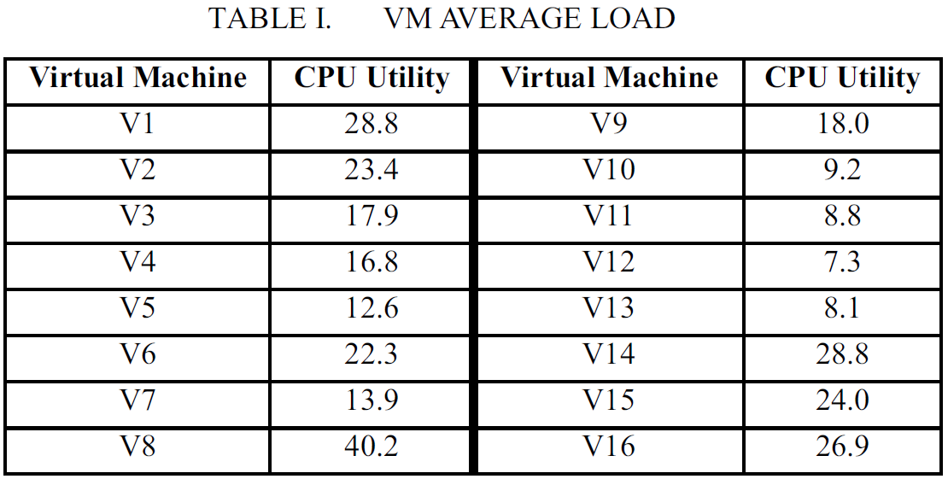

Algorithm Analysis (Cont.)
Astringency Analysis of the Genetic Algorithm
To test the astringency, the following experiment is conducted
  Scale of the population D=50
  Replication prob. $P_{r}=0.1$
  Hybridization prob. $P_{c}=0.9$
  Variation prob. is self-adaptive prob.
  System load variation is smaller than $σ$

Slide 18
Experiment and Results Analysis
Experiment setup
  On the Platform ISF® and open-source VM management platform OpenNebula [19]
  Use a PM as the host machine (root node)
    Installed OpenNebula front-end
    OS: RHEL5.4
    CPU: Intel Core 2 Duo 3.0 GHz
    Memory: 2 GB
    Disk capacity: 320 GB
  Whole network is connected by LAN
  Client PMs are the second level nodes and VM client on PMs are the child nodes
  Whole algorithm is realized by C++
[19] OpenNebula, “OpenNebula Software,” http://www.opennebula.org, 2010.

Slide 19
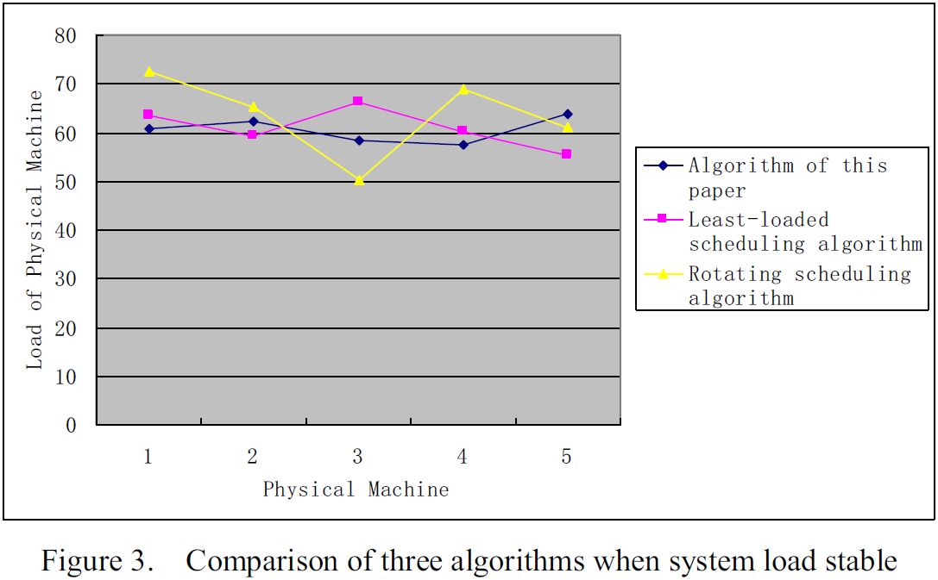
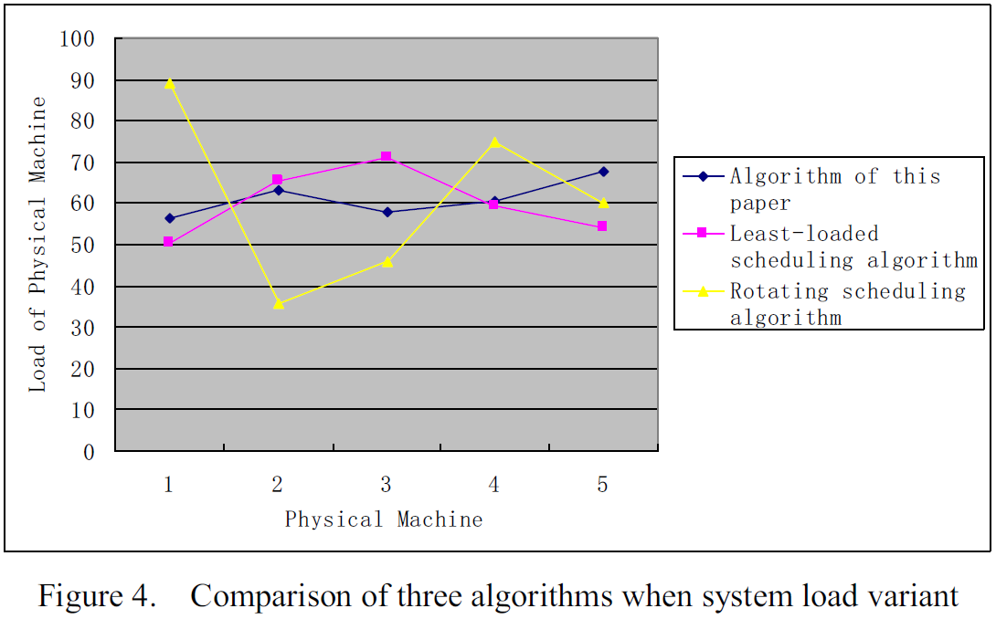
Experiment and Results Analysis (Cont.)
Algorithm Effect Analysis

Slide 20
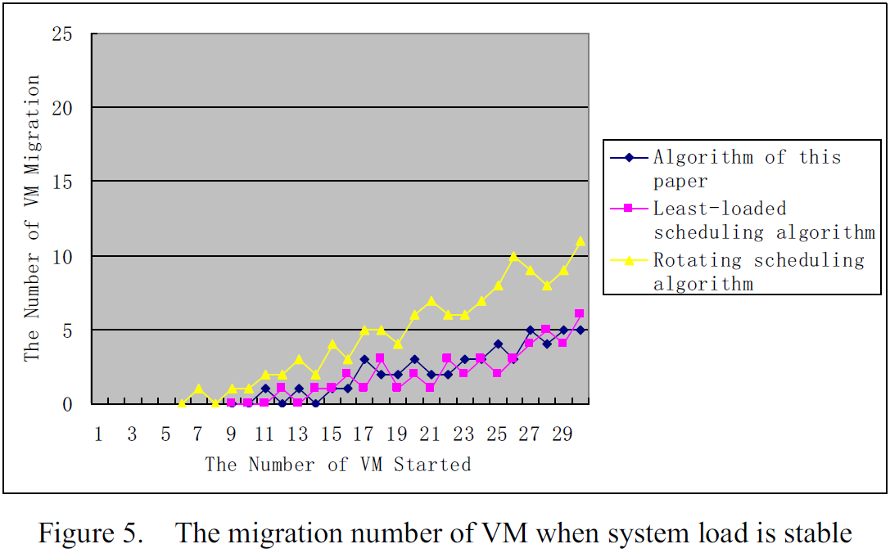
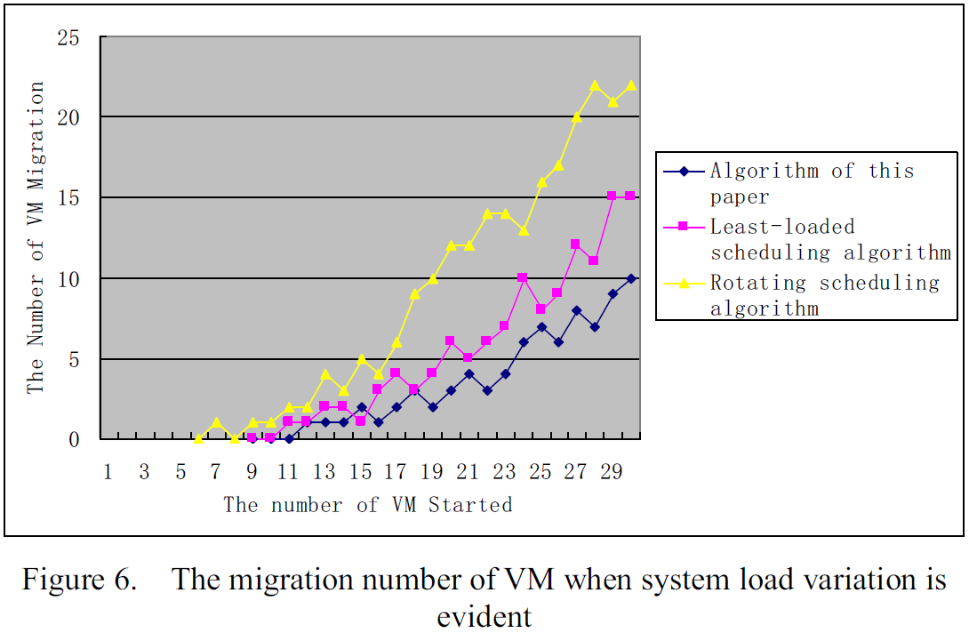
Experiment and Results Analysis (Cont.)
Migration Cost Analysis

Slide 21
Conclusion
This paper presents a scheduling strategy on VM load balancing based on genetic algorithm
The method according to historical data and current states computes in advance the influence it will have on the whole system
The method achieves the best load balancing and reduces or avoids dynamic migration thus resolves the problem of load imbalance and high migration cost
A monitoring and analyzing mechanism is needed to better solve the problem of load balancing

