Slide 1
A Survey Of Distributed Video Coding
NTHU NMSL
Shu-Ting Wang
2012/12

Slide 2
Abstract
Introduction
System Framework
  DISCOVER Codecs
  Recent Research and Future work

Slide 3
Abstract
Introduction
System Framework
DISCOVER Codecs
Recent Research and Future work

Slide 4
Which Theories?
Slepian and Wolf for lossless distributed source coding
Wyner and Ziv for the lossy distributed source coding

Slide 5
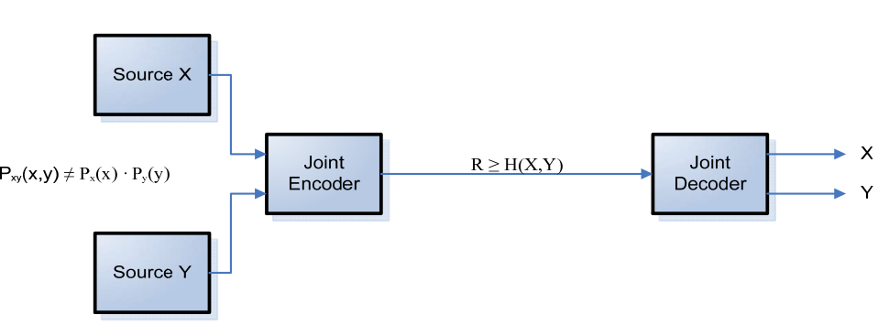
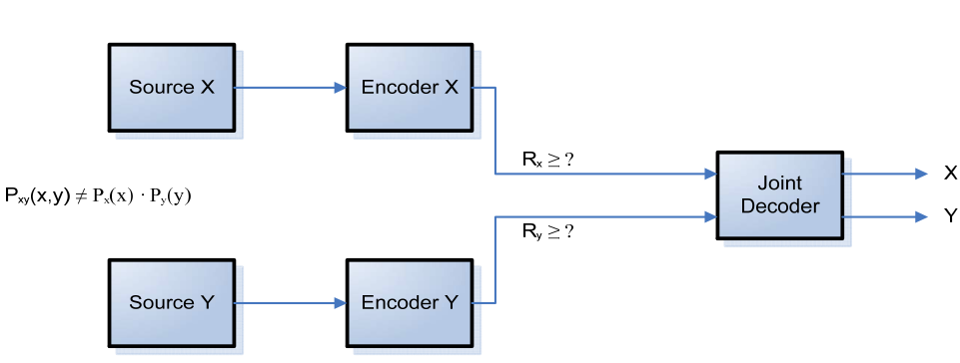
Basics(1/4)
the rate-distortion performance achieved when performing joint encoding and decoding of two correlated sources can also be obtained by doing separate encoding and joint decoding

Slide 6
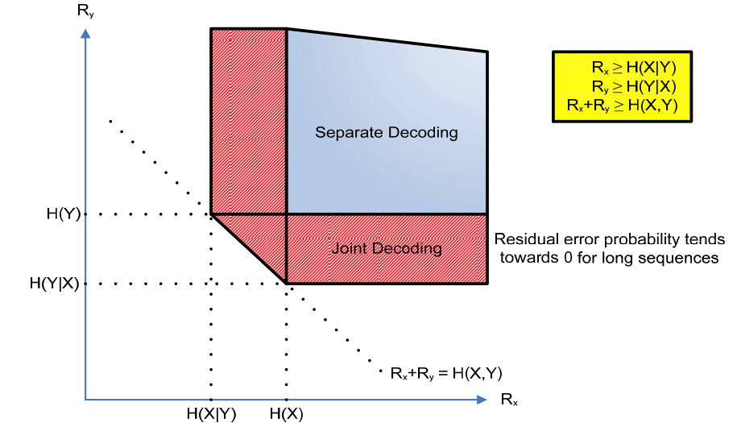
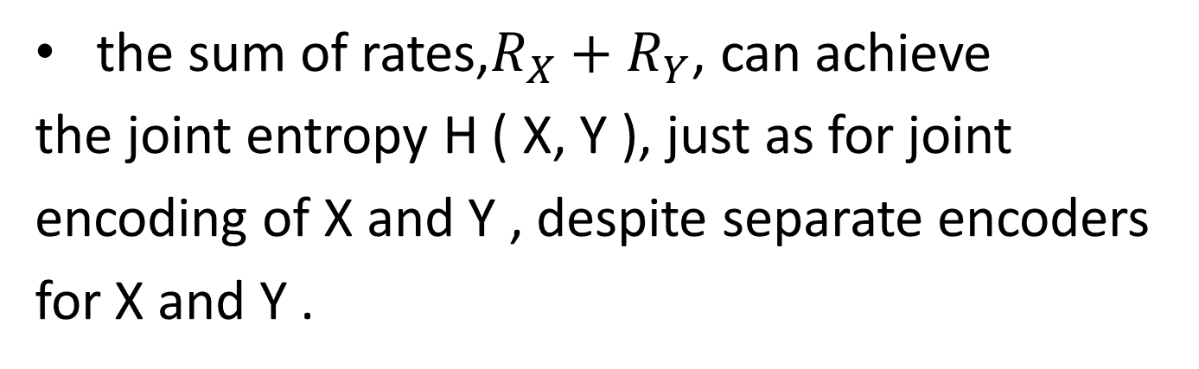
Basics(2/4)
the sum of rates,$R_{X}+R_{Y}$, can achieve
the joint entropy H ( X, Y ), just as for joint
encoding of X and Y , despite separate encoders
for X and Y .
Notes:
Consider two statistically dependent i.i.d. ﬁnite-alphabet
random sequences X and Y . With separate conventional
entropy encoders and decoders one can achieve RX H ( X )
and RY H ( Y ), where H ( X ) and H ( Y ) are the entropies
of X and Y , respectively

Slide 7
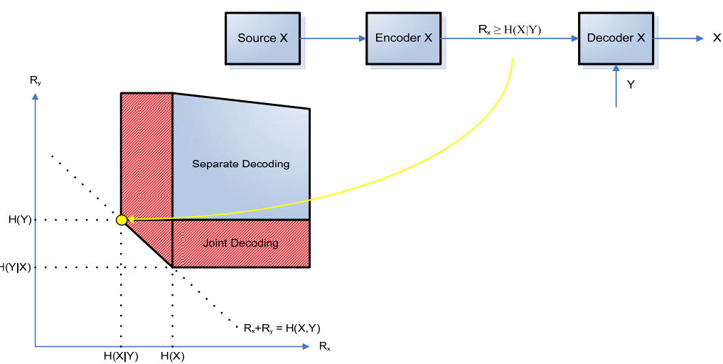
Basics(3/4)
The source produces a sequence X with statistics that depend on side information Y which improve decoding.
Notes:
Since RY = H ( Y ) is achievable for (conventionally)
encoding Y , compression with receiver side information cor-
responds to one of the corners of the rate region in Fig. 2, and
hence RX >=H ( X | Y ), regardless of the encoder’s access to
side information Y .

Slide 8
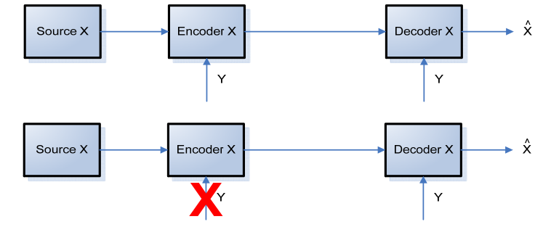
Basics(4/4)
We are interested in the case where Y is available at the decoder, but not at the decoder.

Slide 9
Abstract
Introduction
System Framework
DISCOVER Codecs
Recent Research and Future work

Slide 10
Early Architectures
Two kinds of architecture
  PRISM
  Stanford
Nowadays, state-of-the-art codecs are based on Stanford architecture because of its efficiency.

Slide 11
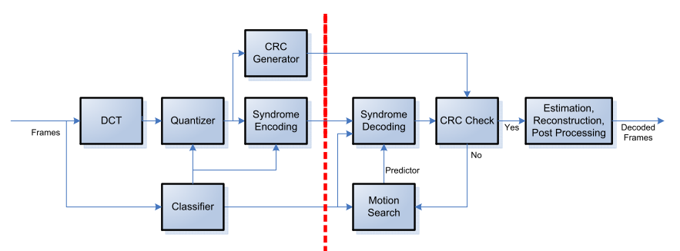
PRISM Architecture

Slide 12
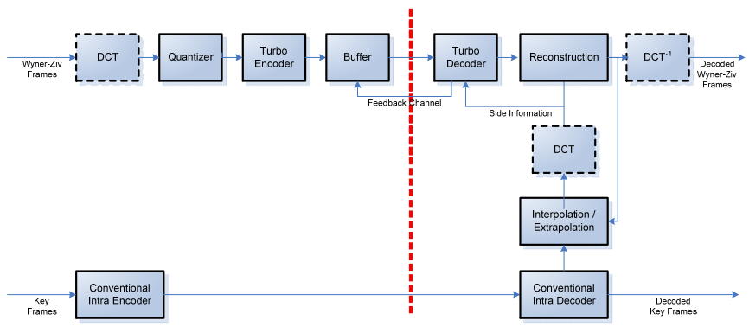
Stanford Architecture

Slide 13
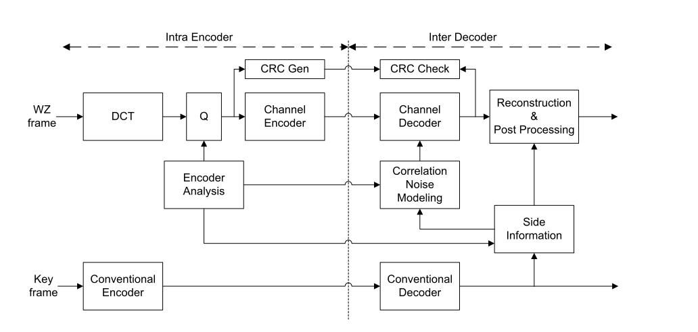
Overview

Slide 14
Road Map

Slide 15
Frame Splitting
Input frames are split into two parts
  Key Frames
  Wyner-Ziv Frames
Key frames are
  coded by MPEG/H.264 intra
  to prevent error drifting problem

Slide 16
Road Map

Slide 17
Discrete Cosine Transform(1/2)
DCT has good energy compaction property and human eyes can hardly perceive the high frequency bands.
The transform-domain DVC codec has shown
its better R-D performance than the pixel-
domain one

Slide 18
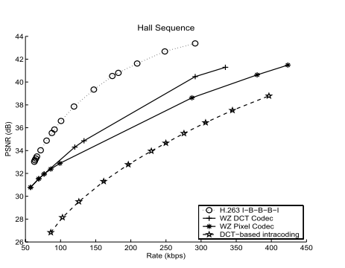
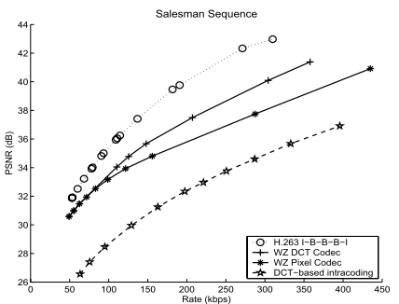
Discrete Cosine Transform(2/2)

Slide 19
Road Map

Slide 20
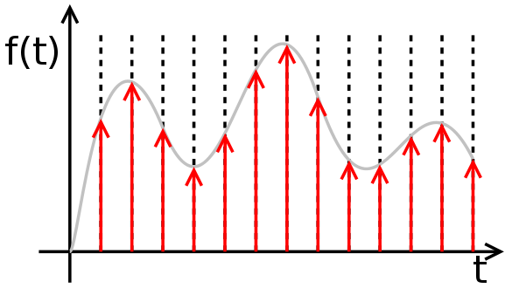
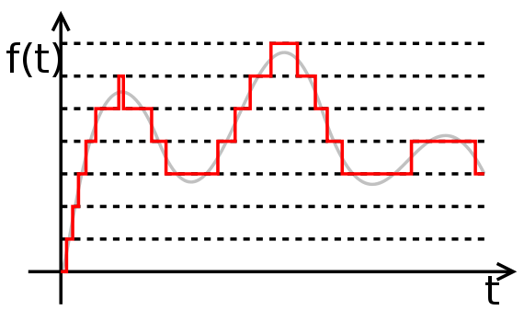
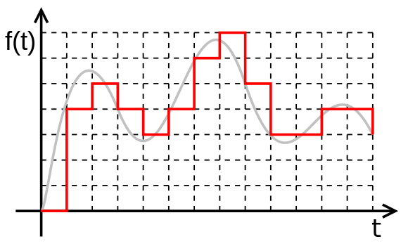
Quantization(1/3)
Sampled signal
Quantized signal
Digital signal (sampled, quantized)

Slide 21
Quantization(2/3)
Q table is simple for implementation, it cannot keep the coding quality on various video sequences.
Stanford-based DVC codecs have the Q table for quantization like traditional video codecs

Slide 22
Quantization(3/3)
PRISM employing the classiﬁcation method
  Low correlation : use conventional coding
  High correlation: skip
  Other: distributed coding

Slide 23
Road Map

Slide 24
Encoder
PRISM codec do more on encoder to achieve better rate-distortion performance.
Encoder can generate hash code for decoder (hash-based motion estimation) to choose better side information.

Slide 25
Road Map

Slide 26
Channel Coding(1/2)
Turbo code or LDPC code are usually used to encode the quantized bands bit-plane by bit-plane.
Parity bitstreams (or syndrome bits) are kept in the buffer.
Rate estimator will determine how many parity bits to be sent to the decoder.

Slide 27
Channel Coding(2/2)
Cyclic Redundancy Check (CRC) is used to verify the correctness of the decoded bands.
Obvious disadvantage: the iterative decoding process cause significant delay.
Many research are focus on rate estimation and reducing the number of feedback

Slide 28
Road Map

Slide 29
Side Information
The key operation of the side information generation is motion-compensated frame interpolation or hash-based motion estimation , where true motion ﬁeld is required to get the best quality.
The quality of Wyner-Ziv frames is strongly determined by the the side information.

Slide 30
Road Map

Slide 31


Correlation Noise Modeling(1/2)
DVC systems usually use Laplacian distribution to model the bit conditional probability of bit-planes for decoding.
Notes:
由於它可以看作是兩個不同位置的指數分布背靠背拼接在一起，所以它也叫作雙指數分布。兩個相互獨立同機率分布指數隨機變數之間的差別是按照指數分布的隨機時間布朗運動

Slide 32
Correlation Noise Modeling(2/2)
A good correlation noise model leads to better
R-D performance. Early methods are offline
training methods.
Online modeling and TRACE( transfrom- domain adaptive correlation estimation) are purposed to improve the modeling algorithm.

Slide 33
Road Map

Slide 34
Reconstruction and Post-processing
The minimum min square error (MMSE) method and Inverse DCT are applied to get the optimal decoded frames.
The deblocking filter technique in traditional codec can be adopted to DVC system.

Slide 35
Abstract
Introduction
System Framework
DISCOVER Codecs
Recent Research and Future work

Slide 36
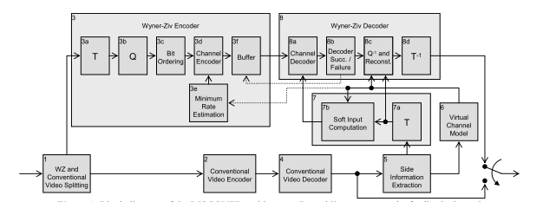
DISCOVER architecture

Slide 37
DISCOVER RoadMap

Slide 38
Frame Splitting
For the DISCOVER codec, an adaptive Group of Picture (GOP)size selection module was developed to control the (non-periodic) insertion of key frames in between the WZ frames.

Slide 39
DISCOVER RoadMap

Slide 40
Channel Encoder and Buffer(1/2)
The LDPCA codes are better than the turbo codes at the capacity of many communication channels, including the virtual channel in DVC.
An LDPCA encoder consists of
  LDPC syndrome-former
  accumulator
If the decoder fails, more accumulated syndromes are requested from the encoder buffer using a feedback channel.

Slide 41
Channel Encoder and Buffer(2/2)
If the decoder fails, more accumulated syndromes are requested from the encoder buffer using a feedback channel.

Slide 42
DISCOVER RoadMap

Slide 43
Frame Interpolation Framework(1/5)
Previous
Key frames
Low pass filter
Motion Vector
Bi-Directional
Motion
Compensation
Interpolated
frames
Forward Motion
Estimation
Bi-Directional
Motion
Estimation
Spatial Smoothing
Next
Key frames
Low pass filter

Slide 44
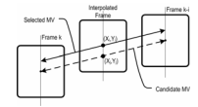
Forward Motion Estimation(2/5)
Forward Motion Estimation ,the rigid block based motion estimation scheme, fails to capture all aspects of the motion field
Once the frame interpolation is performed, overlapped and uncovered areas will appear.
Notes:
This is because the motion vectors obtained do not necessarily intercept the interpolated frame at the center of each non-overlapped block in the interpolated frame.

Slide 45
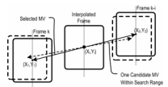
Bi-Directional Motion Estimation(3/5)
This motion estimation technique selects a linear trajectory between the next and previous key frames passing at the center of the blocks in the interpolated frame.
Notes:
i.e. (x1 , y1 ) = (xi , yi ) + MV(B i ) and (x2 , y2 ) = (xi , yi ) -
MV(B i ), where (x1 , y1 ) is the coordinates of the block in the previous key frame, (x2 , y2 ) are the coordinates
of the block in the next frame and MV(B i ) represents the motion vector obtained in the previous section
divided by half, since the interpolated frame is equally distant to both key frames.

Slide 46
Spatial Smoothing(4/5)
Sometimes the motion vectors have low spatial coherence.
This can be improved by weighted vector median filters, which maintains the motion field spatial coherence by looking for candidate motion vectors at neighboring blocks at each block.

Slide 47
Bi-Directional Motion Compensation(5/5)
When final motion vector field is obtained, the interpolated frame can be filled by using bidirectional motion compensation as defined in standard video coding schemes.

Slide 48
DISCOVER RoadMap

Slide 49
Virtual Channel Model
& Soft Input Calculation
The DISCOVER codec uses a Laplacian distribution to model the correlation noise, i.e. the error distribution between corresponding DCT bands of SI and WZ frames.
The DISCOVER codec estimate the Laplacian distribution parameter α at the DCT band level and at the coefficient level.

Slide 50
DISCOVER RoadMap

Slide 51
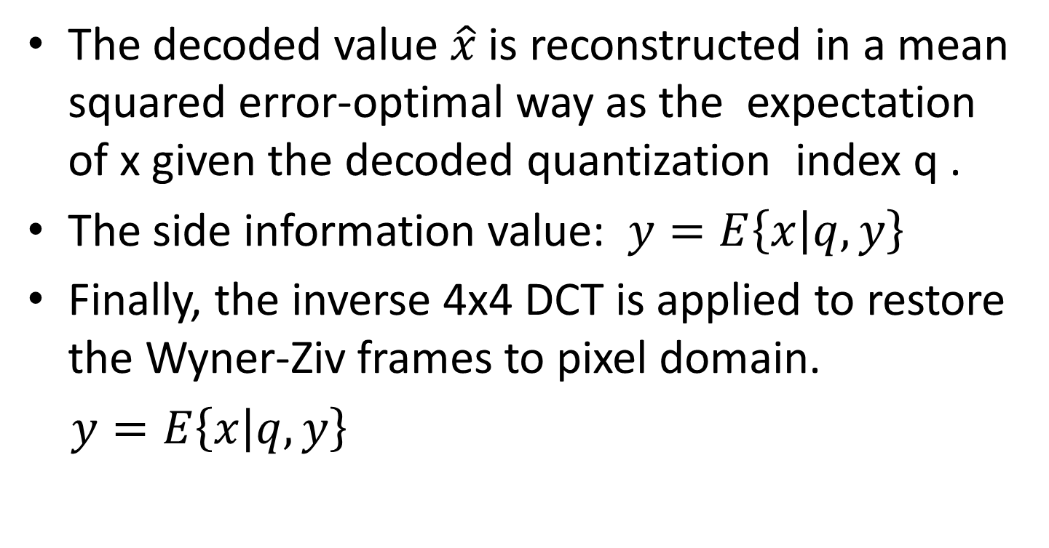
Reconstruction and Inverse Transform
The decoded value $\hat{x}$ is reconstructed in a mean squared error-optimal way as the expectation of x given the decoded quantization index q .
The side information value: $y=E\left\{x | q,y\right\}$
Finally, the inverse 4x4 DCT is applied to restore the Wyner-Ziv frames to pixel domain.
$y=E\left\{x | q,y\right\}$

Slide 52
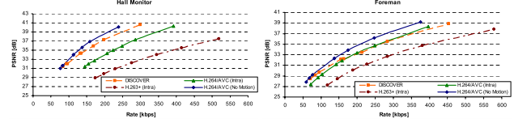
DISCOVER Performance

Slide 53
Abstract
Introduction
System Framework
DISCOVER Codecs
Recent Research and Future work

Slide 54
Recent Research
Recent research are focus on
  Side information: frame interpolation technique
  Correlation noise modeling
  Fast decoding : Using GPU to speed up decoding
  New codec architecture: VISNET II DVC codec by some people who develop DISCOVER codec
  distributed compressive video sensing (DCVS) is to simultaneously capture and compress video data

Slide 55
Future Work
Distributed video streaming
Wireless low-power surveillance
Visual sensor networks

