Slide 1
A design and implementation of OpenFlow Controller handling IP multicast with Fast Tree Switching
Daisuke Kotani, Kazuya Suzuki and Hideyuki Shimonishi
2012 IEEE/IPSJ International Symposium on Applications and the Internet

Slide 2
Introduction
IP-multicast is useful in modern multi-media applications for transporting large data from single point to one or multiple receivers
But, there are still some serious problems of IP based multicast
One of them is reconstructing multicast tree while network failure occurs
This will cause packets loss that is intolerable
Traditionally, we use prepare redundant multicast tree to overcome them
However, it require centralized computation to computing tree that is surprisingly suit for OpenFlow/SDN
Kotani et al. design a algorithm to reduce packet loss while multicast tree reconstruction with OpenFlow

Slide 3
Related works
For IP multicast group management….
IP multicast use IGMP to manage Join/leave from multicast group
IP multicast use PIM-SM, PIM-DM or DVMRP for routing
These protocols use unicast routing or flooding
Hence, it will takes much time to recover multicast tree
There is better method for efficient using network bandwidth called IGMP snooping, but it will limit sender’s location

Slide 4
Related works
For multicast tree…
Multicast Extension OSPF can centrally compute multicast trees
But, it flood group member information to all routers
P2MP MPLS enable traffic engineering in multicast such as bandwidth guaranteed multicast and fast failure recovery using MPLS fast reroute mechanism
But P2MP MPLS can not be used in receivers dynamically join/leave case, because the path is set up by sender side

Slide 5
Set up multicast tree for multicast group
Early mechanism need to modify flow entries in many switches
They propose following rules to speed up multicast tree switching:
Multiple multicast tree of same group coexist in the network
Unique tree ID for each multicast tree which will be embedded into packet header as Ethernet destination address
Sender switch rewrites header of multicast packets to that the tree ID embedded

Slide 6
Procedure of switching multicast tree
Calculate alternative tree and assign new ID which will be mapped to Ethernet destination address
Set up flow entries of the alternative tree in the switches other than the sender switch
Replace the flow entry in the sender switch
Remove un-used flow entries from switches

Slide 7
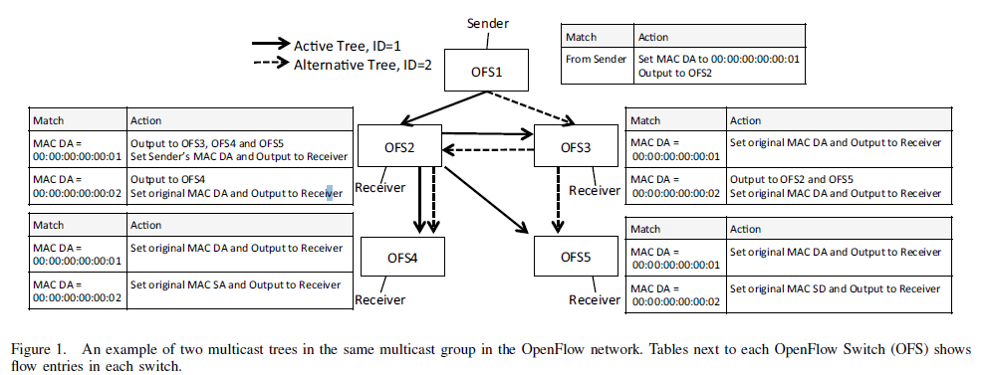
Example in OpenFlow network

Slide 8
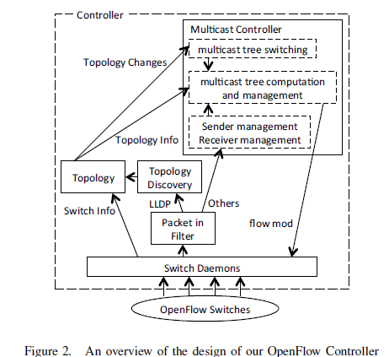
IMPLEMENTATION OF OPENFLOW CONTROLLER
Controller compute multicast trees and set up flow entries that are required to deliver multicast packets into the switches
Controller requires the senders’ and receivers’ locations in the network and topology information to compute multicast trees
Sender’s location is used to determine the root of a multicast tree and the leaves of the tree are the receivers’ locations
Topology information is used to define the graph to calculate trees

Slide 9
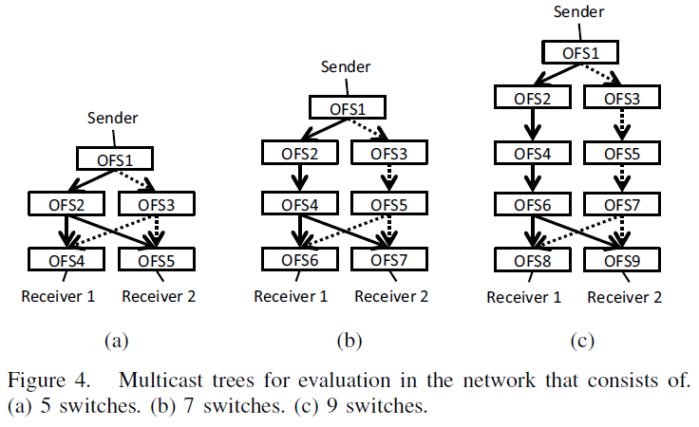
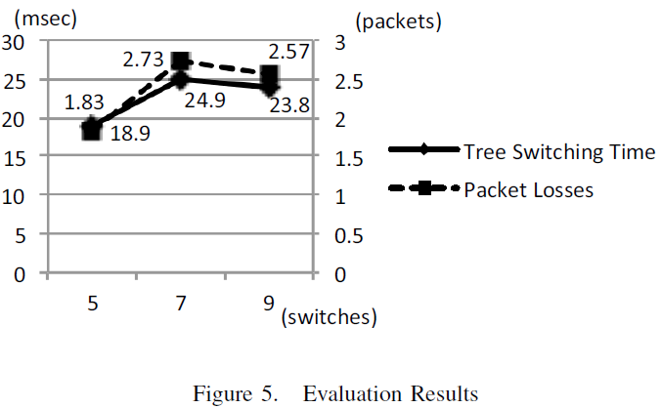
Evaluation

Slide 10
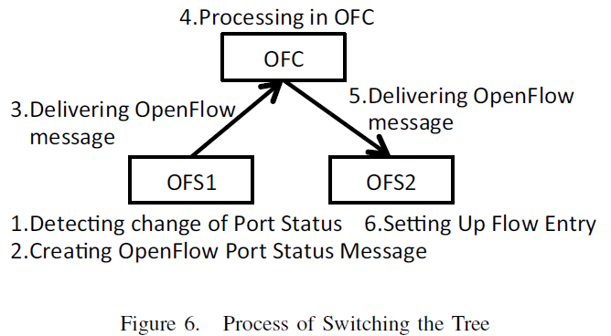
Discussion & Conclusion
Some factors need be considered in real enviroments:
1) round trip time
2) packets other than multicast
Future works:
1) reduce the flow entries of backup multicast trees
2) a method to switch trees faster in the enviroments
that RTTs are long

