Slide 1
Adaptive Scalable Video Streaming in Wireless Networks
Siyuan Xiang, Lin Cai, Jianping Pan

Slide 2
Outline
Introduction
Problem Formulation
Performance Evaluation
Conclusions

Slide 3
Introduction
To investigate the optimal streaming strategy for Dynamic Adaptive Streaming over HTTP(DASH) in wireless networks.
To Formulate the rate adaptation problem as a finite Markov Decision Process(MDP).
To evaluate the proposed streaming strategy and compare it with existing work.
Notes:
1.提出一個在 DASH 上找出最佳的 streaming 決策。
2.他們將這個決策用 MDP 來解。
3.最後跟 Rate adaption for adaptive HTTP streaming 所提的演算法做比較。

Slide 4
Outline
Introduction
Problem Formulation
Performance Evaluation
Conclusions

Slide 5
Problem Formulation(1/4)
State at step t: s_{t} = (q_{t}, ∆q_{t}, v_{t}, ∆v_{t}, bw_{t}, d_{t})
q_{t} is the queue length in terms of the number of buffered frames.
∆q_{t} is the queue variation. i.e, ∆q_{t} = q_{t} – q_{t-1}
v_{t} is the version index of the last received segment.
∆v_{t} the difference of video versions requested in consecutive steps.
bw_{t} is the available bandwidth at step t.
d_{t} is the number of received segments.
Notes:
每個狀態代表的是現在網路的品質。
可以依這些參數決定下一個狀態的網路品質。
像是 queue 的長度、queue 長度的變動量、最後收到的 segment 的版本、版本變動量、目前頻寬跟已收到的 segments。

Slide 6
Problem Formulation(2/4)
Action set: A(s) = {A_{i}, A_{u}, A_{w}}
A_{i} (i = -L+1, …, L-1) means to request the next segment with i layer higher or lower than the current one. L is the number of versions.
A_{u} means to “upgrade” the last received segment.
A_{w} means to wait for a time duration of T_{s.} (T_{s} is the constant playback time of segment)
Notes:
這是 MDP model 定義的 Action。
說明這個演算法在每一個狀態中可以從這三個行動中選一個。
第一個是提升或是降低下一個 segment 的影像品質。
第二個是升級最後收到 segment 的品質。
最後一個是不收任何的 segment 並等待一段時間，大約是 700 ms，這個行動可以解決 buffer 被塞爆的情況。

Slide 7
Problem Formulation(3/4)
Table 1: Rewards Associated with States
s_{t} = s | R(s)
(*, *, *, *, N_{T}) | 0
(0, *, *, *, *) | -F + ∆q
(F⁺, *, *, *, *) | -F - ∆q
(*, ∆q, *, ∆v, *) | Min(-α|∆v|, -|∆q|)
N_{T} is the total number of segments the client needs to request.
F = B_{T} × N_{s} B_{T} is the target buffer size in terms of the number of segments. N_{s} is the number of frames per segment.
F⁺ means the number of buffered frames is larger than B_{T} × N_{s.}
α to make a trade-off between average playback quality and playback smoothness.
Notes:
當每個狀態選擇動作之後會得到 reward，這是 reward 相關的定義。
Alpha 是可以設定的參數，愈低的話代表畫質愈好，愈高的話代表播放愈順暢。

Slide 8
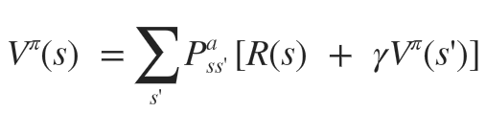
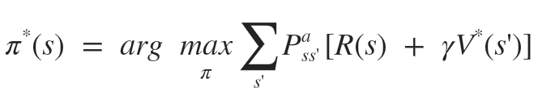
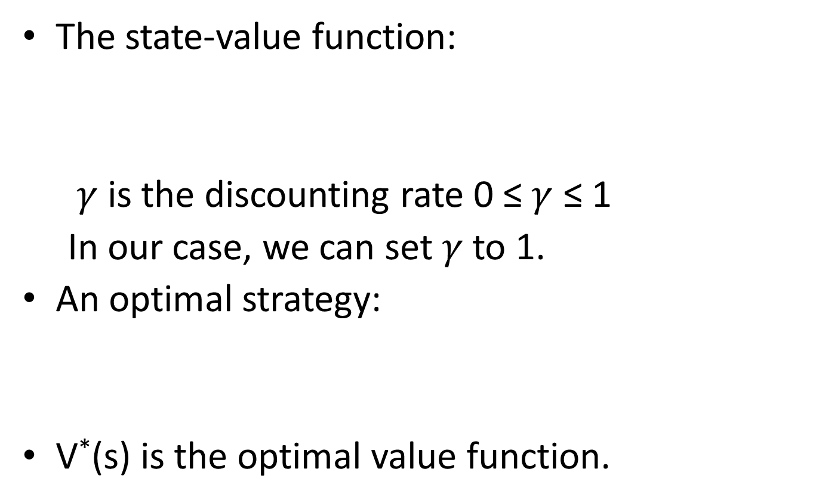
Problem Formulation(4/4)
The state-value function:
$γ$is the discounting rate 0 ≤$γ$ ≤ 1
In our case, we can set$γ$to 1.
An optimal strategy:
V*(s) is the optimal value function.
Notes:
這是他所義定的公式，要找出最佳解 pi star。

Slide 9
Outline
Introduction
Problem Formulation
Performance Evaluation
Conclusions

Slide 10
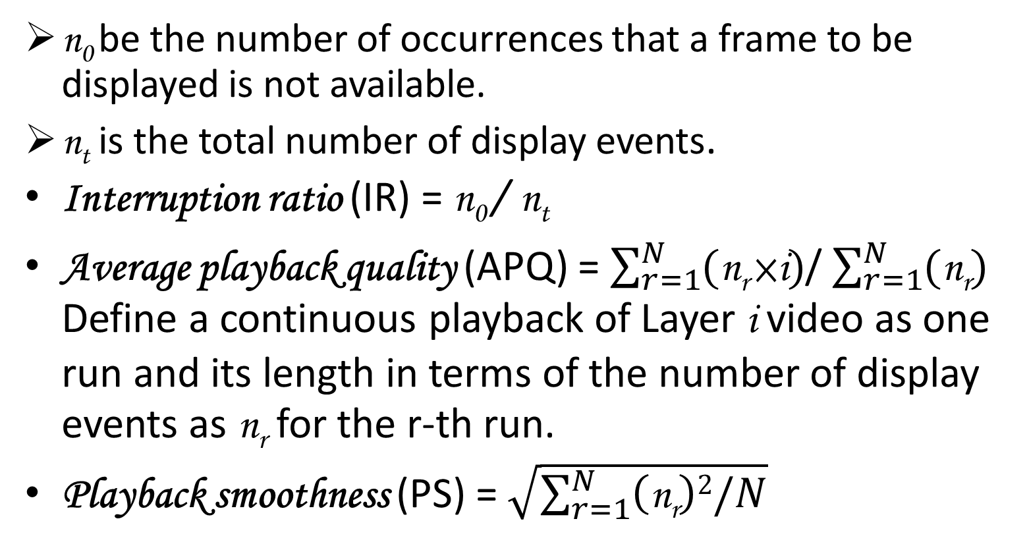
QoE Metrics
n₀ be the number of occurrences that a frame to be displayed is not available.
n_{t} is the total number of display events.
Interruption ratio (IR) = n₀ / n_{t}
Average playback quality (APQ) = $\sum_{r=1}^{N}{(\text{n}\text{r} \text{×}\text{i})}$/ $\sum_{r=1}^{N}{(\text{n}\text{r})}$ Define a continuous playback of Layer i video as one run and its length in terms of the number of display events as n_{r} for the r-th run.
Playback smoothness (PS) = $\sqrt{\sum_{r=1}^{N}{\left(\text{n}\text{r}\right)2/N}}$
Notes:
他有這三個指標來量化 streaming 的品質。
第一個 interruption ratio 代表播放失敗的比率。
第二個 Average playback quality 是說平均播放質品的 index。
第三個 Playback smoothness ：在播放時的流暢情況。

Slide 11
Experimental Settings(1/3)
Table 2: Layer Configuration
Resolution | Avg. bit-rate (Kpbs) | std bit-rate deviation | Y-PSNR | Layer index
320x180 | 112.84 | 39.01 | 35.47 | 1
320x180 | 238.94 | 88.84 | 39.44 | 2
640x360 | 363.82 | 140.33 | 35.90 | 3
A(s) = {A₋₂, A₋₁, A₀, A₁, A₂, A_{u}, A_{w}}
For A_{w}, the client will wait for 700 ms (one time step)
Notes:
他將品質分成三個 layer，layer index 1 是質品最低，layer index 3 是品質最高的。
分成三曾後，每個 state 可以做的動作就有這七種。
每次等待時間為 700 ms。大約為播放一個 segment 的時間。

Slide 12
Experimental Settings(2/3)
Table 3: State Prob. And Available Bandwidth
State | 1 | 2 | 3 | 4
Bandwidth (Kpbs) | 50.32 | 180.63 | 260.38 | 550.75
Steady state prob (P₁) | 0.026 | 0.102 | 0.407 | 0.465
Steady state prob (P₂) | 0.103 | 0.256 | 0.385 | 0.256
Each layer is chopped into small segments of 17 frames.
The total number of segments N_{T} is 200.
Frame rate is 24 frames per second.
Notes:
他將網路的狀況分成這四種 state，
這個 p1 p2 是兩個不同的 機率轉移矩陣，分別表示兩種不同的網路環境。

Slide 13
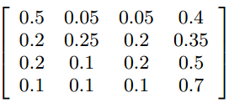
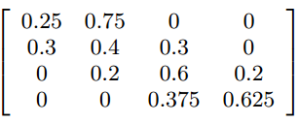
Experimental Settings(3/3)
 | P₁ | P₂
Probability Transition Matrix
Average bandwidth | 337.6 Kbps | 292.84 Kbps
Notes:
就是這兩個 轉移矩陣，以長久來看，p1 的網路狀態會比 p2 還的好。

Slide 14
Performance Comparison(1/5)
Table 4: Playback Performance
P | B_{T} | ALG | IR | APQ | PS | Max queue
P₁ | 20 | RA | 0 | 2.03 | 117.30 | 23
 |  | OS | 0 | 2.22 | 189.72 | 20.5
 | 30 | RA | 0 | 1.91 | 124.45 | 33
 |  | OS | 0 | 2.19 | 237.37 | 30.2
 |  | FL(3) | 0.07 | 2.78 | 314.7 | 13.6
P₂ | 20 | RA | 0 | 1.68 | 155.27 | 23
 |  | OS | 0 | 1.88 | 246.54 | 20.4
 | 30 | RA | 0 | 1.60 | 200.5 | 33
 |  | OS | 0 | 1.87 | 268.32 | 30.1
 |  | FL(2) | 0.03 | 1.93 | 1176.74 | 24.7
(for P₁, OS uses $α$=1; for P₂, OS uses$α$=2)
Notes:
這是他們做的實驗結果，
Os 就是他們自己的演算法，ra 是另一篇論文所提出的演算法，fl 代表固定在某一個 layer index。
可以看到這篇所提出的演算法不管在哪種情況下都比 ra 好，而且 Max queue 的需求也比較低一些。

Slide 15
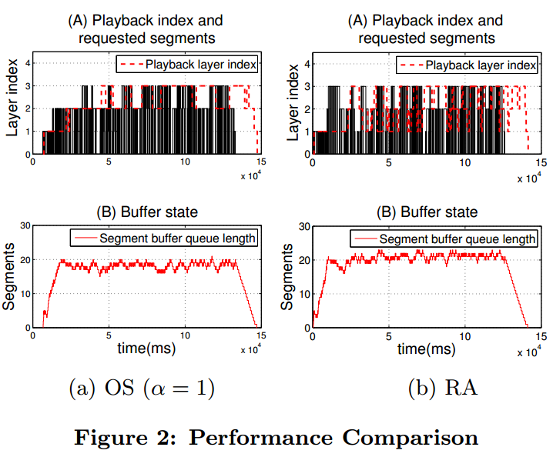
Performance Comparison(2/5)
The transition matrix is P₁ and B_{T} = 20
Notes:
這是 os 及 ra 用 p1 transition matrix 跟 buffer size 設定為 20 的兩個比較圖。
上面的是 layer index 切換的情況，下面的是 queue 使用的情況。
可以看到 os 切換的次數相對於 rs 來得少，所以播放也會更順暢。
而 queue 的用量也比較低一點。

Slide 16
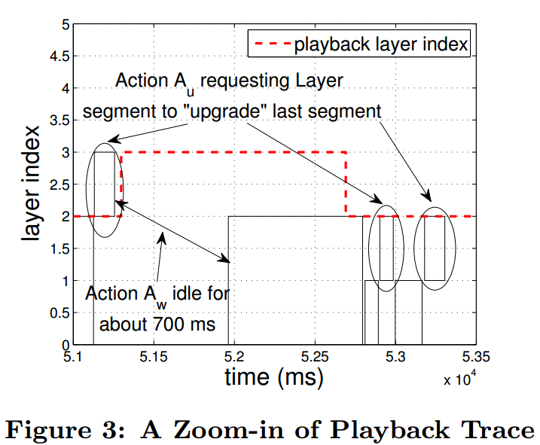
Performance Comparison(3/5)
Notes:
這是將上圖 os 的 layer index 切換情況放大來看。
兩條黑線中間是代表等待一段時間，像這邊凸起來就是 upgrade 質品。

Slide 17
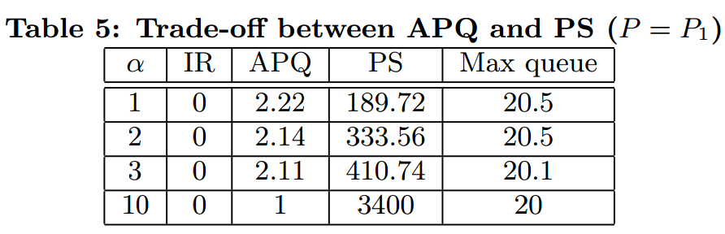
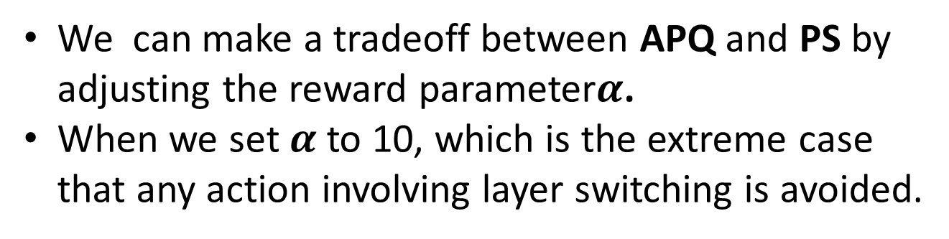
Performance Comparison(4/5)
We can make a tradeoff between APQ and PS by adjusting the reward parameter$α$.
When we set$α$to 10, which is the extreme case that any action involving layer switching is avoided.
Notes:
這個實驗是調整 alpha 參數來看各數值的結果。
可以發現 alpha 愈高的播放愈順暢，因為減少了 switch layer index 的次數，
但是相對來說，播放的品質也比較差。

Slide 18
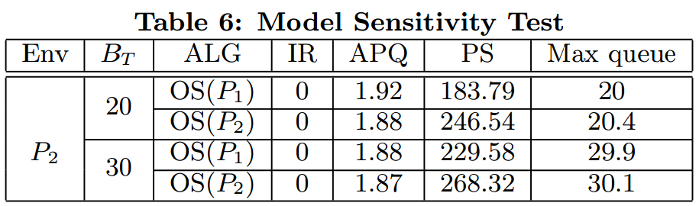
Performance Comparison(5/5)
When the matrix in the decision process does not match the real situation, the performance degrades slightly, but still in a tolerable range.
Notes:
這個實驗是假設所使用的決定不符合現實的網路狀態的話，產生的影響。
想表達他們的 os 演算法不管是不是符合現實網路狀態，都在可接受的範園內，影響不會很大。

Slide 19
Outline
Introduction
Problem Formulation
Performance Evaluation
Conclusions

Slide 20
Conclusions
Experiment results have show that the proposed solution is feasible and substantially outperforms the existing one.
There are several issues worth further investigation.
To fully utilize the layered feature of SVC.
How to design an on-line algorithm to estimate the bandwidth transition matrix.
How to organize the layer segments efficiently and optimize the segment size require.
Notes:
最後他們提出的 os 決策演算法確實比 ra 演算法更好。
這邊有提到幾個值得更進一步研究的方向。

