Slide 1
An Interactive Region-of-Interest Video Streaming System for Online Lecture Viewing
Aditya Mavlankar, Piyush Agrawal, Derek Pang, Sherif Halawa, Ngai-Man Cheung and Bernd Girod
Information Systems Laboratory, Department of Electrical Engineering
Stanford University, Stanford, CA 94305, USA
Email: aditya.mavlankar@ieee.org, {piyushag, dcypang, halawa, ncheung, bgirod}@stanford.edu

Slide 2
1. Introduction
2. Overview of System Architecture
3. IRoI Video Streaming
3.1. Proposed Coding Scheme
3.2. Parallelization Employed by IRoI Encoder
3.3. Adaptive Frame Skipping for IRoI Video Coding
4. Automatic RoI Selector
4.1. Tracking mode
4.2. Preset mode
5. Slide Recognition
6. Pilot Project Evaluation
7. Conclusions

Slide 3
1. Introduction
2. Overview of System Architecture
3. IRoI Video Streaming
3.1. Proposed Coding Scheme
3.2. Parallelization Employed by IRoI Encoder
3.3. Adaptive Frame Skipping for IRoI Video Coding
4. Automatic RoI Selector
4.1. Tracking mode
4.2. Preset mode
5. Slide Recognition
6. Pilot Project Evaluation
7. Conclusions

Slide 4
Introduction
existing solutions only provide pre-defined view
ClassX: interactive online lecture viewing system developed at Stanford University
allows interactive pan/tilt/zoom while watching
avoids sending entire field-of-view in high resolution
-> reducing required data rate
3. offers automatic lecturer tracking
-> alleviating navigation burden on online viewer
4. employs slide recognition
5. low-cost, efficient, pragmatic solution

Slide 5
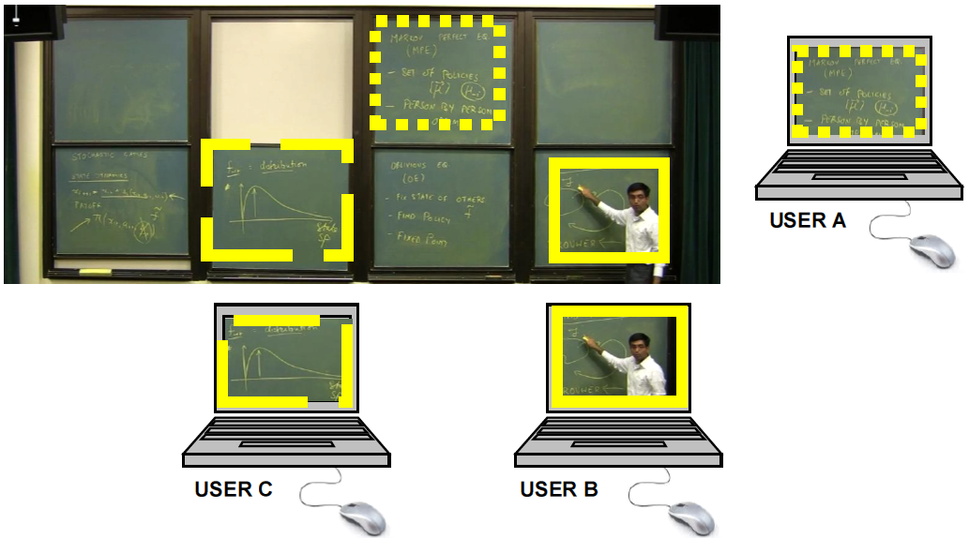
Fig. 1. A typical podium consisting of multiple writing boards. Sample RoIs chosen by three viewers.

Slide 6
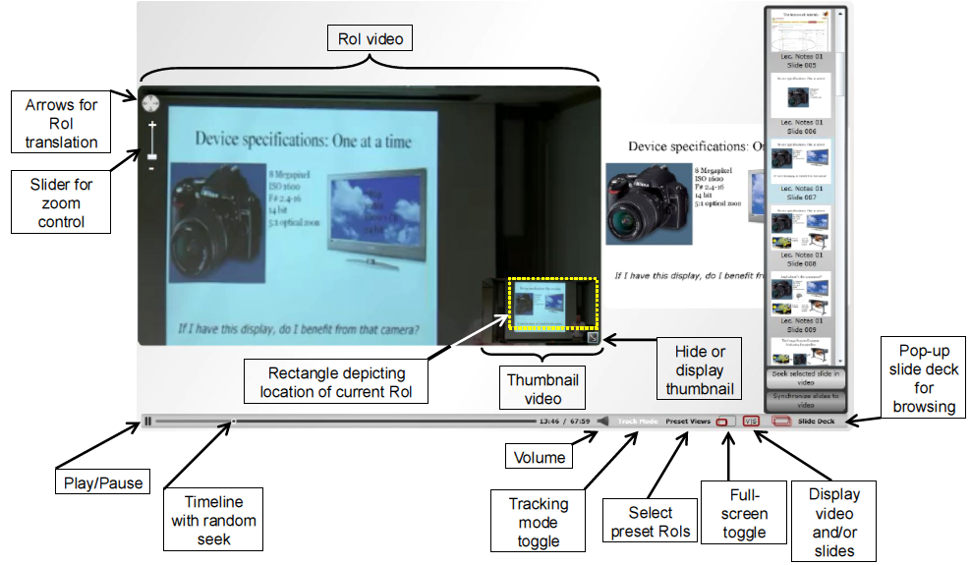
Fig. 2. Screenshot of the ClassX video player and available controls.

Slide 7
1. Introduction
2. Overview of System Architecture
3. IRoI Video Streaming
3.1. Proposed Coding Scheme
3.2. Parallelization Employed by IRoI Encoder
3.3. Adaptive Frame Skipping for IRoI Video Coding
4. Automatic RoI Selector
4.1. Tracking mode
4.2. Preset mode
5. Slide Recognition
6. Pilot Project Evaluation
7. Conclusions

Slide 8
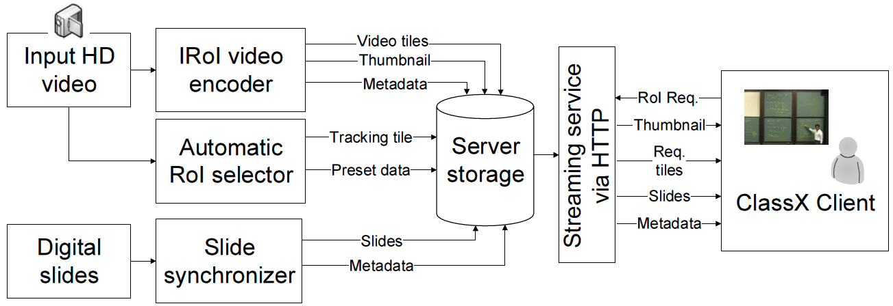
video is decoded and fed to the IRoI video encoder
creates multiple resolution layers
layers are subdivided into
non-overlapping tiles
Fig. 3. Overview of System Architecture

Slide 9
Each tile is independently compressed using H.264/AVC.
A thumbnail overview is created and encoded using an H.264/AVC encoder.
Fig. 3. Overview of System Architecture

Slide 10
If user selects Tracking mode, client receives thumbnail and Tracking tile
Fig. 3. Overview of System Architecture

Slide 11
Digital presentation slides are analyzed and matched against the video.
slide deck consumes little data rate
-> transmitted in entirety
Fig. 3. Overview of System Architecture

Slide 12
1. Introduction
2. Overview of System Architecture
3. IRoI Video Streaming
3.1. Proposed Coding Scheme
3.2. Parallelization Employed by IRoI Encoder
3.3. Adaptive Frame Skipping for IRoI Video Coding
4. Automatic RoI Selector
4.1. Tracking mode
4.2. Preset mode
5. Slide Recognition
6. Pilot Project Evaluation
7. Conclusions

Slide 13
1. Introduction
2. Overview of System Architecture
3. IRoI Video Streaming
3.1. Proposed Coding Scheme
3.2. Parallelization Employed by IRoI Encoder
3.3. Adaptive Frame Skipping for IRoI Video Coding
4. Automatic RoI Selector
4.1. Tracking mode
4.2. Preset mode
5. Slide Recognition
6. Pilot Project Evaluation
7. Conclusions

Slide 14
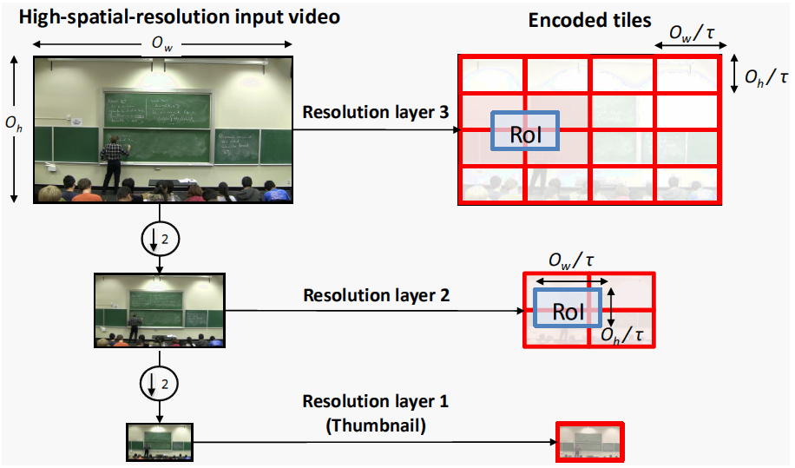
Fig. 4. Proposed coding scheme shown for the case of three resolution layers. The original high-spatial-resolution video is dyadically downsampled to create multiple resolution layers.

Slide 15
3.1. Proposed Coding Scheme
input video of size o_{w} × o_{h} is dyadically downsampled to create K resolution layers
The lowest resolution layer provides thumbnail overview
Let τ = 2^{K}-1. Each tile has spatial dimensions
of $\frac{\text{o}\text{w}}{\text{τ}}\text{ × }\frac{\text{o}\text{h} }{\text{τ}}$pixels, which is also equal to the size of the RoI display portion at the client’s side.

Slide 16
3.1. Proposed Coding Scheme
The tile size, RoI display dize, and choice of resolution layer guarantee any chosen RoI overlaps at most four tiles from the relevant layer
-> client needs to decode and synchronize at most five H.264/AVC video streams (including thumbnail)
in Tracking mode, only two tiles (Tracking tile and thumbnail) are fetched

Slide 17
1. Introduction
2. Overview of System Architecture
3. IRoI Video Streaming
3.1. Proposed Coding Scheme
3.2. Parallelization Employed by IRoI Encoder
3.3. Adaptive Frame Skipping for IRoI Video Coding
4. Automatic RoI Selector
4.1. Tracking mode
4.2. Preset mode
5. Slide Recognition
6. Pilot Project Evaluation
7. Conclusions

Slide 18
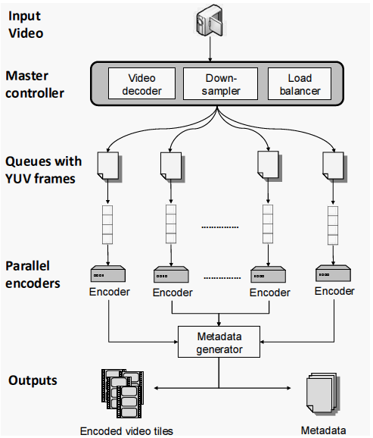
first decodes the input video file into raw YUV frames,
distributes the task of encoding each tile
encodes respective tile into an H.264/AVC bit-stream
builds file container and annotates video with information (such as time length and position)

Slide 19
1. Introduction
2. Overview of System Architecture
3. IRoI Video Streaming
3.1. Proposed Coding Scheme
3.2. Parallelization Employed by IRoI Encoder
3.3. Adaptive Frame Skipping for IRoI Video Coding
4. Automatic RoI Selector
4.1. Tracking mode
4.2. Preset mode
5. Slide Recognition
6. Pilot Project Evaluation
7. Conclusions

Slide 20
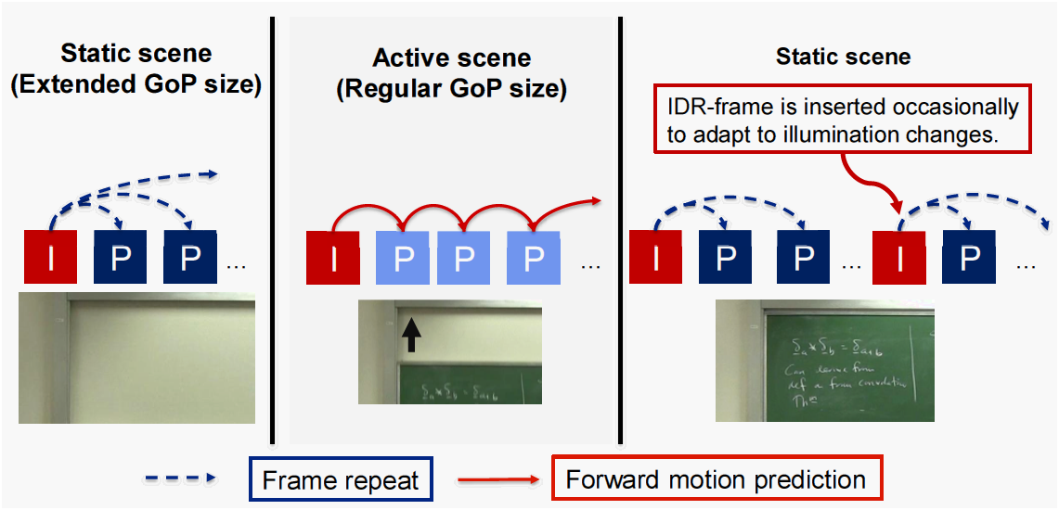
3.3. Adaptive Frame Skipping for IRoI Video Coding
lecture videos often contain large static backgrounds and small active regions
for static tiles, simply encode a single static frame
-> lower the encoding complexity and storage requirement

Slide 21
1. Introduction
2. Overview of System Architecture
3. IRoI Video Streaming
3.1. Proposed Coding Scheme
3.2. Parallelization Employed by IRoI Encoder
3.3. Adaptive Frame Skipping for IRoI Video Coding
4. Automatic RoI Selector
4.1. Tracking mode
4.2. Preset mode
5. Slide Recognition
6. Pilot Project Evaluation
7. Conclusions

Slide 22
1. Introduction
2. Overview of System Architecture
3. IRoI Video Streaming
3.1. Proposed Coding Scheme
3.2. Parallelization Employed by IRoI Encoder
3.3. Adaptive Frame Skipping for IRoI Video Coding
4. Automatic RoI Selector
4.1. Tracking mode
4.2. Preset mode
5. Slide Recognition
6. Pilot Project Evaluation
7. Conclusions

Slide 23
4.1. Tracking mode
mimics human camera operator by generating video that follows the lecturer
server-side algorithm first detects a set of target points based on lecturer's features
group the target points by k-means clustering to generate a set of matching templates
find the lecturer's starting location at the beginning of the video
apply backgroud subtraction with running Gaussian average to trake lecturer
trajectory is continuous and often constrained to horizontal direction -> tracking problem becomes 1-D problem

Slide 24
1. Introduction
2. Overview of System Architecture
3. IRoI Video Streaming
3.1. Proposed Coding Scheme
3.2. Parallelization Employed by IRoI Encoder
3.3. Adaptive Frame Skipping for IRoI Video Coding
4. Automatic RoI Selector
4.1. Tracking mode
4.2. Preset mode
5. Slide Recognition
6. Pilot Project Evaluation
7. Conclusions

Slide 25
4.2. Preset mode
allow users to choose fixed preset RoIs from a set of pre-determined locations
viewers can switch between different boards
server-side algorithm applies Canny filter and determines a set of closed rectangular contours in the video

Slide 26
1. Introduction
2. Overview of System Architecture
3. IRoI Video Streaming
3.1. Proposed Coding Scheme
3.2. Parallelization Employed by IRoI Encoder
3.3. Adaptive Frame Skipping for IRoI Video Coding
4. Automatic RoI Selector
4.1. Tracking mode
4.2. Preset mode
5. Slide Recognition
6. Pilot Project Evaluation
7. Conclusions

Slide 27
5. Slide Recognition
1. extraction of keyframes from video
Compute frame difference between successive frame and declare slide transition when difference exceeds a threshold
To reduce probability of false positive, locate foreground objects and exclude them from computing frame difference
With detected transition and extracted keyframes, match keyframes against a deck of slides

Slide 28
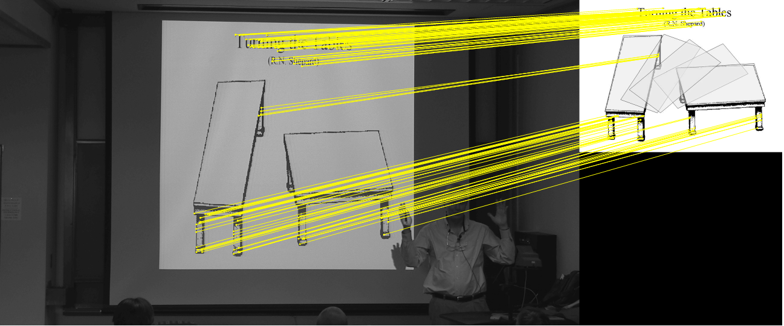
5. Slide Recognition
2. matching keyframes to a deck of slides using pairwise image comparison

Slide 29
1. Introduction
2. Overview of System Architecture
3. IRoI Video Streaming
3.1. Proposed Coding Scheme
3.2. Parallelization Employed by IRoI Encoder
3.3. Adaptive Frame Skipping for IRoI Video Coding
4. Automatic RoI Selector
4.1. Tracking mode
4.2. Preset mode
5. Slide Recognition
6. Pilot Project Evaluation
7. Conclusions

Slide 30
6. Pilot Project Evaluation
Pilot deployment of ClassX at Stanford University since Sep. 2009
Analyze usage data gathered between Jan. 2010 and Apr. 2010.
Cover two courses with distinct lecturing styles: one mainly relies on digital slide and the other exclusively uses blackboards
For two courses, published a total of 37 lectures, each lecture is about 75 mins and recorded by a static camera with resolution of 1920 x 1080 pixels and at 30 frames/sec.
Camera compresses the videos using H.264/AVC at 24 Mbps
IRoI encoder creates 3 dyadic resolution layers with a total of 21 tiles, each tile has 480 x 270 pixels
Tracking tile is generated with resolution of 960 x 540 pixels
...

Slide 31
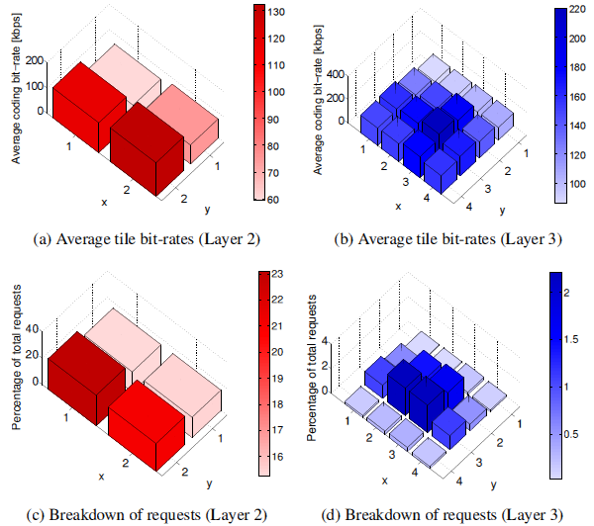
Fig. 8. Average coding bit-rate and percentage of total requests for each tile from resolution layers 2 and 3. The x and y coordinates correspond to the spatial location of each tile relative to the top left corner of the video.

Slide 32
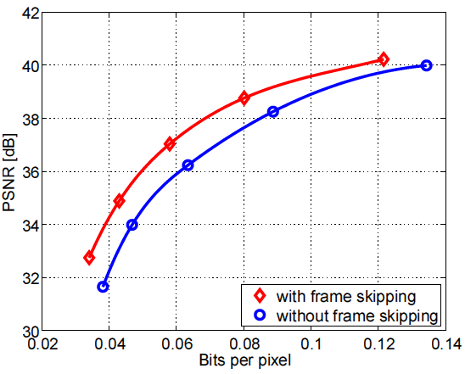
Experiment performed on two 15-min video segments, encoded into 21 tiles across 3 resolution layers
Adaptive frame skipping has average coding gain of:
2 dB at low bit-rates
0.6 dB at high bit-rates
Fig. 9. PSNR with and without adaptive frame skipping.

Slide 33
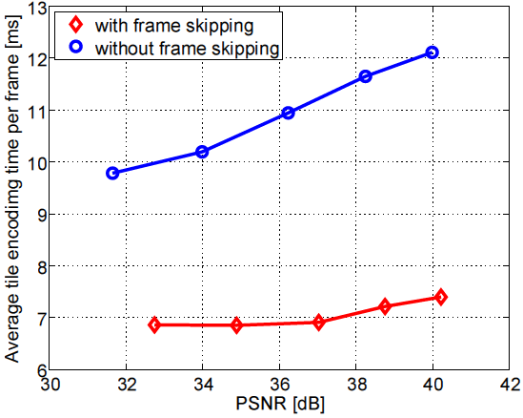
Adaptive frame skipping reduces average encoding time by:
up to 40% at low quality
up to 30% at high quality
Fig. 10. Encoding time with and without adaptive frame skipping. The encoding time is the average encoding time spent per frame per tile.

Slide 34
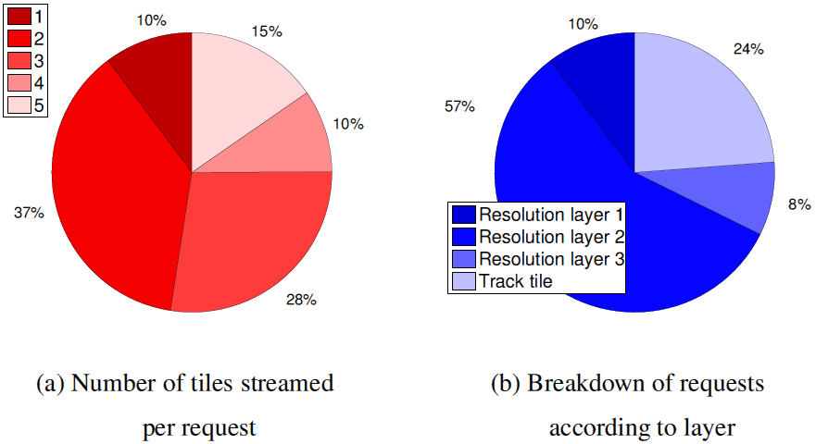
During the pilot deployment, server received a total of 84,064 video streaming requests from 782 unique IP addresses.
Mean transmission bit-rate per session is 493 kbps with standard deviation of 246 kbps.
The highest observed bit-rate is 2342 kbps and the lowest oberved bit-rate is 133 kbps.
Each user requires about 2.82 tiles on average.
Average tile switching delay is 3.4 seconds with standard deviation of 1.9 seconds.
Tile switch delay is the time between RoI change and when all newly required tiles start playing back.

Slide 35
Resolution layer 2 received the highest number of requests
-> layer 2 offers the best trade-off between video details and the field-of-view

Slide 36
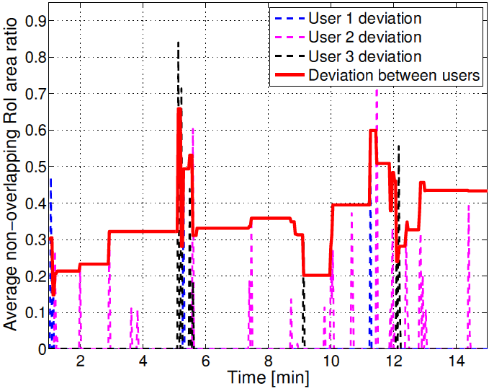
Analyze positions and sizes of RoIs recorded from 5 users watching 15-min video.
To measure how often a user operates pan, tilt and zoom, we calculate non-overlapping area of user's RoI with previously requested RoI.

Slide 37
1. Introduction
2. Overview of System Architecture
3. IRoI Video Streaming
3.1. Proposed Coding Scheme
3.2. Parallelization Employed by IRoI Encoder
3.3. Adaptive Frame Skipping for IRoI Video Coding
4. Automatic RoI Selector
4.1. Tracking mode
4.2. Preset mode
5. Slide Recognition
6. Pilot Project Evaluation
7. Conclusions

Slide 38
7. Conclusions
ClassX, a system for lecture video recording, publishing and streaming
User can watch videos anytime with pan/tile/zoom functionality
Although several tiles from multiple resolution layers are encoded while preparing for online publishing, the encoding complexity is reasonably low.
-> 75-min lecture can be published after about
140-min of processing

Slide 39
7. Conclusions
Automatically create video that mimics human camera operator
Automatically recognized and advanced slides
User can also select particular slide and jump to segment in the video where that slide is discussed
Found that users choose Tracking mode as well as control RoI themselves

