Slide 1
Auto-Scaling to Minimize Cost and Meet Application Deadlines in Cloud Workflows
Ming Mao
Department of Computer Science
University of Virginia
Charlottesville, VA 22904
ming@cs.virginia.edu
Marty Humphrey
Department of Computer Science
University of Virginia
Charlottesville, VA 22904
humphrey@cs.virginia.edu

Slide 2
Introduction
Goals that auto-scaling framework should achieve:
- balance performance and cost
- deliver at least the same level of performance as existing enterprise IT infrastructure
- offer different options for computing resources
- notice the considerations of real cloud deployments

Slide 3
Introduction
Current mechanisms:
- schedule-based
e.g. “Run 10 instances between 8AM to 6PM each day and 2 instances all the other time”
- rule-based
e.g. “Add 2 instances when average CPU utilization is above 70% for 5 minutes”

Slide 4
Introduction
This paper explores a more general application model
Goal: to ensure that all jobs finish before their respective deadlines
- deadlines are not “hard deadlines”
Consider both job-level and global-level cost-efficiency
The approach can save 9.8%-40.4% cost compare to other mechanisms
Notes:
The authors believe that people generally care about the turnaround time of a service, so they choose deadlines as the performance requirements.

Slide 5
Problem Formalization
Assumptions
four roles:
- cloud application owner
- cloud application users
- cloud application itself
- cloud resources
Notes:
application owner deploys the application in a cloud provider
application users submit jobs with performance requirements to the application
application owner purchases resources from the cloud provider to run the application and service job requests

Slide 6
Problem Formalization
Assumptions (Cloud Application, Job & Task)
a cloud application consists of several service units
a job consists of sub tasks (simply referred to as taks)
all jobs are submitted into the entry unit
jobs can be categorized into different classes
service units can be classified as compute-intensive, I/O-intensive, or neither
Notes:
Jobs can be categorized into different classes based on their processing flows

Slide 7
Problem Formalization
Assumptions (Cloud resources & pricing)
cloud provider offers several types of VMs
VM instances are priced by hour
application owner can estimate task processing times on different types of VMs
cloud instances can be acquired at any time, but there are instance acquisition lags
do not consider jobs with theoretically impossible deadlines
Notes:
Partial-hour consumption is always rounded up to one hour
However, it may take some time for an instance to be ready to use
We call such waiting time as instance acquisition lag

Slide 8
Solution
first calculate number of VMs needed
schedule tasks on each VM using Earliest Deadline First (EDF) algorithm
also pre-analyze job classes for potential task bundling and deadline re-assignment

Slide 9
Solution
Preprocessing
Step 1 – Task Bundling
Step 2 – Deadline Assignment
Dynamic scaling-consolidation-scheduling
Step 3 – Scaling
Step 4 – Instance Consolidation
Step 5 – Dynamic Scheduling

Slide 10
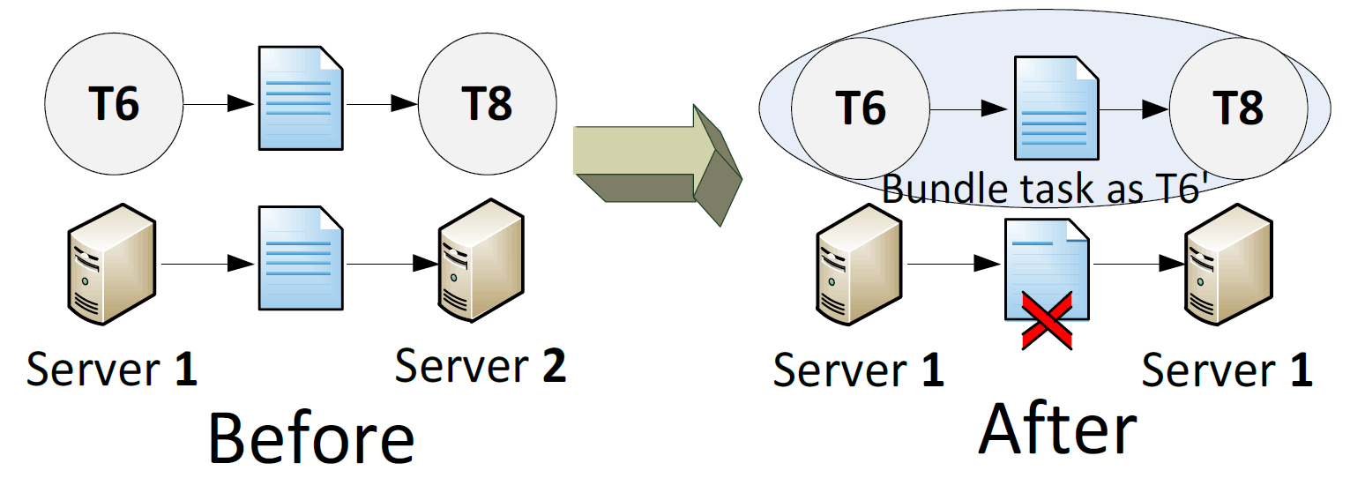
Solution
Step 1 – Task Bundling
- treat adjacent tasks that prefer the same instance type as one task and force them to run on the same instance
Notes:
save data transfers by using the temporary results stored locally

Slide 11
Solution
Step 2 – Deadline Assignment
- deadlines are associated with jobs, not tasks
- Use deadline assignment in a DAG [16], assign individual deadlines to tasks proportionally based the processing time on their most cost-efficient machines
- If such assignment cannot finish all jobs in time, further use a heuristic introduced by [17]
[16] J. Yu, R. Buyya and C. Tham. 2005. A Cost-based Scheduling of Scientific Workflow Applications on Utility Grids. In Proceedings of the First IEEE International Conference on e-Science and Grid Computing. Melbourne, Australia, Dec. 2005, pp. 140-147.
[17] R. Sakellariou and H. Zhao. 2005. Scheduling Workflows with Budget Constraints. Integrated Research in Grid Computing. CoreGrid series, Springer-Verlag, 2005.
Notes:
[16] Their approach is to assign deadlines proportionally by tasks’ fastest execution time and search for the cheapest service for each task
[17] will calculate the job makespan for an initial deadline assignment

Slide 12
Solution
Step 2 – Deadline Assignment
- deadlines are associated with jobs, not tasks
- Use deadline assignment in a DAG [16], assign individual deadlines to tasks proportionally based the processing time on their most cost-efficient machines
- If such assignment cannot finish all jobs in time, further use a heuristic introduced by [17]
[16] J. Yu, R. Buyya and C. Tham. 2005. A Cost-based Scheduling of Scientific Workflow Applications on Utility Grids. In Proceedings of the First IEEE International Conference on e-Science and Grid Computing. Melbourne, Australia, Dec. 2005, pp. 140-147.
[17] R. Sakellariou and H. Zhao. 2005. Scheduling Workflows with Budget Constraints. Integrated Research in Grid Computing. CoreGrid series, Springer-Verlag, 2005.
Notes:
[16] Their approach is to assign deadlines proportionally by tasks’ fastest execution time and search for the cheapest service for each task
[17] will calculate the job makespan for an initial deadline assignment

Slide 13
Solution
Step 2 – Deadline Assignment
Notes:
do parallel reduction to save three instance hours

Slide 14
Solution
Step 3 – Scaling
- define load vector (LV) for each task
- after deadline assignment, an execution interval [T₀, T₁] is scheduled for each task, and we know its running time on VM_{m} is t_{m} => LV is defined as [t_{m}/(T₁-T₀)]
- consider instance acquisition lag => [T₀, T₁] should be [T₀ + lag_{v}, T₁]
Notes:
if the ratio is greater than 1, the task cannot be finished in time
every time when updating the task load vectors, the deadline assignments need to be recalculated
(some tasks may be finished earlier than their original assigned deadlines and reassignment can possibly allow later tasks to run on cheaper machines)

Slide 15
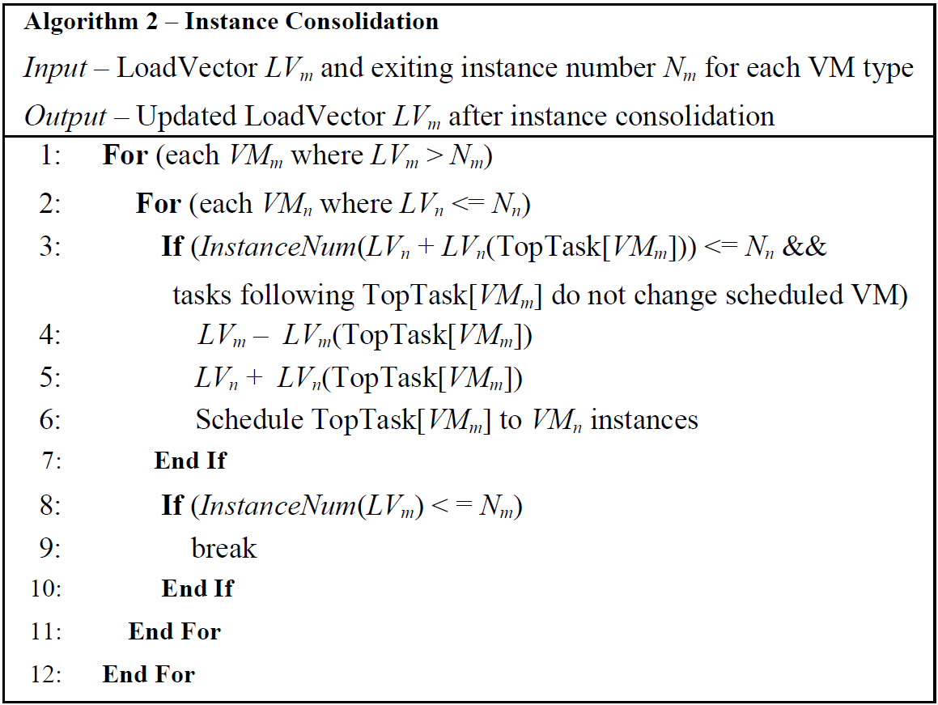
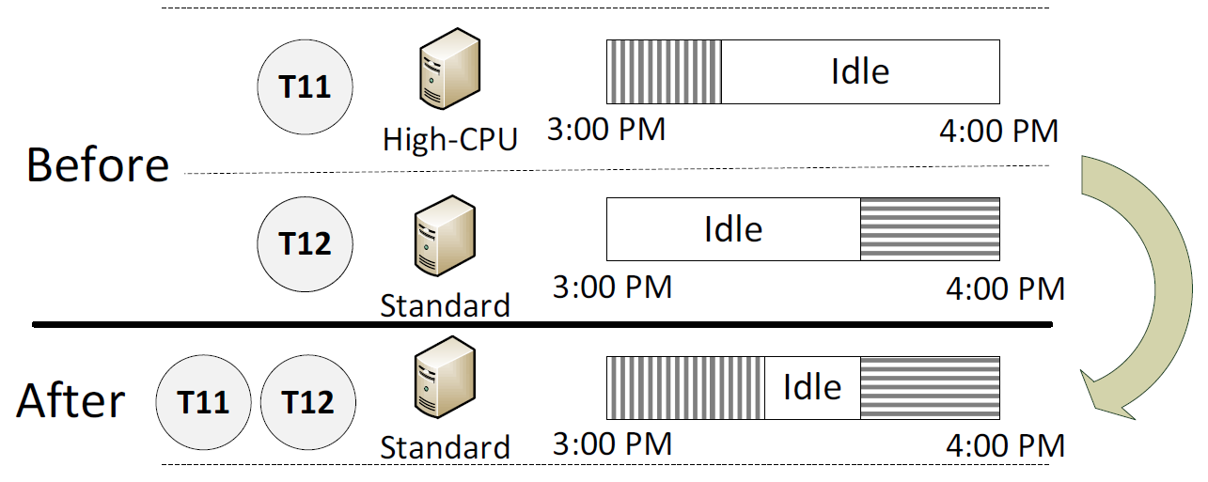
Solution
Step 4 – Instance Consolidation
- avoid partial instance hours to save money
Notes:
sometimes, we need to make a decision to run tasks on their non-cost-efficient machines to consolidate partial instance hours and we call this process instance consolidation

Slide 16
Solution
Step 5 – Dynamic Scheduling
- after deadline assignment and instance consolidation, every task in scheduled to a VM type
- use Earliest Deadline First (EDF) algorithm to sort tasks by their deadlines for each VM type
- EDF is the optimal scheduling algo. in this case [37][38]
[37] Earliest Deadline First Scheduling. http://en.wikipedia.org-/wiki/Earliest_deadline_first_scheduling
[38] Earliest Deadline First Scheduling. http://retis.sssup.it-/~lipari/courses/str06/10.edf.pdf

Slide 17
Evaluation
[16] J. Yu, R. Buyya and C. Tham. 2005. A Cost-based Scheduling of Scientific Workflow Applications on Utility Grids. In Proceedings of the First IEEE International Conference on e-Science and Grid Computing. Melbourne, Australia, Dec. 2005, pp. 140-147.
Notes:
hybrid applications are mix of pipeline applications and parallel applications
each of these workloads is a typical application or scenario

Slide 18
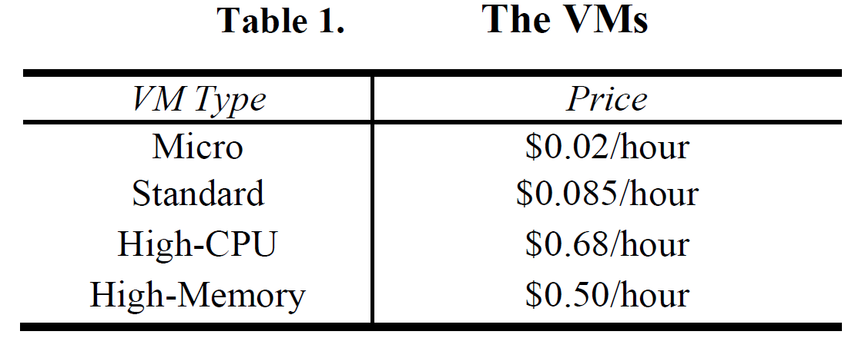
Evaluation
The prices of these VMs are the same as Amazon EC2

Slide 19
Evaluation
Two existing approaches as the baseline: Greedy[16] and GAIN[17]
- Greedy: always try to find the cheapest instance among all the live instances
- GAIN: starts with the cheapest plan and iteratively improves the plan based on the cost-efficiency rank
Compare to our approach denoted as Scaling-Consolidation-Scheduling (SCS)
[16] J. Yu, R. Buyya and C. Tham. 2005. A Cost-based Scheduling of Scientific Workflow Applications on Utility Grids. In Proceedings of the First IEEE International Conference on e-Science and Grid Computing. Melbourne, Australia, Dec. 2005, pp. 140-147.
[17] R. Sakellariou and H. Zhao. 2005. Scheduling Workflows with Budget Constraints. Integrated Research in Grid Computing. CoreGrid series, Springer-Verlag, 2005.
Notes:
It is a challenge to establish a baseline to compare the mechanism because cost-efficiency is usually not a first-class concern for existing research
starts with the cheapest plan and iteratively improves the plan based on the cost-efficiency rank until the budget cap is reached

Slide 20
Evaluation
Have randomly generated task execution time on different types of VMs and tried 50 combinations for each workload pattern => test results have shown similar performance
For each application and workload pattern, simulate a 72-hour period for each test with four different deadlines – 0.5 hour, 1 hour, 1.5 hour and 2 hour
Assume instance acquisition lag is 6.5 min
Notes:
the authors won’t detail the information of the task running time

Slide 21
Evaluation
Notes:
the following three slides are the test results with different workload patterns
for each application model and deadline, the authors show the total running cost and the average instance utilization information

Slide 22
Evaluation

Slide 23
Evaluation

Slide 24
Evaluation
When deadline is short, three approaches tend to have similar performance
When deadline is longer, SCS generally can save the most cost and Greedy approach performs the worst
- the importance of choosing suitable types of VMs
Among the four workload patterns, the Growing case has the highest utilization
- when workload volume is high enough, task level cost-efficiency could dominate the overall cost
Notes:
GAIN approach however always schedules the tasks on their preferred cost-efficient instances. In this way, it achieves cost optimization for each job and saves more cost than Greedy
more and more jobs are submitted quickly, all instances are filled with tasks and partial instance-hours becomes fewer

Slide 25
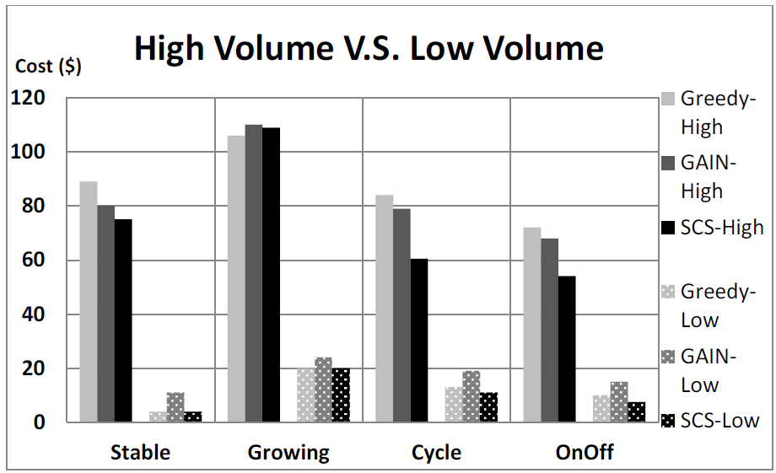
Evaluation
For light workload volume, placing tasks on their preferred cost-efficient instances may not always save money
Notes:
they test the extreme cases for heavy workload and light workload
light workload – because instances are not fully utilized and there could be a large portion of unutilized instances hours
Greedy approach works better than GAIN when workload volume is low because it schedules as many tasks on the cheapest machines as possible, which is actually an instance consolidation strategy
SCS works better than Greedy and GAIN in both cases
this is the result of pipeline application, but the parallel and hybrid applications show the similar performance

Slide 26
Conclusion

