Slide 1
Cache-centric Video Recommendation: An Approach to Improve the Efﬁciency of YouTube Caches
D. Krishnappa, M. Zink, C. Griwodz, and P. Halvorsen (MMsys ‘13)

Slide 2
Motivation
Each minute 72 hours of new videos are uploaded to YouTube
Over 4 billion hours of videos are watched each month
YouTube traffic made up more than 60% of the global Internet traffic.

Slide 3
Contribution
Propose a caching approach that use YouTube’s recommendation system to increase the efficiency of caches
Evaluate the proposed related list reordering approach by YouTube traces obtained from a university campus network

Slide 4
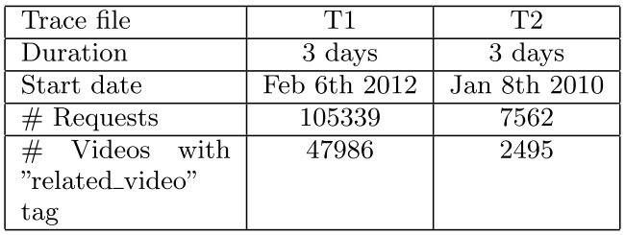
Data Set Analysis
related_video tag: the video was selected from a viewer from the related video list
About 50% of the viewers select from the top ﬁve related videos and over 70% for the top ten videos

Slide 5
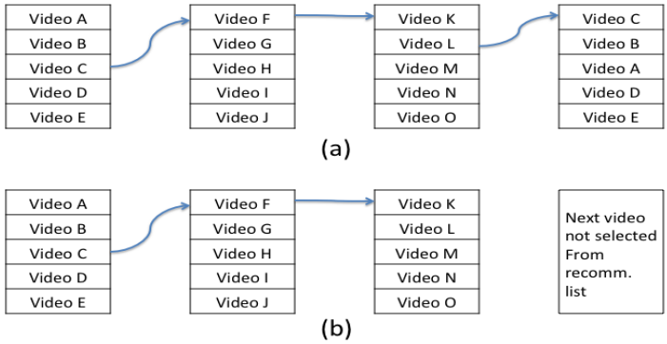
Chain and Loop Count

Slide 6
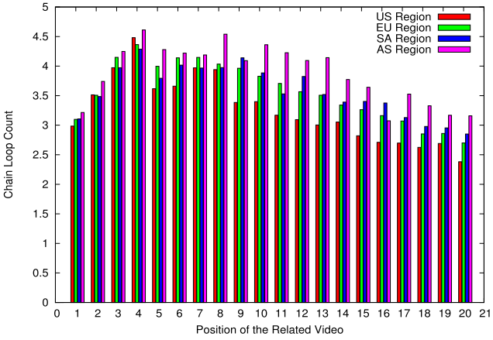
Loop Length at Fixed Positions
Use a PlanetLab-based measurement
The position does not impact loops length

Slide 7
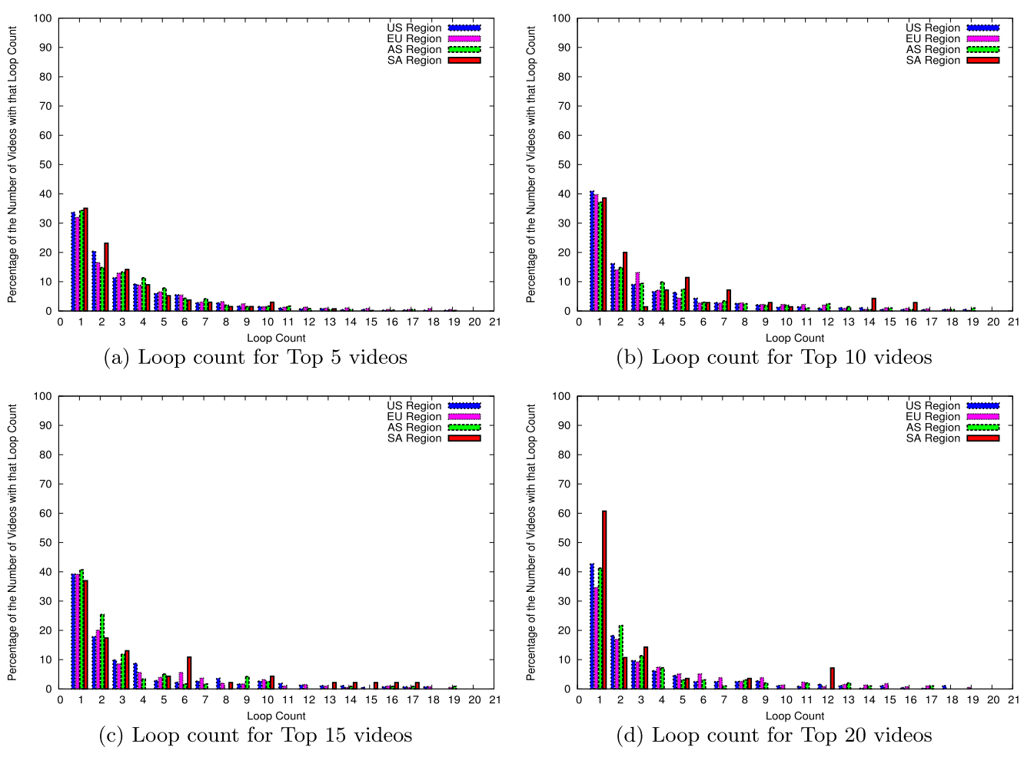
Loop Length at Random Positions
YouTube does not assign the video to positions for some internal purpose

Slide 8
Video Origin
There are three different ranges of average RTTs (<3ms, 3ms to 12ms, and >12 ms) and from 3 different subnet ranges (cache level)
The requested videos position in the related list are almost uniform in each level caches
The position of the video in the related list is not according to caching

Slide 9
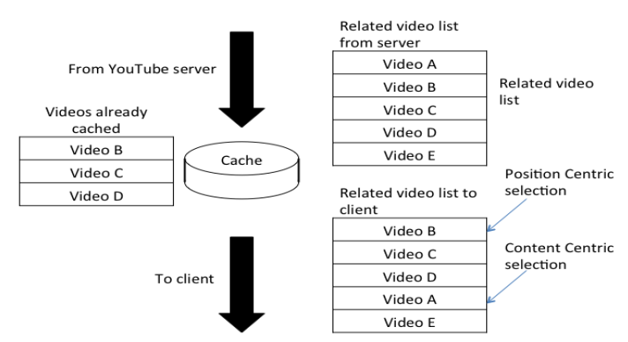
Local Recommendation to Improve Caching

