Slide 1
Cross-Layer Architecture for Adaptive Video Multicast Streaming Over Multirate Wireless LANs
José Villalón¹, Pedro Cuenca¹, Luis Orozco-Barbosa¹, Yongho Seok², and Thierry Turletti³
IEEE J. Sel. Area. Commun., vol. 25, no. 4, pp. 699-711, May 2007
¹Instituto de Investigación en Informática de Albacete, 02071 Albacete, Spain
²LG Electronics Institute of Technology, 16 Woomyeon-Dong, Seocho-Gu, Seoul, Korea
³INRIA Projet Planéte, 2004 route des Lucioles, 06902 Sophia Antipolis, France

Slide 2
Introduction
Challenges: (1&2 from IEEE 802.11 standards)
- does not make use of Acknowledgement (ACK) frames
- does not provide guidelines on the best rate to be used
- Channel conditions between AP and Mobile Terminals (MTs) may differ and AP cannot know the operating conditions of each MT
The authors proposed Auto Rate Selection mechanism for Multicast (ARSM) in multirate wireless LAN
Main idea: MTs with the worst conditions will receive only the base layer of the encoded H.264 video
Notes:
AP: Access Point
MT: Mobile Terminal

Slide 3
Background
A. Multicast for Multirate Wireless LANs
- [9] used Leader-Based Protocol (LBP) ARQ mechanism
- [10] decribed 802.11MX
- [11] used RAM (RTS/CTS mechanism)
B. Use of Hierarchical Video Coding
- base layer and enhancement layer
- consider H.264 video encoding standard
[9] J. Kuri and S. K. Kasera, “Reliable multicast in multi-access wireless LANs,” ACM Wireless Networks, vol. 7-4,
[10] S. K. S. Gupta, V. Shankar, and S. Lalwani, “Reliable multicast MAC protocol for wireless LANs,” in Proc. IEEE ICC, May 2003.
[11] A. Basalamah, H. Sugimoto, and T. Sato, “Rate adaptive reliable multicast MAC protocol for WLANs,” in Proc. IEEE VTC, May 2006.
Notes:
[9] LBP: Assign a leader to exhibit the worst signal quality in the group
[10] 802.11MX: use ARQ(Automatic Repeat-reQuest) mechanism supplemented by a busy tone signal (need a signaling channel)
ARQ includes: Error Detection, Retransmission after Timeout, Positive ACK, NACK and Retransmission
RAM: Rate Adaptive Multicast

Slide 4
Auto Rate Selection for Multicast (ARSM)
AP starts by multicasting Multicast Probe (MP) frame
Each member estimates SNR of the channel
MT with lowest SNR will be in charge of replying AP first, by issuing a Multicast Response (MR) frame
AP assigns this MT to be the leader
Leader is responsible for acknowledging the multicasts packets on behalf of all the group members
AP will select its PHY data rate according to the leader’s SNR value
Notes:
SNR(Signal-to-noise ratio): quality of the wireless medium
PHY: physical layer

Slide 5
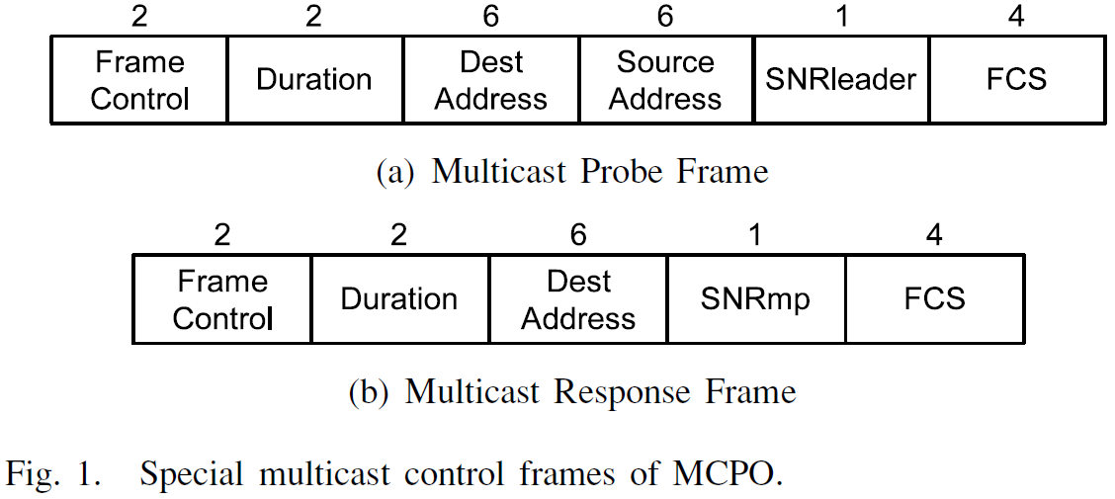
Auto Rate Selection for Multicast (ARSM)
After sending MP frame, AP will wait for some time given by the Short Inter Frame Space (SIFS)
At the time of sending MP frame, AP starts MP_timer
Duration is initially set to ${CW}_{m} ×SlotTime$
Notes:
Short Interframe Space (SIFS): the small time interval between the data frame and its acknowledgment
MP_timer decremented by one slot whenever the channel has been idle for a time slot. When AP detects activity, it will freeze MP_timer
CWm is the length of the contention window, expressed in slots

Slide 6
Auto Rate Selection for Multicast (ARSM)
When MT replies the MR frame, MT uses BackoffTimer to reduce the collision probability
According to the received information and MP_timer, AP could know the outcome of its query:
- Explicit Feedback: AP receives MR frame from a MT within the multicast group
- Implicit Feedback: AP receives corrupted MR frame and the MP timer has not expired
- No Feedback: AP does not receive MR frame and the MP_timer of the AP expires
Notes:
Explicit Feedback: AP determines the SNR value of the MT and transmits multicast data frames accordingly
Implicit Feedback: This occurs when several MTs reply to the MP frame simultaneously and the MR frames have collided
No Feedback: This occurs when all MTs have left or that MP frame has been corrupted during its transmission

Slide 7
Auto Rate Selection for Multicast (ARSM)
Explicit Feedback: AP can determine the SNR and identity of MT to become group leader
Implicit Feedback: AP cannot identify MT and will send a second MP frame before sending the following multicast data frame
Through Multicast Channel Probe Operation (MCPO), AP can estimate SNR value of the leader
To reduce the overhead of MTs, authors propose a Dynamic Multicast Data Transmission procedure
Notes:
When AP successfully delivers multicast data frame, MCPO is deactivated. AP will adapt its PHY data rate using the SNR value of the group leader.
AP shows a failure of Nth consecutive multicast transmissions (detected via NACKs), it initiates MCPO.

Slide 8
Hierarchical ARSM (H-ARSM)
Adaptation of ARSM to Hierarchical Video Communications
ARSM mechanism guarantees that all members properly receive all packets at the highest possible PHY data rate
Under H-ARSM, video is encoded into base and enhancement layers
Packets containing the base layer of video are sent following rules by ARSM
Instead of choosing a leader, H-ARSM selects the member with the highest SNR

Slide 9
Hierarchical ARSM (H-ARSM)
One ARSM decided the base layer should be transmitted at 1 or 2 Mbps, then H-ARSM decides the enhancement layer should be transmitted at 5.5 Mbps
One ARSM decided the base layer should be transmitted at 5.5 Mbps, then H-ARSM decides the enhancement layer should be transmitted at 11 Mbps
One ARSM decided the base layer should be transmitted at 11 Mbps, then H-ARSM decides the enhancement layer should be transmitted at 11 Mbps

Slide 10
Performance Evaluation
Environment:
- OPNET Modeler tool 11.5
(integrates the IEEE 802.11 simulators, LBP, RAM, ARSM and H-ARSM mechanisms)
Scenarios:
- Evaluate and compare ARSM, RAM and LBP while hierarchical video coding is not applied
- Evaluate and compare RAM, H-ARSM and ARSM while hierarchical video coding is applied

Slide 11
Performance Evaluation
Scenarios:
- model an IEEE 802.11b WLAN consisting of an AP, 9 or 18 multicast wireless MTs, and 5 unicast wireless MTs
- Network size is a geographical area of 50m x 50m and is increased in both dimensions by 10m x 10m to a maximum of 140m x 140m (AP is in the center)
- The multicast MTs move randomly at 5 km/h and unicast MTs are static and placed close to AP

Slide 12
Performance Evaluation
Scenarios:
- Use the sequence Mobile Calendar encoded on CIF format at 25 frames/s
- When applying hierarchical coding, base layer accounts approximately for 30% of the total video data
- Use two average video transmission rates (around 400 kbps and 700 kbps)

Slide 13
Performance Evaluation
Metrics:
- multicast throughput: successfully received average data rate by all multicast MTs
- unicast throughput: total throughput received by AP from all unicast MTs
- multicast packet loss rate: $\frac{packets not received by a MT}{total packets transmitted}$
- overhead (%):

Slide 14
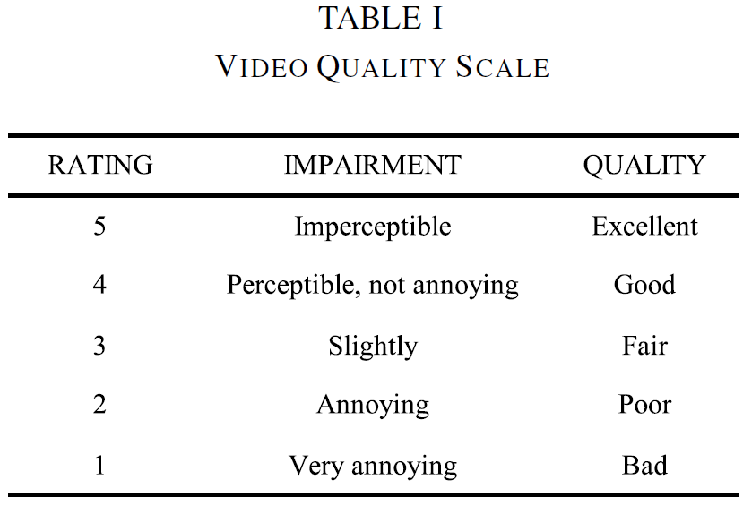
Performance Evaluation
Metrics:
- delay: the time when data packet is inserted into channel and the time when packets actually reaches MT
- jitter: between two consecutive video frames
- video quality perceived by the end user: using Moving Pictures Quality Metric (MPQM) [28]
[28] C. J. Van den Branden and O. Verscheure, “Perceptual quality measure using a spatio-temporal model of human visual system,” in Proc. SPIE, Jan. 1996, vol. 2668, pp. 450–461.

Slide 15
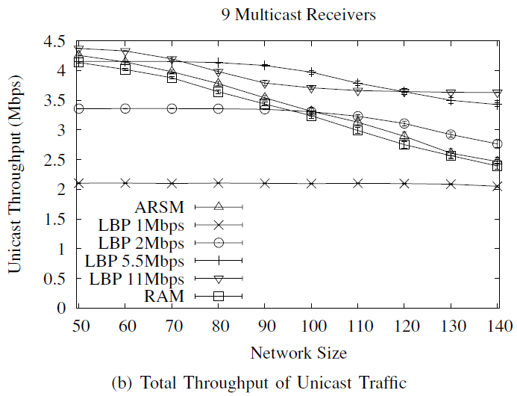
Results
Notes:
3(a): ARSM, RAM and LBP are able to provide a reliable multicast for all network sizes
For other rates, LBP decreases as the network size increased
This shows the benefits of adapting PHY data rates into account the channel conditions
3(b) shows ARSM outperforms RAM and LBP (because ARSM introduces less overhead than RAM, and LBP use a fixed PHY data rate)
RAM: Rate Adaptive Multicast

Slide 16
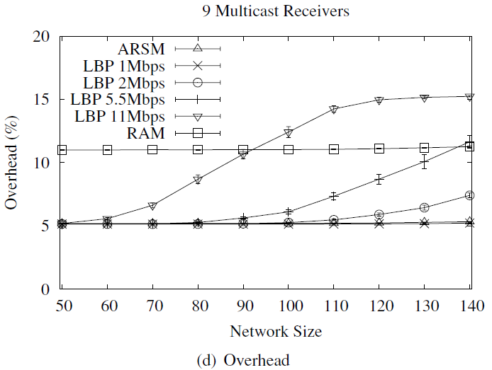
Results
Notes:
RAM use RTS/CTS control frames => twice overhead of ARSM

Slide 17
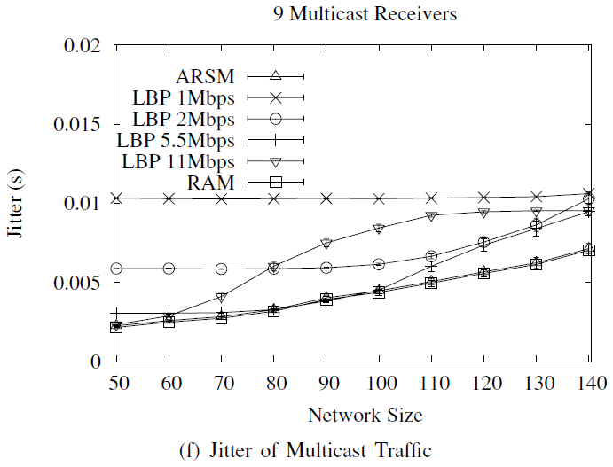
Results
Notes:
ARSM and RAM outperform because PHY data rate is used

Slide 18
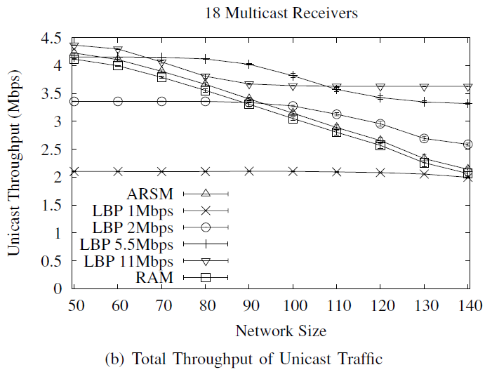
Results
Notes:
Fig. 4 shows ARSM is able to cope with large multicast group sizes

Slide 19
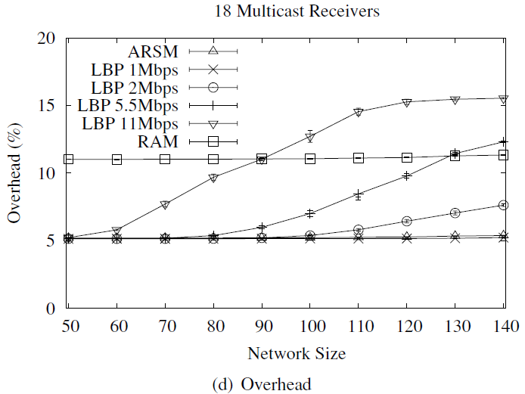
Results
Notes:
Fig. 4 shows ARSM is able to cope with large multicast group sizes

Slide 20
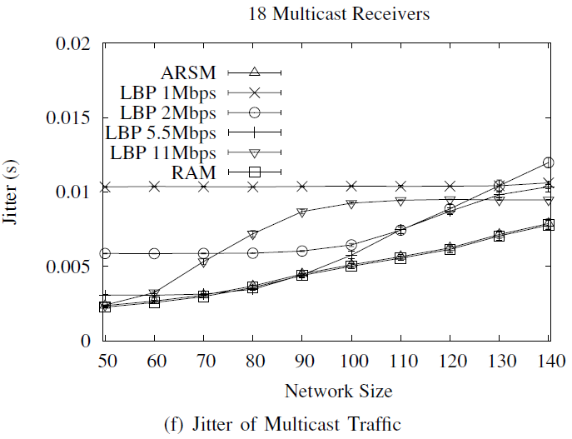
Results
Notes:
Fig. 4 shows ARSM is able to cope with large multicast group sizes

Slide 21
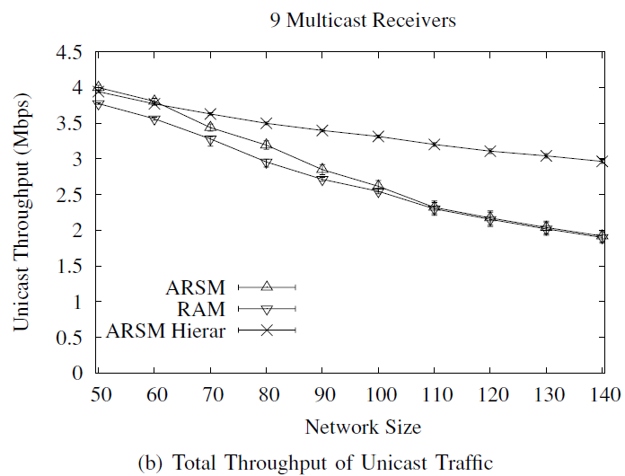
Results
Notes:
Fig. 5(a) shows H-ARSM sends all traffic independently of the network size
Fig. 5(b) shows H-ARSM is better than RAM and ARSM
(HP: base layer, LP: enhancement layer)

Slide 22
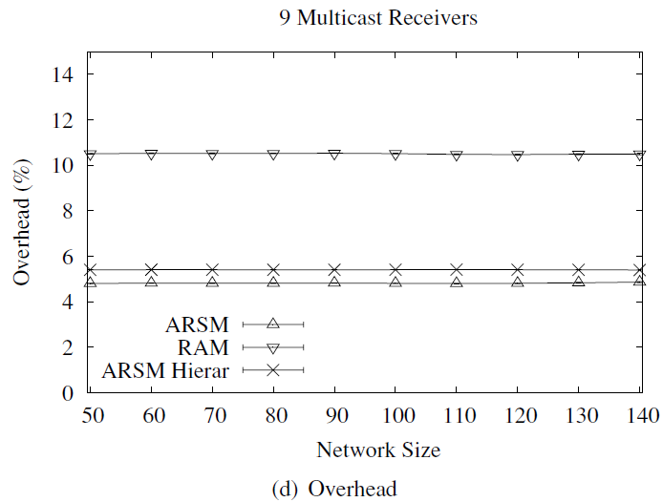
Results
Notes:
5(c) shows HP can deliver all packets containing base layer to the multicast group
5(d) shows H-ARSM introduces lower ovehead

Slide 23
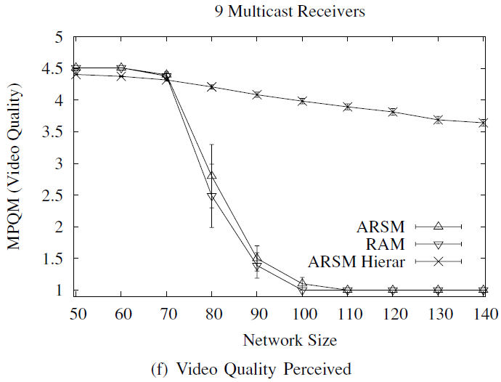
Results
Notes:
5(f) shows the quality of H-ARSM is always guaranteed since the base layer is always delivered

Slide 24
Conclusion
The authors propose a cross-layer architecture for adaptive video multicast streaming over multirate wireless LANs
The PHY data rate used for the multicast traffic is determined based on the feedback received by the group leader
The results show that the real-time video streaming quality of the total system can be drastically improved

