Slide 1
Usages of DASH for Rich Media Services
C. Concolato, J. Le Feuvre, R. Bouqueau
MMSys '11

Slide 2
Introduction
New types of multimedia devices
smartphone, tablet PC, smartTV
User want to view the same audiovisual service at different place
How to efficient delivery of audiovisual services to a large number of users and devices

Slide 3
Introduction (cont.)
Web video:
Broadcast ← return channel is not available
RTP in unicast or multicast ← UDP traffic is available
HTML 5
Video content can be enriched with graphics, animations, textual meta-data
Content provider
tightly synchronized with the media content
Ex: DTV, advertisements, voting, annotations
Notes:
Broadcast channel : tight synchronization between audio-visual data and service updates

Slide 4
Introduction (cont.)
Usage of DASH:
How DASH can be useful to rich media technologies
How rich media technologies can be useful to DASH

Slide 5
Scenarios
Media elements:
Audio, video, images, text, graphics
Organized in a specific 2D/3D manner
Scenarios:
Some where rich media service is static
Some where rich media data changed rapidly

Slide 6
Scenarios - Controlling a session from a Web page
Multiple video streams
for each different camera angle
Multiple audio streams
Each language
Multiple subtitles streams
Using MPD (Media Presentation Description)
Defined by DASH
Some controls to enable the selection of
A camera angle, sound track, and subtitle track

Slide 7
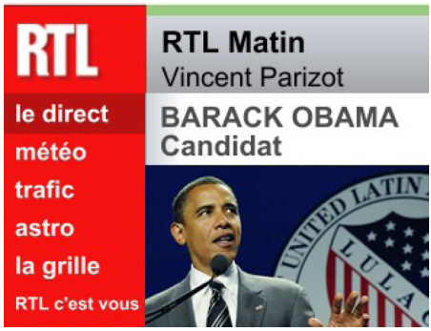
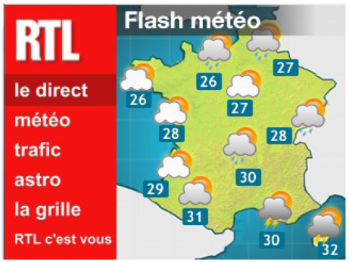
Scenarios - Visual Web Radio
Extension of traditional Web Radio into Visual Web Radio
Add a visual component (non video)
Carry additional visual information
Speaker speaks about President Obama
Speaker speaks about weather

Slide 8
Scenarios - Interactive Service Design Switching
TV program
Consisting of audio and video streams delivered in DASH
Synchronize
Such as active speaker name and biography
Tight synchronization between interactive application and the DASH stream
Handle unpredictable events in live broadcast
Red Alert Codes trigger ← fast phone call dialing or emailing
Failure of the contribution network
switch to a different program
Change current interactive application

Slide 9
Related Works
WhatWG Adaptive Streaming
Control of quality of service at the player
Video layer switching or buffer management
Not sufficient to cover our scenario 1 (browser level)
Broadcast
MPEG-2 Transport Stream← carry file or MPEG-4 BIFS media stream
Internet
Pull ← request new data from web server
Push ← send new data from server to the client
Relay on script ← AJAX, COMET or HTML5
No support audio-video synchronization

Slide 10
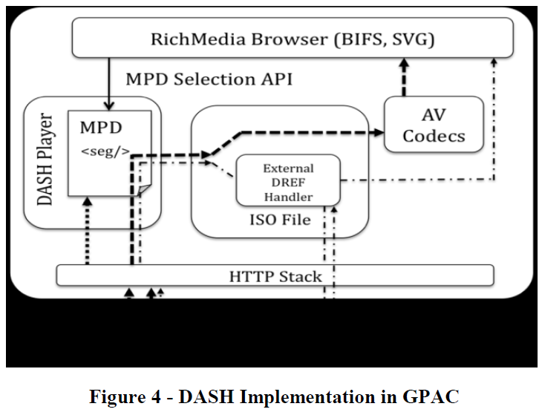

Slide 11
Study of DASH for rich media – Linking MPD from a Rich Media Document
Representation : a given media resource delivered by the network
Multiple-media ← video and audio track
Not offer any flexibility regarding audio or subtitle track selection
Single-media ← only audio
Can be assigned to a given group
Only group and representation have identifiers
Notes:
Rich Media Documents : HTML 5 page

Slide 12
Linking MPD from a Rich Media Document (cont.)
Simple approach
Identify representations to be played from the HTML content
HTML author would have to manage the stream switching logic
Better approach
Each group constitutes the set of alternative representation
Identify groups
Define subsets in the MPD to avoid playing two audio track together
HTML browser would need to be aware of group and representation identifiers

Slide 13
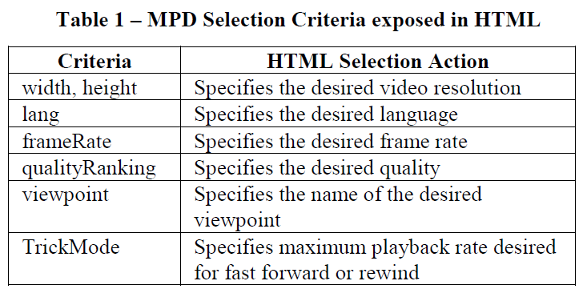
Linking MPD from a Rich Media Document (cont.)
Bandwidth-related criteria are handled directly by DASH player

Slide 14
Linking MPD from a Rich Media Document (cont.)
Embed video/audio resources within a rich media document
Use of dedicated elements and attributes
HTML5, SVG, BIFS
Web page can pass parameters to the DASH player

Slide 15
Study of DASH for rich media – Using MPD to carry Rich Media Services
Broadcast channel
Tight synchronization between audio-visual data and service updates
Transposed in an on-demand context over HTTP
HTTP for AJAX or COMET
RTP for BIFS or DIMS
Follow a different path
Audio-visual data presented in the service
Originate from a different server ← more delay
Not suited for tight synchronization
How the service updates and be carried in DASH ?

Slide 16
Using MPD to carry Rich Media Services (cont.)
First approach
Embed BIFS media data in the DASH session
DASH session uses ISO Base Media File Format as a container
Initialization segment contains without media data
Second Approach
Extract the static part of presentation (of the BIFS stream) from the DASH session
Images referenced through HTTP links
Greatly reduces the bandwidth
Notes:
Create Random Access Points (RAP) in BIFS streams

Slide 17
Using MPD to carry Rich Media Services (cont.)
Optimizing :
Non-empty initialization segments in DASH
Carry static media data in order to save bandwidth
Using the DataReferenceBox tool to define an external data source for ISOBMFF
Allowing client to fetch sample data on a given server outside of the DASHed file
Using SampleDependencyBox tool to eliminate redundant sample
Notes:
DataReferenceBox for ISOBMFF

Slide 18
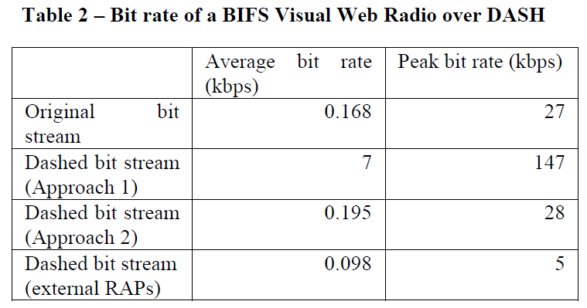
Using MPD to carry Rich Media Services (cont.)

Slide 19
Implementation
Implemented proposal in GPAC
Open-source multimedia framework supporting many interactive language
Also implemented DASH support in GPAC player
DASH player in in charge of parsing the MPD
Selects the representation based on bandwidth criteria
Scheduling the segment downloads and sending them to MPEG-2 TS or ISOBMF
Extended ISO reader to support external data references

Slide 20
Conclusion
Investigated how Rich Media languages can be used with DASH technologies
Presented how Rich Media services can be carried in a DASH session
Future work :
Implementation of real-time live DASH services

