Slide 1
DASH in Twitch: Adaptive Bitrate Streaming in Live Game Streaming Platforms
Karine Pires, Gwendal Simon
Telecom Bretagne, France
CoNext’14 (VideoNext’14)

Slide 2
Outline
Intro
About Twitch
Collected Dataset
Which Channel to transcode?
Evaluation
Discussions & Conclusion

Slide 3
Intro

Slide 4
Intro
Twitch is getting big lately
4th largest traffic in US…blah blah blah
Adaptive Bitrate streaming have been deployed by some video provider
However, not in live streaming service yet
Large number of concurrent channel

Slide 5
Pros & Cons
Pros and cons if ABR is deployed in live streaming
Pros
Improved QoE
Reduced bandwidth consumption
Cons
Extra computing resource needed

Slide 6
Addressed Problem
The trade-off between benefits and cost for ABR in live game streaming platforms
Three months of real trace from Twitch
Problem: which video channels should use ABR?
Two strategies
On-the-fly
At-the-startup

Slide 7
About twitch

Slide 8
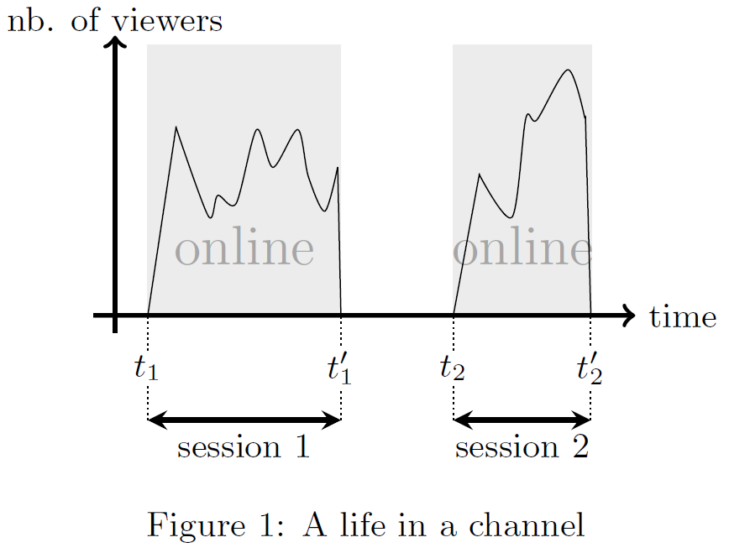
About Twitch

Slide 9
Collected Dataset

Slide 10
The Dataset
Collected using API provided by Twitch
Update once every 5 min
From Jan 6 to Apr 6, 2014 (3 months)
Total number of viewers
Total number of concurrent online channels
Number of viewers per session
Other channels metadata
More than 5 million sessions

Slide 11
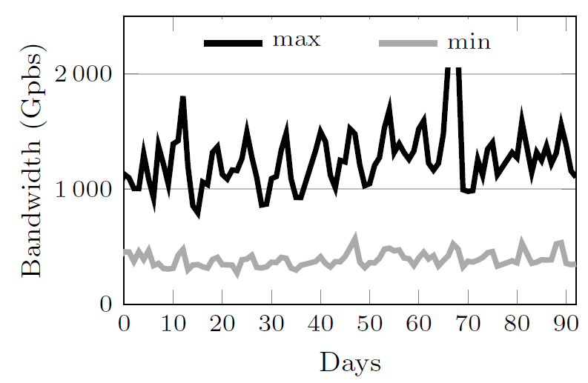
Delivery Needs
Total bandwidth usage
Daily peak is often more than 1.5 Tbps
Daily minimum always above 400 Mbps

Slide 12
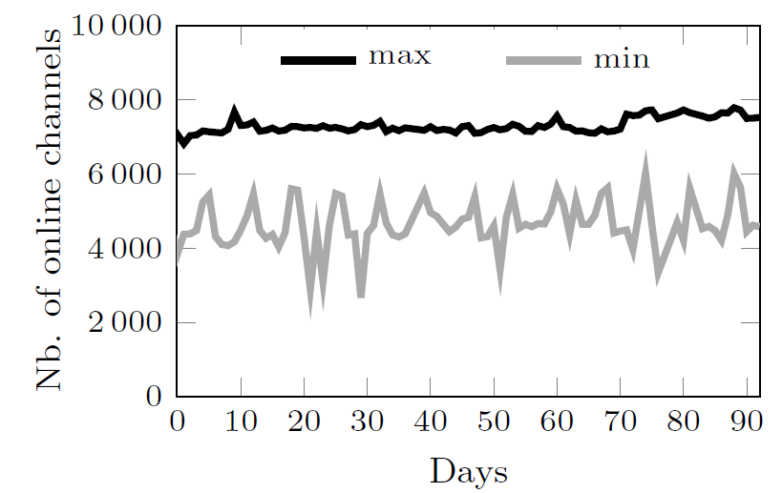
Computing Needs
The number of channels
Between 4000 to 8000

Slide 13

Channel Popularity – Zipf law?
Youtube follows Zipf law
Check whether if it’s also the case here
Validate using Normalized Root-Mean-Square Deviation (NRMSD)
Between real data and fitting curve
0.0095 with CI lesser than 1%
Conclusion: Follow Zipf law

Slide 14
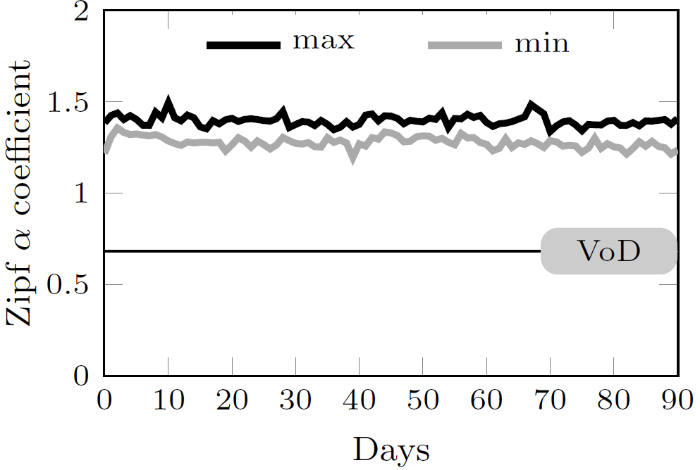
Channel Popularity - α
The larger the α is, the bigger gap between popular channel and unpopular channel is
Always larger than 1.3
A few very popular channel, a ton of empty channel

Slide 15
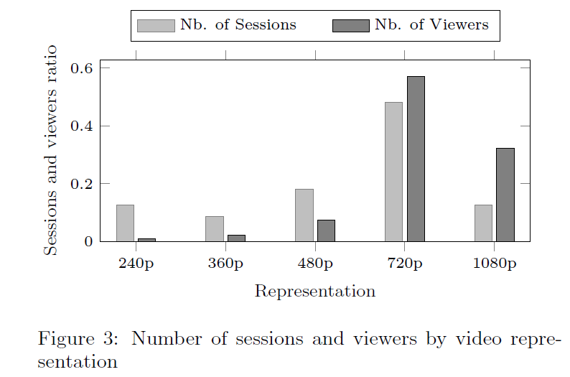
Raw Video Quality
Stream under 720p: 40% of the channel, 8% of the viewer

Slide 16
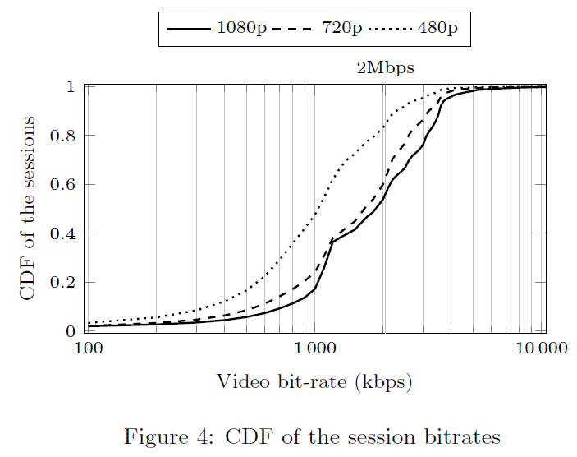
Raw Video Quality

Slide 17
Observation
ABR streaming is needed
To cope with the high delivery cost
To allow viewers with low download rate to watch channels
Applying ABR to all channel is costly
Channels should not be treated equally
Since most of them are not popular

Slide 18
Which channel to transcode?

Slide 19
The More Popular Channels
With higher bitrate and resolution
Over 92% of the viewer watch channels with 720p or higher raw video stream
Benefits
Improve QoE for viewers with low download rate (called degraded viewer)
Reduce overall bandwidth requirement for same population

Slide 20
Two Strategy
On-the-fly
Should have better interactivity
Switch to ABR when the number of viewer surpass j
Called threshold-j
At-startup
Intuition: if the channel is popular before, it’ll stay popular
Use ABR for the k most popular channel
Called top-k

Slide 21
Evaluation

Slide 22
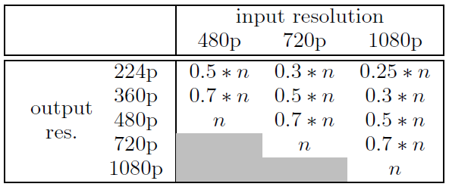
Datasets
The collected dataset
Number of viewer
Bitrate, resolution
Dataset from another DASH study
Get the download rate
Randomly assign these rate to viewer from first dataset

Slide 23
Evaluated Strategies
Baseline
All: apply ABR streaming to all channels
None: no ABR streaming, send the raw video to every viewer
Top-K: set k=50
Threshold-J: set j = 100

Slide 24
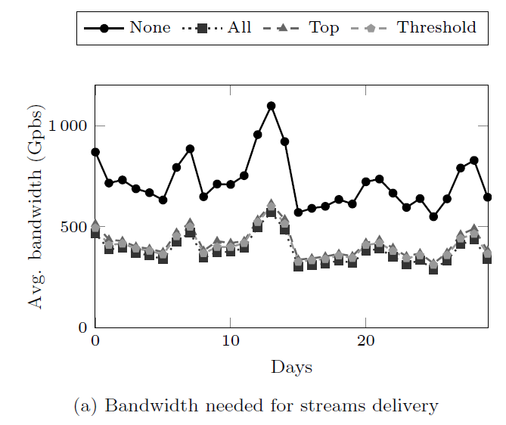
Consumed Bandwidth
Small difference between All and Threshold-J/Top-K
Most of the bandwidth is consumed by more popular channels

Slide 25
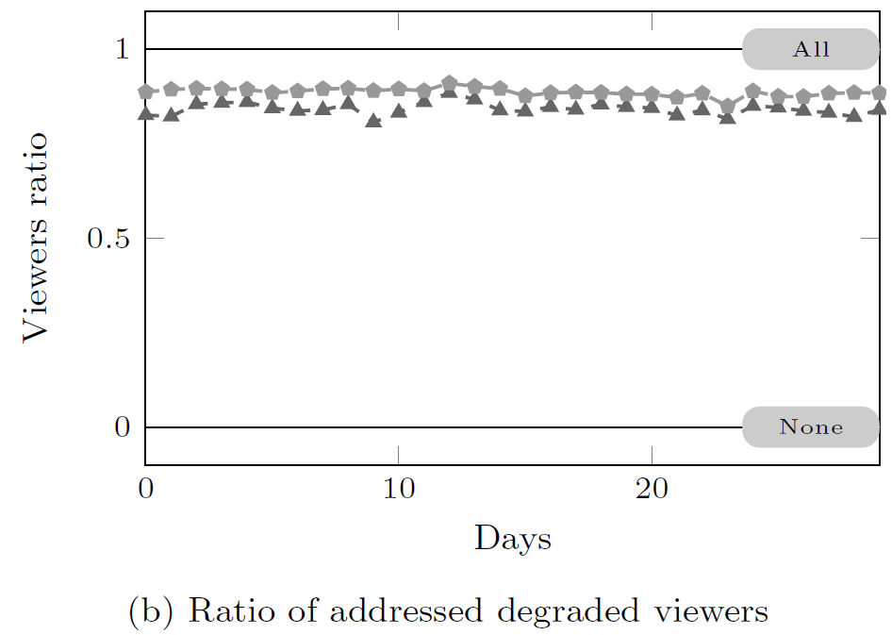
Addressed Degraded Viewers
Filtered out the hopeless viewers (download rate below 224p, the lowest possible)

Slide 26
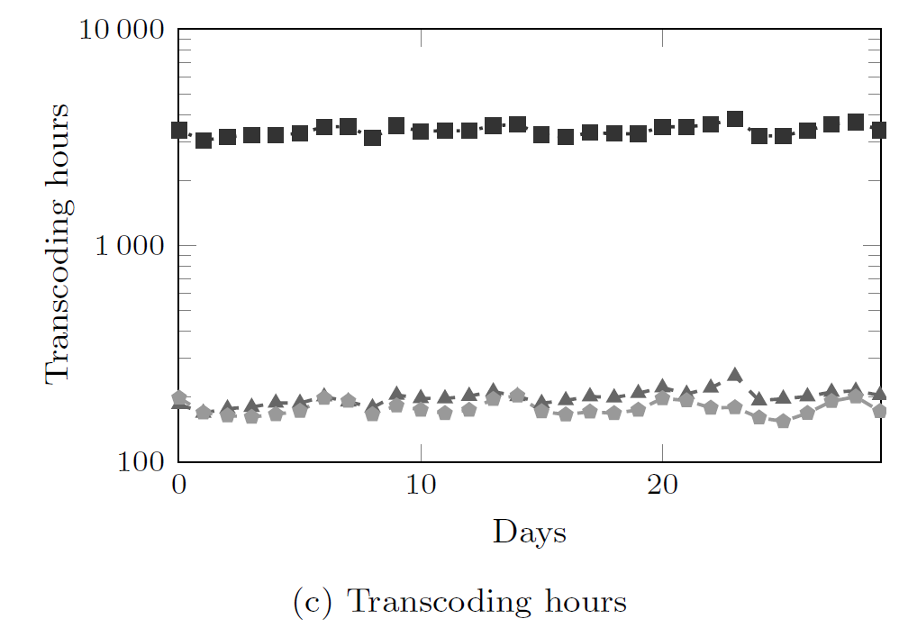
Computing Need for Transcoding
All is an order of magnitude larger than Top-K and Threshold-J
Use a strange hour counting

Slide 27
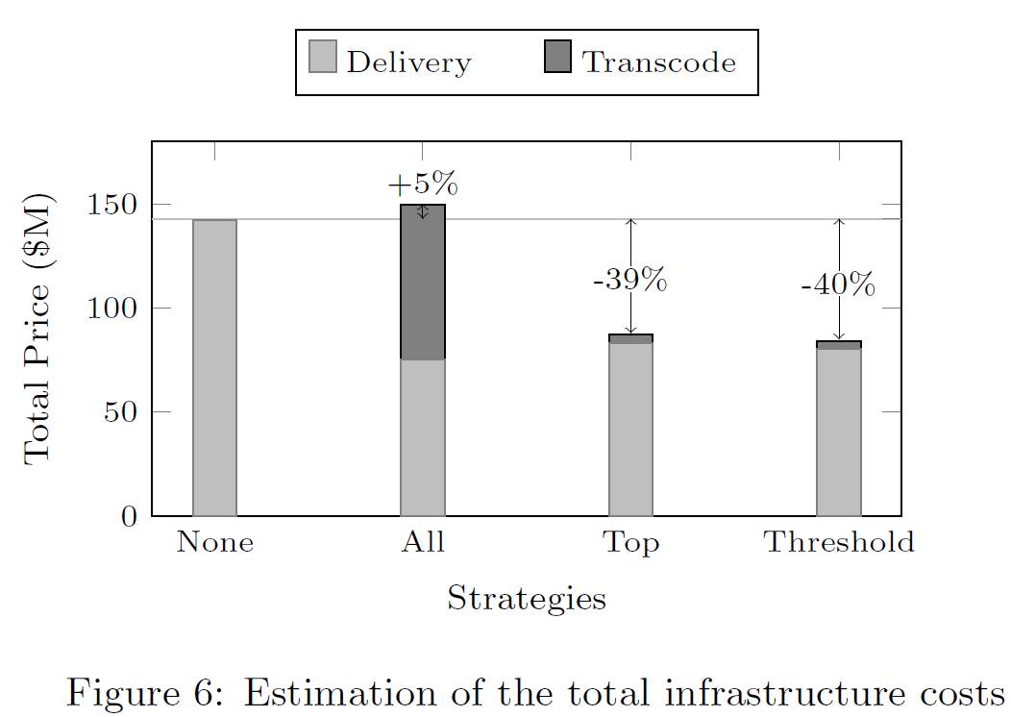
Overall Cost
Transcoding cost: Zencoder price
Bandwidth cost: Amazon FrontCloud price

Slide 28
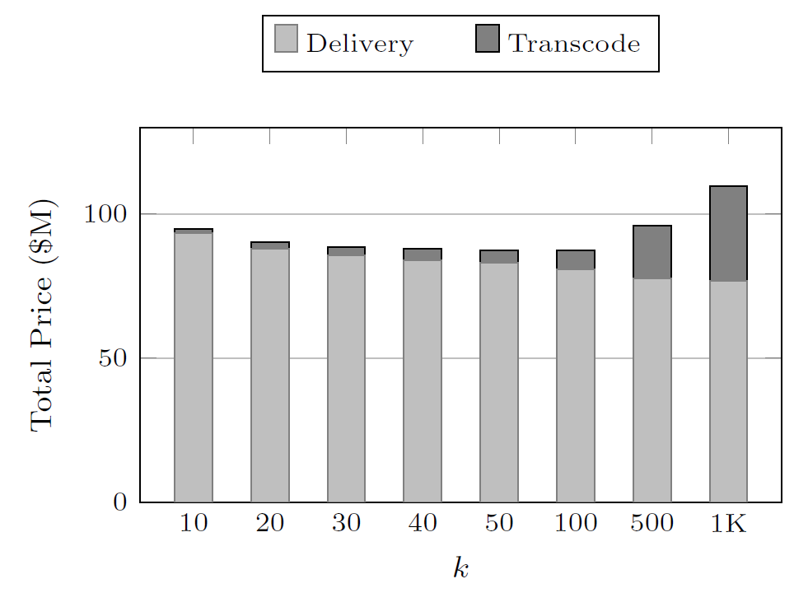
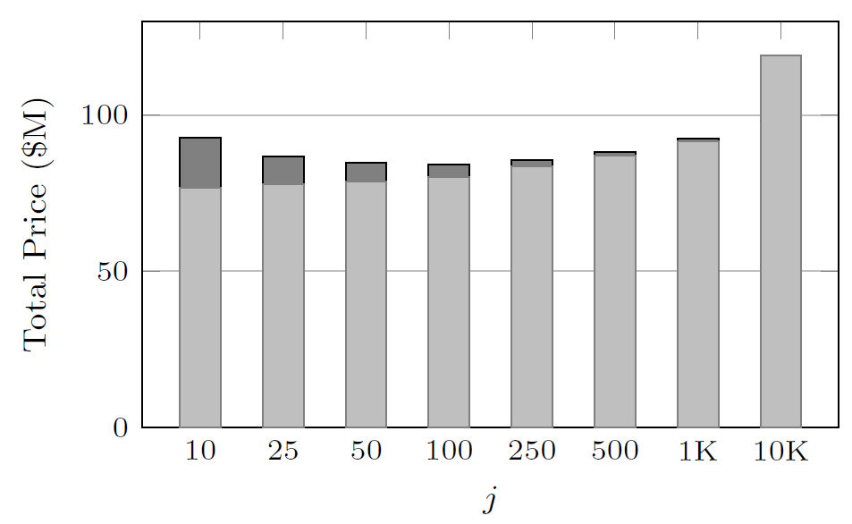
Different K and J

Slide 29
Discussion & conclusion

Slide 30
Discussion & Conclusion
Argue that at-startup strategy (Top-K) is good enough
Only slightly behind Threshold-J
Easier to implement

