Slide 1
Dude, the Source of Lags Is on Your Computer
NetGames 2013
De-Yu Chen, Hao-Tsung Yang, Kuan-Ta Chen
Institute of Information Science, Academia Sinica

Slide 2
Introduction & related work

Slide 3
Introduction
Players hate Lag
Most players can’t identify the root cause
In previous paper
How player perceive lag
What does player think of the causes
How they react

Slide 4
Introduction
Collaborating with Gamania
Over 5000 minutes of trace
Over 500 players and their report
Contribution of this paper
Develop a Game Experience Monitor
Player’s computer is the major source of lag

Slide 5
Related Work
Conclusion from the past
Delay > Packet loss
Frame rate > Frame resolution
This paper is based on empirical large-scale user traces
Not on-sited controlled
Performance metrics and reports are more realistic

Slide 6
Motivating Study

Slide 7
Motivating Study
From previous work
For details, please refer to [1]

Slide 8
Motivating Study
A. Perceptions of Lag
1) Players are highly affected by intermittent lag
2) Players usually blame game servers for lagging
3) Player believe that lag is strongly related to their online game play time and number of avatars on the screen

Slide 9
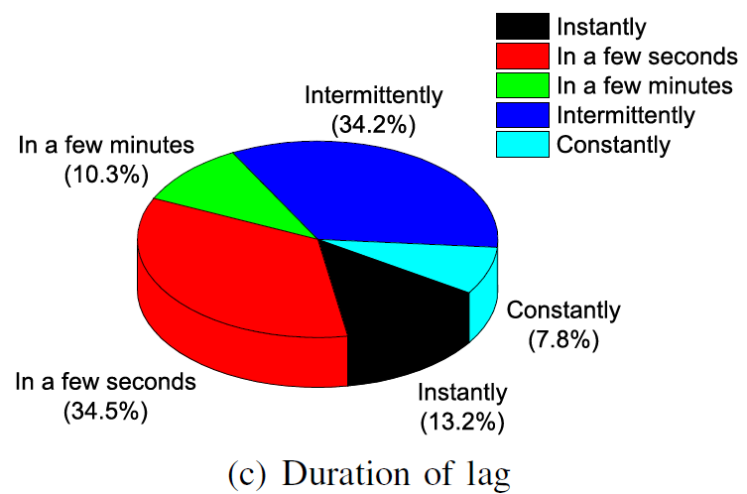
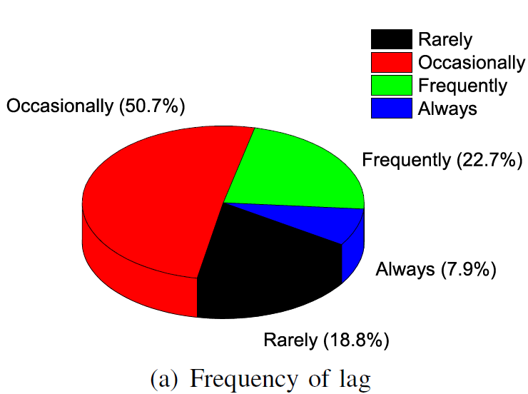
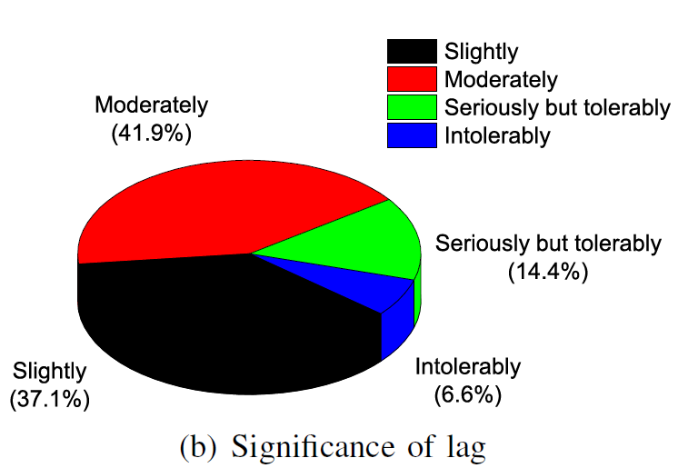
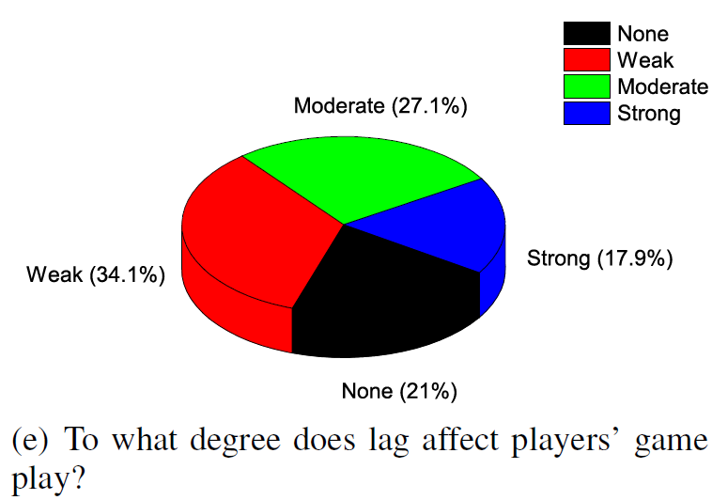
Motivating Study
Players are highly affected by intermittent lag

Slide 10
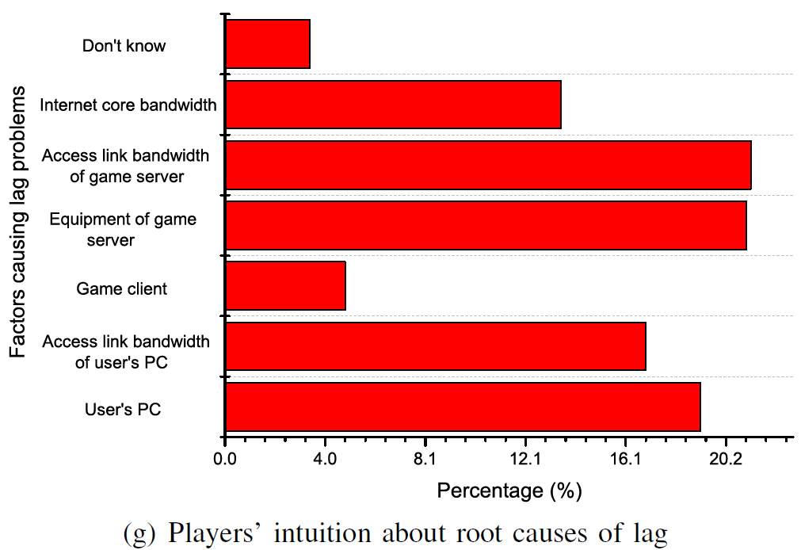
Motivating Study
Players usually blame game servers for lag

Slide 11
Motivating Study
Players think lag is strongly related to play time and the number of avatars on the screen

Slide 12
Motivating Study
B. Reactions to Lag
1) Players usually tolerate or ignore lag
2) Players think that lag influence their game play
3) Players blame lag as the reason they quit games
4) Players tend to keep silent or complain on forums

Slide 13
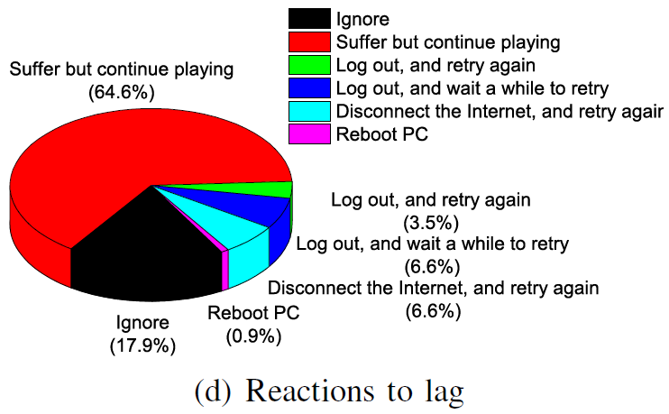
Motivating Study
Players usually tolerate or ignore lag

Slide 14
Motivating Study
Players think that lag influence game play

Slide 15
Motivating Study
Players blame lag as the reason they quit games
Up to 57.6% say that there is a moderate or strong relationship

Slide 16
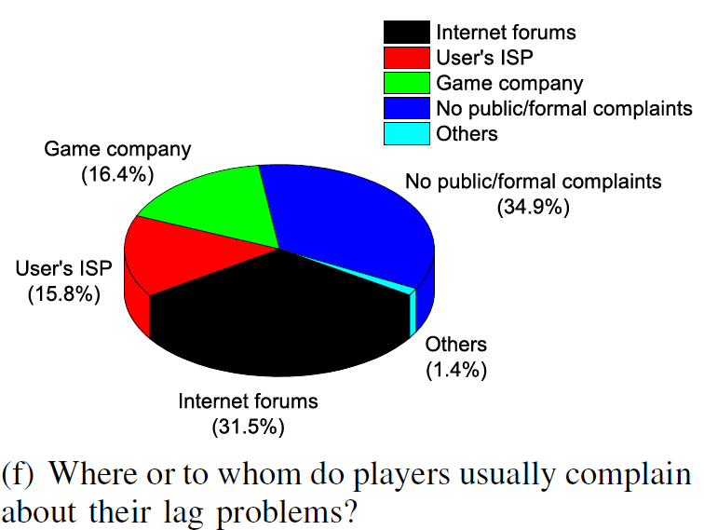
Motivating Study
Players tend to keep silent or complain on forums
But not to game company or ISPs

Slide 17
Motivating Study
C. Solutions to Lag
1) Most players have no background in using network tools to identify the root causes
2) Players demand software tools that either diagnose the root cause or mitigate lag

Slide 18
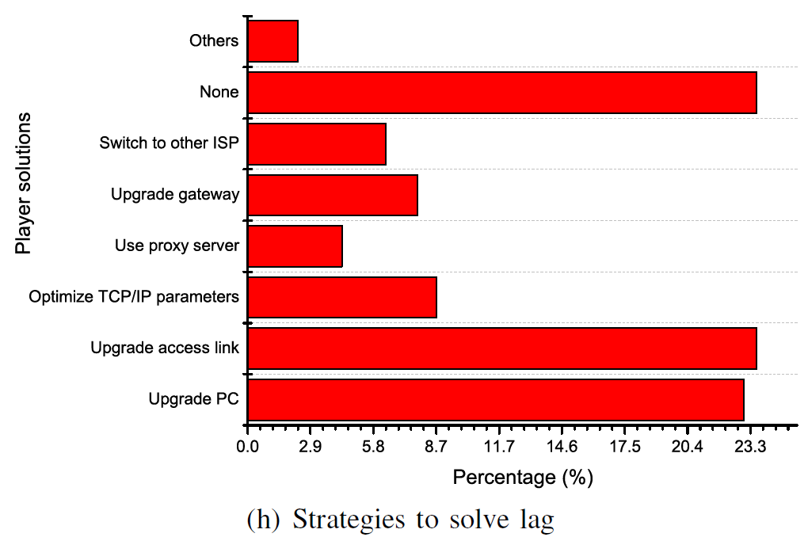
Motivating Study
Most players have no background in using network tools to identify the root causes

Slide 19
Motivating Study
Players demand software tools that either diagnose the root cause or mitigate lag
Diagnose the root cause (86%)
Mitigate lag (93.9%)

Slide 20
Motivating Study
Players demand software tools that either diagnose the root cause or mitigate lag
Diagnose the root cause (86%)
Mitigate lag (93.9%)

Slide 21
Game Experience Monitor(GEM)

Slide 22
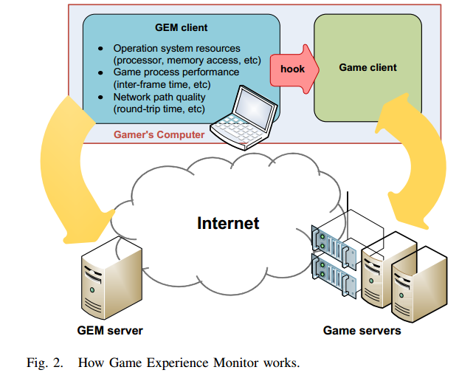
Game Experience Monitor
Directly look into the players’ computers and network
A software system called Game Experience Monitor(GEM)

Slide 23
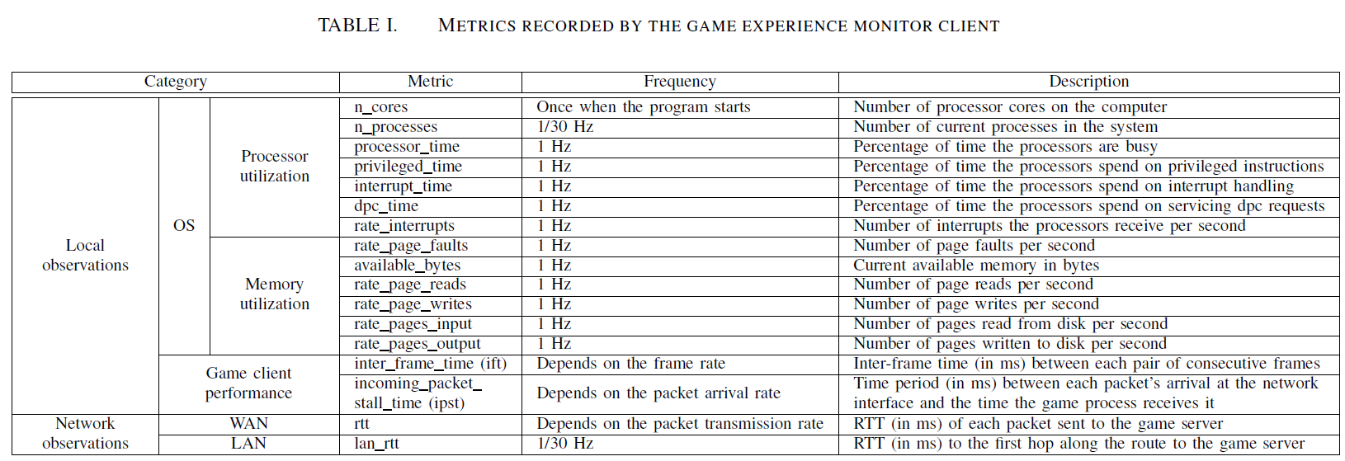
Game Experience Monitor
GEM monitor following things

Slide 24
Data collection

Slide 25
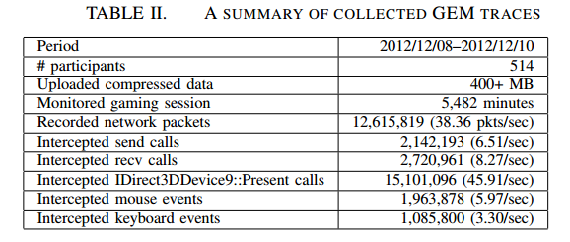
Data Collection
Working with Gamania
A game called Bubble Fighter in 2012
泡泡大亂鬥

Slide 26
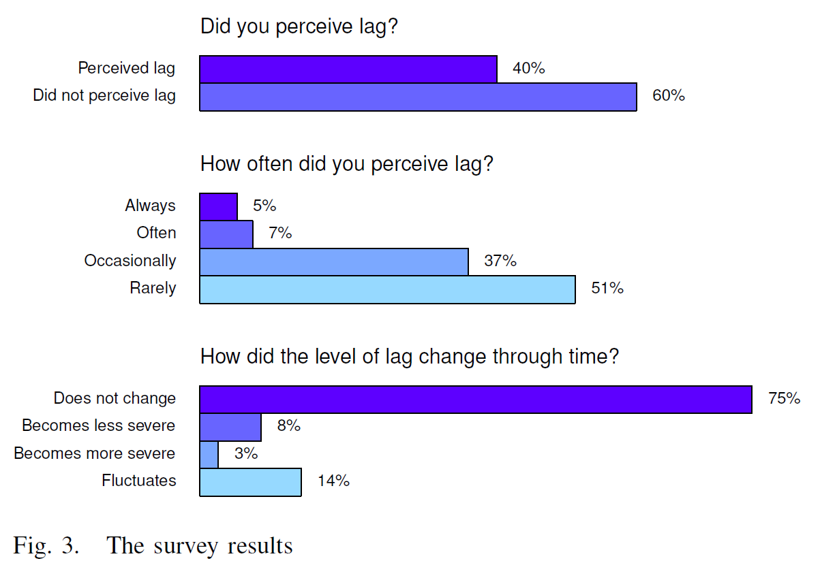
Data Collection
Survey

Slide 27
Root Cause analysis of lag

Slide 28
Root Cause analysis of lag
Focus on three possible sources
Overloading of gamer’s computer
Use inter-frame-time(ift) as representative index
Unstable LAN connectivity
Use first-hop round-trip time(lan_rtt) as indicator
Unstable Internet Connectivity
Use round-trip time(rtt) as indicator

Slide 29
Root Cause analysis of lag
A. Correlation Analysis
A matric should be highly correlated with gamers’ perception of lag if it has significant effect.
Use Pearson correlation coefficient
Cor higher means more relative
p-value represent the significance of Cor

Slide 30
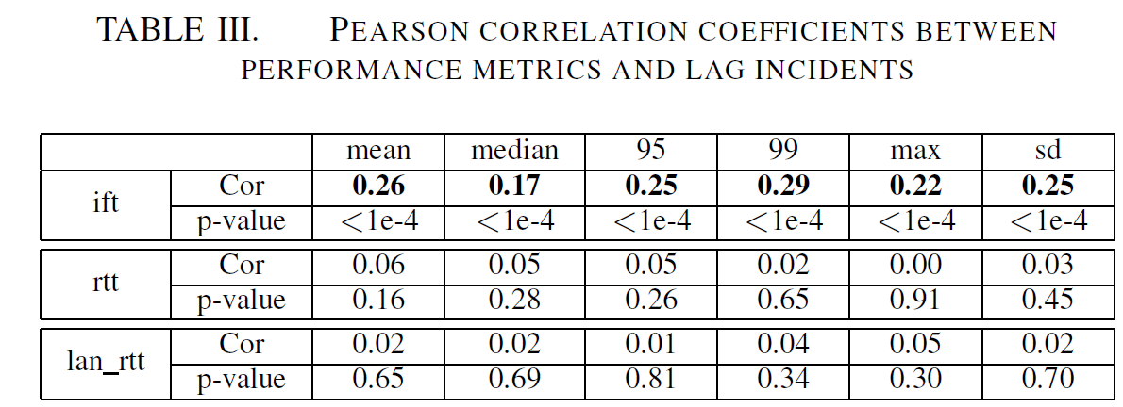
Root Cause analysis of lag
A. Correlation Analysis
ift:
Cor: 0.17~0.29
p-value: smaller than 1e-4
Correlations result are significant

Slide 31
Root Cause analysis of lag
A. Correlation Analysis
rtt and lan_rtt:
Cor: all below 0.1
No clear correlations
p-value: all over 0.1
Not much significance

Slide 32
Root Cause analysis of lag
A. Correlation Analysis
Conclusion
Overloading of gamers’ computer is more likely to be the root cause of lag
Surprising result

Slide 33
Root Cause analysis of lag
B. Classification and Regression Trees Modeling
A strong cause of lag should be able to be used to predict lag
Use CART model for each metric
10-fold cross-validation

Slide 34
Root Cause analysis of lag
B. Classification and Regression Trees Modeling
ift: 67.51%
rtt: 56.81%
lan_rtt: 59.34%
Conclusion: ift outperforms the others, it’s consistent with the result from correlation analysis

Slide 35
Conclusion

Slide 36
Motivating Study
Tackle the long-standing question
“What is the major cause of lag”
Developed a software
GEM
Conclude that the cause of lags are usually from gamer’s computer

